Slide 1
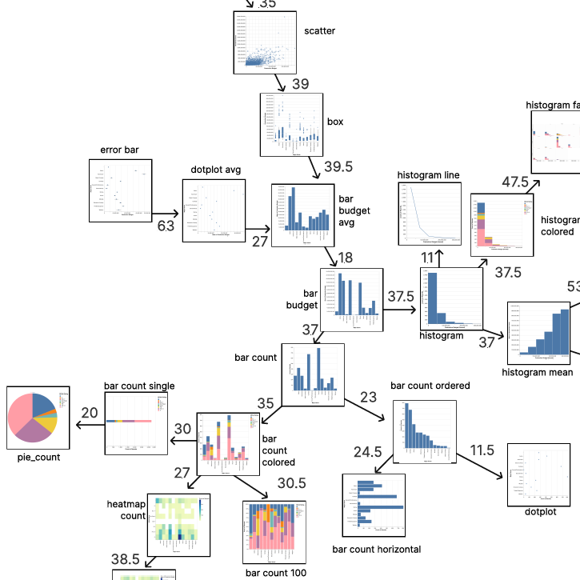
Metrics-Based Evaluation and Comparison of Visualization Notations
Nicolas Kruchten ¹, Andrew M. McNutt ², Michael McGuffin ¹
1. ÉTS, Montreal, Canada
2. University of Washington and University of Utah, USA

Slide 2
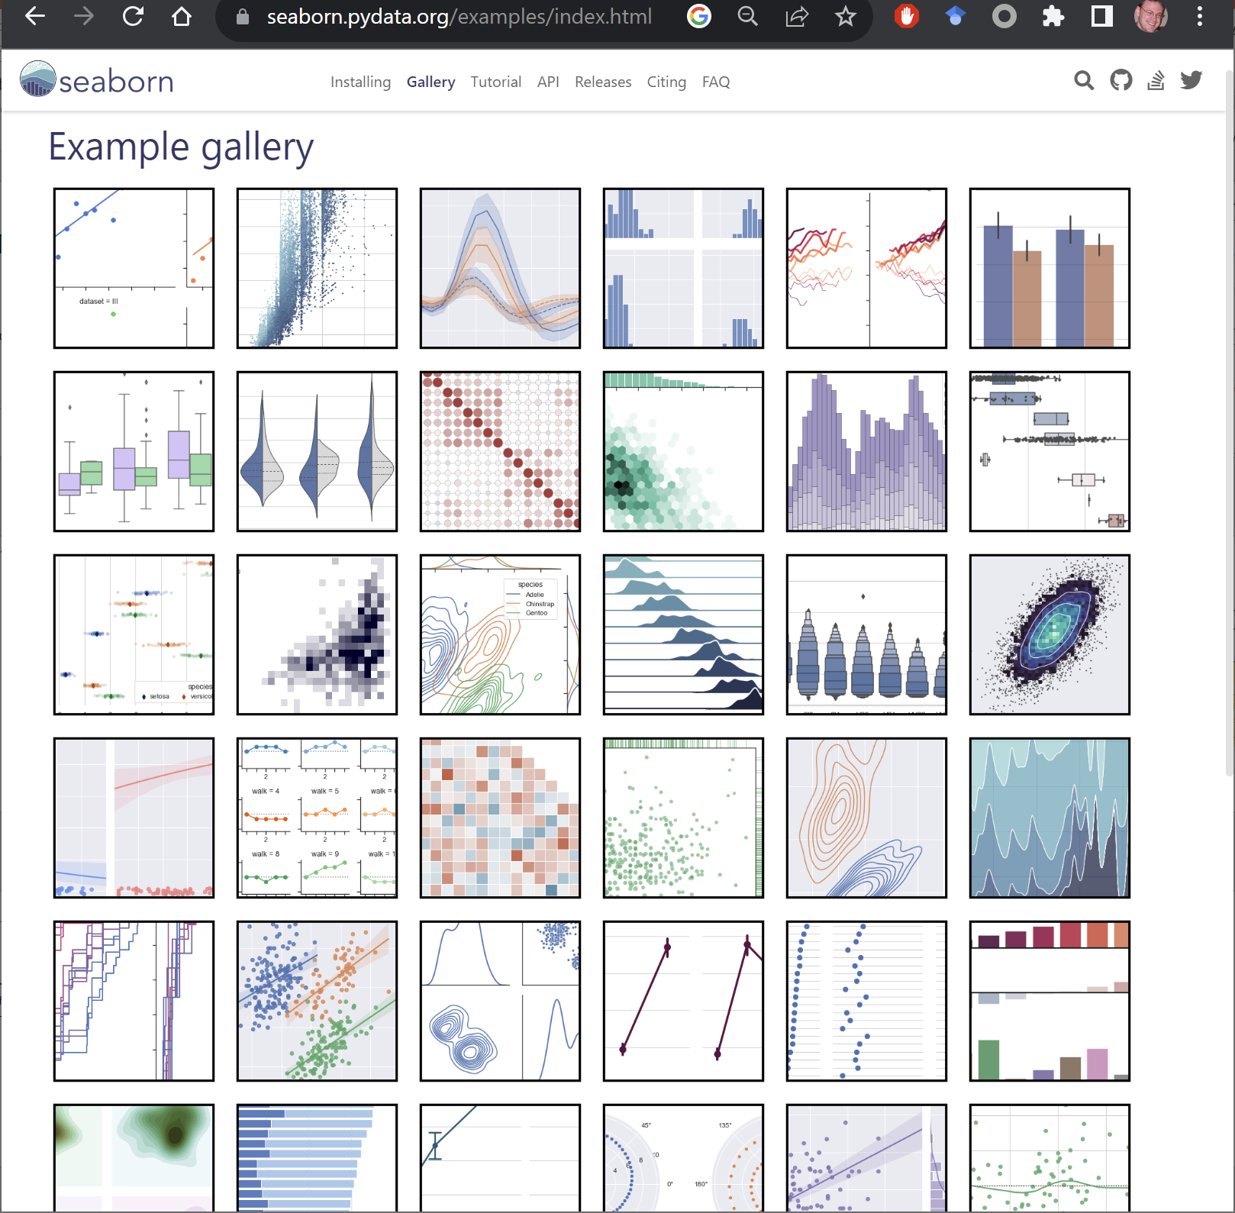
Galleries for Seaborn and Altair

Slide 3
https://pythonplot.com/ - a kind of “Rosetta Stone”

Slide 4
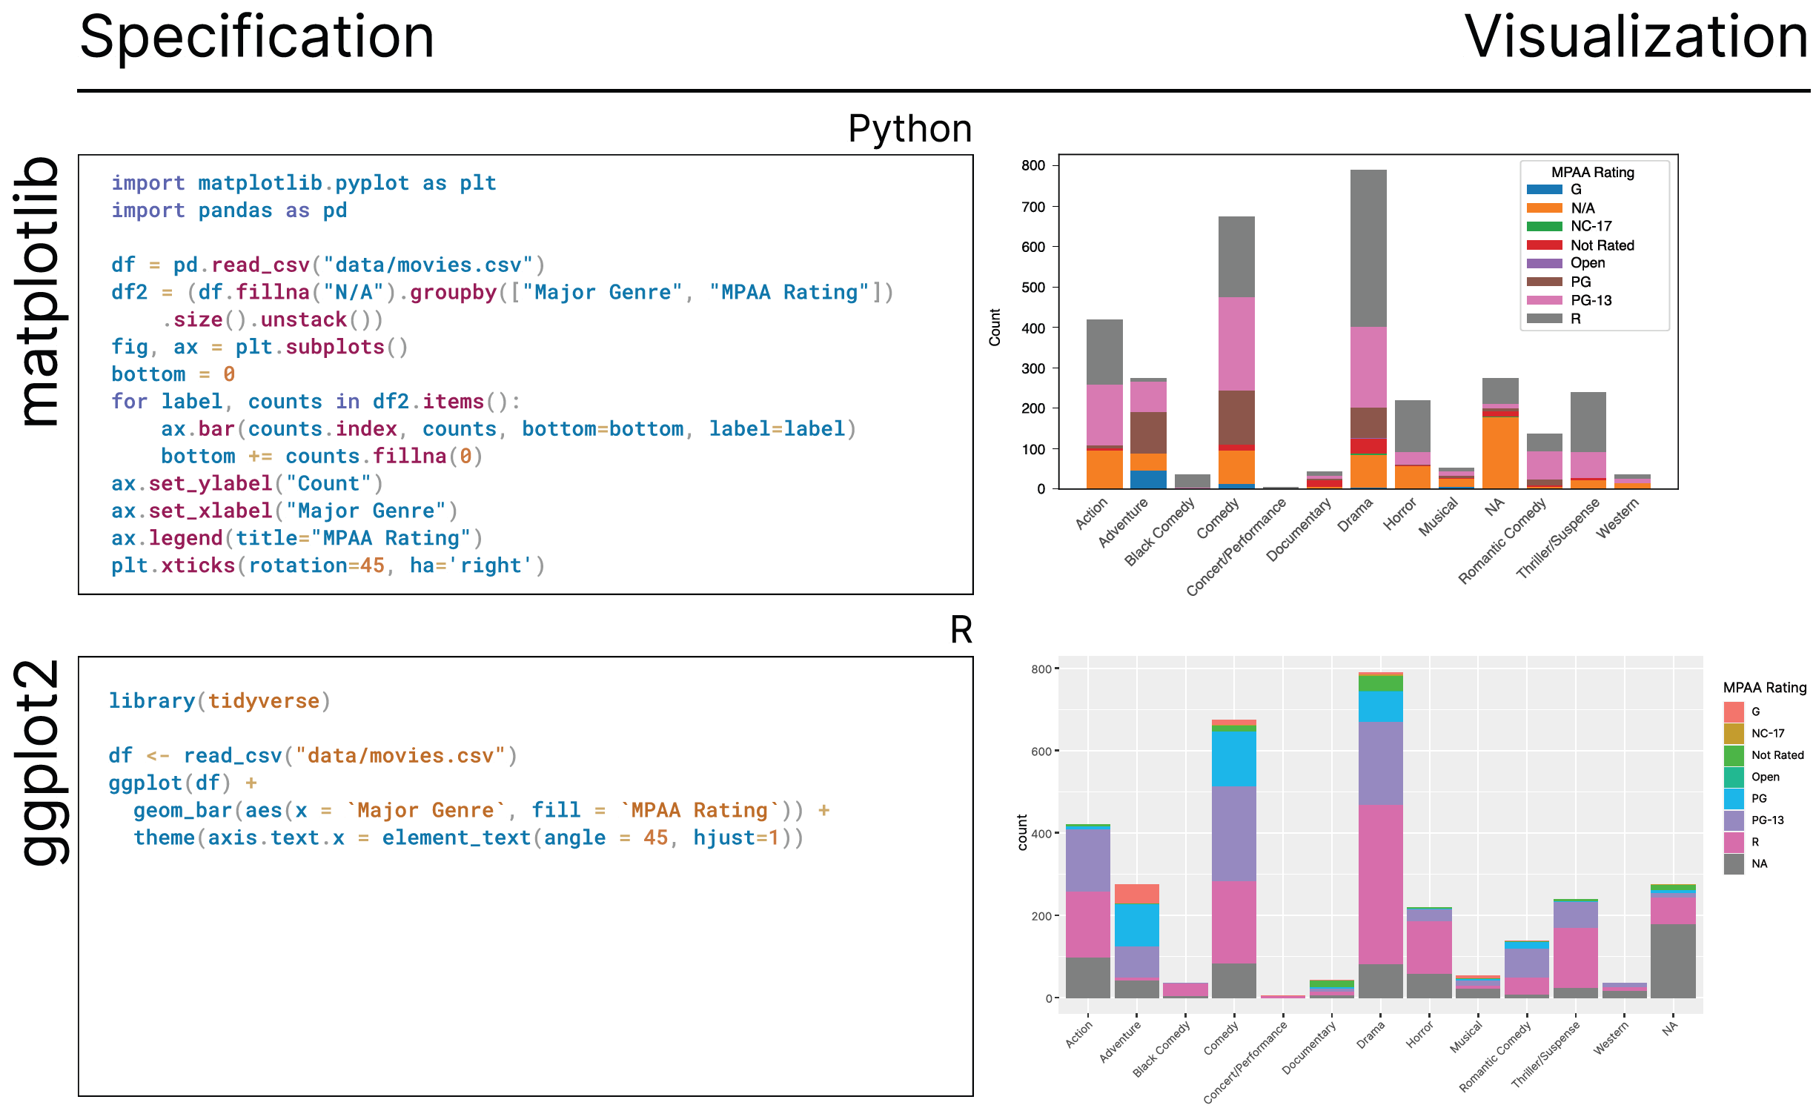

Slide 5
Altair (Python)
ggplot2 (R)
matplotlib (Python)
pandas.plot (Python)
plotly.express (Python)
plotly.graph_objects (Python)
seaborn (Python)
seaborn.objects (Python)
Vega-Lite (JSON)
Libraries, Grammars, Domain-specific languages
Notations

Slide 6
How to evaluate and compare the usability of notations?
Galleries of example visualizations
Ad hoc; difficult to compare
Theoretical frameworks, e.g., Cognitive Dimensions of Notation (terseness, viscosity, etc.)
Require expertise; can be subjective
Empirical evaluations
Expensive, time-consuming
Our approach: metrics-based
Quantitative and automatically computable
Notations are comparable
We demonstrate how to quantify some of the Cognitive Dimensions of Notation

Slide 7
Metrics we propose:
Potential uses of metrics:
Evaluating, and communicating about, new notations
Help with selecting a notation, and with learning a new notation

Slide 8
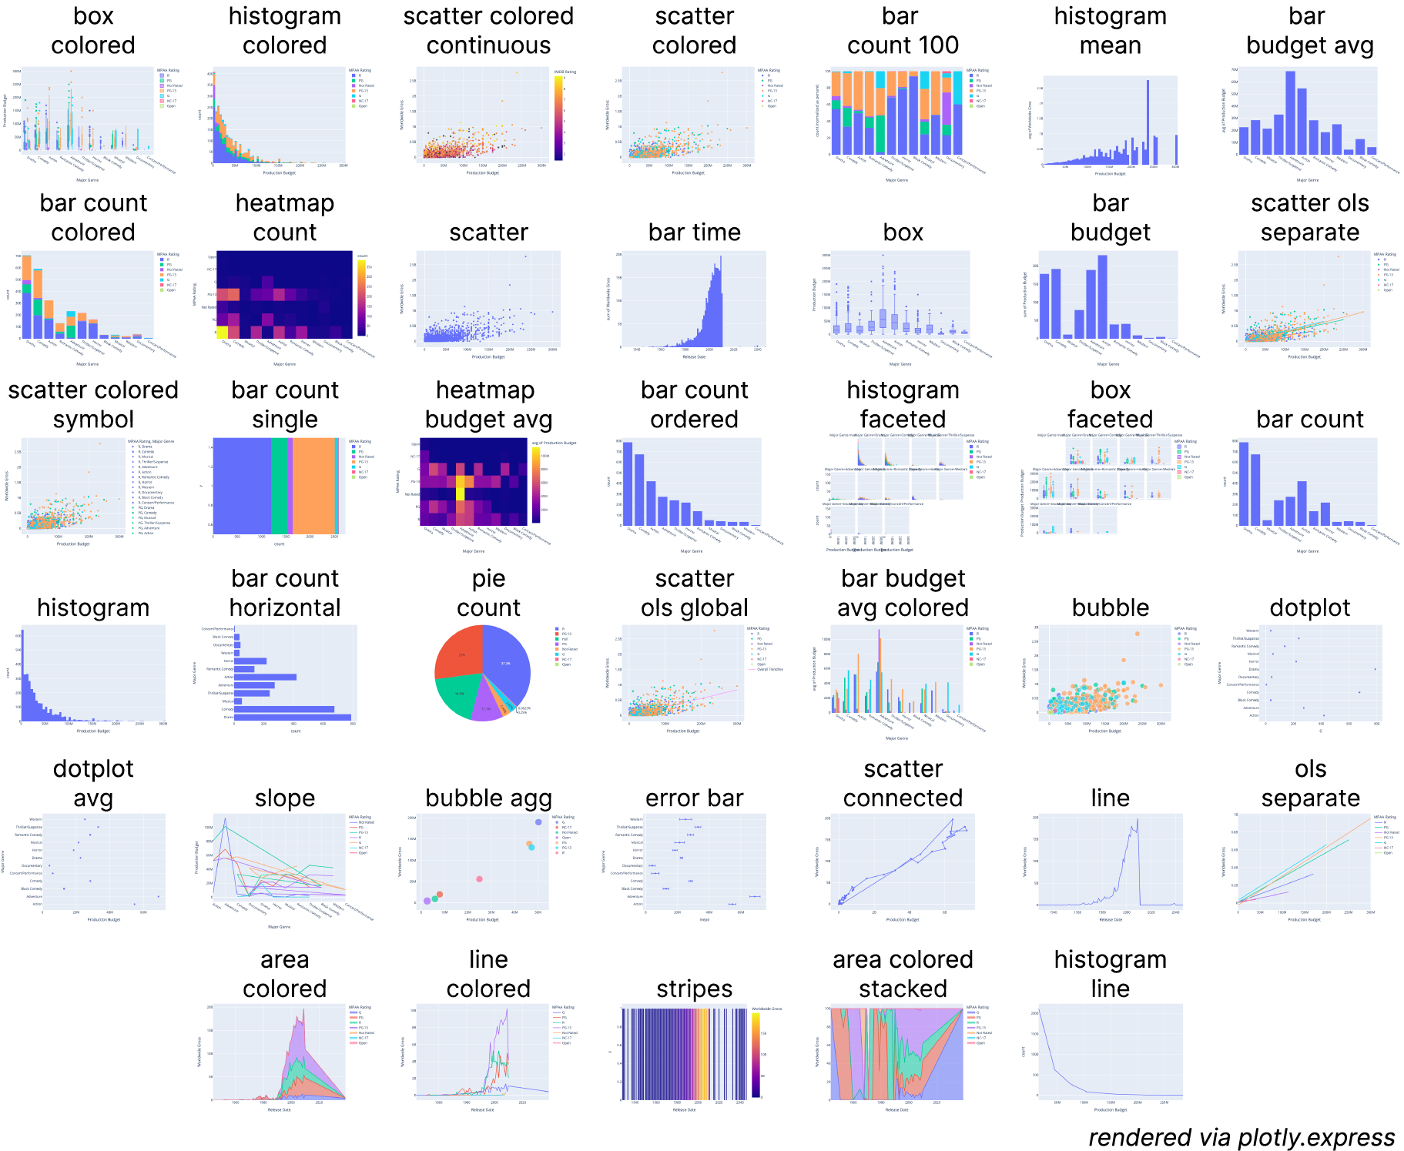
40 visualizations

Slide 9
Multi-notation gallery: 40 visualizations × 9 notations (Altair, ggplot2, matplotlib, pandas.plot, plotly.express, plotly.go, seaborn, seaborn.objects, Vega-Lite)
Our website: https://app.notascope.io/

Slide 10
Metrics
Work
 | … a notation | … a specification | … a pair of specifications
Economy of … | Vocabulary size, in unique tokens
Terseness of … | Median spec length, in bytes | Length of spec, in bytes
Viscosity of … | Sprawl = median distance between all pairs of specs | Remoteness = median distance to all other specs | Distance (Levenshtein edit distance, or Compression distance)

Slide 11
Metrics
 | … a notation | … a specification | … a pair of specifications
Economy of … | Vocabulary size, in unique tokens
Terseness of … | Median spec length, in bytes | Length of spec, in bytes
Viscosity of … | Sprawl = median distance between all pairs of specs | Remoteness = median distance to all other specs | Distance (Levenshtein edit distance, or Compression distance)

Slide 12
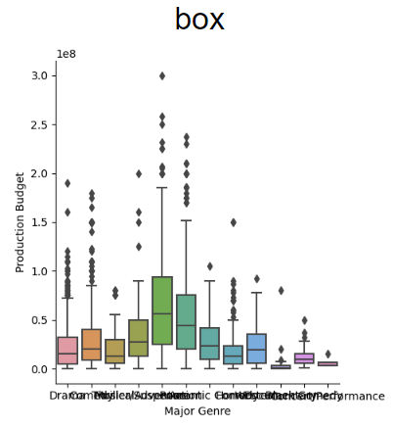
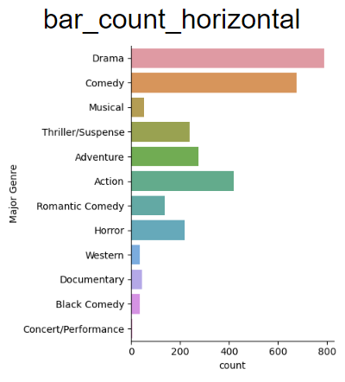
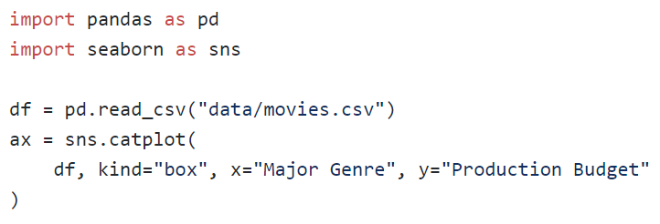
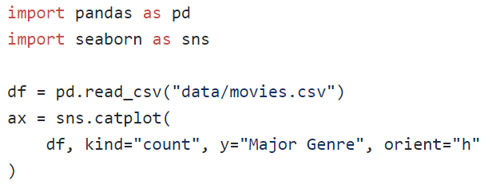
Two specs in the Seaborn notation:

Slide 13
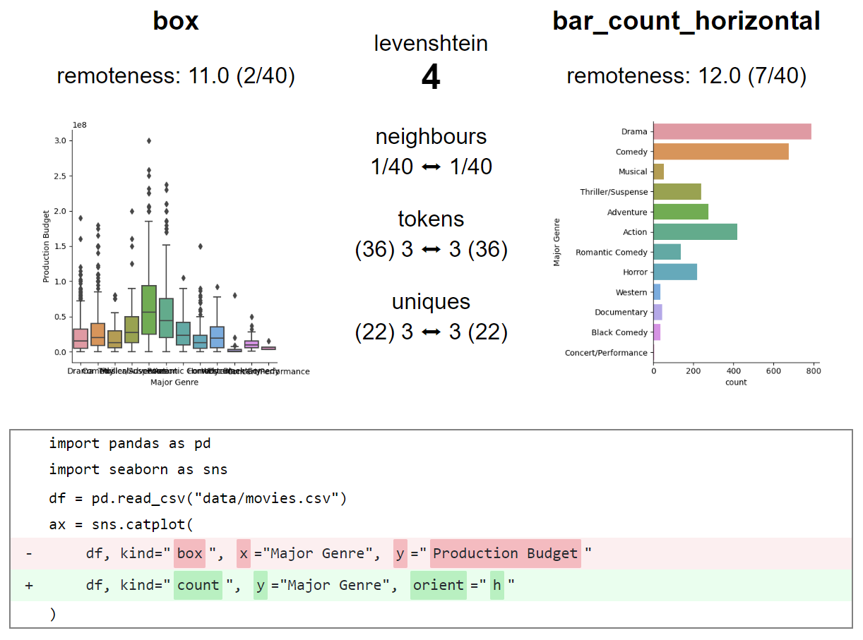
Two specs in the Seaborn notation:
Distance = 4

Slide 14
Metrics
 | … a notation | … a specification | … a pair of specifications
Economy of … | Vocabulary size, in unique tokens
Terseness of … | Median spec length, in bytes | Length of spec, in bytes
Viscosity of … | Sprawl = median distance between all pairs of specs | Remoteness = median distance to all other specs | Distance (Levenshtein edit distance, or Compression distance)

Slide 15
Metrics
 | … a notation | … a specification | … a pair of specifications
Economy of … | Vocabulary size, in unique tokens
Terseness of … | Median spec length, in bytes | Length of spec, in bytes
Viscosity of … | Sprawl = median distance between all pairs of specs | Remoteness = median distance to all other specs | Distance (Levenshtein edit distance, or Compression distance)

Slide 16
Metrics
 | … a notation | … a specification | … a pair of specifications
Economy of … | Vocabulary size, in unique tokens
Terseness of … | Median spec length, in bytes | Length of spec, in bytes
Viscosity of … | Sprawl = median distance between all pairs of specs | Remoteness = median distance to all other specs | Distance (Levenshtein edit distance, or Compression distance)
We expect:
(Vocabulary size) ∝ 1/(Median spec length)

Slide 17
Metrics
 | … a notation | … a specification | … a pair of specifications
Economy of … | Vocabulary size, in unique tokens
Terseness of … | Median spec length, in bytes | Length of spec, in bytes
Viscosity of … | Sprawl = median distance between all pairs of specs | Remoteness = median distance to all other specs | Distance (Levenshtein edit distance, or Compression distance)
We expect:
(Vocabulary size) ∝ 1/(Median spec length)
(Median spec length) ∝ Sprawl

Slide 18
Metrics
 | … a notation | … a specification | … a pair of specifications
Economy of … | Vocabulary size, in unique tokens
Terseness of … | Median spec length, in bytes | Length of spec, in bytes
Viscosity of … | Sprawl = median distance between all pairs of specs | Remoteness = median distance to all other specs | Distance (Levenshtein edit distance, or Compression distance)
We expect:
(Vocabulary size) ∝ 1/(Median spec length)
(Median spec length) ∝ Sprawl
(Vocabulary size) ∝ 1/Sprawl

Slide 19
Metrics
 | … a notation | … a specification | … a pair of specifications
Economy of … | Vocabulary size, in unique tokens
Terseness of … | Median spec length, in bytes | Length of spec, in bytes
Viscosity of … | Sprawl = median distance between all pairs of specs | Remoteness = median distance to all other specs | Distance (Levenshtein edit distance, or Compression distance)
We expect:
(Vocabulary size) ∝ 1/(Median spec length)
(Median spec length) ∝ Sprawl
(Vocabulary size) ∝ 1/Sprawl

Slide 20
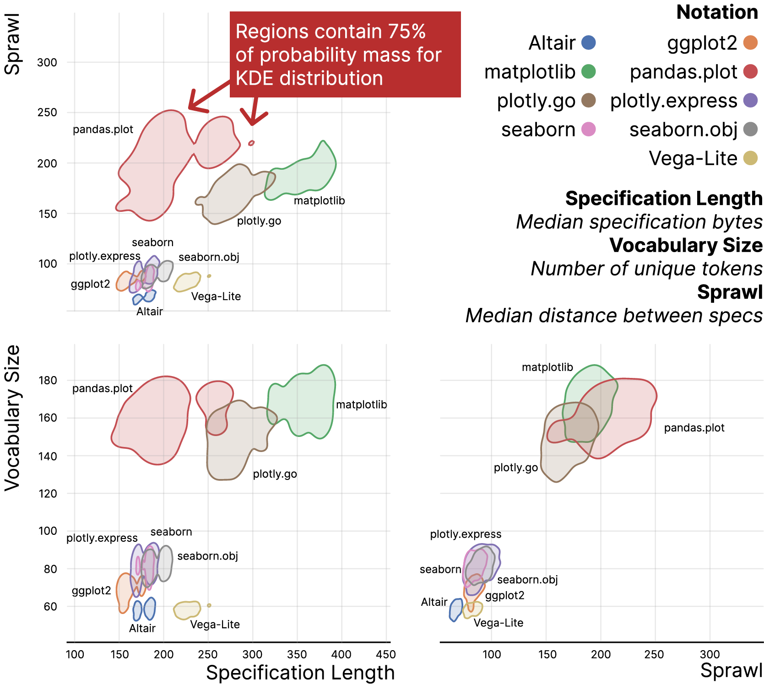
Median spec length

Slide 21
Median spec length
We expected:
(Vocabulary size) ∝ 1/(Median spec length)
(Median spec length) ∝ Sprawl
(Vocabulary size) ∝ 1/Sprawl
What we found:
No
Partially confirmed
Opposite found

Slide 22
Median spec length
We expected:
(Vocabulary size) ∝ 1/(Median spec length)
(Median spec length) ∝ Sprawl
(Vocabulary size) ∝ 1/Sprawl
What we found:
No
Partially confirmed
Opposite found

Slide 23
Median spec length
We expected:
(Vocabulary size) ∝ 1/(Median spec length)
(Median spec length) ∝ Sprawl
(Vocabulary size) ∝ 1/Sprawl
What we found:
No
Partially confirmed
Opposite found

Slide 24
Median spec length
We expected:
(Vocabulary size) ∝ 1/(Median spec length)
(Median spec length) ∝ Sprawl
(Vocabulary size) ∝ 1/Sprawl
What we found:
No
Partially confirmed
Opposite found

Slide 25
Median spec length
We expected:
(Vocabulary size) ∝ 1/(Median spec length)
(Median spec length) ∝ Sprawl
(Vocabulary size) ∝ 1/Sprawl
What we found:
No
Partially confirmed
Opposite found

Slide 26
“High-level composition”
“Chart templates”
“Grammar”
[Wongsuphasawat 2020]
Median spec length

Slide 27
Feedback from experts
Interviews with 6 experts: authors or maintainers of ggplot2, Vega-Lite, seaborn, matplotlib, Altair, plotly
The visualizations of the notations aligned with their pre-existing mental models of relationships between the notations
Experts generally agreed that the metrics capture important aspects of notation usability, and should be useful for communicating about them

Slide 28
Feedback from experts
Interviews with 6 experts: authors or maintainers of ggplot2, Vega-Lite, seaborn, matplotlib, Altair, plotly
Experts generally agreed that the metrics capture important aspects of notation usability, and could be useful for communicating about them

Slide 29
Contributions:
Metrics-based evaluation method
Multi-notation galleries
Metrics (remoteness, sprawl,…) computable from such galleries
Interviews with experts
NotaScope software at https://app.notascope.io/
Potential uses:
Evaluating, and communicating about, new notations
Help with selecting a notation, and with learning a new notation
Navigation within a documentation system using distances

Slide 30
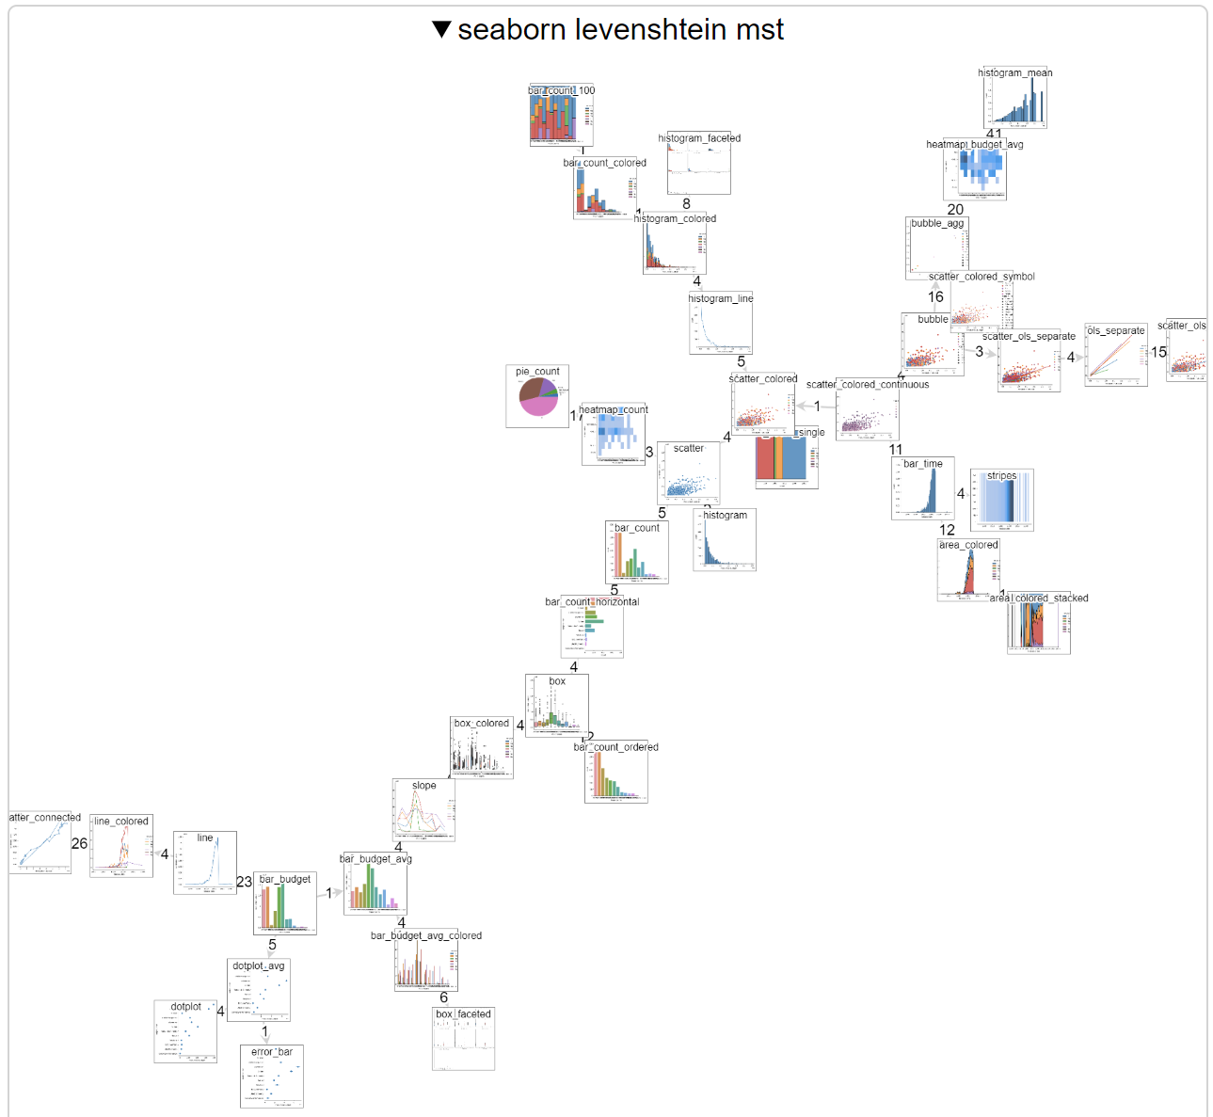
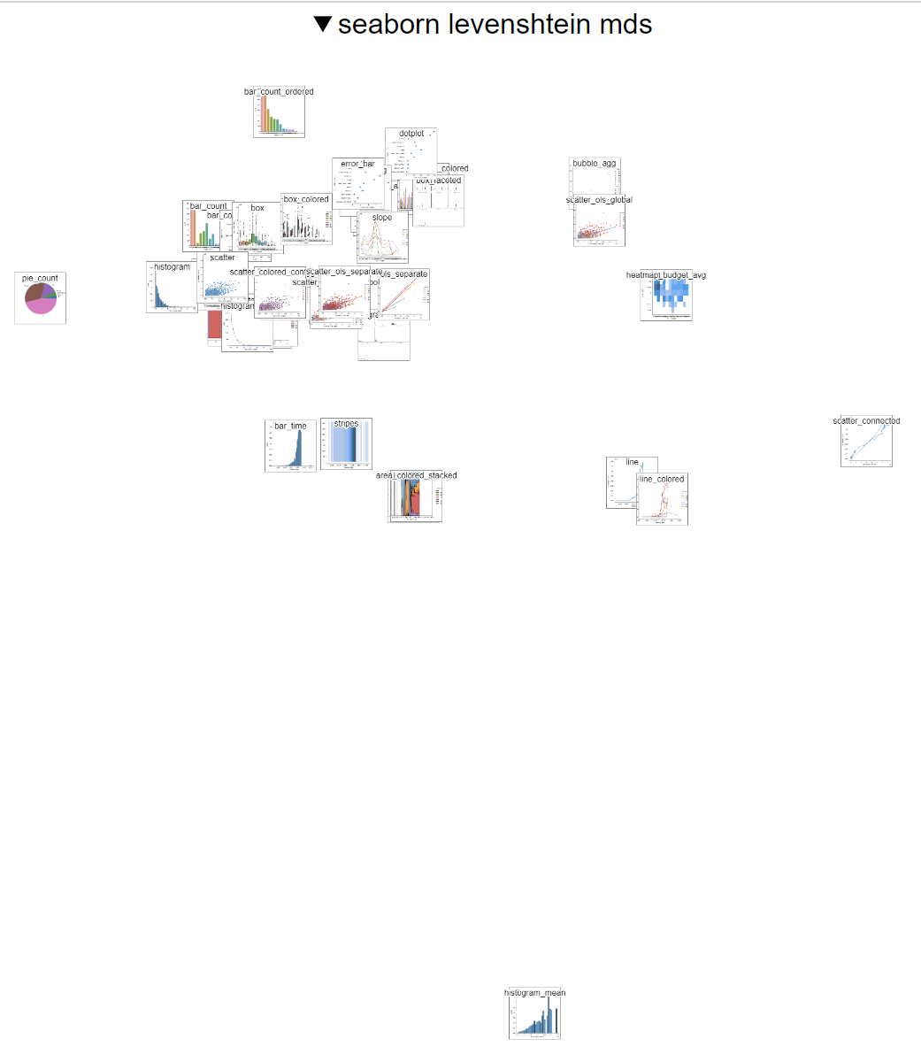
Distances between specs in Seaborn
Minimum spanning tree
Multidimensional scaling
Remoteness of a spec = median distance to all other specs

Slide 31
Distances between specs in Seaborn
Minimum spanning tree
Multidimensional scaling

Slide 32
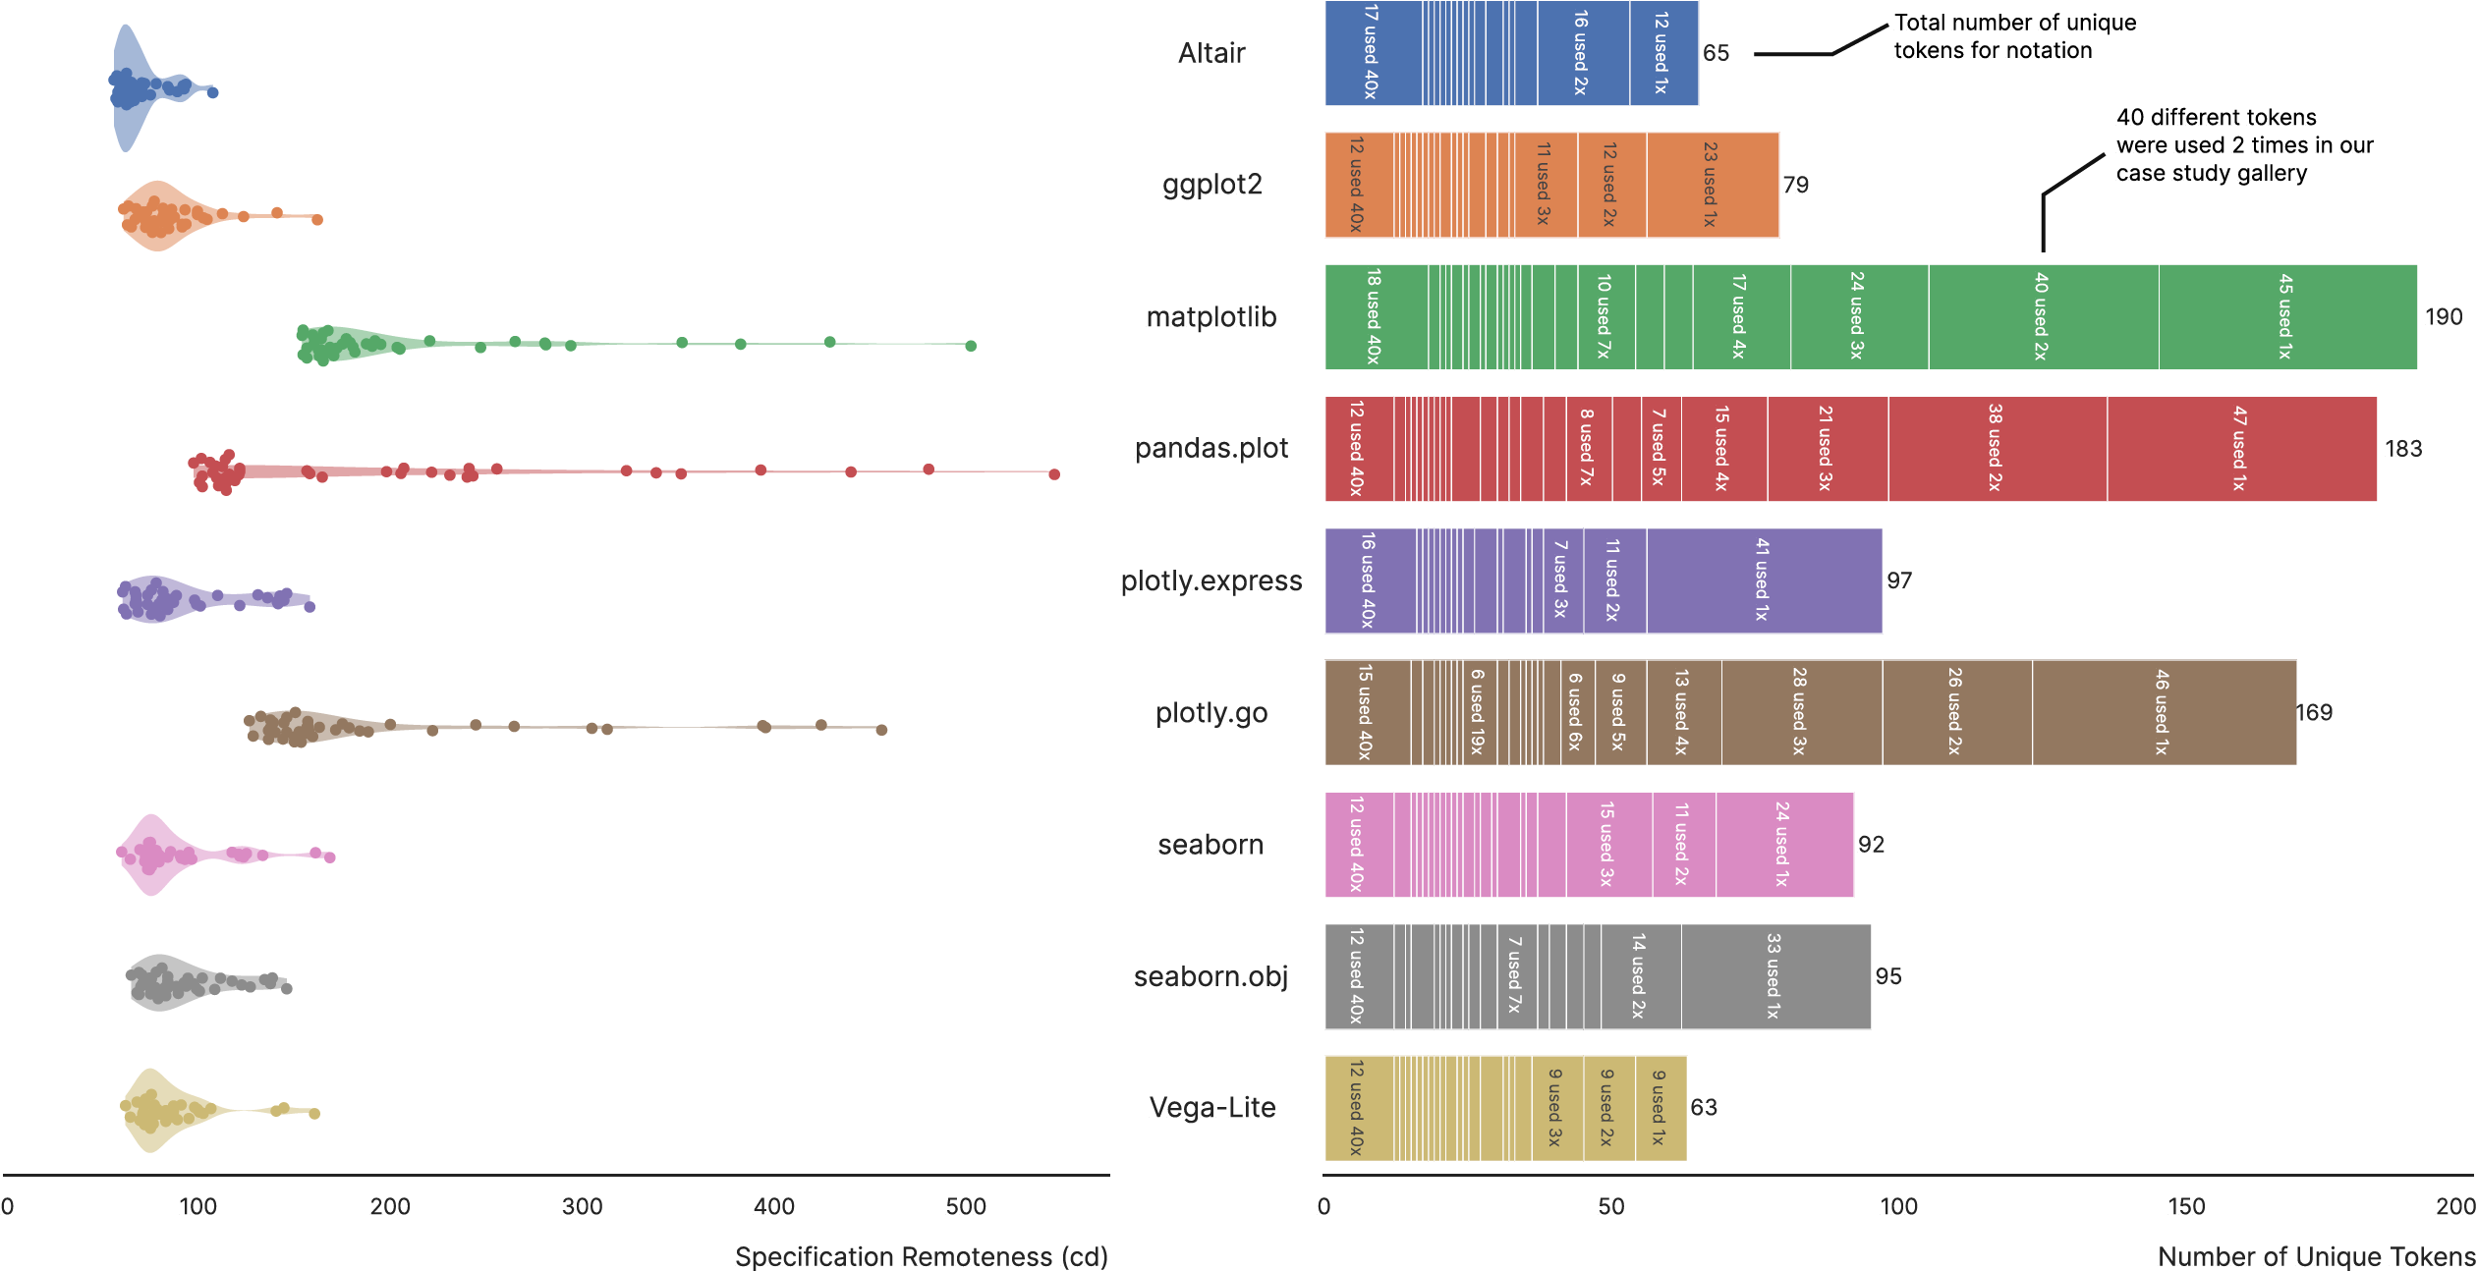
Remoteness of each spec = median distance to all other specs
Number of unique tokens

Slide 33
Contributions:
Metrics-based evaluation method
Multi-notation galleries
Metrics (remoteness, sprawl,…) computable from such galleries
Interviews with experts
NotaScope software at https://app.notascope.io/
Potential uses of this metrics-based approach:
Evaluating, and communicating about, new notations
Help with selecting a notation, and with learning a new notation
Navigation within a documentation system using distances

Slide 34
Future Directions
Extend to other visualization notations
Extend to notations for diagramming, interactive visualizations, sci vis, data wrangling
Using AI assistants to generate multi-notation galleries
Formulating additional metrics
A metric of ‘orthogonality’ of the notation?
Metrics based on user’s mental model

Slide 35
Acknowledgments: Thank you to …
Reviewers for their comments
Domain experts for their time and feedback
NSERC for funding
For more info …
Interactive demo: https://app.notascope.io/
Walthrough of the demo: https://youtu.be/PXwVhaU-8b4
Medium article for general audience: https://t.co/YCfttn0Rbk
Supplemental material: https://osf.io/8924y/

Slide 36
end

Slide 38
Levenshtein edit distance is one way to quantify distance between specs. Another is with Compression distance:
Let C(s) be the Compressed length of spec s.
Define the Compression Distance between specs s₁ and s₂ as
CD(s₁,s₂) = C(s₁+s₂) – min(C(s₁),C(s₂))
where s₁+s₂ is the concatenation of s₁ and s₂.

Slide 39
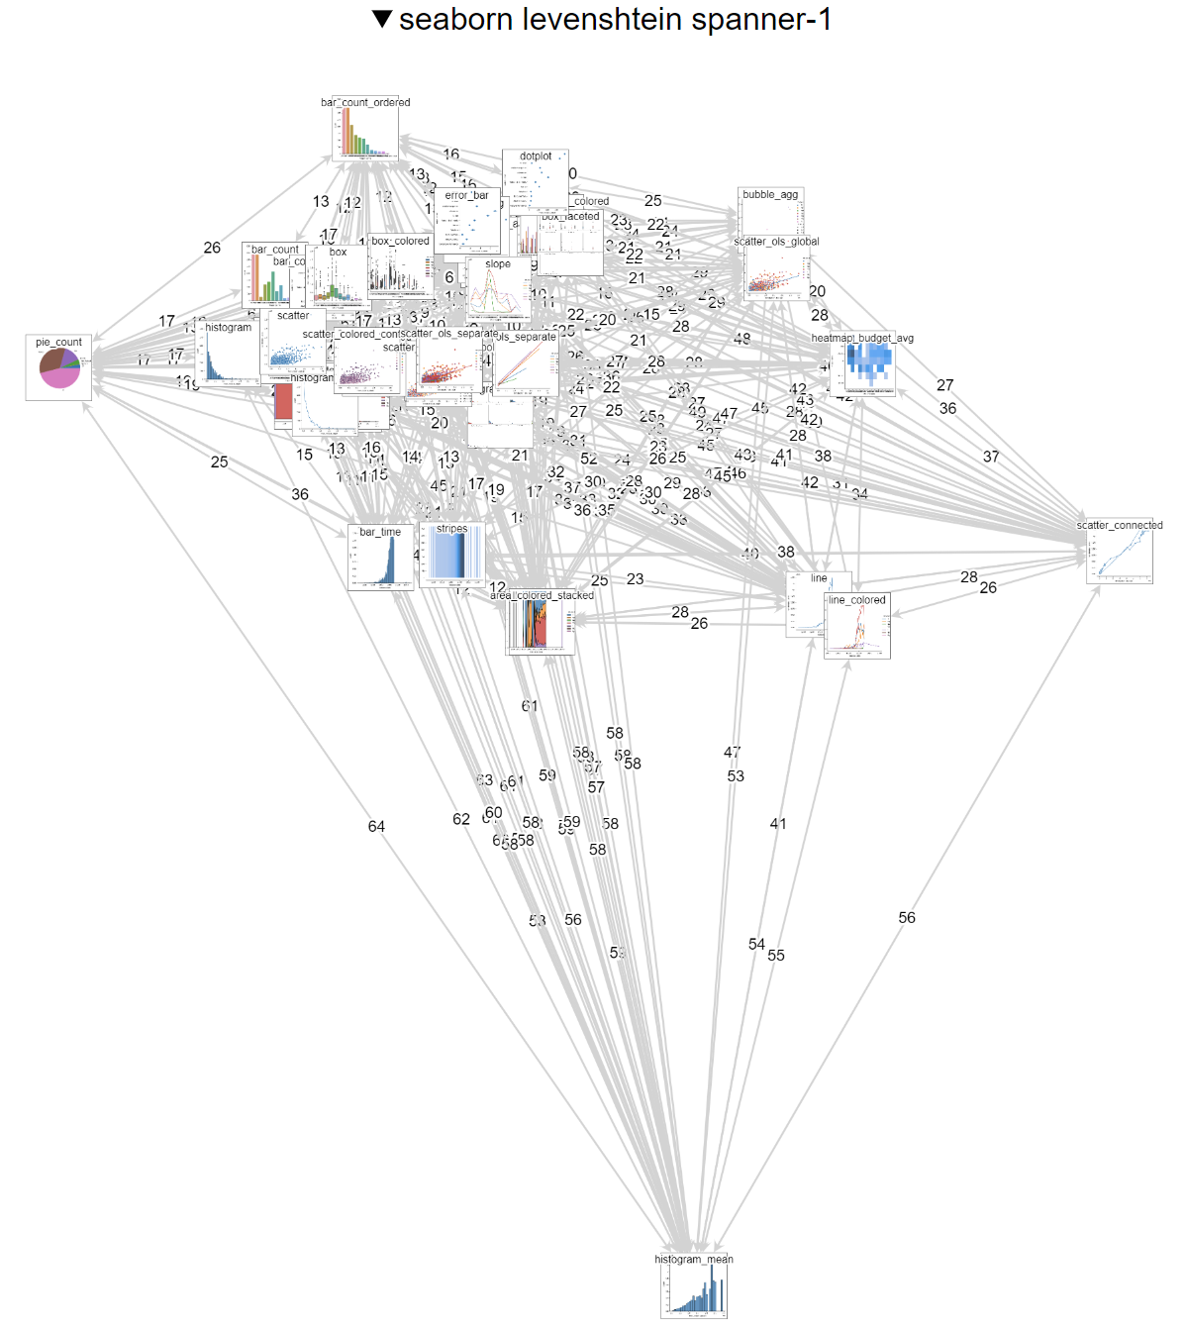
Spanner graph for Seaborn

Slide 40
Minimum spanning tree for Seaborn

Slide 41
Multidimensional scaling for Seaborn

Slide 42
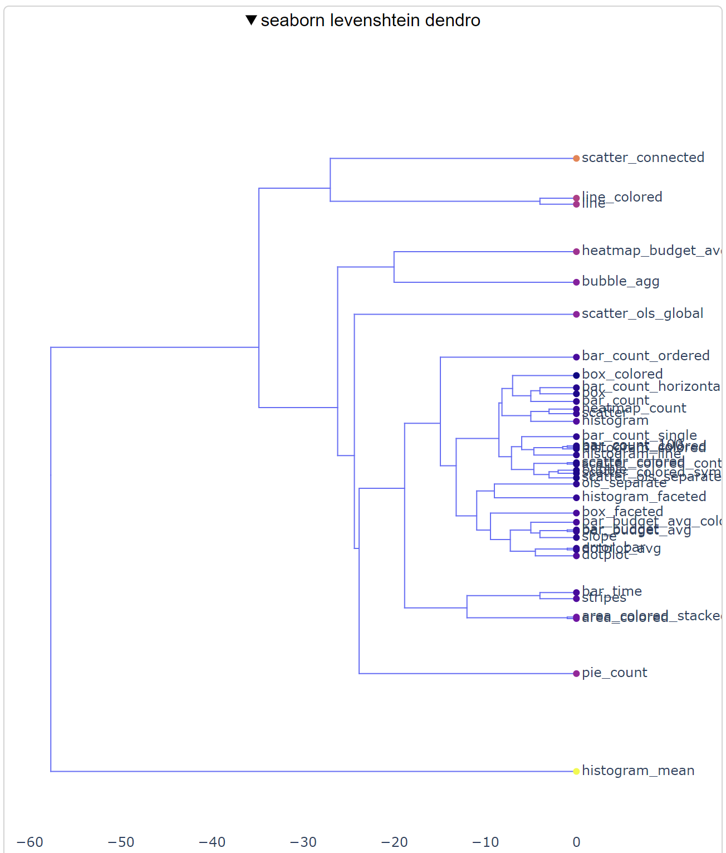
Dendrogram for Seaborn

Slide 43
