Slide 1
Enhancing Image-Based Aging Approaches
Olivier Clément
Eric Paquette

Slide 2
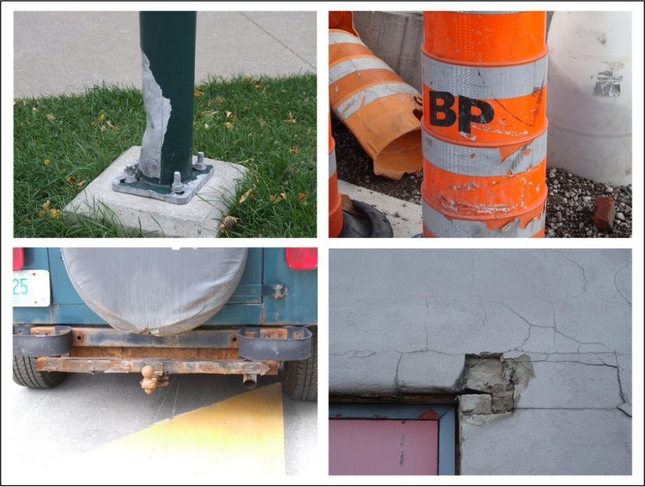
Introduction
Constant evolution of realism of synthetic images
Aging effects are essential
Rust, bumps, dents, mold, or simply dust
Time-consuming task
Many effects on
a single object
Many objects in
a given scene

Slide 3
Presentation outline
Previous work
Image-based aging overview
Objectives and contributions
Enhancements
Automatic positioning system
Improved color-independent process
Conclusion

Slide 4
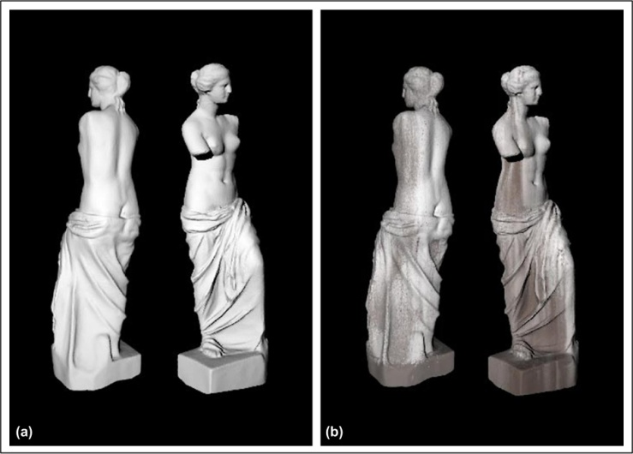
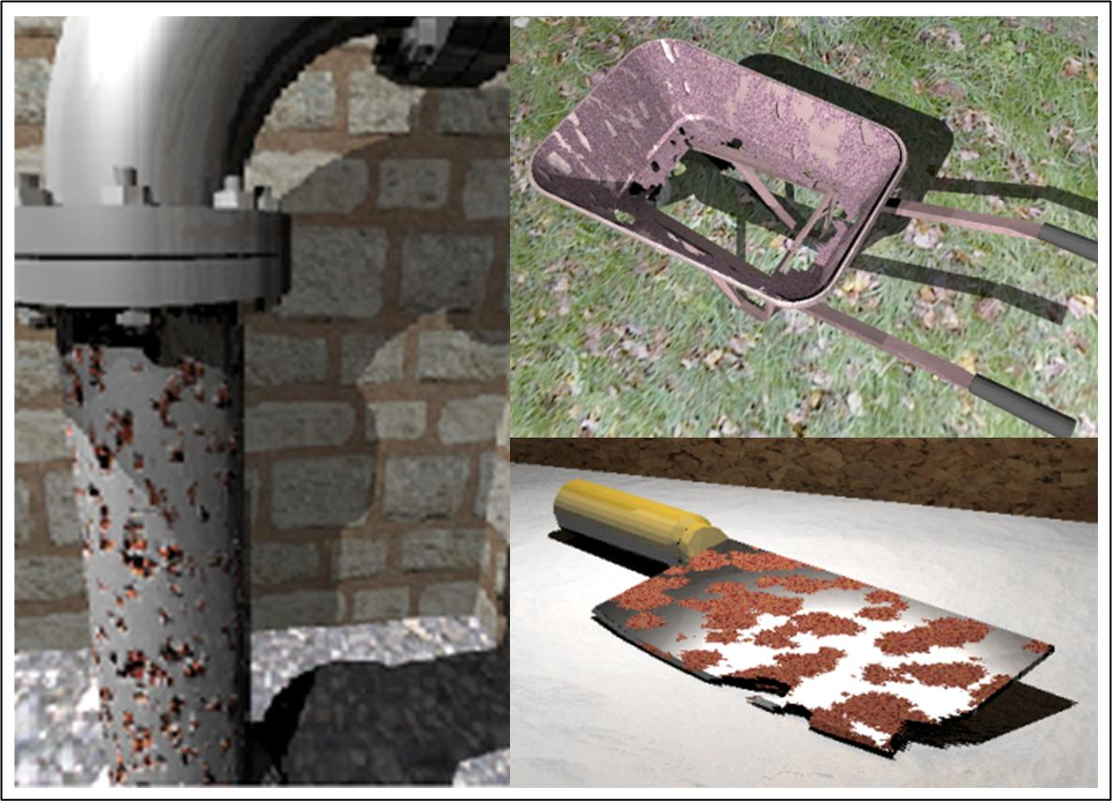
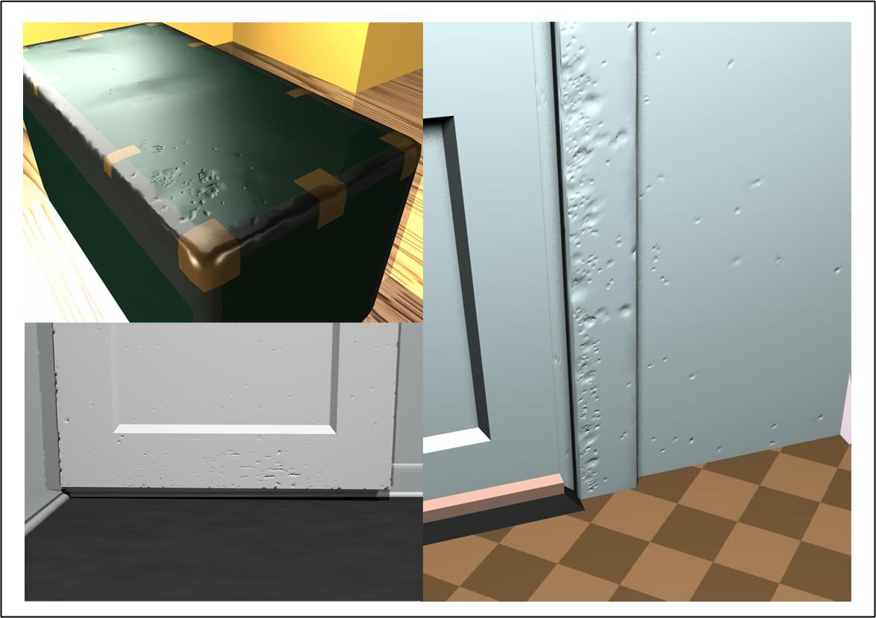
Previous work
Physically-based approaches
[Dorsey and Hanharan 2000; Merillou et al. 2001; O’Brien et al. 2002; etc.]
Highly realistic results
Lengthy calculations
Non-intuitive physical parameters
Empirical approaches
[Chen et al. 2005; Gobron and Chiba 2001; Paquette et al. 2002; etc.]
More intuitive parameters
In both cases
Simulation for a specific type of effect
Do not provide the control required by artists

Slide 5
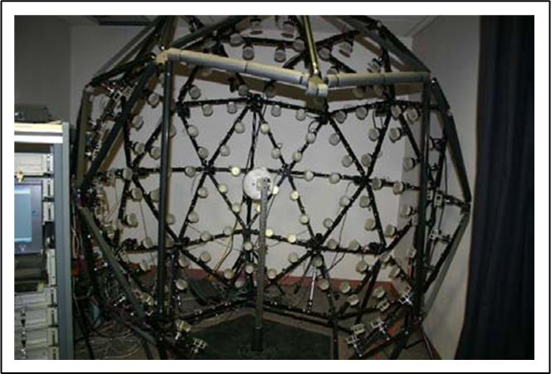
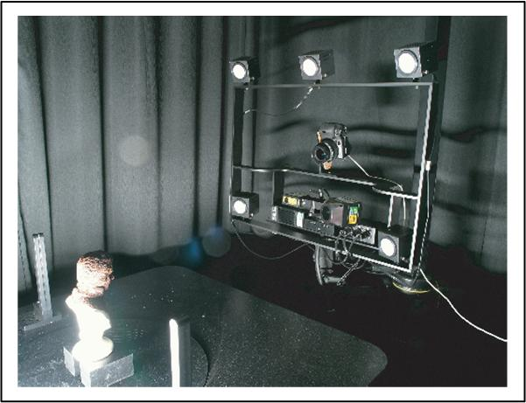
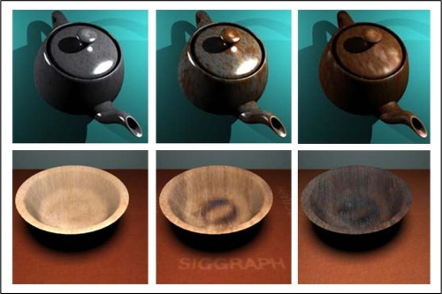
Previous work
Image-based approaches
[Gu et al. 2006; Wang et al. 2006; Lu et al. 2007; etc.]
Capture the changes over time
Reproduce it using texture synthesis
Advantages
Supports various type of effects
No complex physical parameters
Adequate control over the results

Slide 6
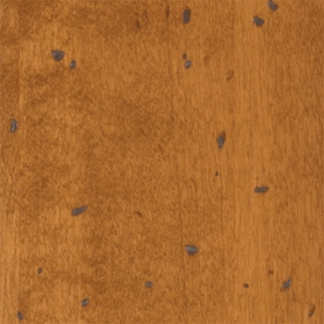
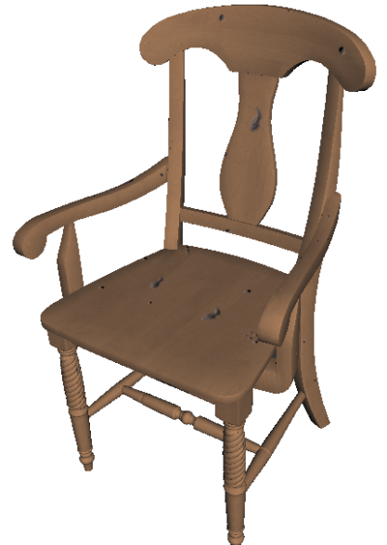
Image-based aging overview
Output texture
Segmentation
+
Texture synthesis
Base texture
Repeated several times for similar aging on different objects or multiple occurrences
Control mask
Such as Gu et al. 2006, Wang et al. 2006, Clement et al. 2007, and Clement and Paquette 2010

Slide 7
Image-based aging considerations
How to capture the example?
Complex capture system (multiple camera setup) (Gu et al. 2006; Lu et al. 2007)
Realistic results, costly, time-consuming, and inadequate for some effects
Simple capture system (single photograph) (Wang et al. 2006; Clement and Paquette 2010)
Flexible, quick, cheap, without restrictions, but gives less information
How to produce the control masks?
Manually (Gu et al. 2006; Wang et al. 2006, Clement et al. 2007)
Automatically using local properties from the capture (Lu et al. 2007)
Automatically using an aging model (aging recipe) (Clement and Paquette 2010)
How to control the resulting coloration?
Only from the coloration of the provided example
(color-dependent process) (Gu et al. 2006; Wang et al. 2006; Lu et al. 2007)
From colors (control points) defined by an artist
(color-independent process) (Clement and Paquette 2010)

Slide 8
Objectives and contributions
Enhancements for image-based approaches
Extensions on automatic positioning system
To add the support of common unhandled cases such as property-based and group-related alignment
Improved color-independent process
To increase the usability of the control points approach by considering the texture information as well

Slide 9
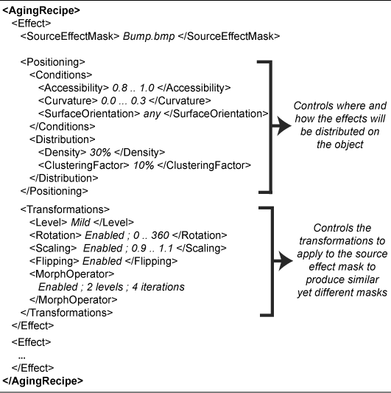
Automatic positioning
Easily generate multiple occurrences and apply similar aging to different objects
Positioning based on an aging model (Clement and Paquette 2010)
General aging model to generate control masks
Without manual editing work
Adequate for evolving and blob-like effects
Mask generation algorithm
For each effect in the aging recipe
Modify the shape of the example using transformations
Select a texel from candidate positions (local property ranges)
Position the effect and repeat until desired density
Notes:
Refer to the original paper for more details on how each parameter is interpreted.

Slide 10
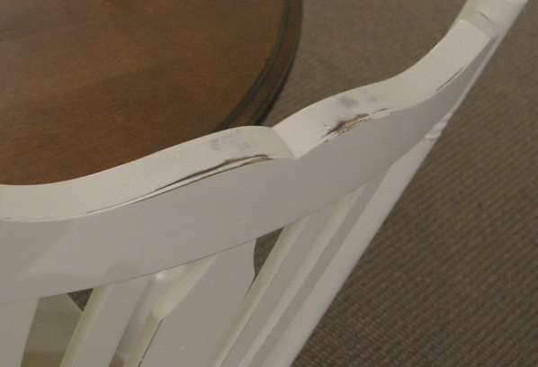
Automatic positioning
Common cases still needing manual work
Property-based alignment
Scratches on edge, bumps on corners, etc.
Group-related alignment
New effects develop in a particular manner related to how a given object is frequently used and because of repeated contacts
Pictures of real examples
TO CHANGE

Slide 11
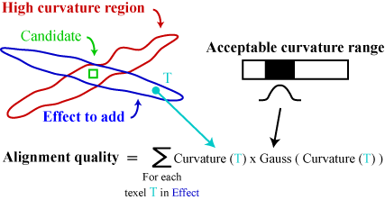
Automatic positioning
Property-based alignment
How to measure the quality of an alignment?
Metric based on the object local properties and the acceptable ranges defined in the aging recipe

Slide 12
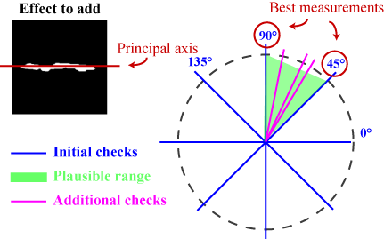
Automatic positioning
Property-based alignment
Iterative algorithm to maximize property alignment
Identify the principal axis using the hotelling transform
Measure the quality of the four primary orientations
Determine a range from the two best measurements
Make some additional measurements within the range
Select the best alignment from all the measurements

Slide 13
Automatic positioning
Group-related alignment
Modify the aging recipe
To support for groups in the aging model
For each new effect in the group
Find the principal axis with hotelling transform
Apply the same rotation
Add a slight random variation in alignment

Slide 14
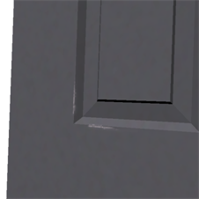
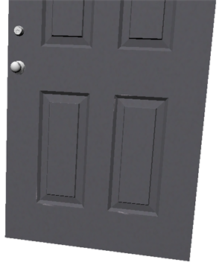
Automatic positioning
Results - Property-based alignment

Slide 15
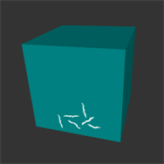
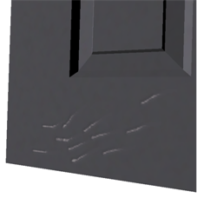
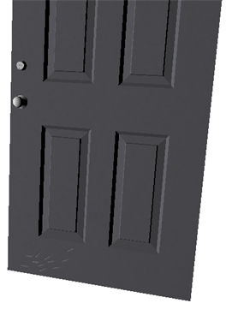
Automatic positioning
Results - Group-related alignment

Slide 16
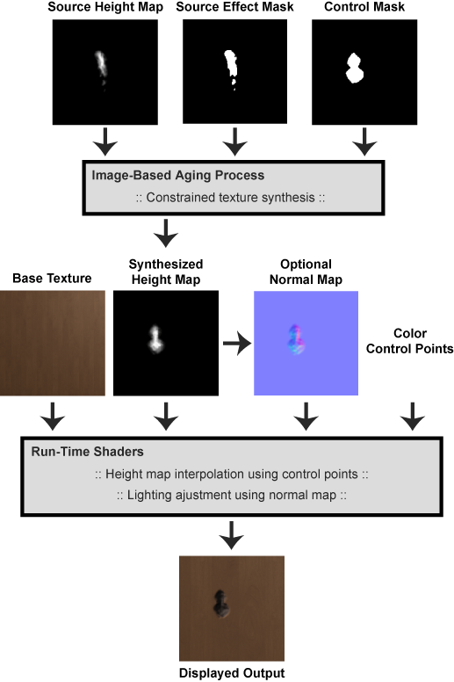
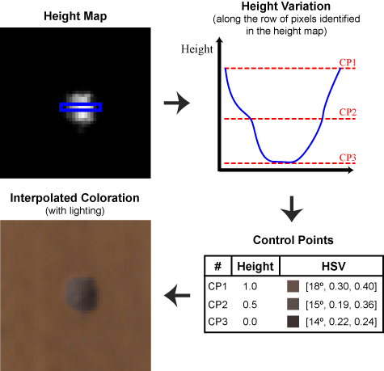
Color-independent process
Typically, effect coloration is based only on the example
Color-independent process introduced recently
Can only handle simple color variation with no complex patterns
The texture information contained in the example is lost
Fixed colors for simple variations
Internal texture is lost

Slide 17
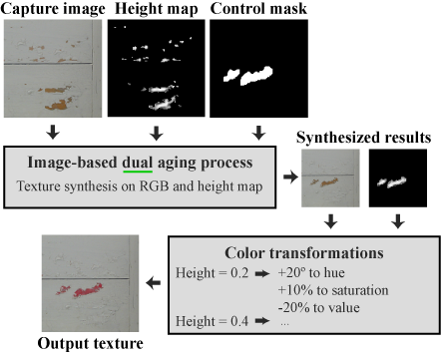
Color-independent process
We propose a dual process
Combining RGB and Height map synthesis with color transformations

Slide 18
Color-independent process
Key benefits
Much more versatile than color-dependent processes
Supports simple color variations and internal texture patterns
Process similar to what could be done in image editing software
Easy and convenient to produce multiple occurrences or similar aging on different objects
Limitations
Needs an initial calibration for the color transformations

Slide 19
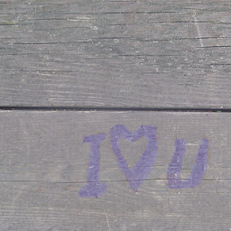
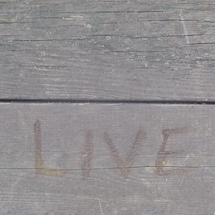
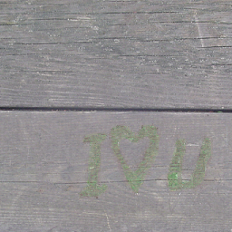
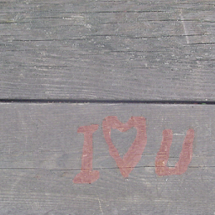
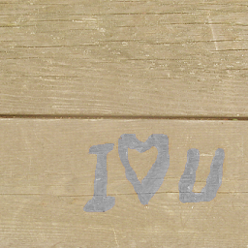
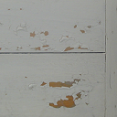
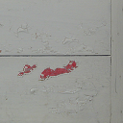
Color-independent process
Capture image
Output texture

Slide 20
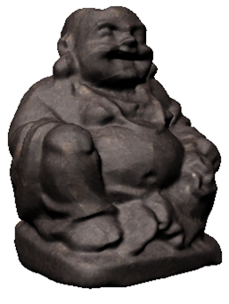
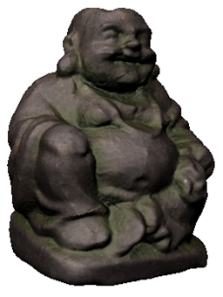
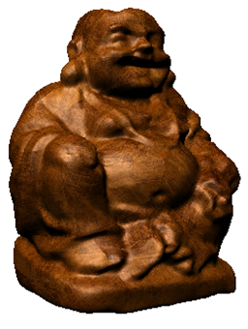
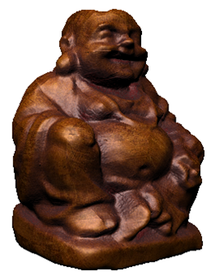
Color-independent process
Results

Slide 21
Conclusion
We proposed enhancements to image-based aging
Property-based alignment
Group-related alignment
Improved dual color-independent process
Further easing the creation of environments containing several aged objects

Slide 22
Questions
?

