Slide 1
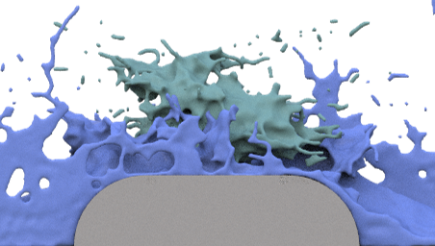
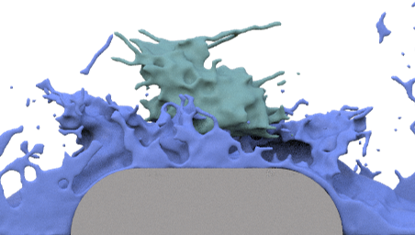
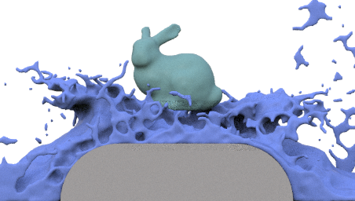
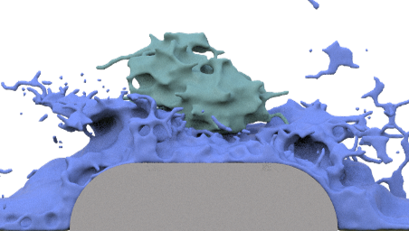
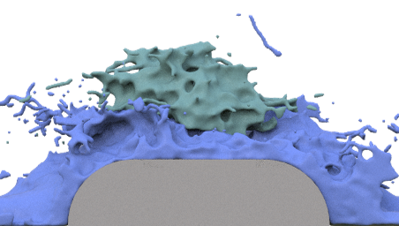

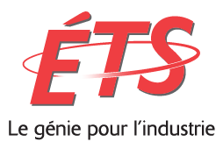



Time Reversal and Simulation Merging for Target-Driven Fluid Animation
Gowthaman Sivakumaran
Carleton University
gowtham.maran1@gmail.com
Eric Paquette
École de technologie supérieure
eric.paquette@etsmtl.ca
David Mould
Carleton University
mould@scs.carleton.ca
Notes:
Hello Everyone
A very good day to you all I’m Gowthaman Sivakumaran and I’m here to present my work on ‘Time Reversal and Simulation Merging for Target-Driven Fluid Animation’
This is a joint project between Professor.Eric Paquette from ETS and my Thesis supervisor Professor. David Mould from Carleton University

Slide 2
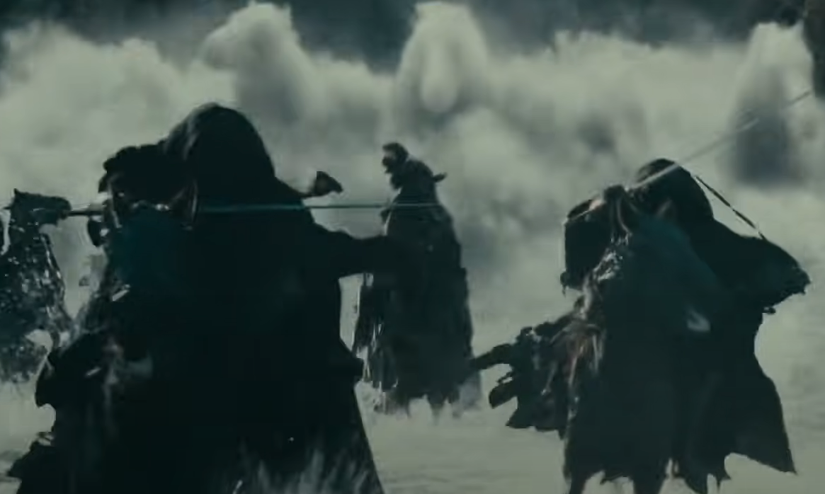
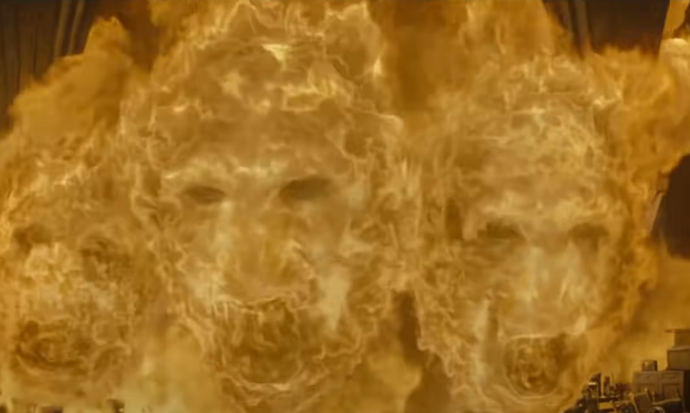
Problem Statement
Matching target surfaces at the desired time within natural-looking surroundings
The Lord of the Rings: The Fellowship of the Ring © New Line Cinema
Harry Potter and the Deathly Hallows Pt. 2 © Warner Bros
Notes:
-Animated fluid effects applications range from movies, TV shows, and advertisements to real-time interactive applications in virtual/augmented reality and computer games.
-Traditional computational fluid simulation is completely governed by physics laws. Having an artistic control over this simulation process is difficult.
Animators can only change the settings of the initial state and must repeat the simulation over and over again in a trial-and-error manner until they end up with the expected fluid motion effect.
-In this paper, We present an approach to control the animation of liquids. This problem statement consists of two main aspects
*The first one is, the simulated fluid should match the desired target surfaces at the desired time. As like the Horse and Face shown in these VFX scenes
*The second one is, this art directed fluid motion should cohesively exist within a natural looking surrounded simulation. Similar to the River and Fire in these examples
The common aspects in these both example is that the surrounded simulation is turbulent in nature which motivates the art directed fluid motion

Slide 3
Main Contributions
• Division of the simulation into source and target
• Division of the target simulation into a forward portion and backward portion
Notes:
The main contribution of our approach is the division of the simulation into source and target, and division of the target simulation into a forward portion and backward portion.
*In this example simulation frame, the division is shown in different colours, blue for source and green for target

Slide 4
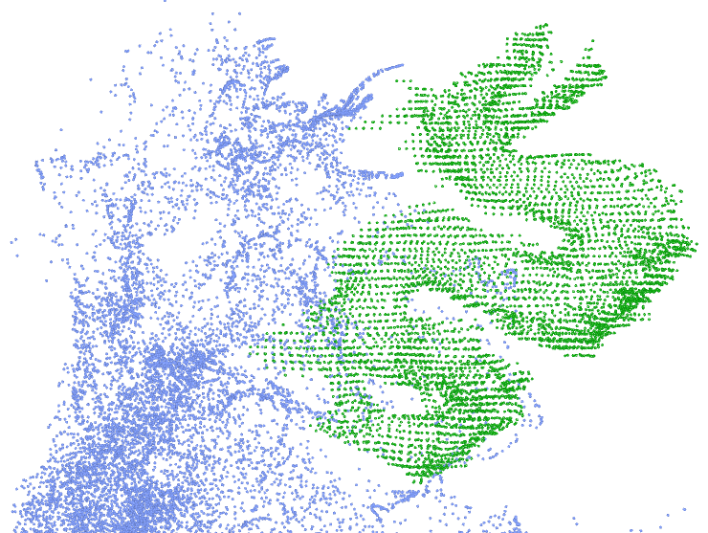
Secondary Contributions
Necessary ingredients to implement the approach in a particle-based simulator
• Distribute target particles to reproduce target shapes • Use source simulation to control initial conditions of target simulations
• Merging source and target simulations for rendering
Notes:
The secondary contributions of our approach comes from its implementation in a particle-based simulator.
-First one is the procedure to distribute target particles to reproduce well-formed target shapes
-Second one is to set the initial conditions of the target simulations, allowing a good integration with the source simulation
-Third one is the procedure to select an appropriate set of particles for surface reconstruction and rendering.
-The example diagram shows the particle representation of target dragon surface shown in green colour emerging from source splashing water shown in blue

Slide 5
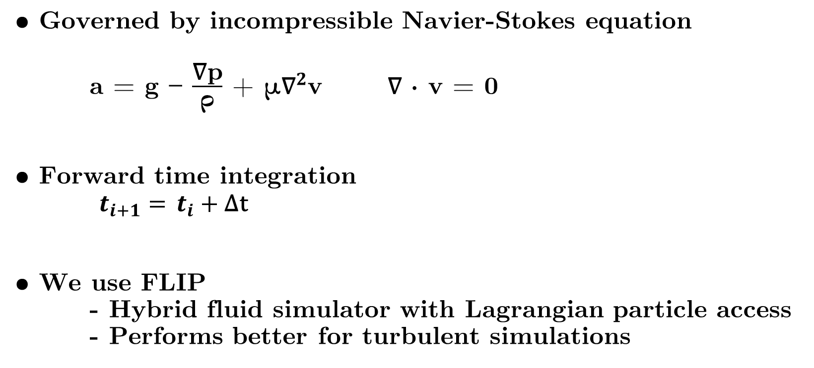
Background – Fluid Simulation
• Governed by incompressible Navier-Stokes equation
a = g − $\frac{\text{∇p}}{\text{ρ}}$ + μ${\text{∇}}^{2}$v ∇ · v = 0
• Forward time integration
$t_{i+1}=$ $t_{i}+$∆t
• We use FLIP
- Hybrid fluid simulator with Lagrangian particle access - Performs better for turbulent simulations
Notes:
-Now we will briefly look into the necessary fluid simulation background on which our approach was built up on
-Traditional computational fluid dynamics is Governed by incompressible Navier-Stokes equation
*First partial differential equation consists of three driving forces respective to gravity, pressure and viscosity. Second equation poses a constrain based on density preservation.
-There could be other additions based on the fluid phenomena that are being simulated, but these are the main four elements found in any fluid simulation.
-In a typical fluid simulation, these four elements are applied for a given fluid state that comprised of acceleration, velocity and displacement and then they are integrated forward in time
-There are many Fluid simulation methods exist. We use Fluid Implicit Particle Method known as FLIP for its easy Lagrangian particle access and better performance in simulating turbulent simulations

Slide 6
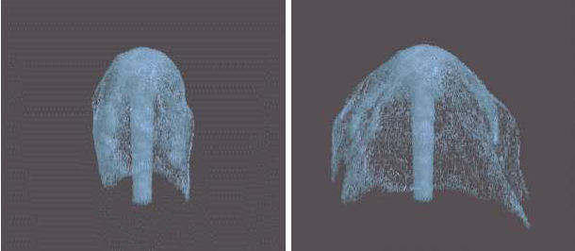
Previous Work
Treuille et al. (2003) Guiding Forces from Target Shapes
Foster and Metaxas (1997) Embedded Controllers
Notes:
-Previous art directed fluid simulation methods, devised number of strategies such as the use of control forces through user-defined guides in terms of control particles and meshes and time reversal. -Foster and Metaxas were the first to present the idea of fluid control using the concept of embedded controllers. These controllers are time and space functions, such as an expanding sphere for explosions. The user’s ability to define a function expressing the motion they seek limits the amount of control they have.
-Another notable work was by Treuille et al. in which they generated guiding forces from target shapes and utilizing those forces to achieve the target fluid motion. The concept of smoke density targets was first developed by them using user-specified keyframes to define target shapes at specific points in the simulation.

Slide 7
Background - Time Reversal Method
Oborn et al. (2018) Time reversal for smoke
Twigg and James (2008) Pioneered time reversal
Notes:
-Time reversal approach is close to our proposed method.
-Time reversal is achieved by simulating with decrementing time step instead of traditional incrementing time step
-Twigg and James first proposed time reversal method for rigid body simulator
-Oborn et al. extended the time reversal idea for smoke simulation
-As seen in the image, from the initial bunny target shape, the smoke is simulated reverse in time
-Then the simulated states are played forward in time to give the illusion of the formation of the bunny
-Their method introduces artificial equation for entropy reduction which results in uncanny motion
-This is Limited to static target models

Slide 8
Our Method
Notes:
Now we’ll look into our proposed art-directed method to control the animation of liquids.

Slide 9

Overview – Overall Simulation
Notes:
-First, we’ll see the overview of our proposed approach using one of the test case results generated from our system.
-Here a running horse target surface is art directed within the background of waterfall source simulation. This is inspired from water horses emerging from raging river in the movie, The Lord of the Rings: The fellowship of the ring

Slide 10
Overview – Source Simulation
Notes:
-This animation shows the waterfall source simulation of the previous example results.
-The source simulation is the main simulation, providing the context and environment in which the target shape appears.
-Our research mainly focuses on the subset of liquid simulation in the domain of fluid simulation. The prominent property that differentiates liquid from other types of fluids is its ability to retain volume and conformation to the shape of its container. Therefore, in order to create a natural-looking believable illusion of liquid animations, the art-directed target liquid shape should arise from an already existing turbulent liquid surface.
- Therefore, the background source simulations used in our system are turbulent in nature

Slide 11
Overview – Target Simulation
Notes:
This is the art directed target shape fluid animation of the running horse.
The target simulation provides the evolution of the target shape;

Slide 12
Overview – Overall Simulation
Notes:
- Both the source and target simulations are merged to give the expected overall art-directed fluid simulation as shown here

Slide 13
Algorithm
(1) Obtain the source simulation
(2) Obtain initial conditions for the target simulation
(3) Carry out the two halves of the target simulation: - One forward
- One backward
(4) Merging the source and target simulation particle sets
(5) Reconstruct the surface and render
Notes:
-This is the overview of our proposed algorithm The steps in the algorithm can be summarized as follows:
(1) Creating and computing the source simulation.
(2) Obtaining initial conditions for the target simulation. Here the target shape is appropriately filled with particles. For each target simulation particle, its velocity is driven from the source simulation.
(3) Then carrying out the two halves of the target simulation: one forward, one backward and joining the two halves together to construct the entire target simulation sequence.
(4) Afterwards, conducting a selection of which particles to keep and remove when merging the source and target simulation particle sets.
(5) Finally, reconstructing the surface and rendering it.
In the following slides, we provide more detail on the scheme outlined now. We will begin by discussing the case of a static target shape appearing at a single frame, followed by a description of how to handle persistent and animated target shapes

Slide 14
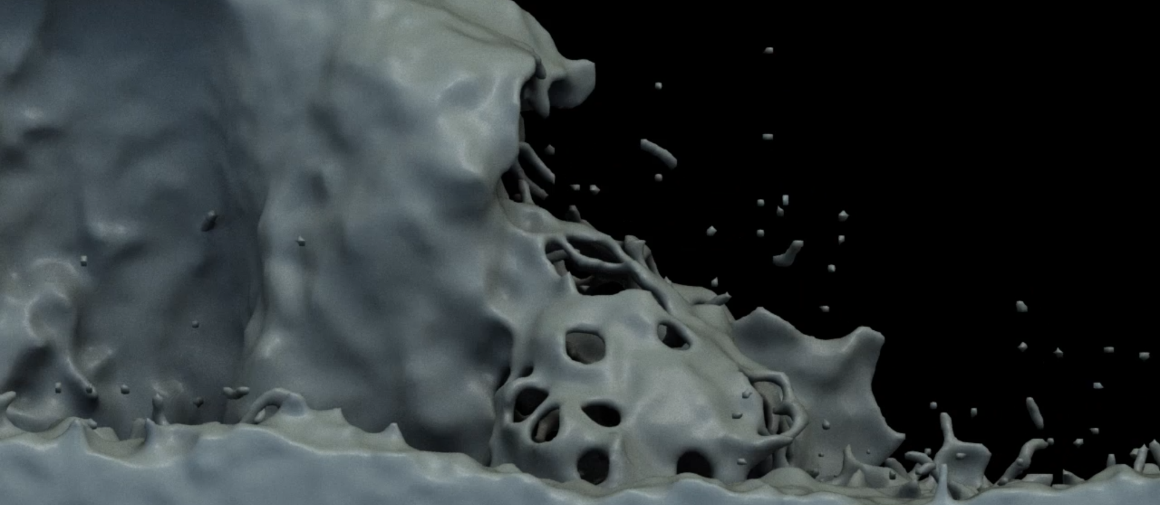
Obtain the source simulation
Notes:
In preparation for the art-directable portion of the fluid motion, the animator first creates the source simulation, representing the surroundings where the effect will appear. The animator will choose the time and placement of the target shape, typically after inspecting the source simulation to guide the decision.
-Source simulation simulated like traditional computational fluid simulation. Other than setting the initial conditions we don’t modify the source simulation
-Our system facilitate importing an already existing source simulation too.

Slide 15
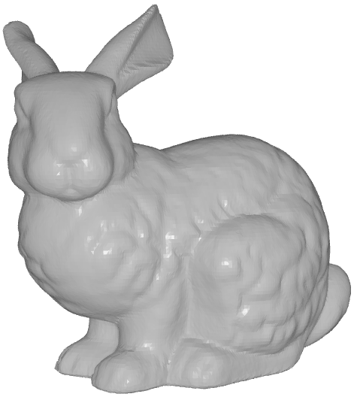
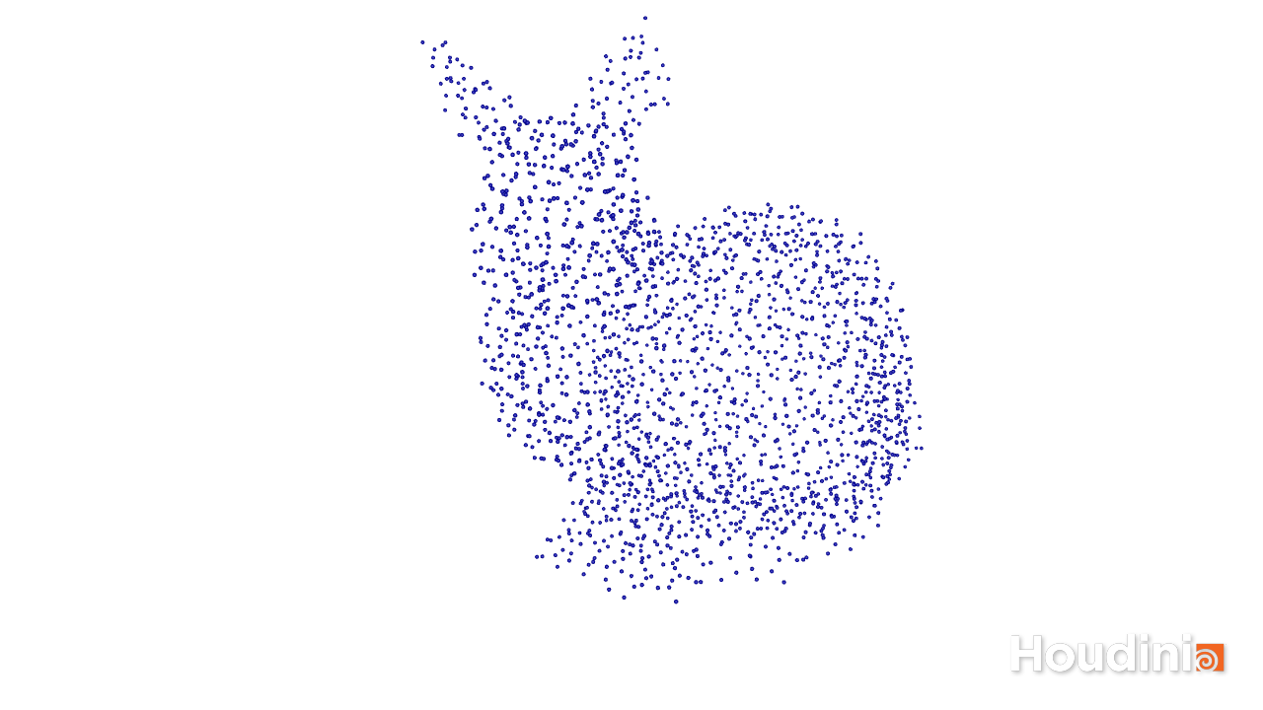
Initial Conditions - Shell Creation
Solid Polygonal Mesh
Poisson Disk Particle Sampled
Notes:
The user must select the target shape, which in our implementation is represented by a solid polygonal mesh.
In order to reproduce the target shape with fluid particles, it might appear that we should simply populate with fluid particles the volume contained within the target shape.
However, as only the fluid surface is visible, particles within the volume typically contribute less to the appearance of the shape: we can save simulation effort by leaving the volume hollow. More importantly, filling the volume leads to sluggish behaviour as the particles restrict one another’s movement; using a hollow shell of particles provides a lighter, more energetic feeling to the animation. To create a shell of particles, we compute a signed distance field from an input mesh, then use a Poisson disc sampling to populate the interior of the mesh

Slide 16
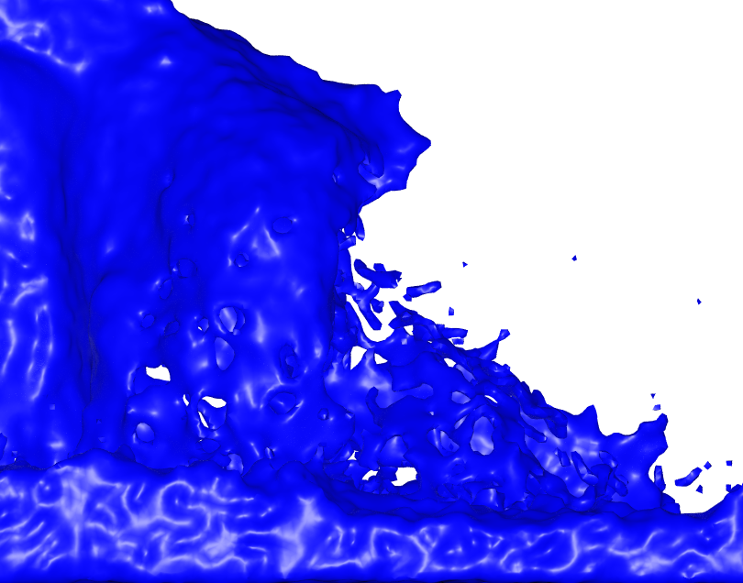
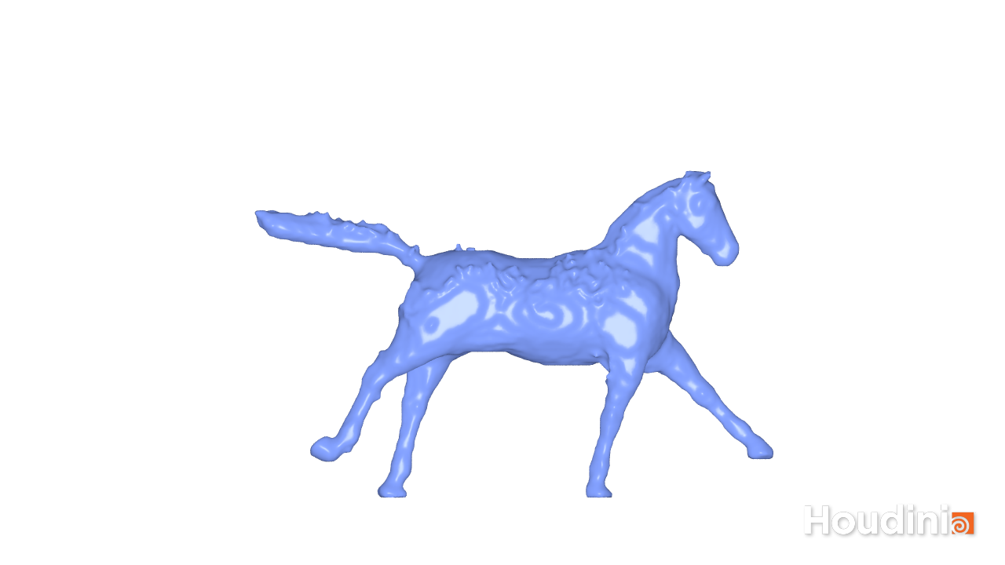
Initial Conditions - Velocity Assignment
Source
Target
Notes:
-For the assigning velocities to the target particles, several strategies are possible, including defining and evaluating an analytic function, or allowing the animator to create a velocity field. While our method is compatible with any of these, creating an adequately complex distribution can be time consuming. Fortunately, we have a complex distribution at hand, which is the source simulation;
-The animator defines a region of the source simulation from which velocities will be obtained. This is often a region relevant to the target simulation, such as its immediate surroundings, or the site of a splash. Source particles within the region are eligible to be sampled.
-Having established a set of eligible source particles, we then sample from them and assign their velocities to randomly selected target particles. Some fraction of target particles are assigned velocities in this manner;
the remainder are assigned velocities by interpolating among those already assigned, using Shepard’s method

Slide 17
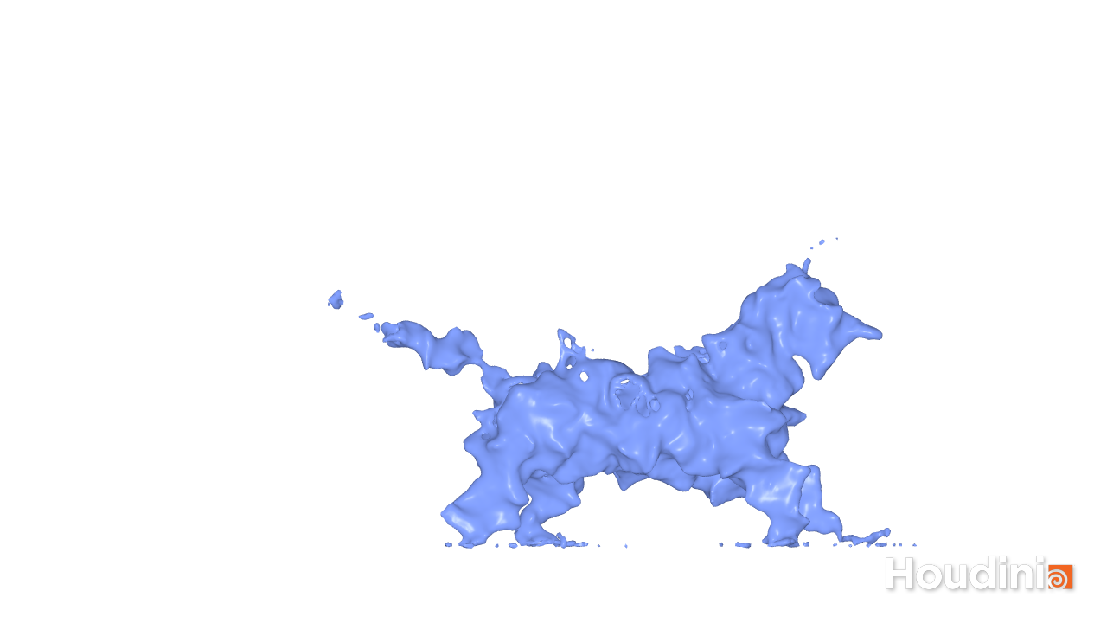
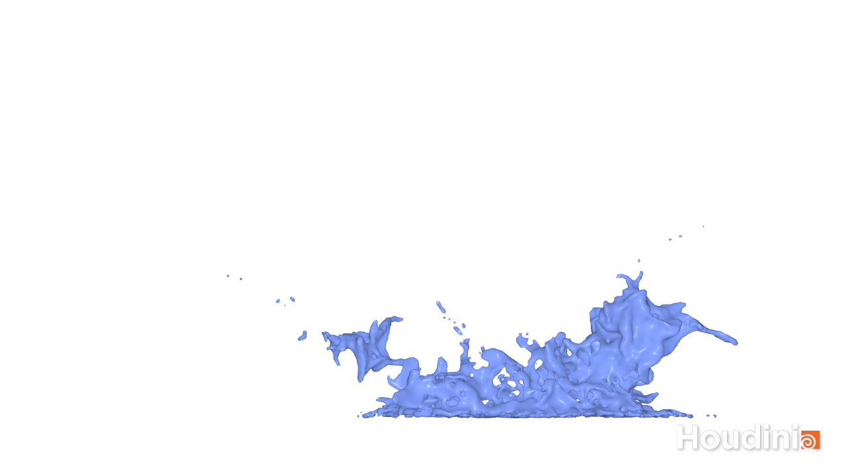
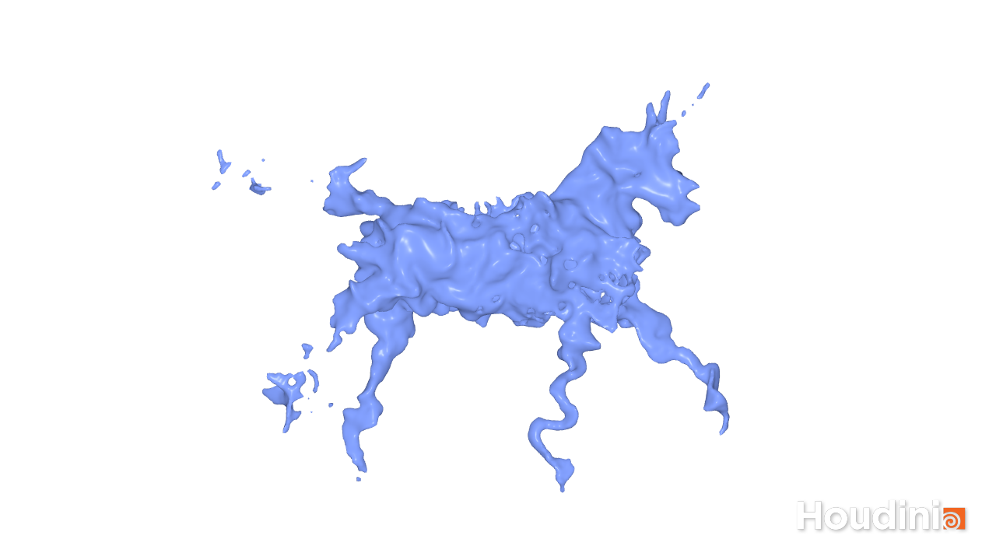
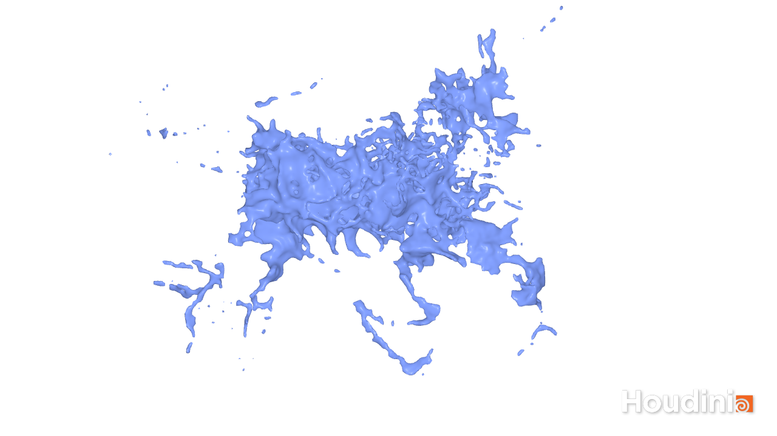
Target Simulation
0
1
2
Forward
V
V
V
0
-1
-2
-V
-V
Backward
-V
-2
-1
0
1
2
V
V
V
V
V
Notes:
Once initial conditions for the target simulation are available, we can compute the target simulation:
-one half forward in time as shown in first row using the initial velocity
-and one half backward in time as shown in row 2, by running the simulator forward but reversing the initial velocity of each particle.
The outcome of the backward simulation is reversed as shown by similar colored boxes in row 3 .
- Finally the forward and backward simulations are concatenated to form the full target simulation

Slide 18
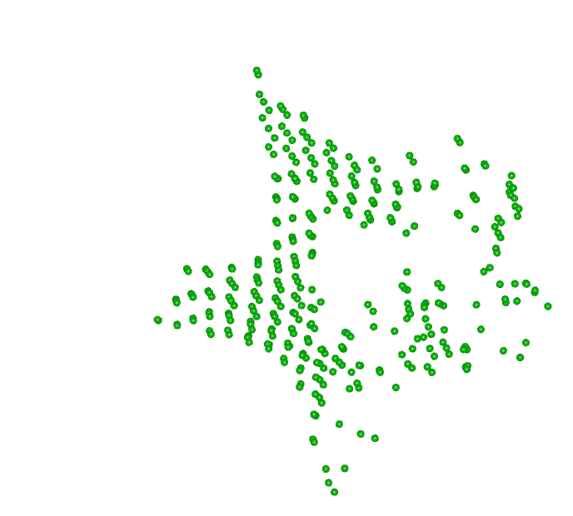

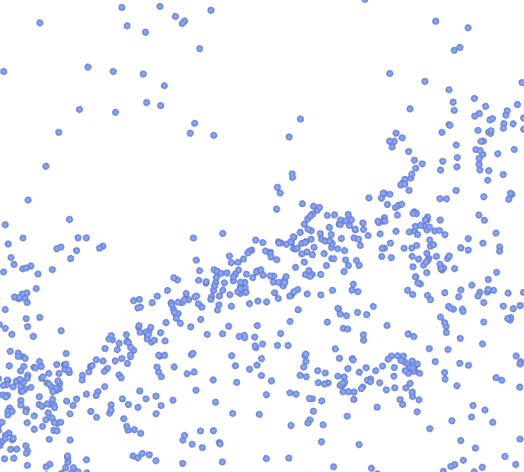
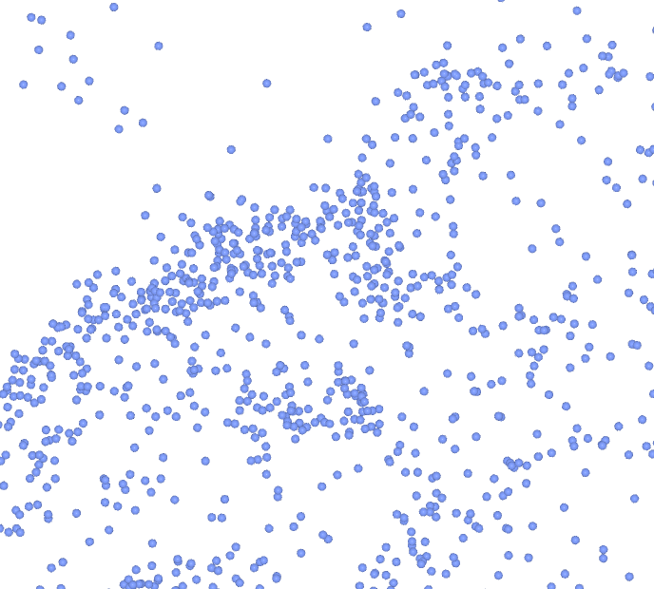
Merging Source and Target Simulations
Target particles are removed when they are close to source particles
Notes:
At this stage, we have a separate source simulation and target simulation. They have been simulated separately and do not interact. The target simulation is intended to last only a short time.
Within this period, however, we will render only a subset of the available particles, hiding some portions of the particle trajectories to improve the plausibility of the animation.
The intent is to hide target particles starting from the moment when they come into close proximity with source particles.
The first image shows the star target shape matched particles in green along with the splashing source water particles in blue.
The second image shows the merging frame where star target shape particles are removed when they close to the splashing source water particles which gives the illusion of the disappearance of the star target shape

Slide 19
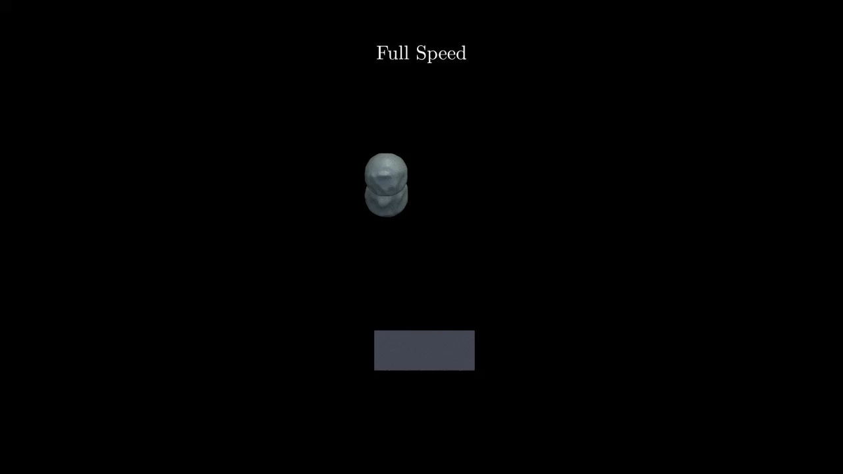
Source: Tank | Target: Stars
Notes:
This example shows the animation of the reconstructed and rendered surface of the merged tank source simulation and star target shapes simulation.

Slide 20
Persistent and Animated Target Shapes
Notes:
The target simulation described so far, creates fluid motion that forms into the target shape for a single moment. However, animators may wish to have a longer-lasting target shape, or even to animate the target shape with keyframe animation or other techniques before it dissolves. We’ll look into it now

Slide 21
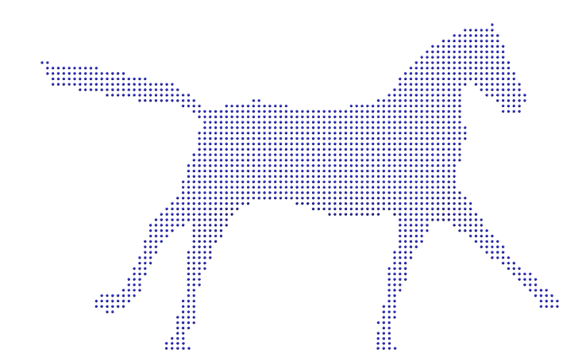
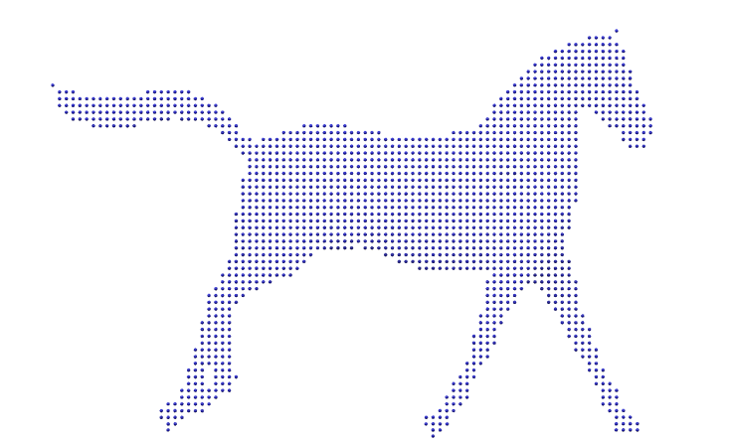
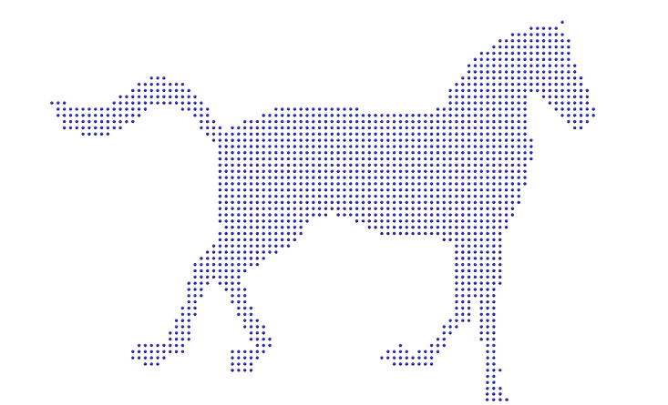
Persistent and Animated Target Shapes
• Input animation into separate target shapes
• Postprocess the simulations to hide some particles
Notes:
We propose breaking an input animation into separate target shapes, each offset in time by some small amount, typically one frame. We will then execute a separate target simulation for each of these target shapes. The target simulations do not interact physically with one another, even though they overlap in time. Instead, we postprocess the simulations to hide some particles, providing an illusion of interaction when the particles appear or disappear.

Slide 22
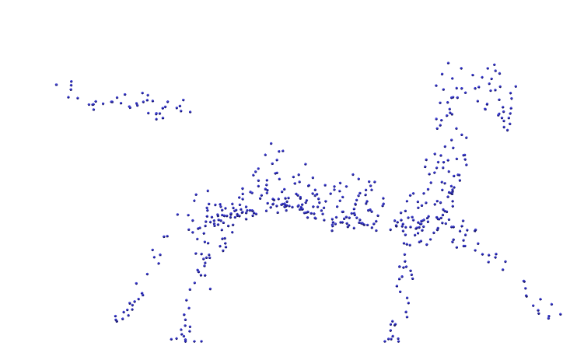
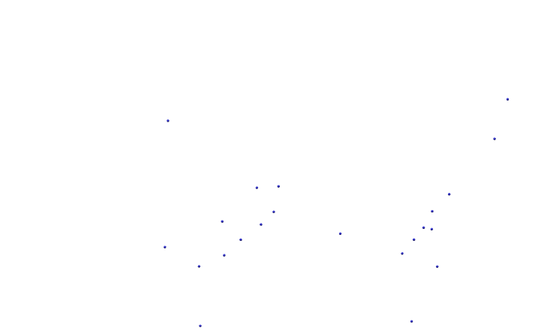
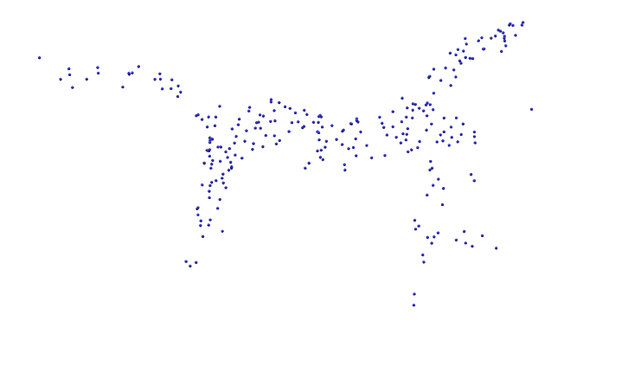



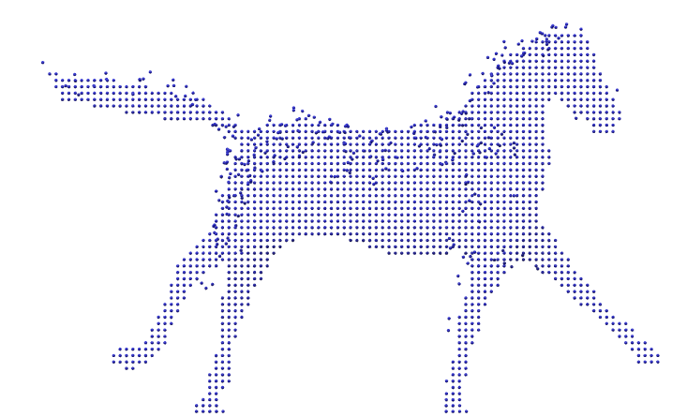
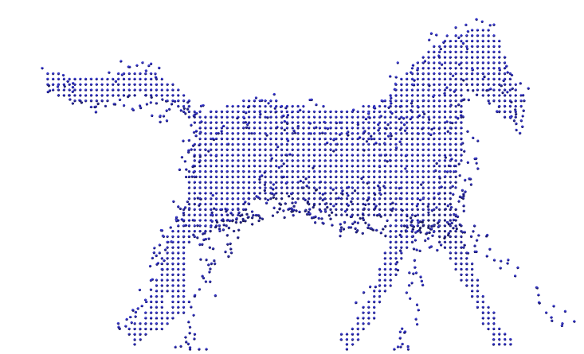
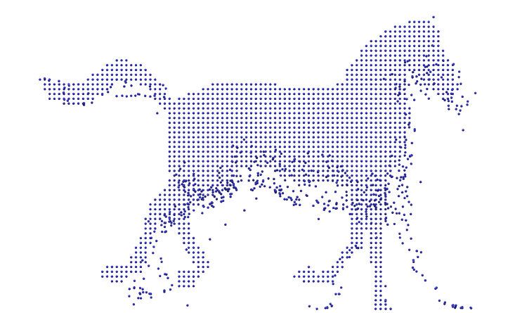
Multiple Target Frames
Time Step 1
Time Step 2
Time Step 3
Keyframe 1
Keyframe 2
Keyframe 3
Combined
Notes:
-This is an example of a target animation sequence with three keyframe instances
-Let’s see how target simulation is carried out for keyframe 2 in this context and generalize it for keyframe 1 and 2
-The target simulation respective to second keyframe is shown in row 2.
-In forward simulation, the particles from second key frame in time step 2 will go to time time step 3 and added with the particle from keyframe 3. -Similarly, In backward simulation, the particles from second key frame in time step 2 will go to time time step 1 and added with the particle from keyframe 1.
-This is an issue. If all the particle of keyframe 2 go to adjascent keyframes, it’ll distort their shape.
- Therefore particles travelling to adjascent time-steps are limited using the sign distance field in relation to the respective key frame for that particular time step.
-Similar procedure is carried out for keyframe 1 and 3.
-Then for each time time step, particles from all the keyframe instances are added to form the final keyframe animation as shown in the fourth row

Slide 23
More particles preserved
Fewer particles preserved
Notes:
In addition, we hide particles that are far from the target shape. Preventing such particles from being rendered improves the visibility of the target shape at later frames.
The first one is more fluid in nature at the compromise of the clear target shape definition and the second one is vice-versa. According to the animator’s artistic need, they can control the number of particles preserved when they are far from the target shape.

Slide 24
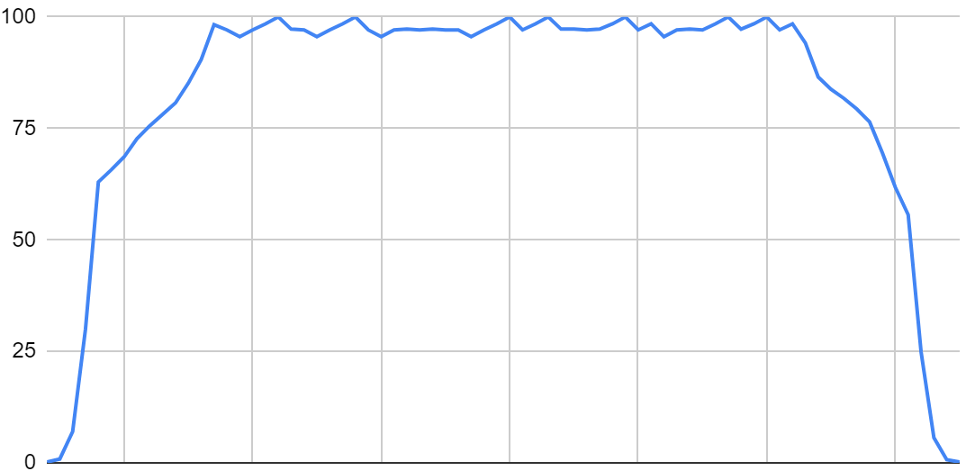
Target Particle Lifetime
Particle %
Time
Animation Starts
Animation Ends
Notes:
This chart shows the target particle life time.
This is where animation starts and this is where animation ends.
Within this range, the number of target particle are persistent in nature and results in the keyframe animation.
Before animation starts, backward simulation of the first key-frame is in action and when that played forward it gives the illusion formation of the target shape. As you can see number of target particles are increasing from zero to total target shape sampled particle amount in this region.
After animation ends, forward simulation of the last key-frame is in action and it gives the illusion of the disappearance of the target shape.
Number of target particles are decreasing from total target shape sampled particle amount to zero in this region

Slide 25
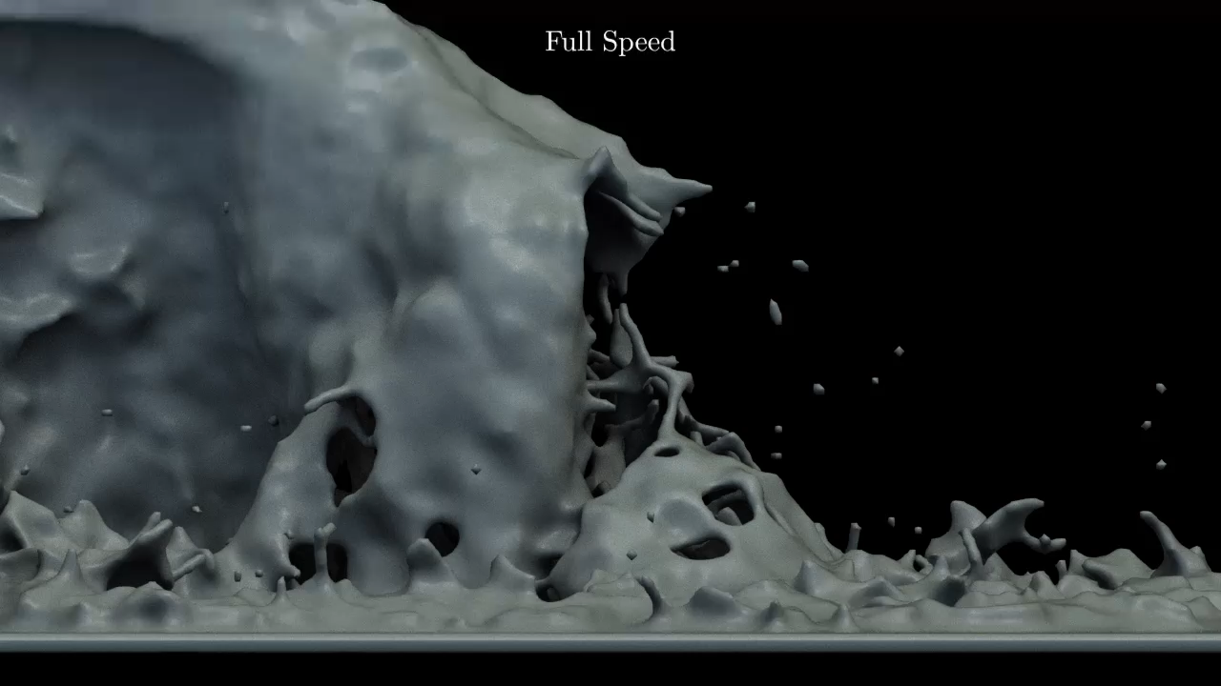
Source: Waterfall | Target: Horse
Notes:
-We’ll revisit the waterfall source and running target horse simulation to demonstrate how Persistent and Animated Target Shapes looks in action

Slide 26
Results
Notes:
Now we’ll look into 4 results generated using our system. The target shape in first two results are static and last two are dynamic in nature

Slide 27
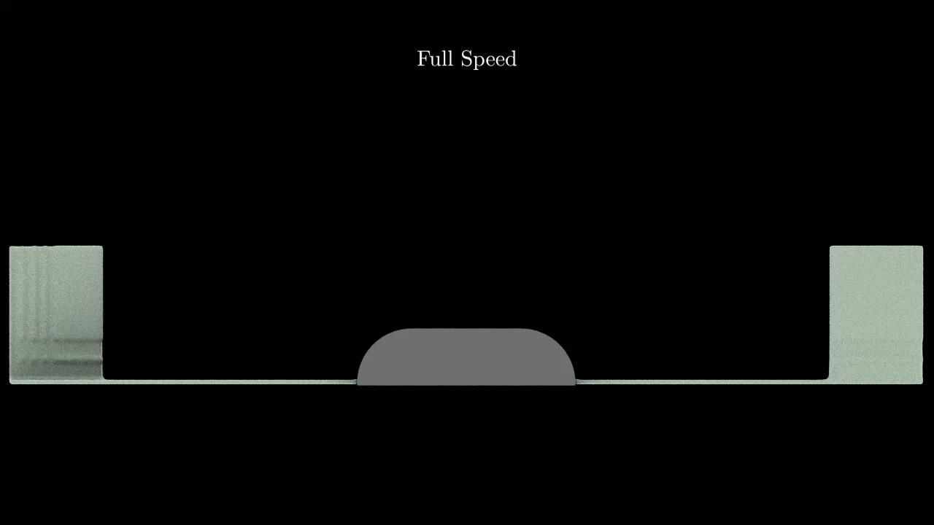
Source: Double Dam | Target: Bunny (Static)

Slide 28
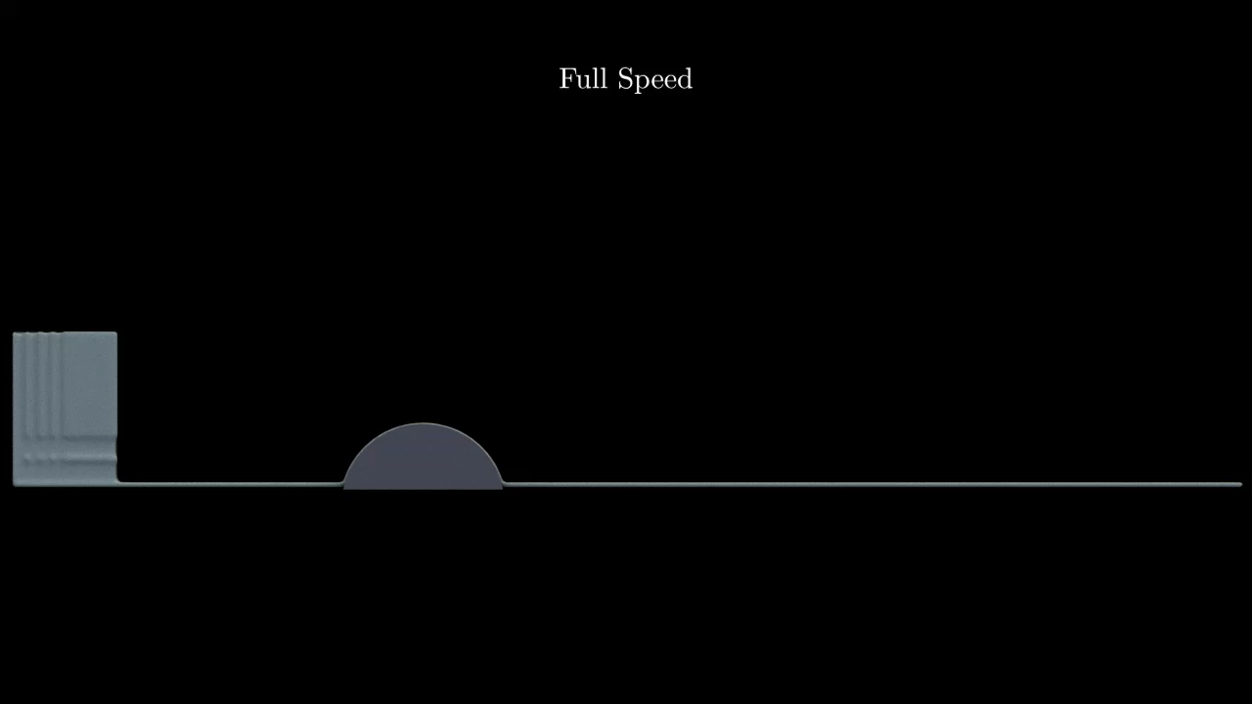
Source: Single Dam | Target: Dragon (Static)

Slide 29
Source: Single Dam | Target: Flying Dragon

Slide 30
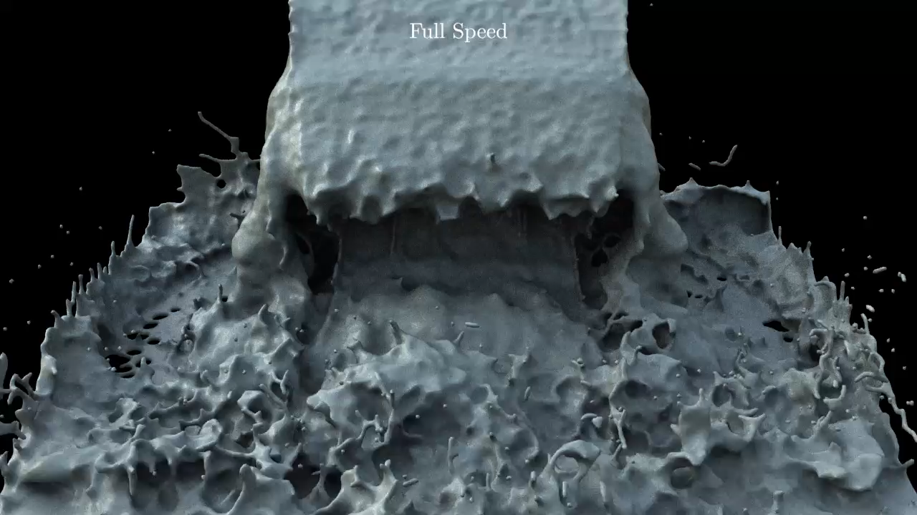
Source: Waterfall | Target: Face
Notes:
This results is inspired from the face from fire vfx sequence in the film Harry Potter and the Deathly Hallows

Slide 31
Performance
Timing is calculated with respect to a single-threaded implementation on a PC equipped with an i7-6700 Intel processor and 16GB RAM.
Table 1: Single targets
Scenario | Shape | Particles | Source | Target
Splash | Star | 2000 | 10s | 6s
Dam break | Dragon | 6600 | 14s | 6s
Double dam break | Bunny | 7500 | 16s | 7s
Table 2: Multiple targets
Scenario | #Targets | Particles | Source | Target
Flying dragon | 16 | 8000 | 23s | 9s
Running horse | 48 | 23000 | 10s | 15s
Face in waterfall | 48 | 14500 | 18s | 32s
Notes:
-In previous slides, we showed several art-directed fluid simulations. Here, we report some statistics summarizing the computational expense of the simulations. The computational cost of calculating initial conditions for the target simulation was negligible for single target. For multiple frames it is bit more expensive, since cross-simulation comparisons are needed
-We report simulation times averaged over active frames so as to normalize for the length of each animation.
Timing is with respect to a single-threaded implementation on a PC equipped with an i7-6700 Intel processor and 16GB RAM.
The particle counts for the target simulations are in the low thousands, a small fraction of the overall particle count. The source simulations typically had on the order of 500 thousand particles.
Because we have separated the source and target simulations, and the greater part of the computational expense is in the source simulation, iteration on the art-directed portion of the animation is expedited:
the animator can experiment with different settings, target shapes and placements, and so on, without needing to rerun the entire simulation.

Slide 32
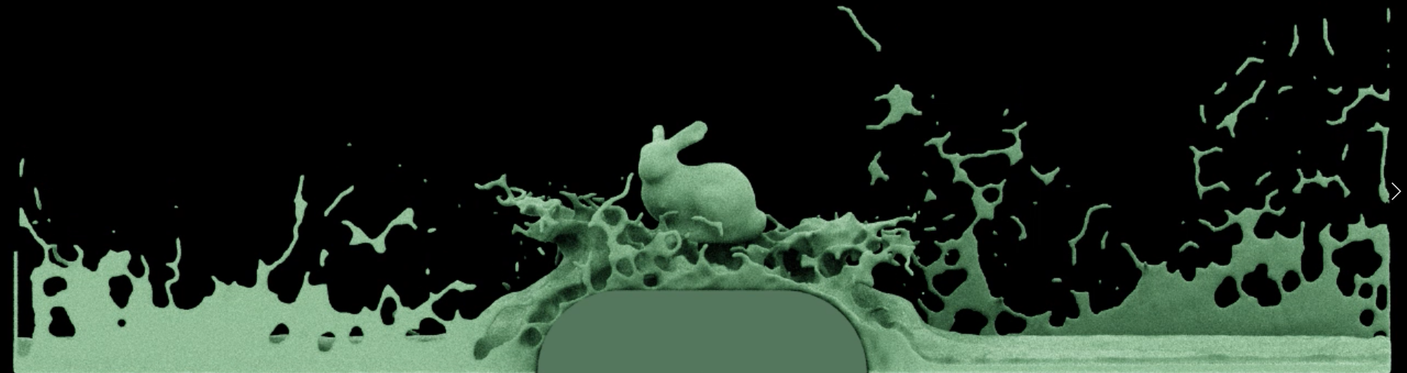
Discussion - Advantages
• Achieves the desired fluid target shape at the desired frame without artificial control forces that tamper with the natural fluid motion
Notes:
When looking into the advantage of our proposed art-directable control approach, it achieves the desired fluid target shape at the desired frame without introducing artificial control forces that tamper with the natural fluid motion.
Our time-reversal art-directable control approach is dedicated to liquid animation, as opposed to the majority of work in this domain that is intended for smoke animation.

Slide 33
Discussion - Advantages
• Compatible with any existing particle-based fluid solver or particle effect engine
Particle-based Fluid Solver
SPH
PIC
FLIP
Others
Notes:
Another significant advantage of our approach is that it is compatible with any existing particle-based fluid solver or particle effect engine.
There is no need to modify the internals of the solver; rather, multiple simulations are run separately, with coordinated assignment of initial conditions, and the outputs of the simulations are integrated in postprocessing.

Slide 34
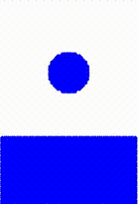
Discussion - Limitations
Lack of interaction between source and target simulations
Notes:
The main limitation of our approach is the lack of physical interaction between source and target simulations.
This demo is generated from FLIP simulator showing how a target water drop will physically interact with source glass of water. This intimate physical interaction is lacking in our system

Slide 35
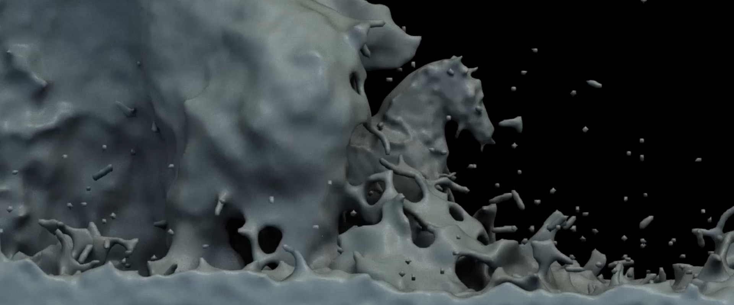
Discussion - Limitations
No guarantee of consistency between source simulation and animated mesh
Notes:
Consistency between the surrounding simulations and the animated mesh is not guaranteed in our system; the initial velocities for the simulation may not match the velocities from the animation. Seamless integration of the target simulation and the animated mesh is another good direction for future work.

Slide 36


Discussion - Limitations
Purely grid-based simulations are not supported
Fluid Solver
Hybrid
Particle
Grid
Notes:
We described a system that works with particle-based simulations. Purely grid-based simulations are not supported, primarily because our approach for merging simulations is based on particle trajectories. Modifying the merging process could open the door to allowing grid-based solvers to use our method.

Slide 37
Discussion - Limitations
Target shape resolution is limited by the particle spacing
Notes:
As described earlier, we sample the target shape with particles. The fidelity with which the target shape can be represented is limited by the particle spacing: surface detailing or fine-scale structures will not be reproduced if below the particle distance. Any approach that make use of particle sampling suffers from this limitations.

Slide 38
Summary
• Method for art-directed fluid simulation:
- Matches the target surfaces at the desired time
- Within a natural-looking surrounding simulation
• A method for connecting the forward and time-reversed backward simulations
• A method for integrating the source and target simulations into a unified output
• Application of time-reversal simulation to liquid animation

Slide 39
Future Work
• More elaborate strategies for merging source and target simulations
• Better integrating animated meshes with the surrounding simulations
• Extending this control system to other forms of fluids
Notes:
Future work will also involve exploring more elaborate strategies for merging source and target simulations, as well as better integrating animated meshes with the surrounding simulations. This gives a natural look and feel where a viewer can’t differentiate where one simulation ends and other starts. A multi-pass strategy could be employed to iteratively modify the source simulation by progressively adding target elements, and a similar idea could be used for multiple target shapes in sequence. Such a strategy should work well with our approach as the simulations do not interfere with each other.
This strategy could be extended to other forms of luids such as fire which is characterised as plasma and smoke. Using PIC solver with its intrinsic viscous nature we could implement this strategy to art-direct sand simulations.

Slide 40

Thank You!

