Slide 1
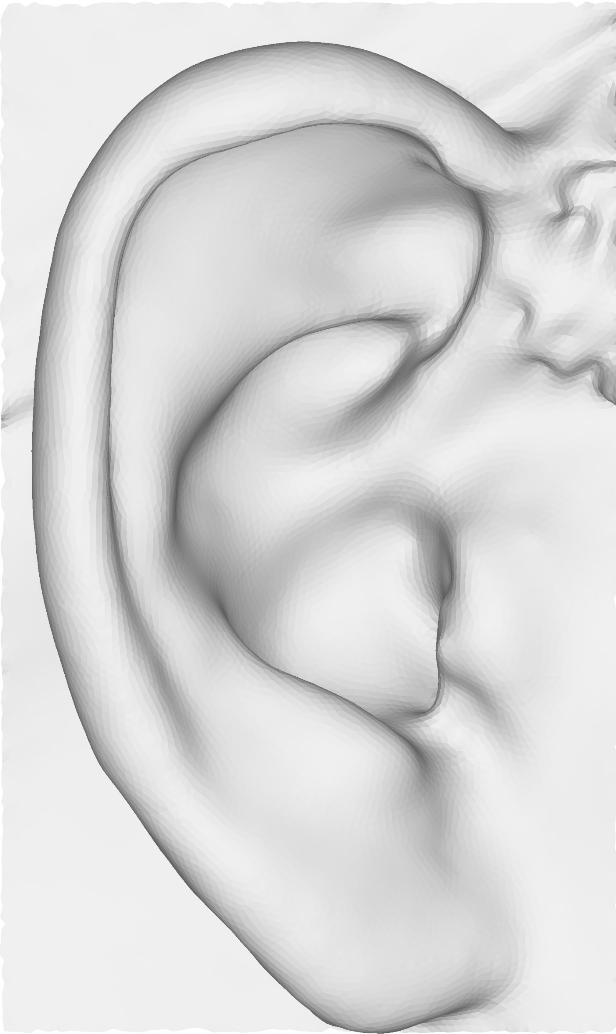
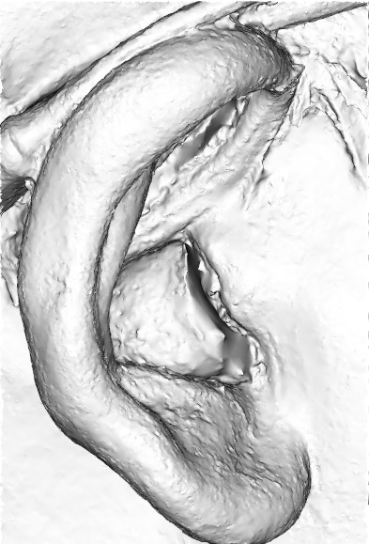
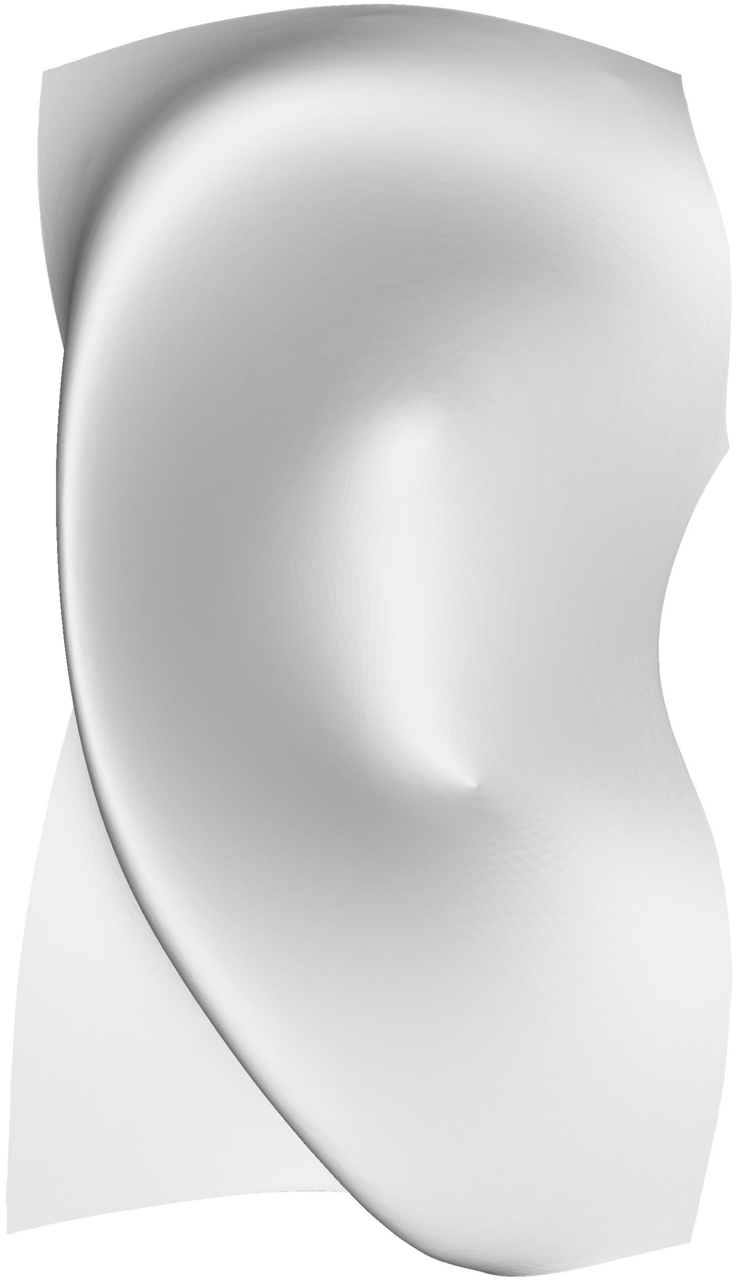
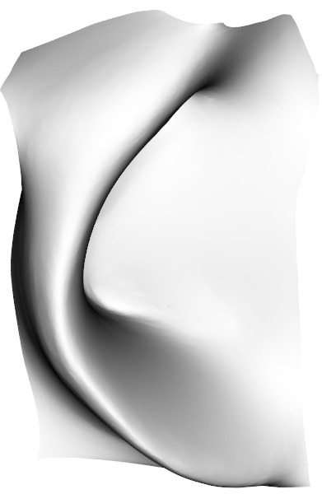
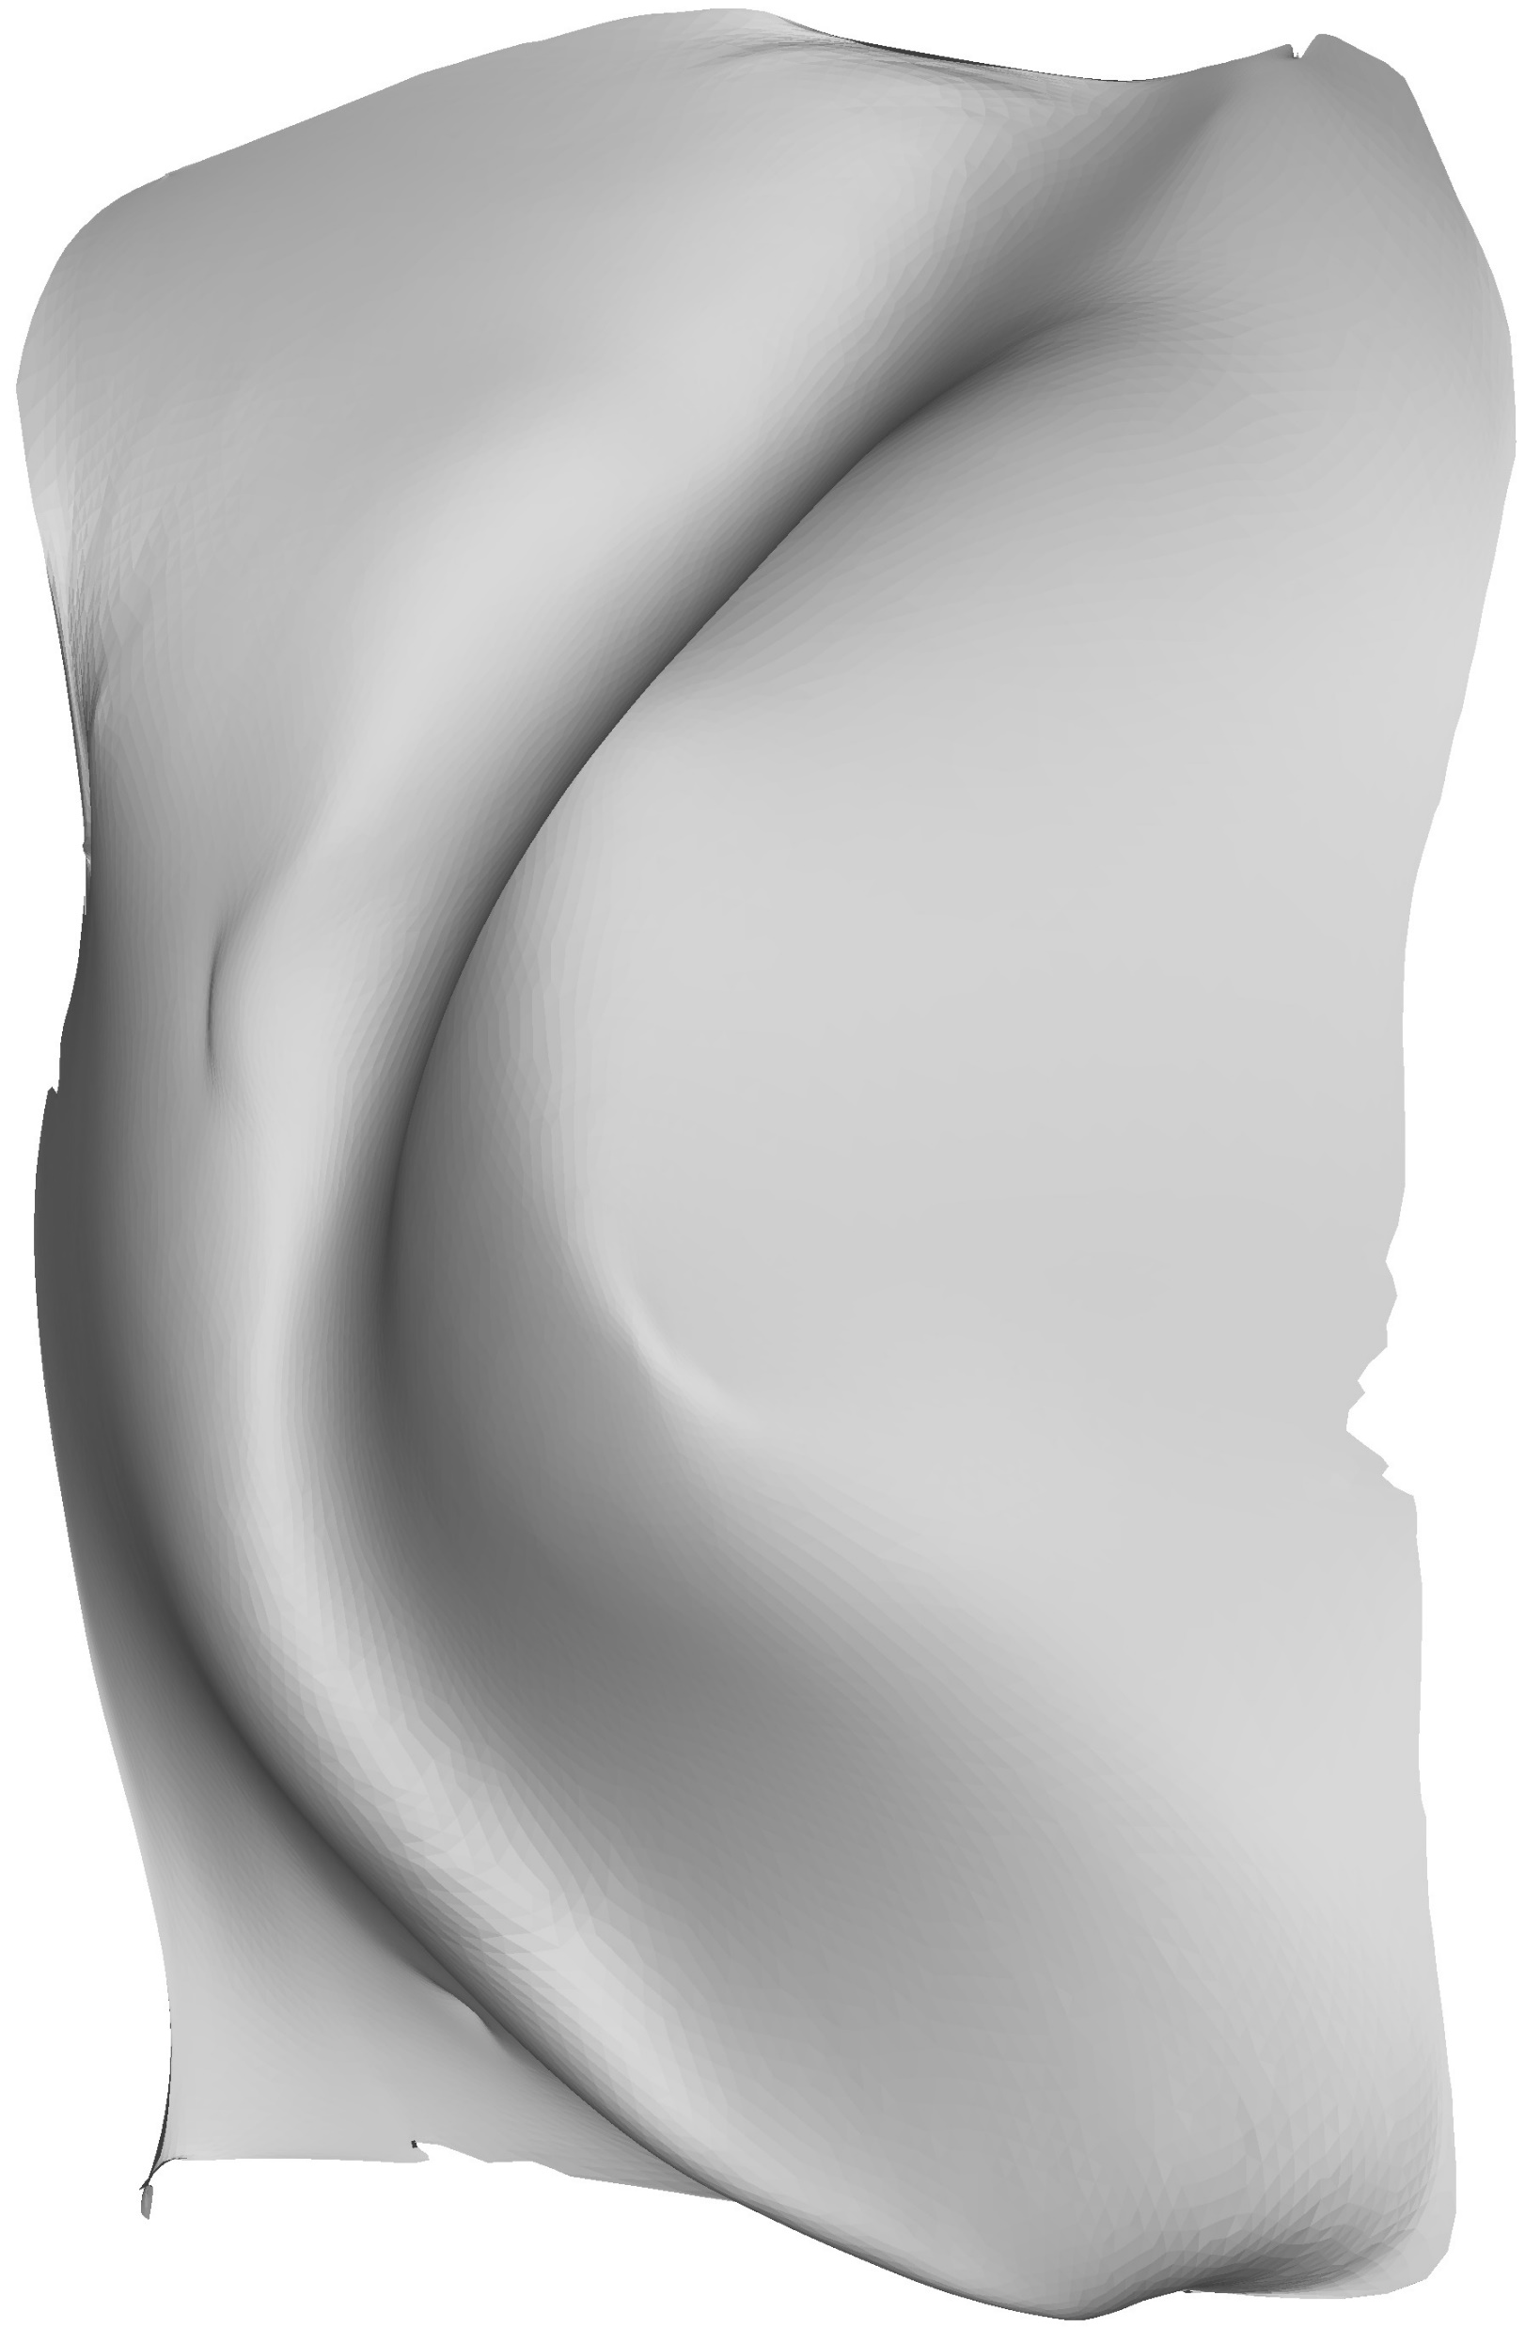
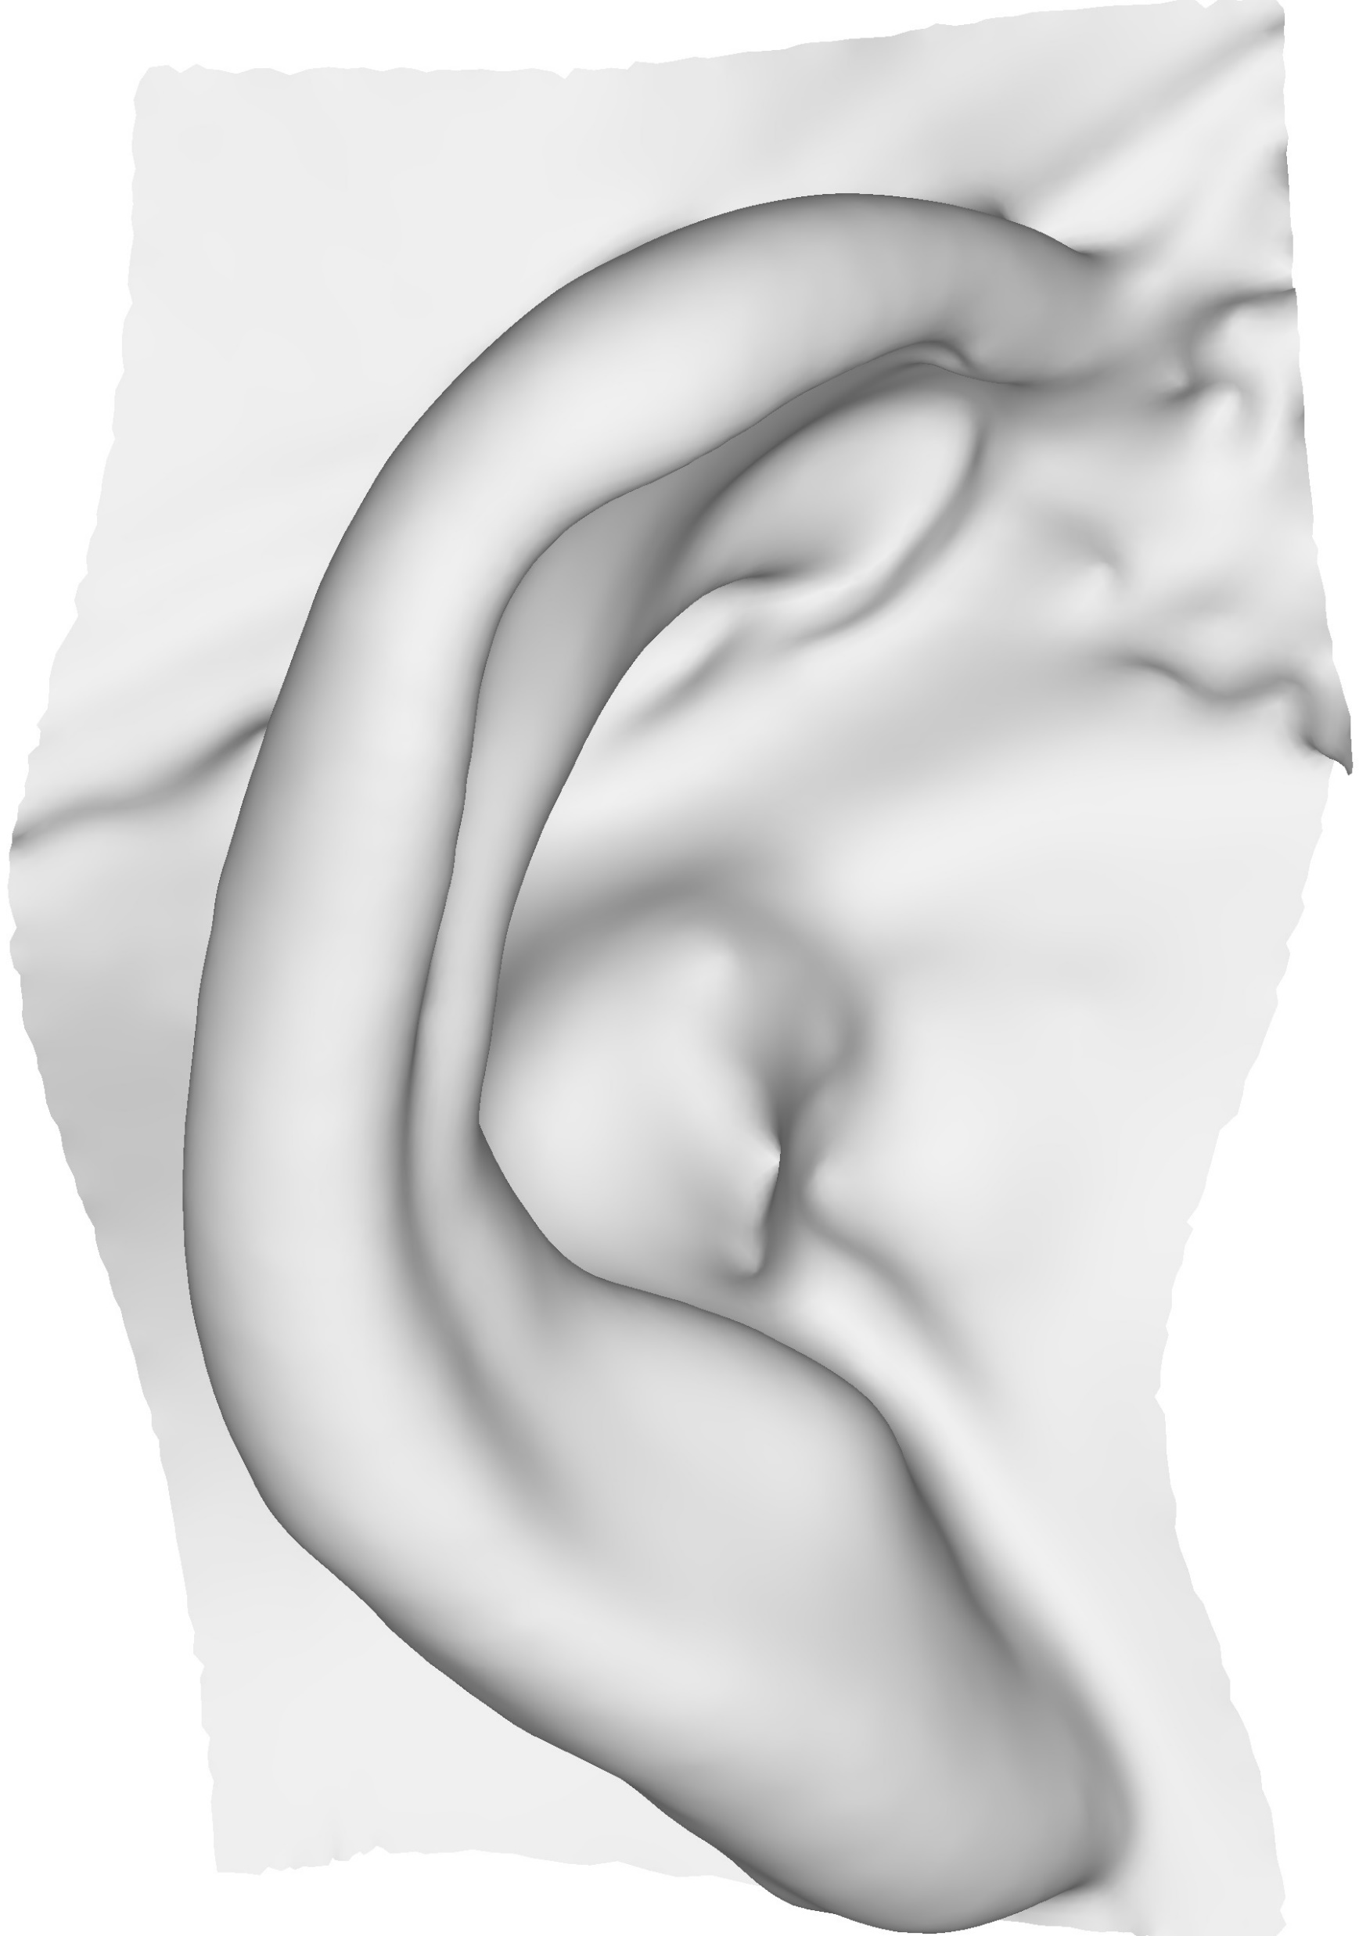
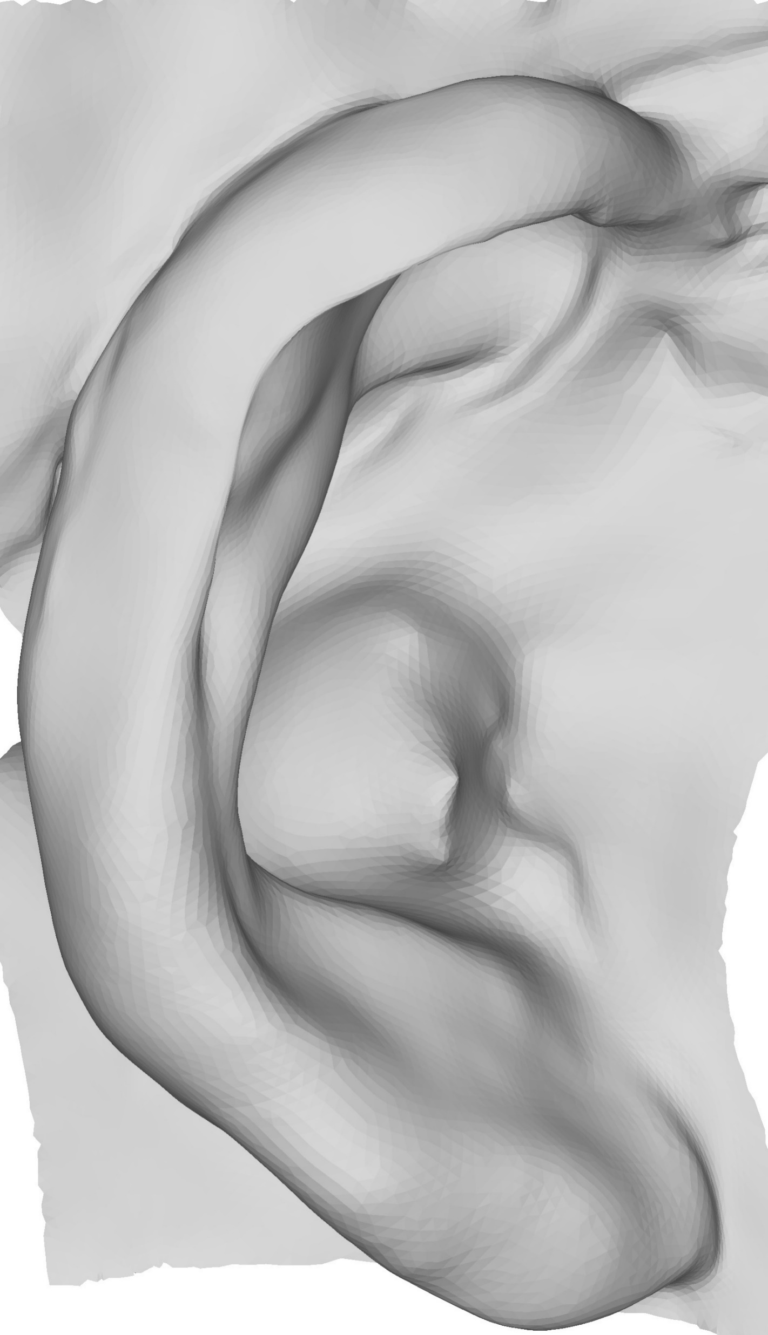

Constraint-Based Spectral Space Template Deformation for Ear Scans
Template
Scan
Smooth Domain
Iterative Deformation
Spectral Reconstruction
Final Deformation
Srinivasan Ramachandran, École de technologie supérieure, Montréal, Canada
Tiberiu Popa, Concordia University, Montréal Canada
Eric Paquette, École de technologie supérieure, Montréal, Canada
Notes:
Hello all, thank you for joining us for this video on Constraint-Based Spectral Space Template Deformation for Ear Scans. My name Srinivasan Ramachandran and I am a PhD student from École de technologie supérieure. In this video we are going to present a template fitting approach for Ears.

Slide 2
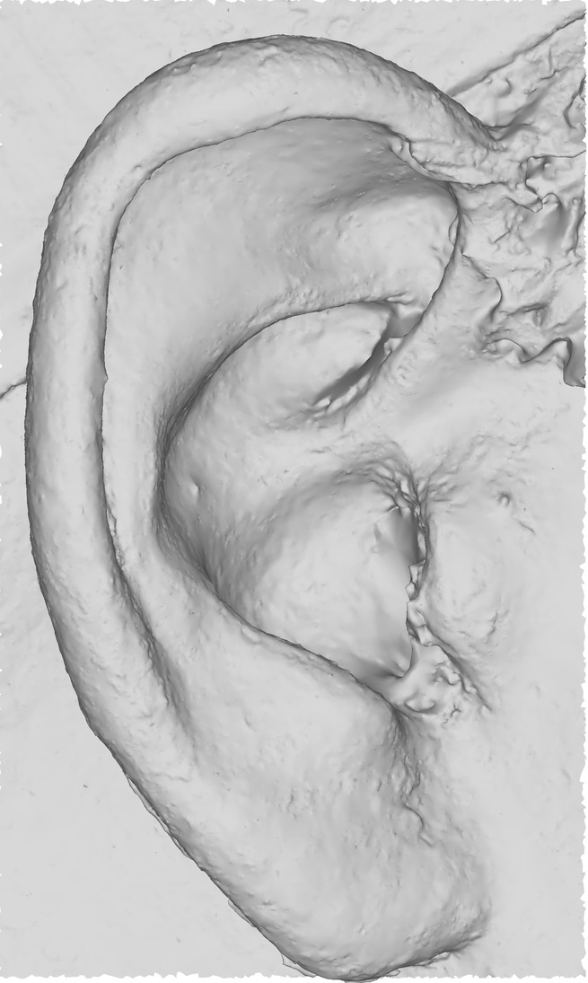
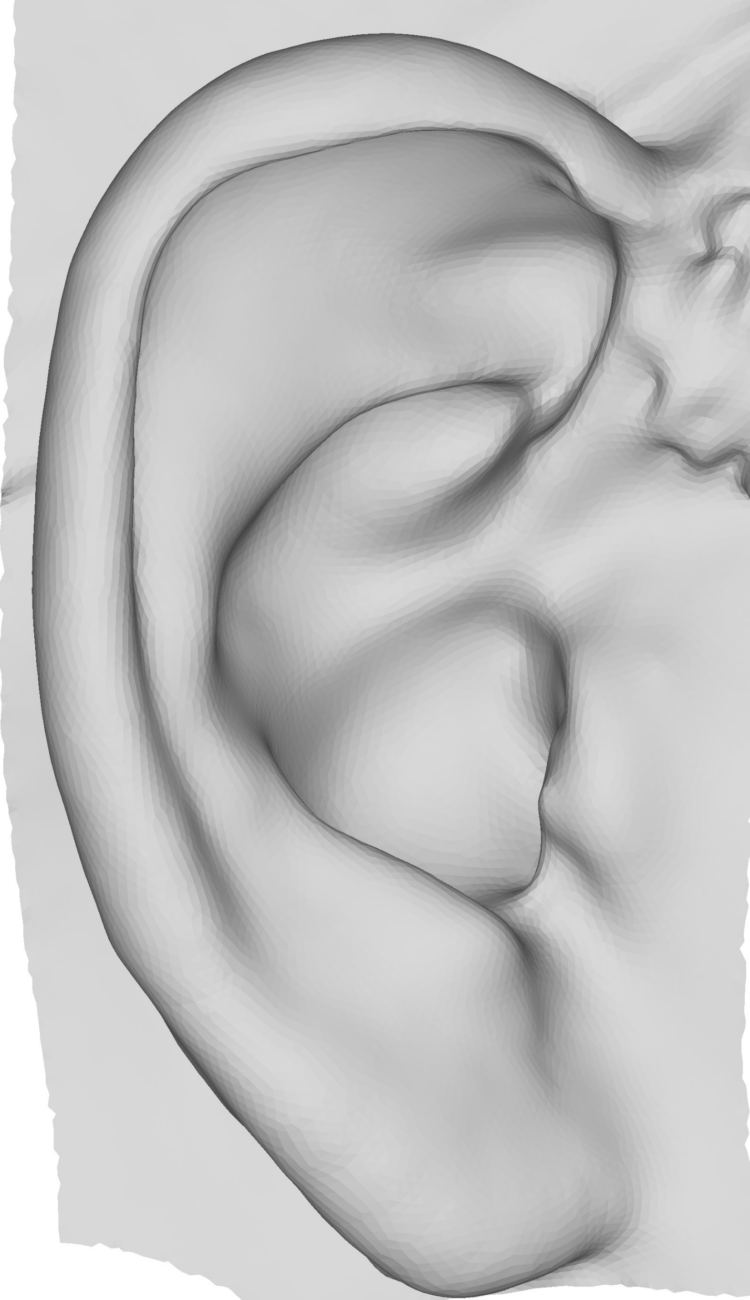
Introduction
Virtual heads are important (gaming, movies, medical, cosmetic, etc.)
Virtual head acquisition
  Raw scan
  Registration of a template
Challenges
  Complexity of the human face
  Does not “effectively” capture all parts of the face
Notes:
Virtual heads are important since they are employed across various fields.
(Click to Animate) There are two steps in acquiring a virtual head,
(Click to Animate) First there is the raw geometric data of the scan, usually a point cloud.
(Click to Animate) The second step registers a smooth well structured template mesh to the scan.
(Click to Animate) The complexity of the human head only adds to the challenge. Furthermore, ears have not received a lot of attention in the literature.

Slide 3
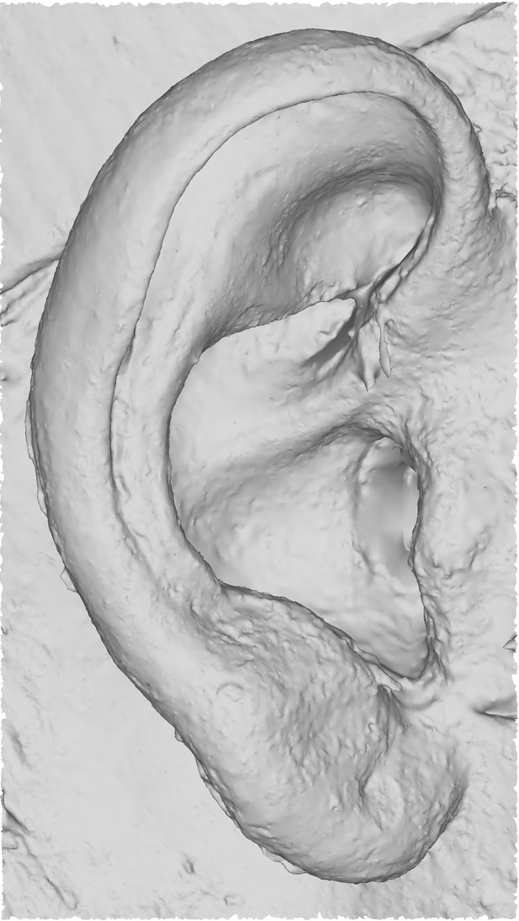
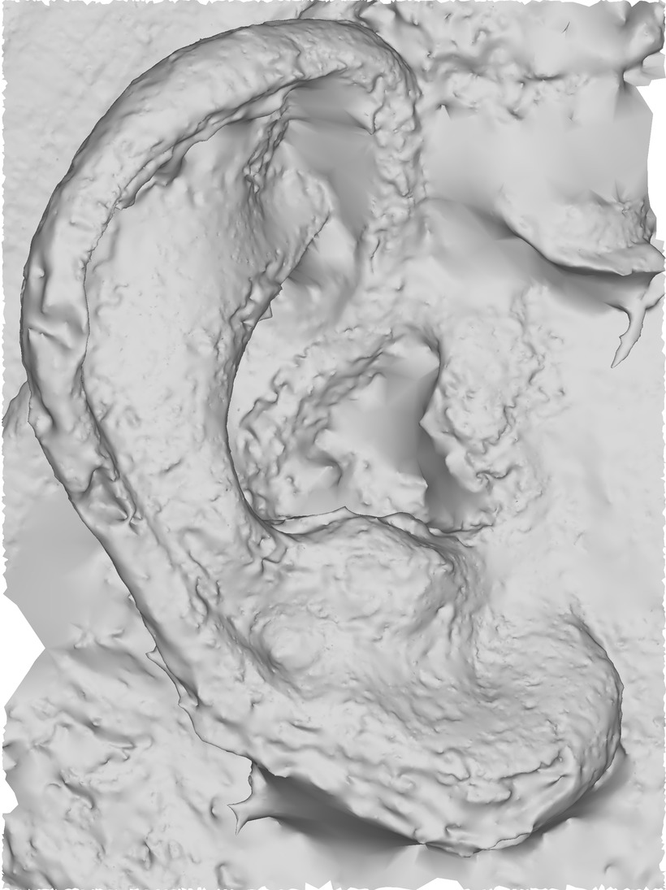

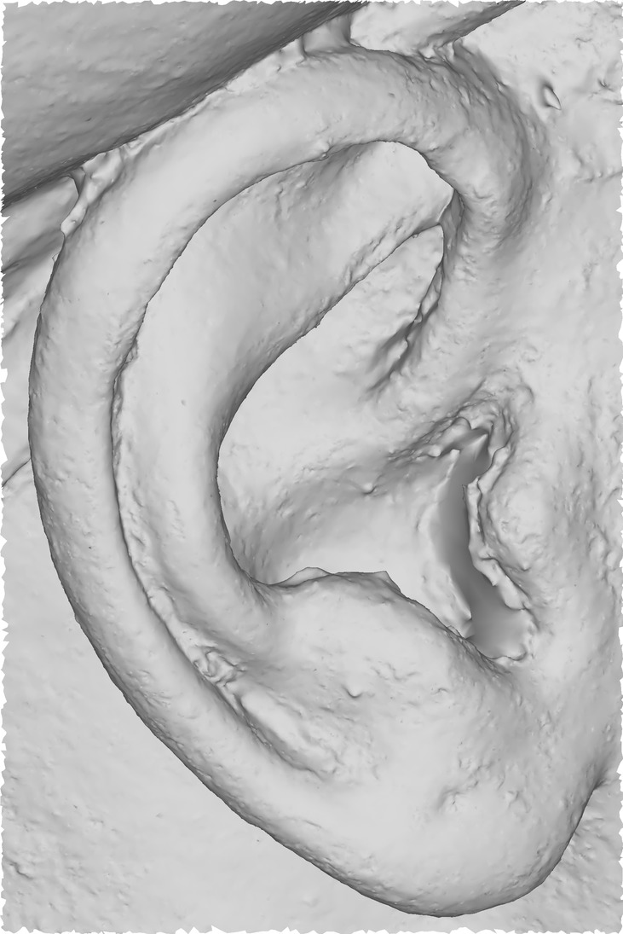
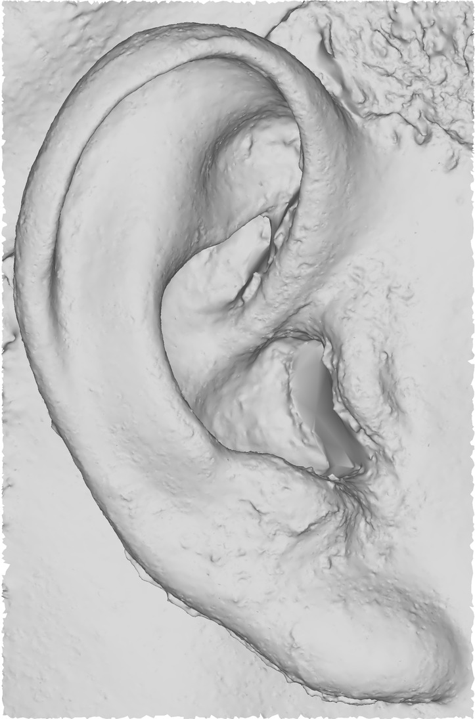
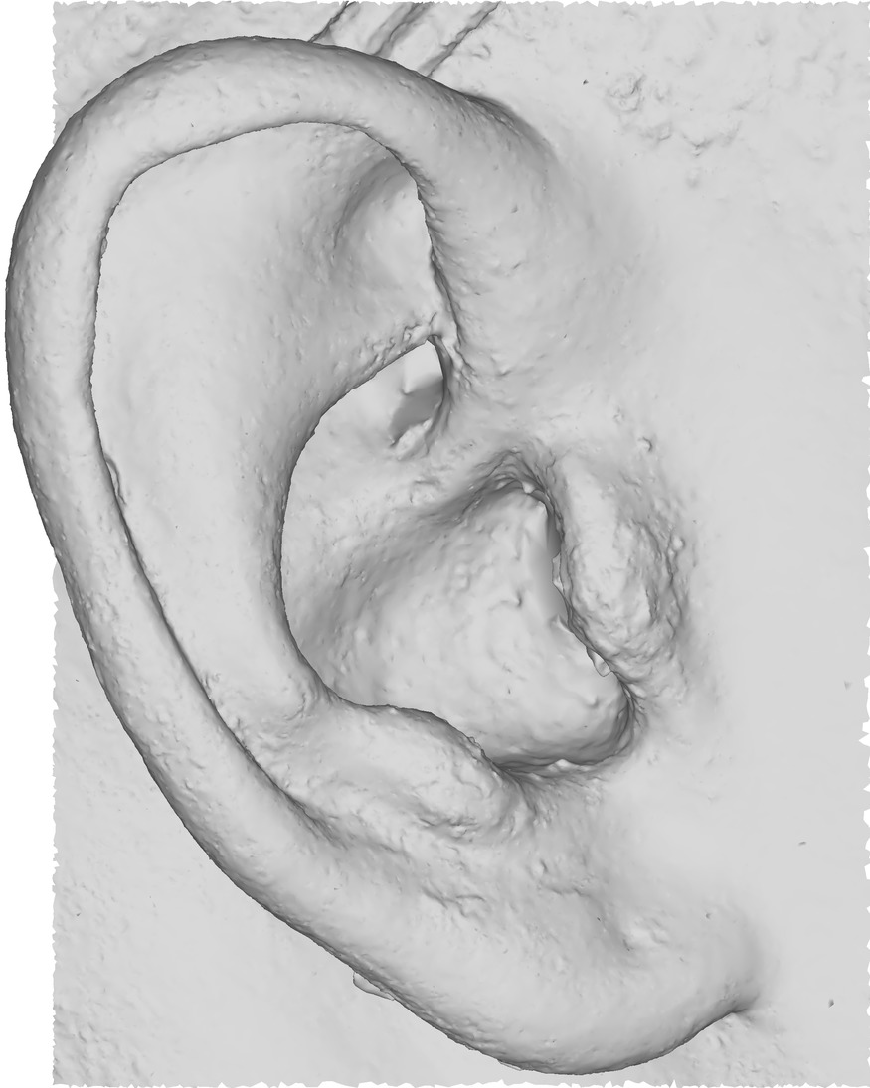
Introduction
Helix
Better template fitting for ears
Ears are rich in their anatomical structure
Different ears, different shapes, diverse
Crux of helix
Antihelix
Tragus
Antitragus
Lobule
Notes:
The goal of our approach is to fill this gap and focus on better template fitting for ears.
(Click to Animate) It can be observed that the ears are naturally rich in their anatomical structure.
(Click to Animate) From our scans of ears of real people, we noticed that ears are different and diverse from each other.

Slide 4
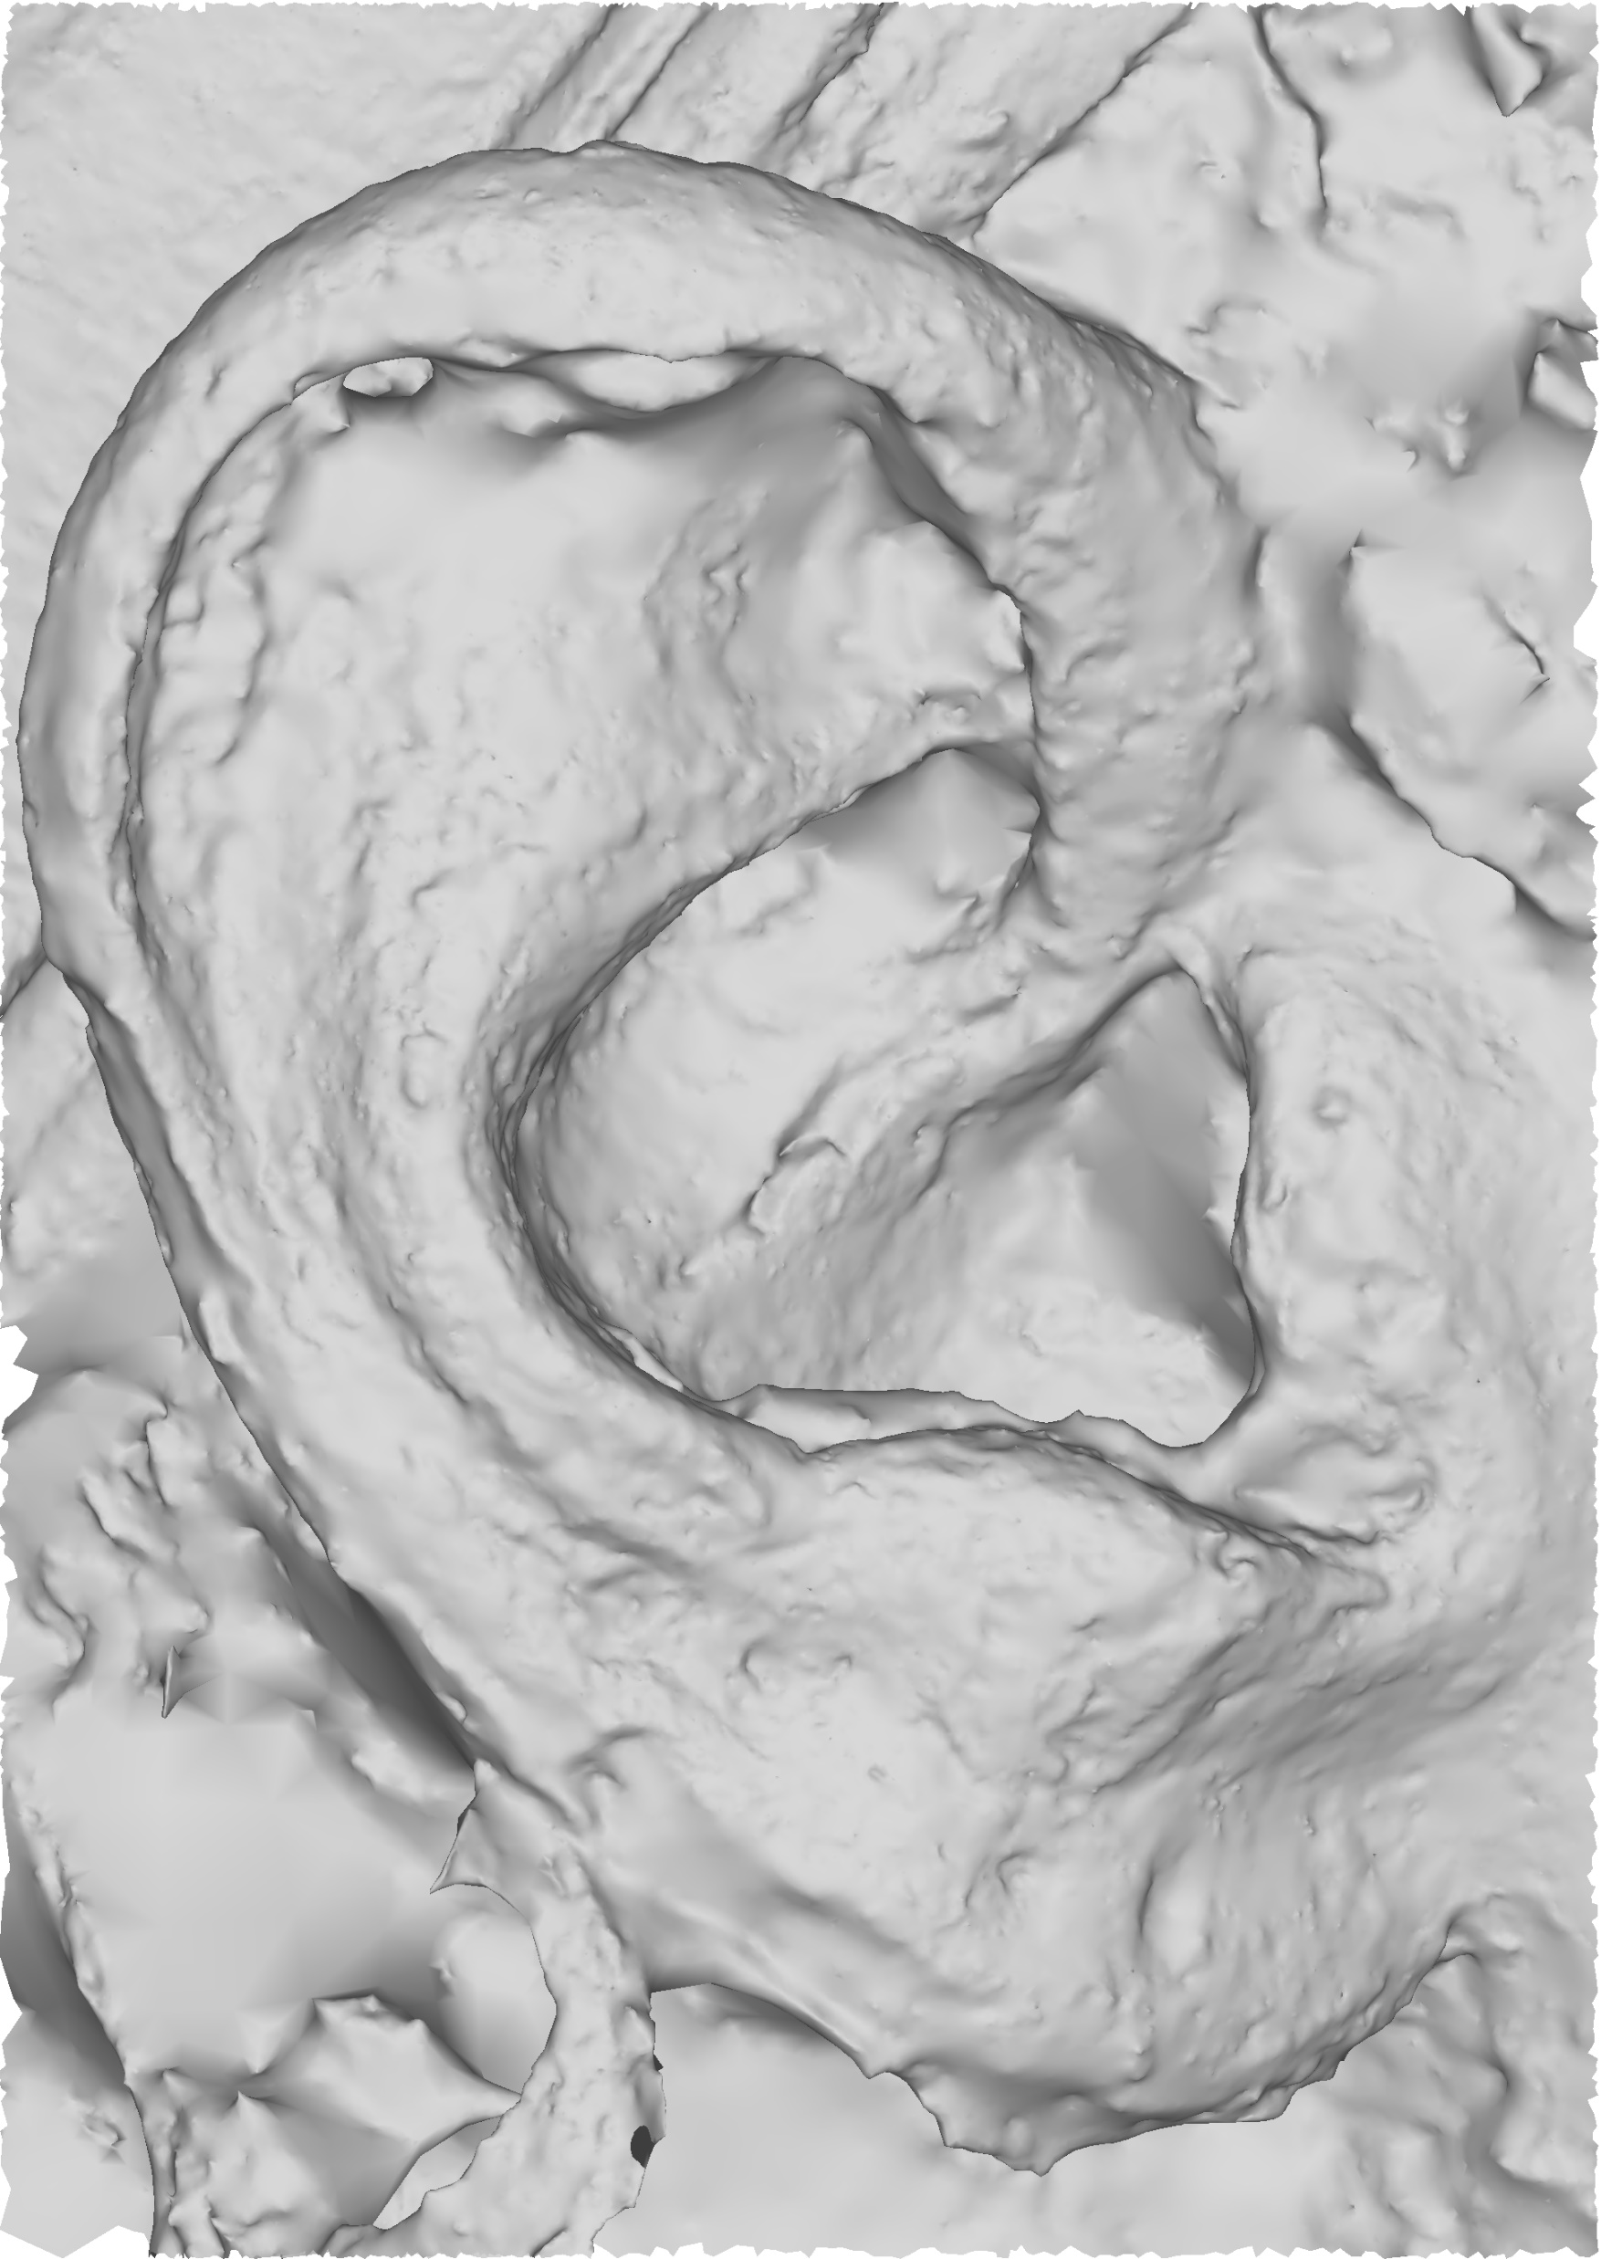
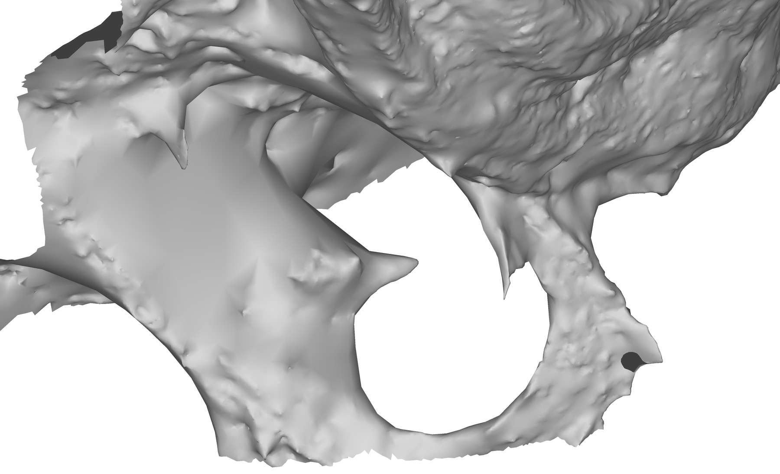
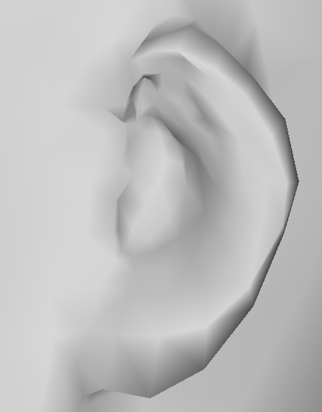
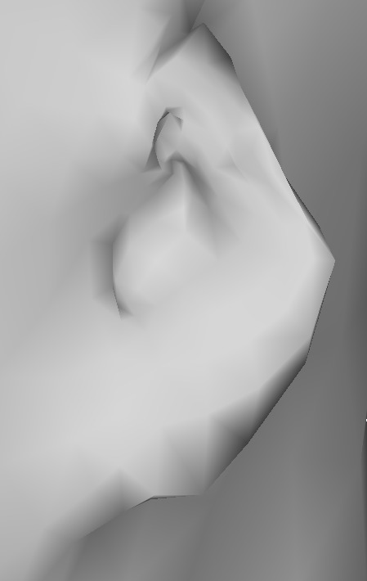
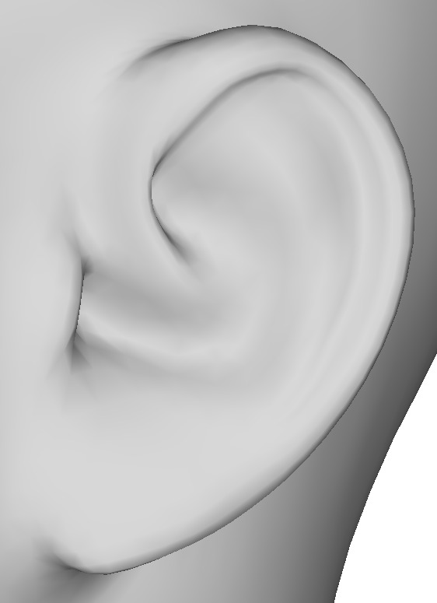
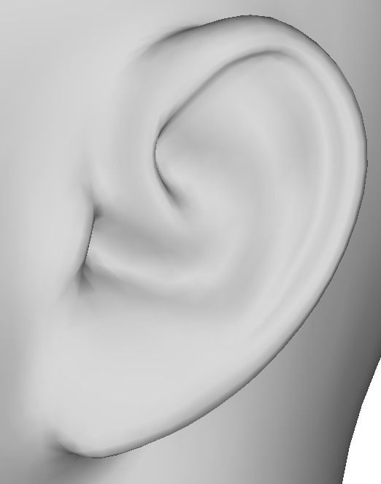
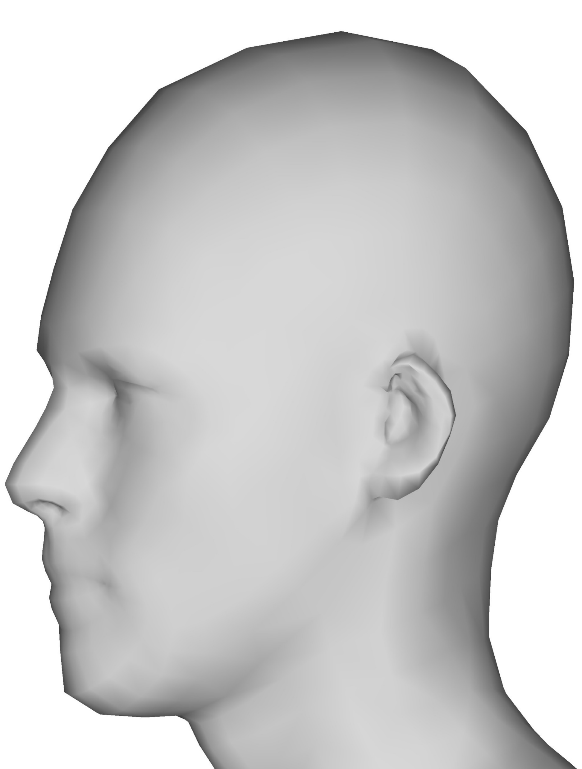
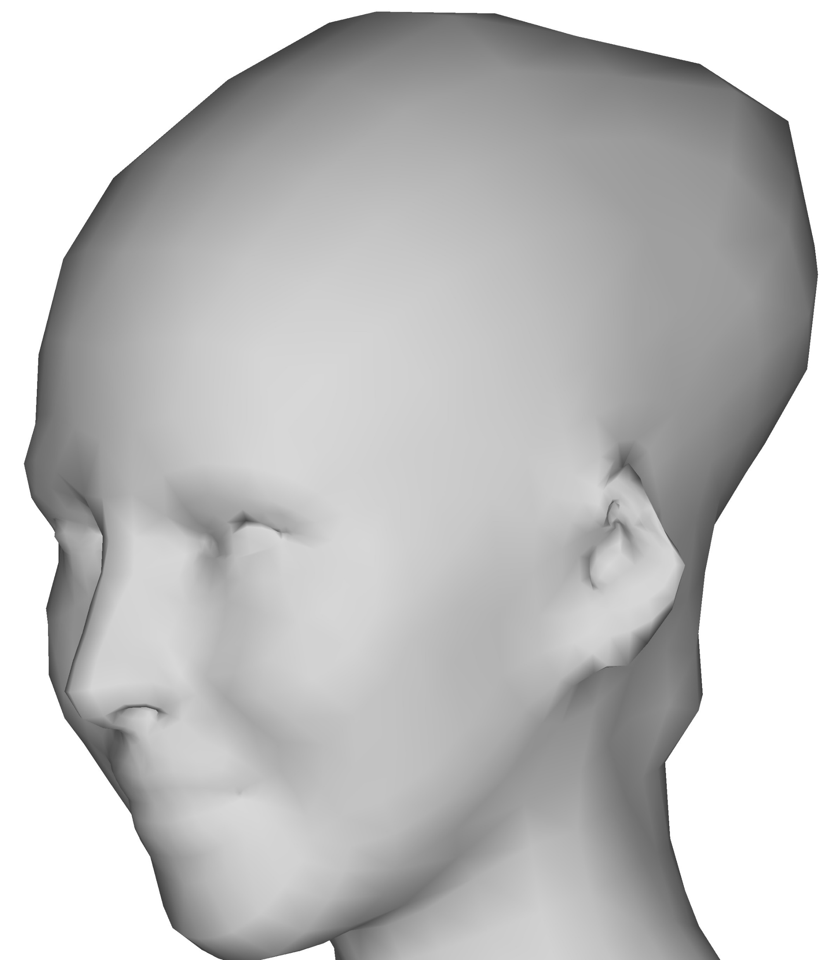
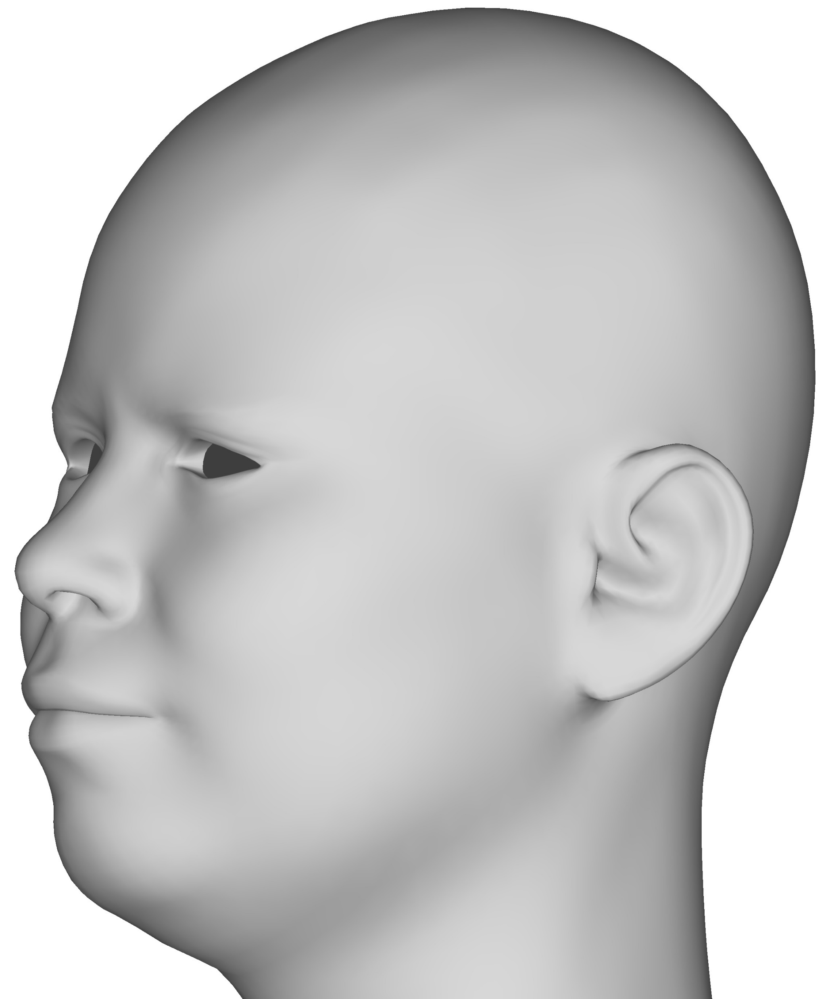
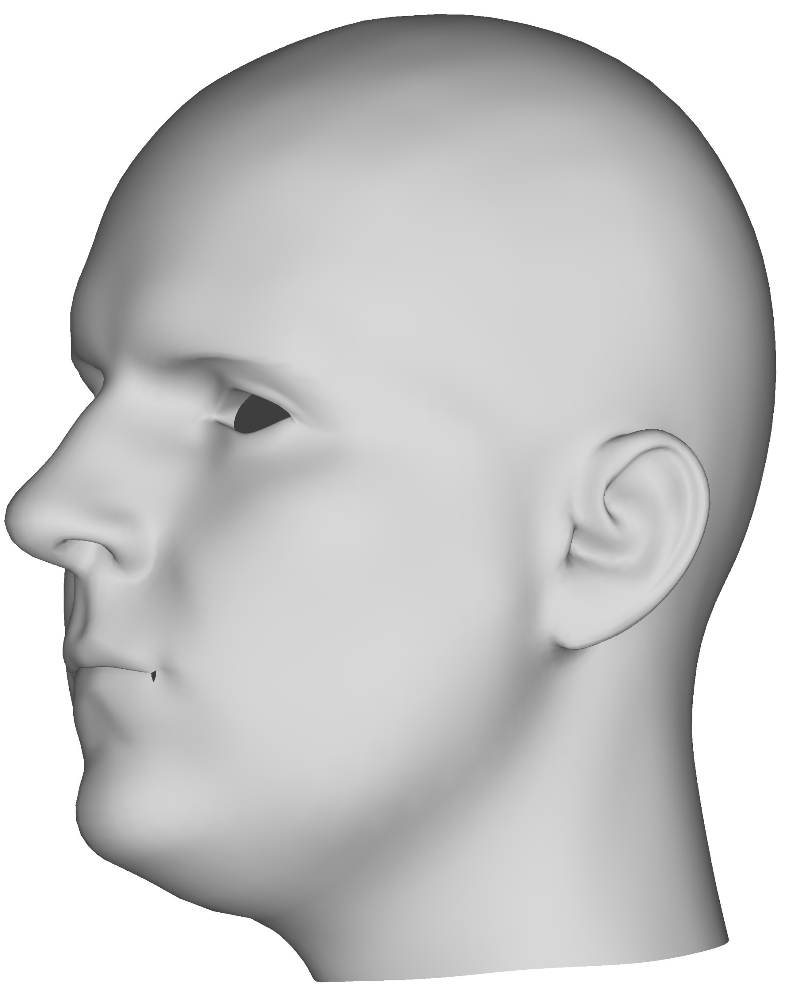
Introduction
Acquisition problems
  Noisy mesh
  Unexpected rings and handles
Template deformation problems
  Noisy result
  Not faithful to original scan shape
FAUST (Bogo et al. [13])
FaceWarehouse (Cao et al. [14])
Notes:
From our current data set of meshes we noticed
(Click to Animate) they were noisy and of bad polygon quality.
(Click to Animate) and also they contained rings and handles
(Click to Animate) Fitting a template to such scans can lead to reproducing a bad shape and also the noise along with it, which is not desirable as noticed in the examples of the faust data set.
(Click to Animate) At the opposite, the FaceWarehouse data set is an example of where it got rid of the noise in the ear region, but the template is not faithful to the original scan shape.
Before we look into the proposed approach let us have a brief discussion on the related literature.

Slide 5
Related Work
Facial parts
Ear detection
Dense registration
Notes:
There are three literature areas important for ear template fitting. We will first begin with the work related to facial parts

Slide 6
Related Work – Facial Parts
One size fits all acquisition is “not enough”
Specialized methods for specific facial parts
  Eyes [10, 11]
  Eyelids [12]
  Lips [19, 20]
  Jaw [42, 43]
  Teeth [36, 38]
Ears received less attention than other facial parts
Notes:
From the literature we saw that there has been efforts to handle a single part of the face at a time, either for the purpose of faithful reconstruction, or fitting, or for a better alignment with other part of the face. Hence it was clear that there is no one magic method that handles all parts of the face. So far there have been efforts to address specific parts like the eyes, eyelids, lips, jaw, and teeth. On the other hand it was seen that ears received less attention when compared to other facial parts.

Slide 7
Related Work: Ear Detection in Biometrics
Image space
  Arab-Zavar and Nixon [8]
  Ansari and Gupta [7]
  Cummings et al. [17]
Image space + depth images
  Yan and Bower [39]
  Chen and Bhanu [15]
Currently literature is widely about detection
Does not address reconstruction
Notes:
The methods related to biometrics use a combination of color images and depth images. They address ears in terms of detection but they do not address the reconstruction of ears.

Slide 8
Related Work: Dense Registration
Multiple methods
  Functional maps [25, 30, 31]
  Blended Intrinsic Maps [24]
  Parametrization to simpler spaces [9, 29]
  Deformation-based [5, 23, 26]
  User provided landmarks [1, 2, 3, 4, 22, 33]
Challenges
  Near-isometry
  Mesh quality of scans
  Picking up noise
  Not automatic (requiring manual landmarks)
Notes:
The third and final connected area of literature is on dense registration. There are many different ways a dense registration can be found such as Functional maps, mobius transformations, parametrizing to simpler spaces, and deforming a source shape iteratively. Some methods also rely on user provided landmarks to establish the mapping. It is challenging to adapt any of these registration methods to our context.
1) some of them work only on near-isometry, which is not applicable in our case
2) Most of the method cannot handle the bad geometry of scans
3) The few that can handle the bad geometry, pick up the noise and other geometry problems, and transfer these problems to the template, which is clearly something we don’t desire.
4) Finally, some require user-provided landmarks while we seek to have a fully automatic approach

Slide 9
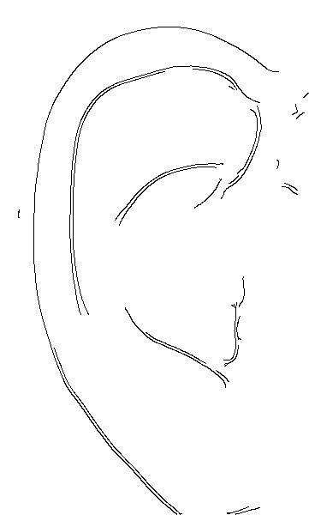
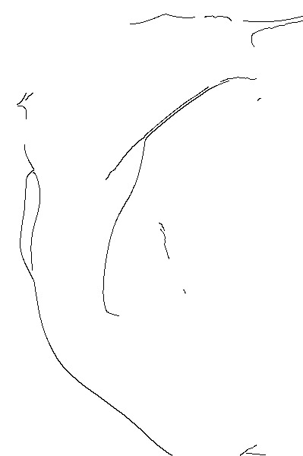
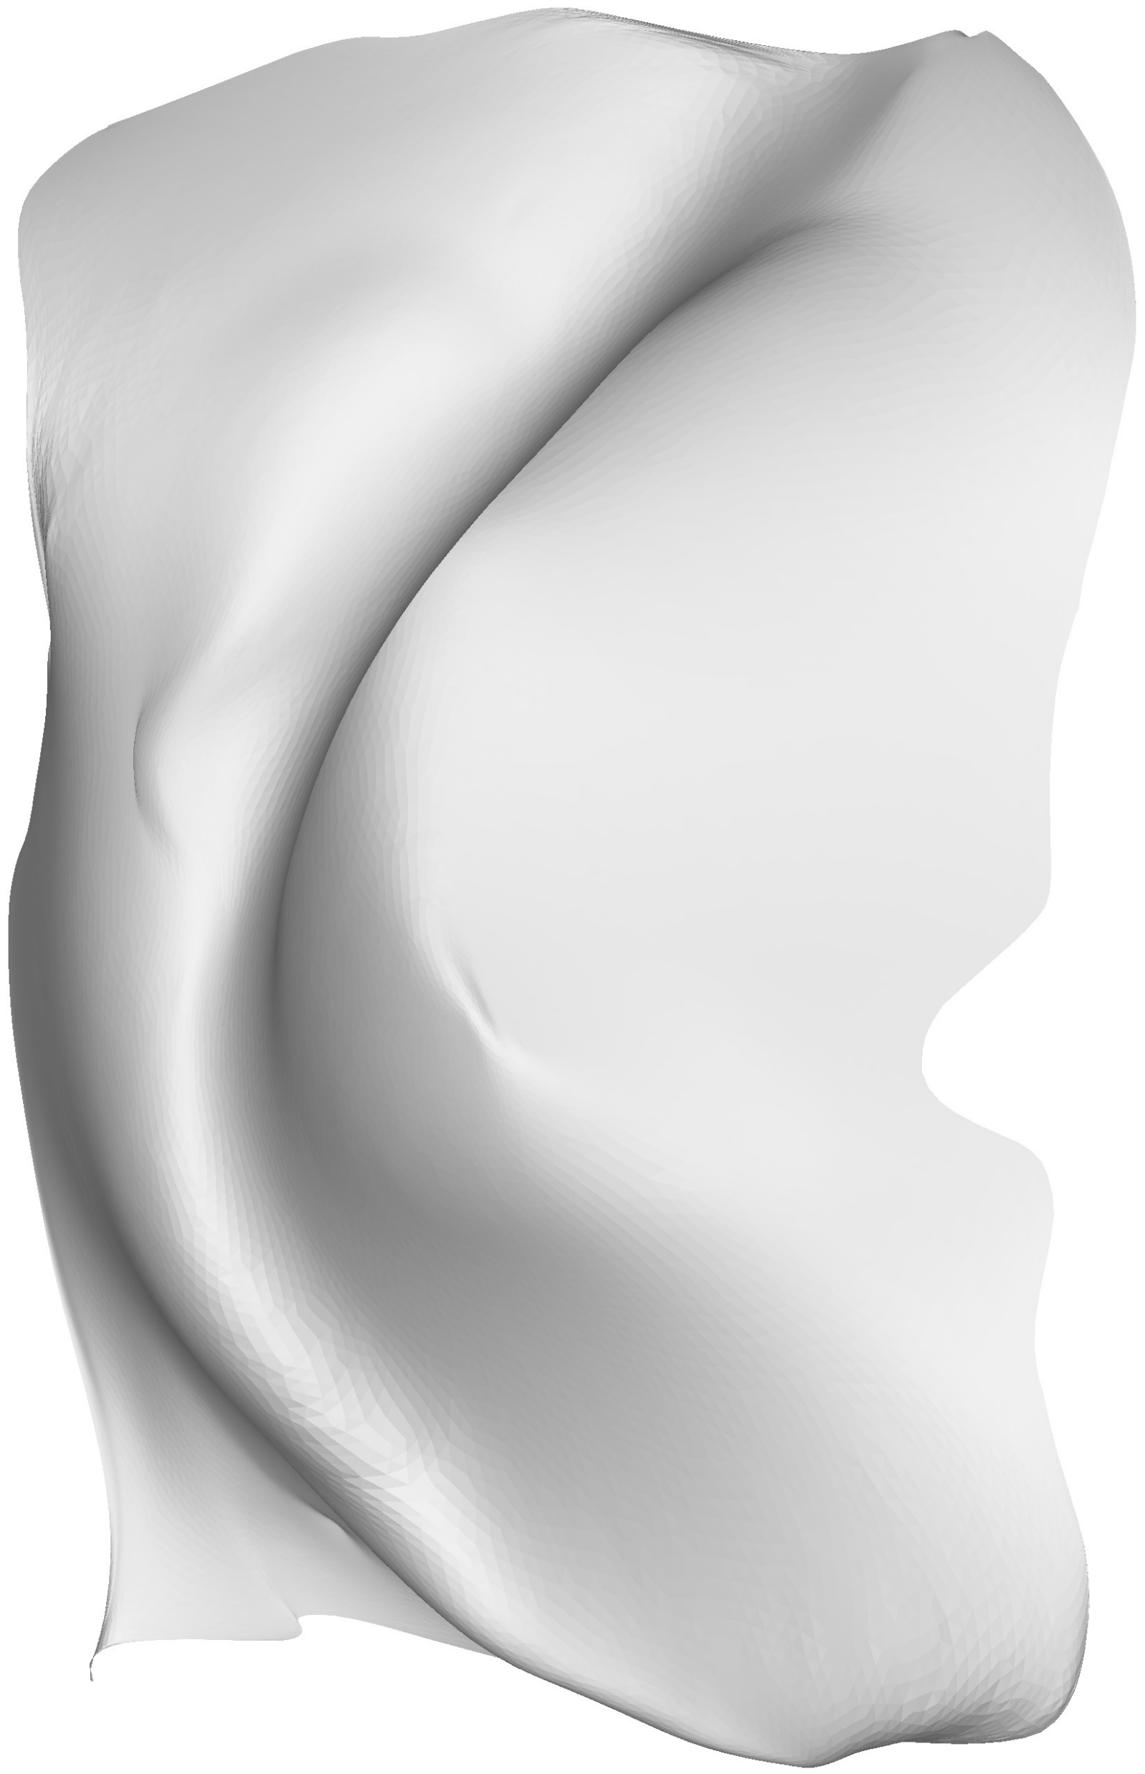

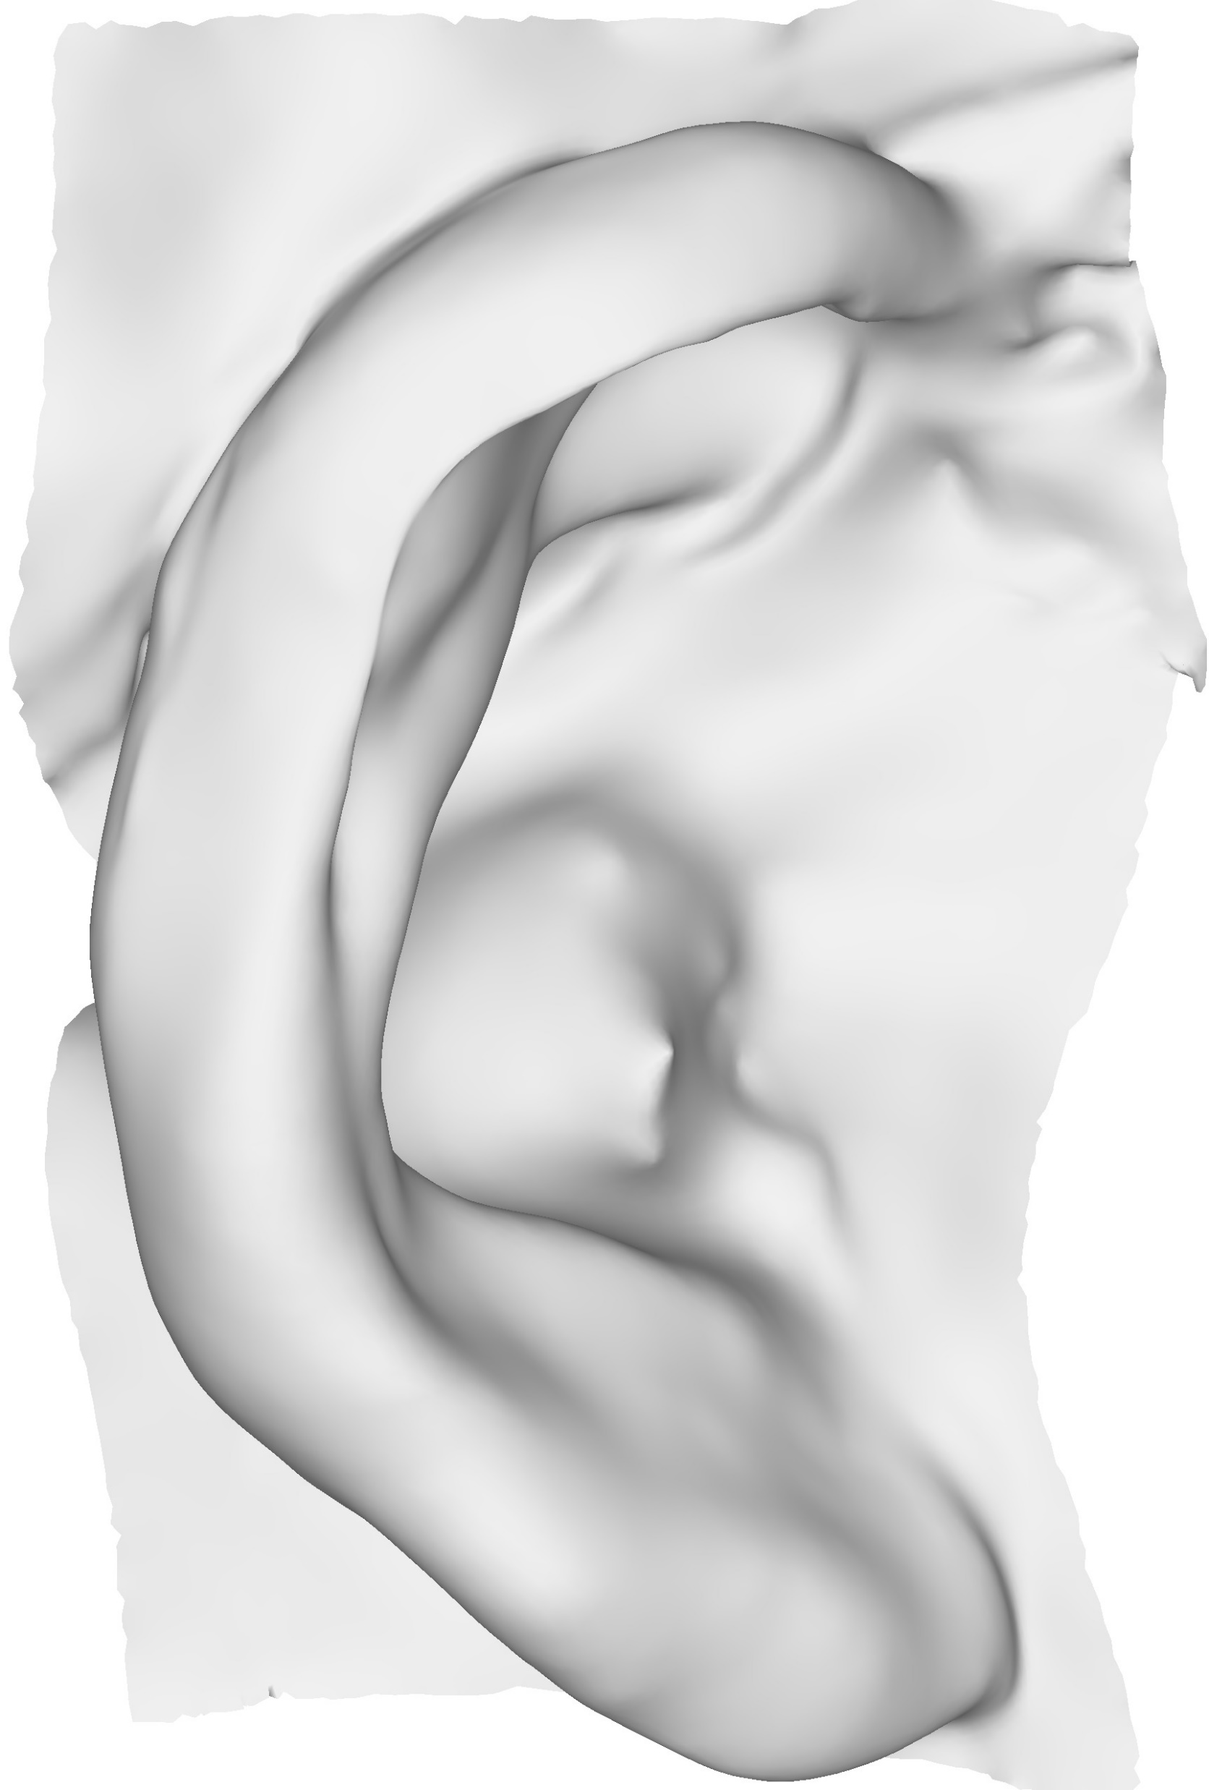
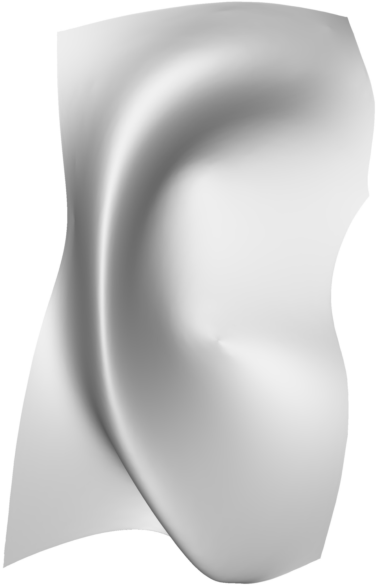



















Pipeline
Smooth Domain
Spectral
Reconstruction
Constraints
Deformed
Template
and Scan
Input Meshes
Align
Map
$$\hat{T_{k}}$$
$$\tilde{T}$$
$$T_{k}$$
$$S_{k}$$
$$C_{T}$$
$$C_{S}$$
$$S$$
Rigid
Aligned
no
Transfer
Deform $\overline{T_{k}}$
Surface
Orientation-Based
Deformation
$$T$$
$$S$$
$a_{d}$< t
$$T′$$
$$S$$
yes
$$\overline{T_{k}}$$
$$C_{\overline{T_{k}}}$$
$$C_{S_{k}}$$
$$\hat{T_{k}}$$
$$T′$$
Notes:
This figure shows the pipeline of our approach. It begins with template and scan meshes and transforms them to a
1 - Smooth domain where it is easier to align the template to the scan
2 – Then, we detect semantic features in image space, and transfer these features to the respective smooth meshes
4 – We continue with an iterative deformation of the template
5- After the iterations are finished, the proposed novel reconstruction adds back the details to the smooth mesh
6 – As a final step, we deform the reconstructed template using constraints based on surface orientation
Let us now inspect each step of the pipeline in more details

Slide 10



Pipeline
Smooth
Domain
Spectral Reconstruction
Constraints
Deformed
Template
and Scan
Input
Meshes
Align
Map
$$\hat{T_{k}}$$
$$\tilde{T}$$
$$T_{k}$$
$$S_{k}$$
$$C_{T}$$
$$C_{S}$$
$$S$$
Rigid
Aligned
no
Transfer
Deform $\overline{T_{k}}$
Surface
Orientation-Based
Deformation
$$T$$
$$S$$
$a_{d}$< t
$$T′$$
$$S$$
yes
$$\overline{T_{k}}$$
$$C_{\overline{T_{k}}}$$
$$C_{S_{k}}$$
$$\hat{T_{k}}$$
$$T′$$
Notes:
Let us look at the first step of the pipeline which is creating smooth meshes

Slide 11
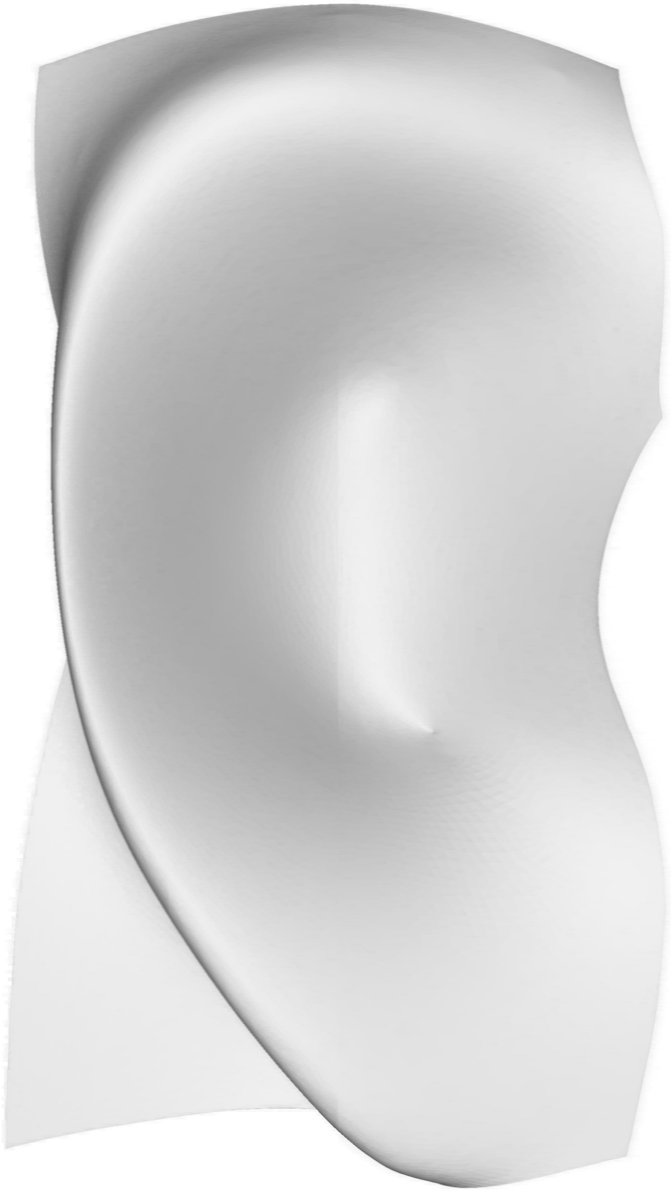





Smooth Domain
Spectral mesh processing
  $L$ = Cotangent [28] Laplacian matrix
  $U_{k}$ = $k$ eigen vectors of $L$
$$V^{′}= U_{k}⋅U_{k}^{⊤}⋅V$$
$$V′$$
$$V$$
Notes:
This slide shows a general construction of smooth meshes. Eigen vectors are computed from the mesh Laplacian matrix. The vertex positions for the smooth domain are calculated by transforming the vertex positions of the original mesh. This is helpful for getting a simpler shape that will be easier to align.

Slide 12
Pipeline
Smooth
Domain
Spectral
Reconstruction
Constraints
Deformed
Template
and Scan
Input
Meshes
Align
Map
$$\hat{T_{k}}$$
$$\tilde{T}$$
$$T_{k}$$
$$S_{k}$$
$$C_{T}$$
$$C_{S}$$
$$S$$
Rigid
Aligned
no
Transfer
Deform $\overline{T_{k}}$
Surface
Orientation-Based
Deformation
$$T$$
$$S$$
$a_{d}$< t
$$T′$$
$$S$$
yes
$$\overline{T_{k}}$$
$$C_{\overline{T_{k}}}$$
$$C_{S_{k}}$$
$$\hat{T_{k}}$$
$$T′$$
Notes:
Let us now look at the alignment step

Slide 13

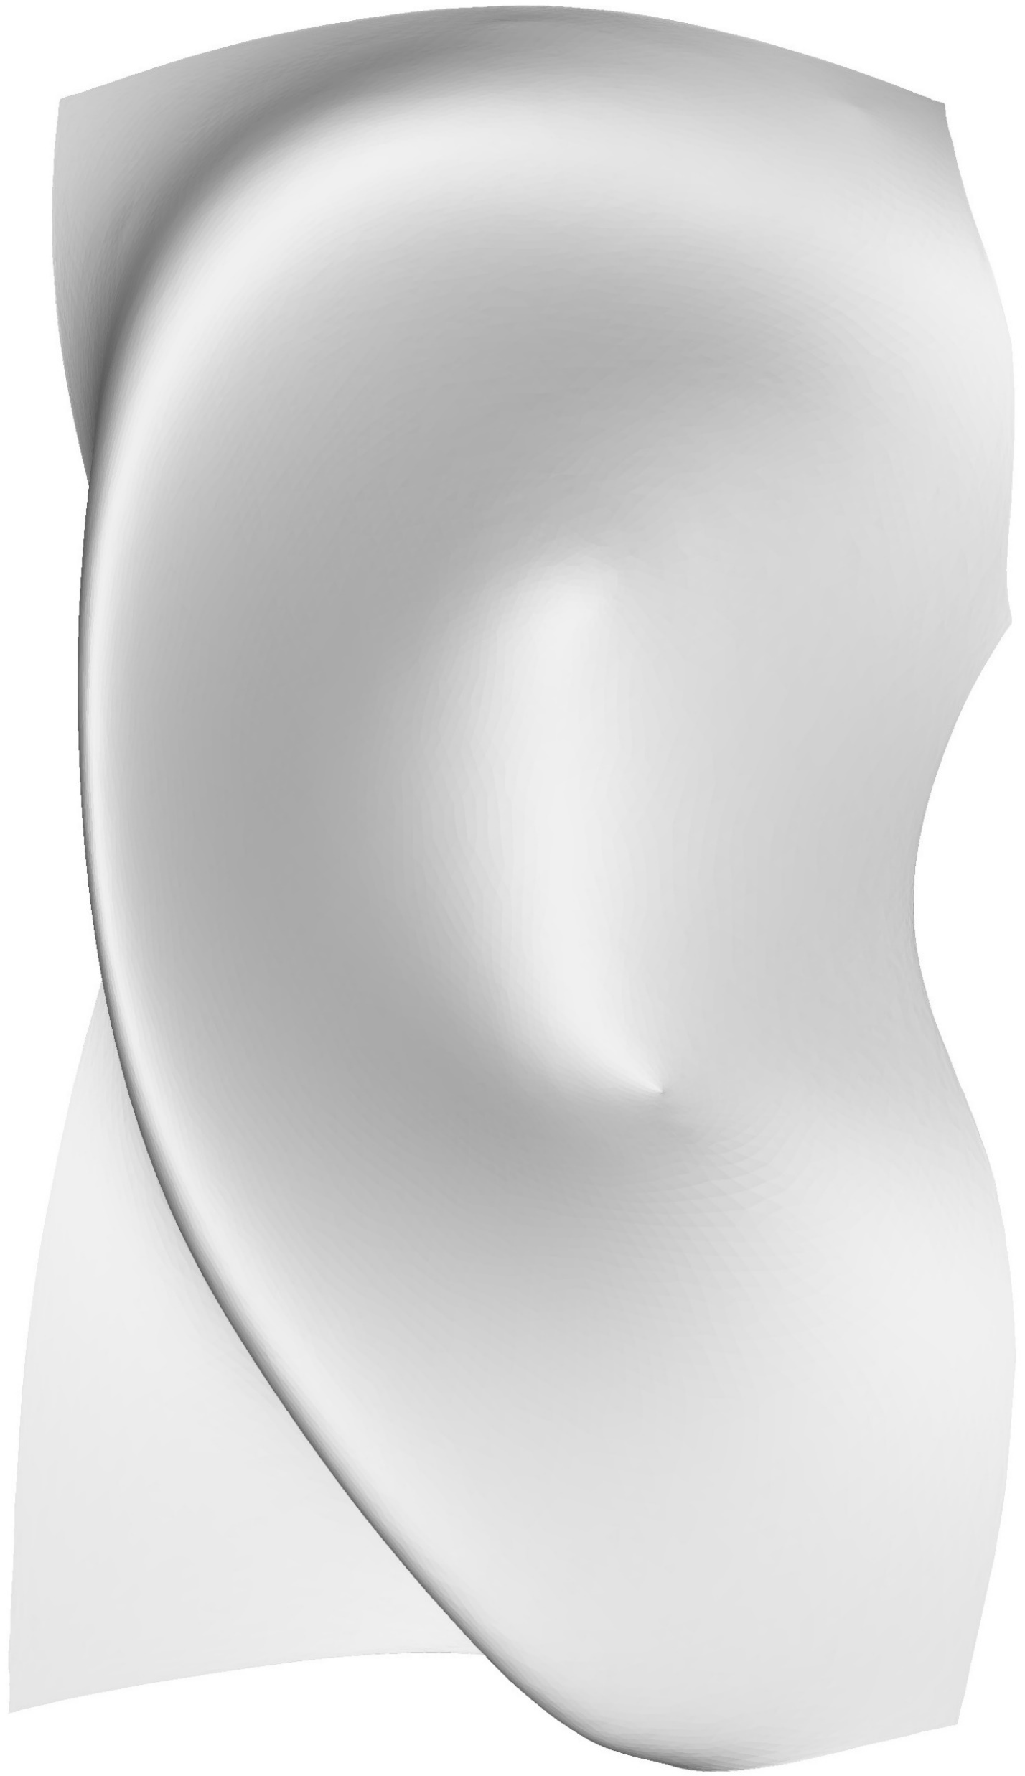



Smooth Domain Rigid Alignment
Smooth Domain
Rigid aligned using GoICP [40]
$$T_{k}$$
$$S_{k}$$
$$\overline{T_{k}}$$
Notes:
With the smooth domain meshes it is easier to align the template and the scan. In our approach, we used GoICP that calculates the optimal translation and rotation between point clouds.

Slide 14
Pipeline
Smooth
Domain
Spectral
Reconstruction
Constraints
Deformed
Template
and Scan
Input
Meshes
Align
Map
$$\hat{T_{k}}$$
$$\tilde{T}$$
$$T_{k}$$
$$S_{k}$$
$$C_{T}$$
$$C_{S}$$
$$S$$
Rigid
Aligned
no
Transfer
Deform $\overline{T_{k}}$
Surface
Orientation-Based
Deformation
$$T$$
$$S$$
$a_{d}$< t
$$T′$$
$$S$$
yes
$$\overline{T_{k}}$$
$$C_{\overline{T_{k}}}$$
$$C_{S_{k}}$$
$$\hat{T_{k}}$$
$$T′$$
Notes:
We will now present our approach to identify constraints for deformation

Slide 15





Constraints
Input Meshes
Render template and scan
  Orthographic camera facing the mesh
  View = bounding box
Canny edge detection
$$T$$
$$S$$
Constraints
$$C_{T}$$
$$C_{S}$$
Notes:
We identify features on the ears that will later serve as deformation constraints. We render the ear meshes and conduct Canny edge detection on the rendered images

Slide 16
Pipeline
Smooth
Domain
Spectral
Reconstruction
Constraints
Deformed
Template
and Scan
Input
Meshes
Align
Map
$$\hat{T_{k}}$$
$$\tilde{T}$$
$$T_{k}$$
$$S_{k}$$
$$C_{T}$$
$$C_{S}$$
$$S$$
Rigid
Aligned
no
Transfer
Deform $\overline{T_{k}}$
Surface
Orientation-Based
Deformation
$$T$$
$$S$$
$a_{d}$< t
$$T′$$
$$S$$
yes
$$\overline{T_{k}}$$
$$C_{\overline{T_{k}}}$$
$$C_{S_{k}}$$
$$\hat{T_{k}}$$
$$T′$$
Notes:
We then transfer these features to the smooth meshes.

Slide 17
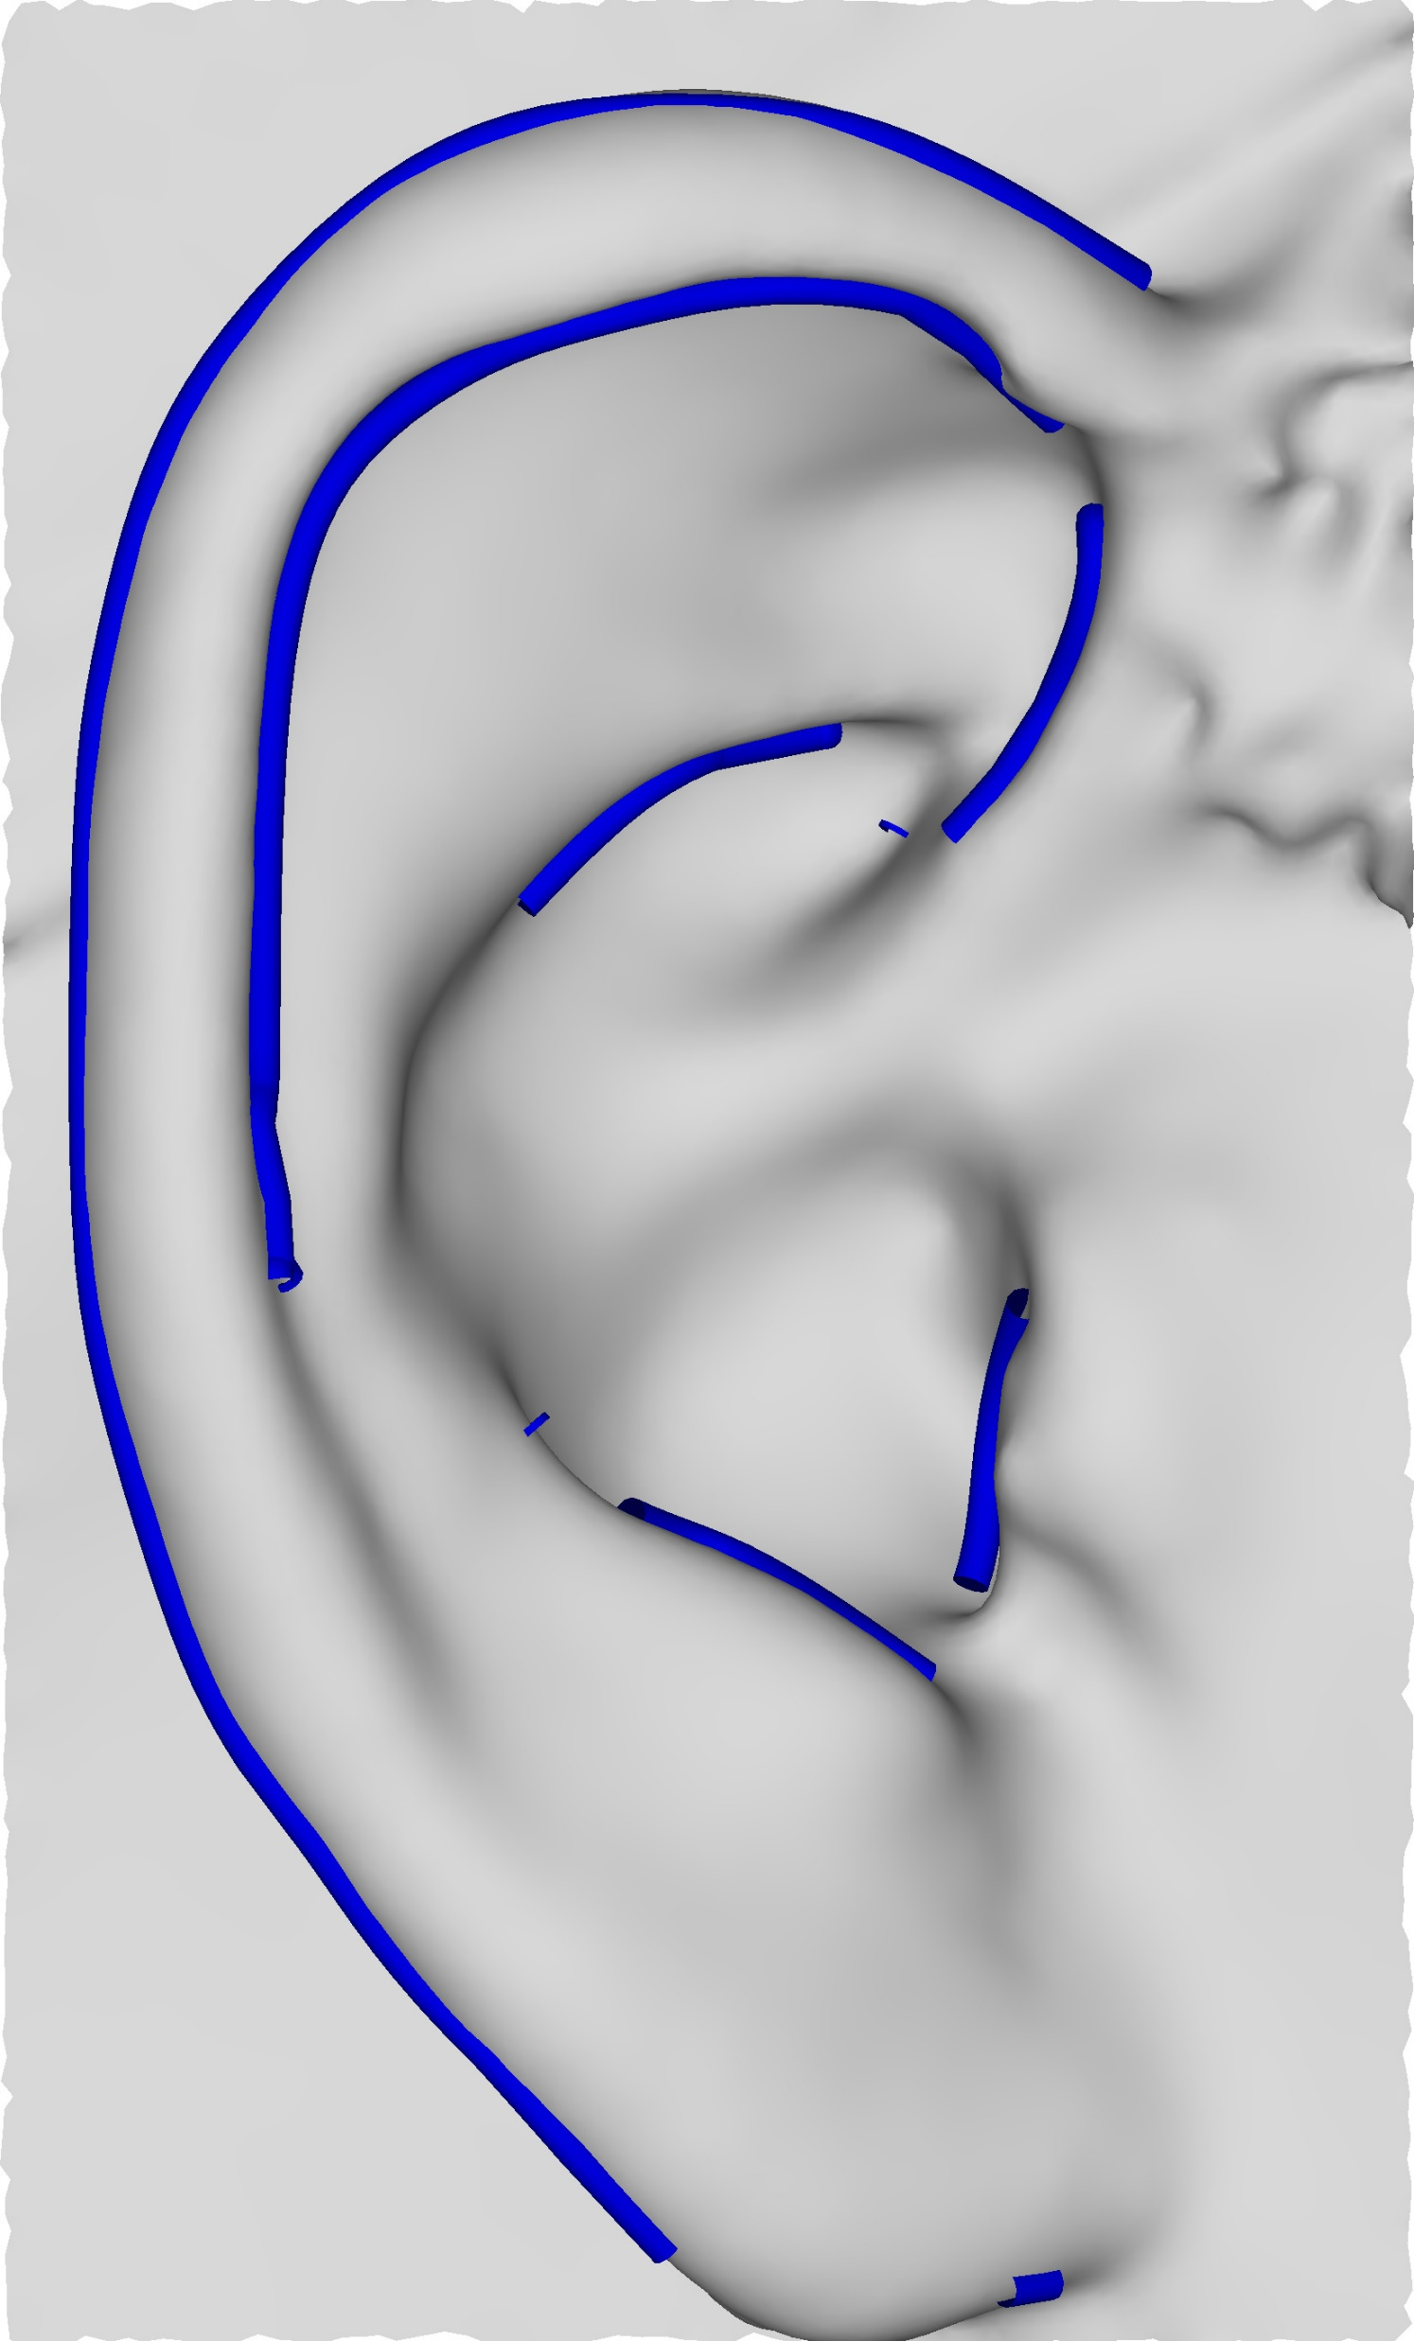
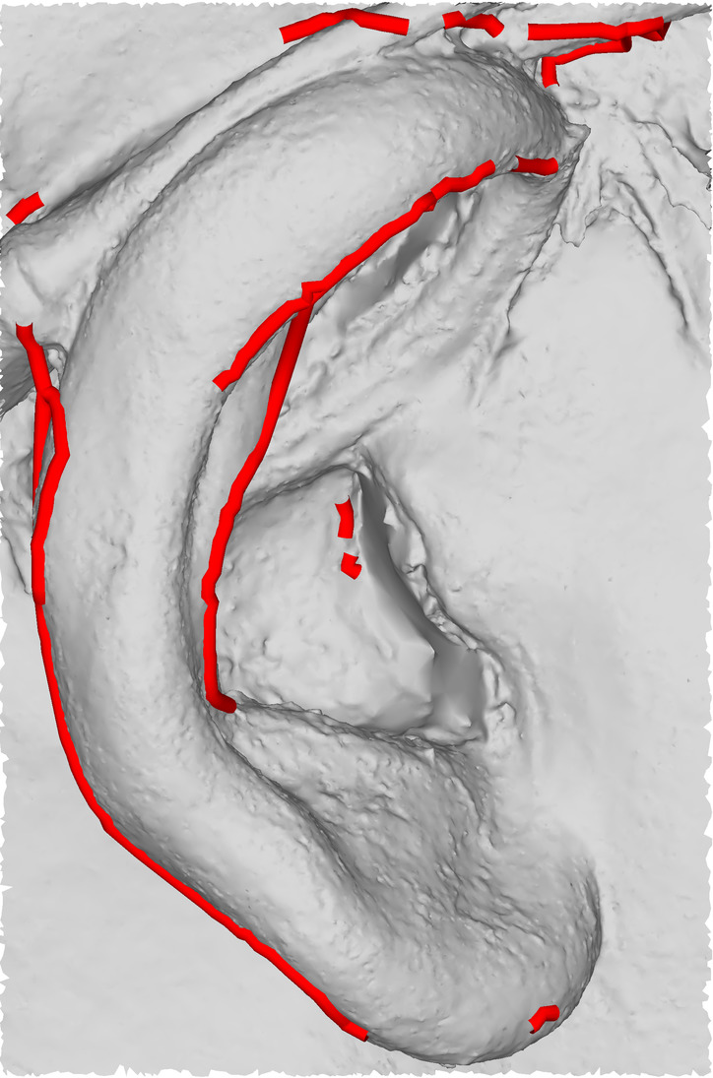




Transfer Constraints on Smooth Domain
Constraints
Unproject
Transfer
$$C_{T}$$
$$C_{S}$$
$$C_{\overline{T_{k}}}$$
$$C_{S_{k}}$$
Notes:
The pixels resulting from the edge detection are unprojected back to the meshes to get their 3D locations. These 3D locations are barycentric coordinates, so it is possible to transfer them on the smooth meshes as well.

Slide 18
Pipeline
Smooth
Domain
Spectral
Reconstruction
Constraints
Deformed
Template
and Scan
Input
Meshes
Align
Map
$$\hat{T_{k}}$$
$$\tilde{T}$$
$$T_{k}$$
$$S_{k}$$
$$C_{T}$$
$$C_{S}$$
$$S$$
Rigid
Aligned
no
Transfer
Deform $\overline{T_{k}}$
Surface
Orientation-Based
Deformation
$$T$$
$$S$$
$a_{d}$< t
$$T′$$
$$S$$
yes
$$\overline{T_{k}}$$
$$C_{\overline{T_{k}}}$$
$$C_{S_{k}}$$
$$\hat{T_{k}}$$
$$T′$$
Notes:
Let's now look at our iterative deformation process.

Slide 19
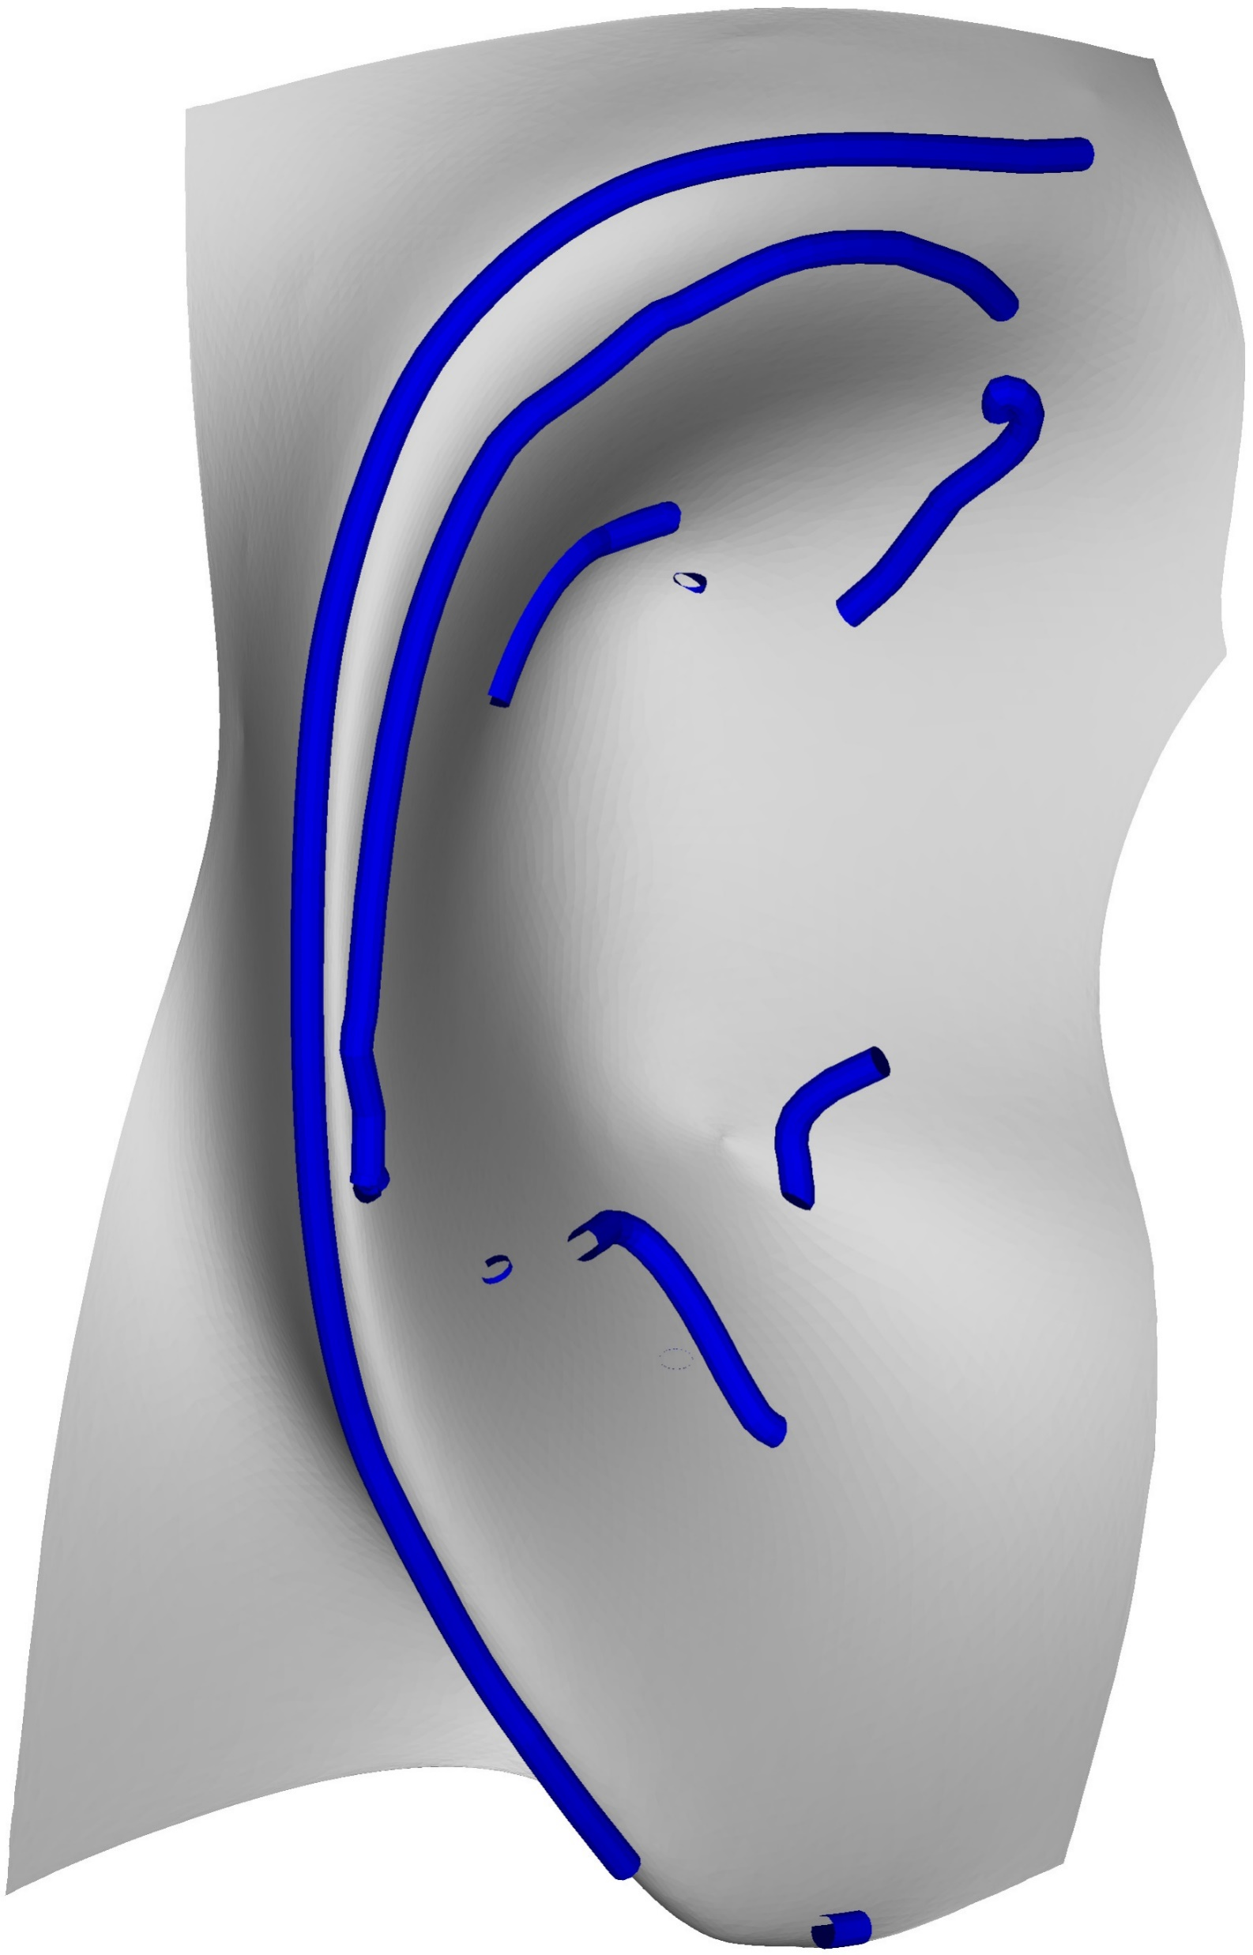
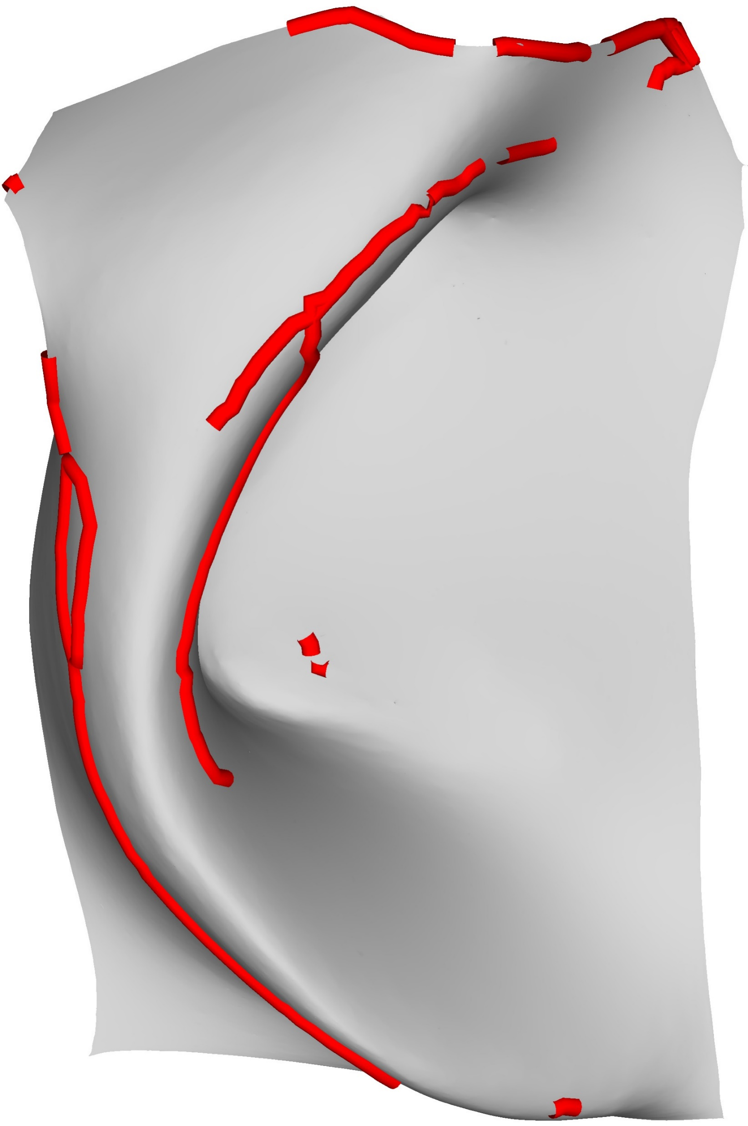
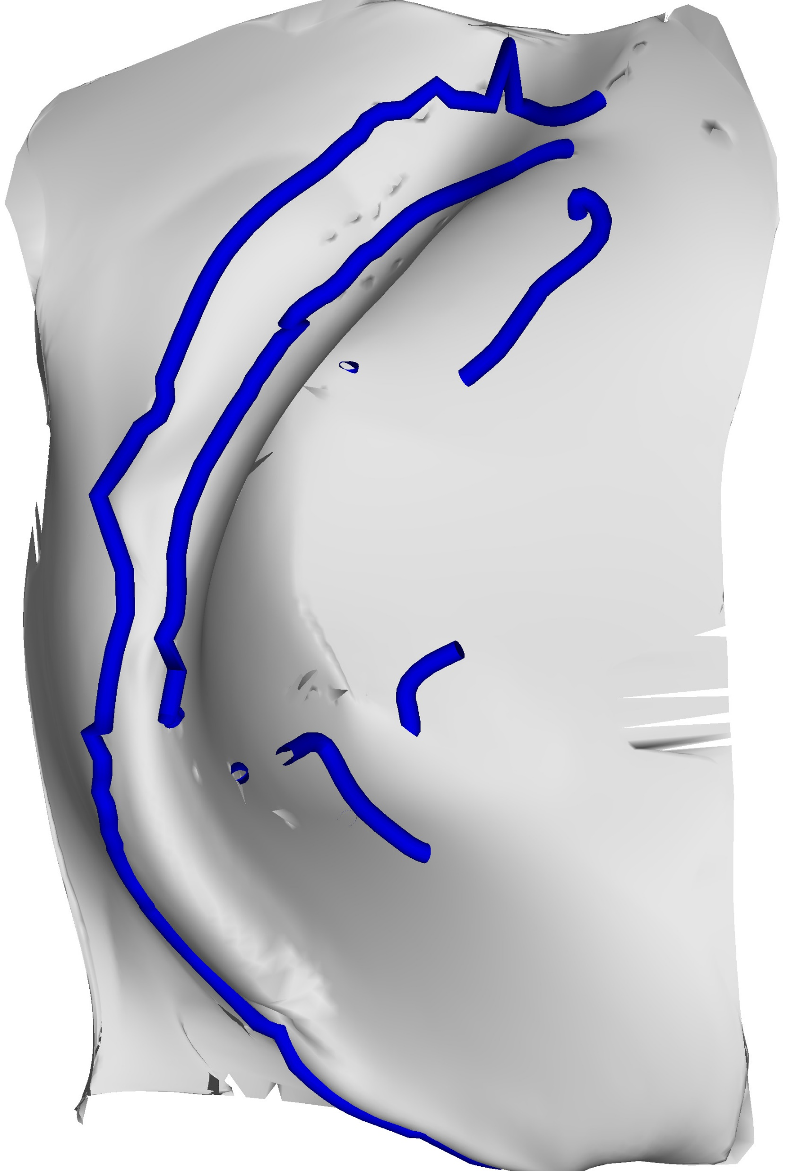
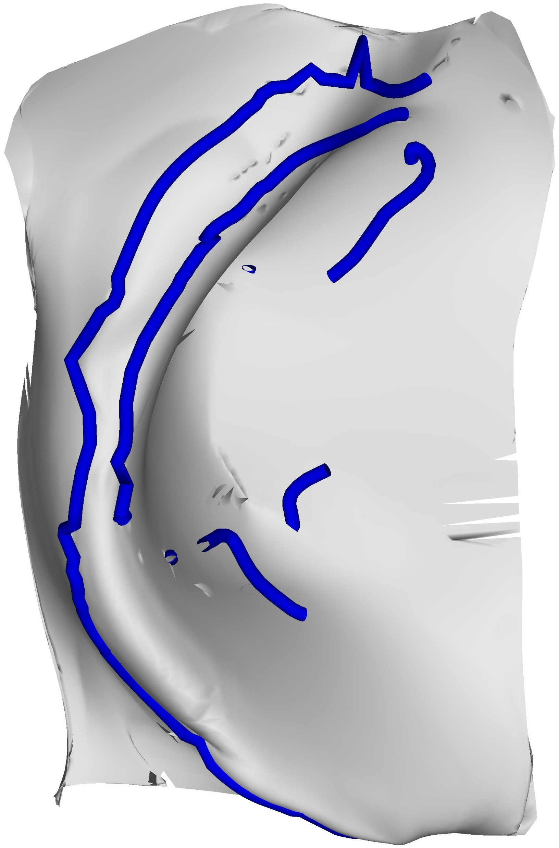








Iterative Deformation
Align
Map
$$\overline{T_{k}}$$
$S_{k}$
No
$a_{d}$< t
$$Iteration_{1}$$
$$Iteration_{2}$$
$$Iteration_{N}$$
Deform $\overline{T_{k}}$
Yes
$$\hat{T_{k}}$$
Notes:
Intro) Now we have the aligned smooth meshes and their semantic features as constraints. The purpose of the semantic features is to help deform the smooth template to match the shape of the smooth scan, but we cannot do that yet because they do not have any mapping between them.
Animate with Click) To find a mapping we Align the semantic features using GoICP.
Animate with Click) And then we find an injective map from the features of the smooth template to those of the smooth scan
Animate with Click) Using this injective map, the smooth template is deformed.
Animate with Click) We iterate until the average distance in the mapping is less than a threshold value.
Animate with Click) When the iterations stop, we can see that the smooth template is similar to the smooth scan at the coarse level.

Slide 20
Pipeline
Smooth
Domain
Spectral
Reconstruction
Constraints
Deformed
Template
and Scan
Input
Meshes
Align
Map
$$\hat{T_{k}}$$
$$\tilde{T}$$
$$T_{k}$$
$$S_{k}$$
$$C_{T}$$
$$C_{S}$$
$$S$$
Rigid
Aligned
no
Transfer
Deform $\overline{T_{k}}$
Surface
Orientation-Based
Deformation
$$T$$
$$S$$
$a_{d}$< t
$$T′$$
$$S$$
yes
$$\overline{T_{k}}$$
$$C_{\overline{T_{k}}}$$
$$C_{S_{k}}$$
$$\hat{T_{k}}$$
$$T′$$
Notes:
We will now show how we add back the details while keeping the deformation from the smooth template

Slide 21


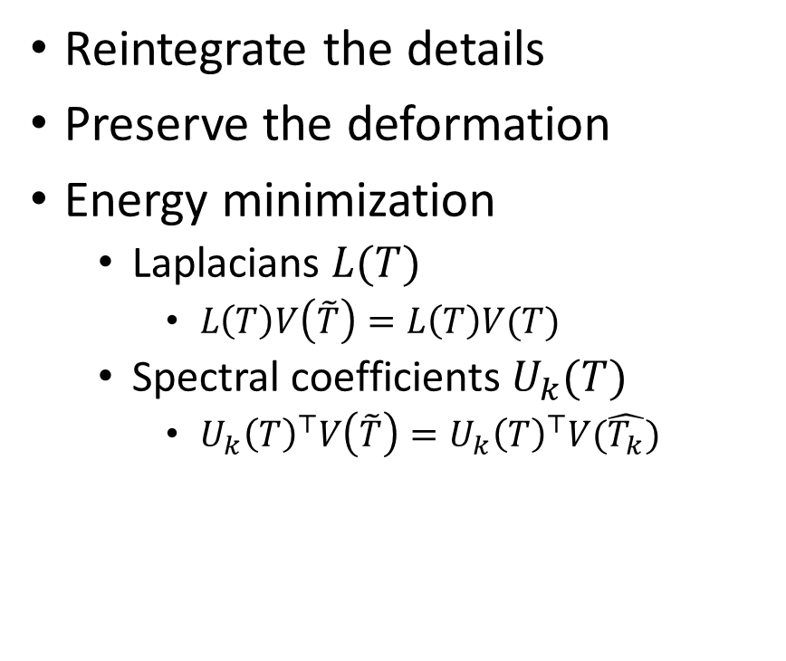

Spectral Reconstruction
Reintegrate the details
Preserve the deformation
Energy minimization
  Laplacians $L(T)$
    $L\left(T\right)V\left(\tilde{T}\right)=L\left(T\right)V(T)$
  Spectral coefficients $U_{k}(T)$
    $U_{k}{\left(T\right)}^{⊤}V\left(\tilde{T}\right)=U_{k}{\left(T\right)}^{⊤}V(\hat{T_{k}})$
$$T$$
$$\hat{T_{k}}$$
$$\tilde{T}$$
$$argmin_{V\left(\tilde{T}\right)} \sum_{i=1}^{n}{{\left\|L_{i}\left(T\right)V_{i}\left(\tilde{T}\right)−L_{i}\left(T\right)V_{i}\left(T\right)\right\|}_{2}^{2} }+ \sum_{i=1}^{n}{{\left\|U_{k}^{i}{\left(T\right)}^{⊤}V_{i}\left(\tilde{T}\right)−U_{k}^{i}{\left(T\right)}^{⊤}V_{i}\left(\hat{T}\right)\right\|}_{2}^{2}}$$
Notes:
While adding back the details to the deformed smooth template, it is also necessary to preserve the deformation undergone during the previous iterative process. For the spectral reconstruction, we propose an Energy minimization composed of two terms,
(Click to Animate) The first term preserves the laplacians of the original template to preserve its geometry
(Click to Animate) The second term consists of the deformation undergone in the smooth domain by the iterative process. This tries to enforce the shape change.
(Click to Animate) The resulting vertex positions are the optimization of these two terms.

Slide 22
Pipeline
Smooth
Domain
Spectral
Reconstruction
Constraints
Deformed
Template
and Scan
Input
Meshes
Align
Map
$$\hat{T_{k}}$$
$$\tilde{T}$$
$$T_{k}$$
$$S_{k}$$
$$C_{T}$$
$$C_{S}$$
$$S$$
Rigid
Aligned
no
Transfer
Deform $\overline{T_{k}}$
Surface
Orientation-Based
Deformation
$$T$$
$$S$$
$a_{d}$< t
$$T′$$
$$S$$
yes
$$\overline{T_{k}}$$
$$C_{\overline{T_{k}}}$$
$$C_{S_{k}}$$
$$\hat{T_{k}}$$
$$T′$$
Notes:
All that remains now is to fine tune the template to better fit the scan.

Slide 23
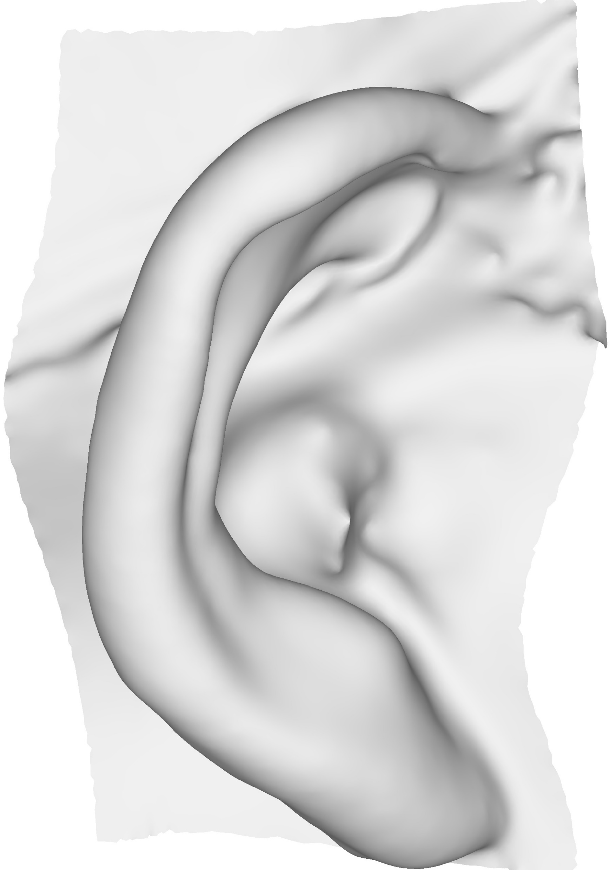

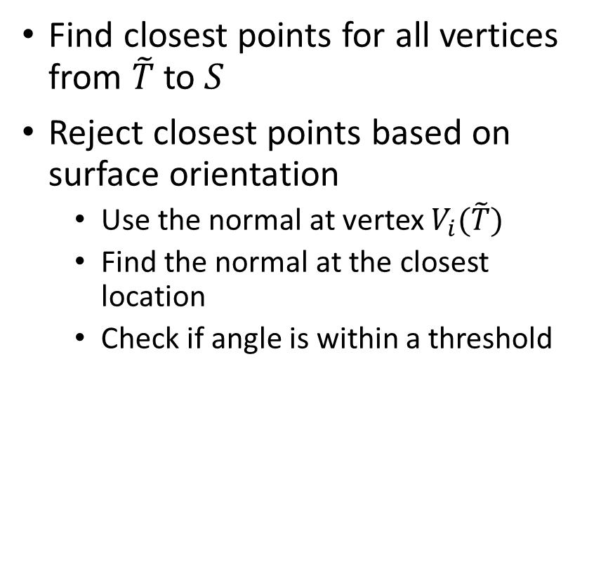

Fine Level Deformation
Find closest points for all vertices from $\tilde{T}$ to $S$
Reject closest points based on surface orientation
  Use the normal at vertex $V_{i}(\tilde{T})$
  Find the normal at the closest location
  Check if angle is within a threshold
$$\tilde{T}$$
$$S$$
α
Notes:
This is the final step in our approach. To fine tune the shape of the template, (Click to Animate) we use closest point correspondences. (Click to Animate) Instead of using all the closest point correspondences, we use a subset.
(Click to Animate) We compare the surface orientation based on the normal of a vertex on the spectrally reconstructed template (Click to Animate) with the normal of the closest point on the surface of scan.
(Click to Animate) If the angle is within a threshold then the closest point is considered, otherwise it is rejected.

Slide 24



Fine Level Deformation
This will be a sparse mapping
Smooth surface deformation through Laplacian surface editing
  With kept closest points as constraints
$$T′$$
$$S$$
Notes:
(Click to Animate) This subset of closest points is infact a sparse map
(Click to Animate) that is then used as constraints for the Laplacian surface editing. This last deformation of the template results in a shape close to the scan but without noise.

Slide 25


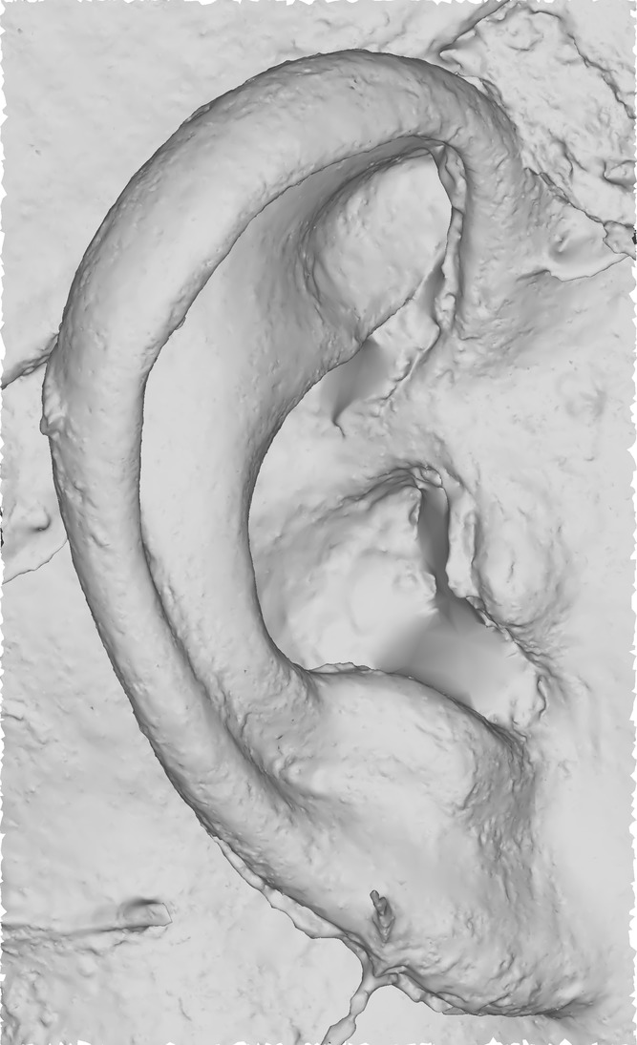
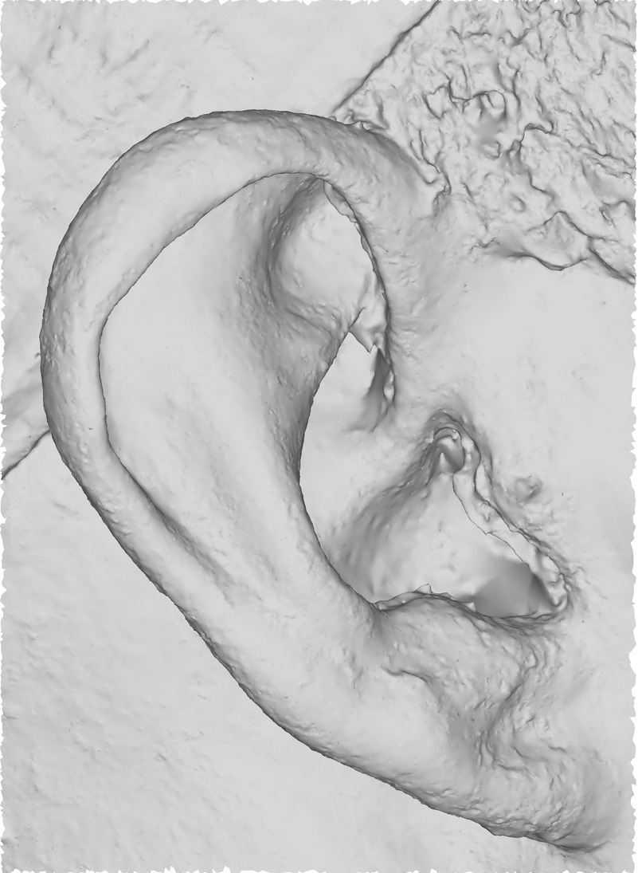
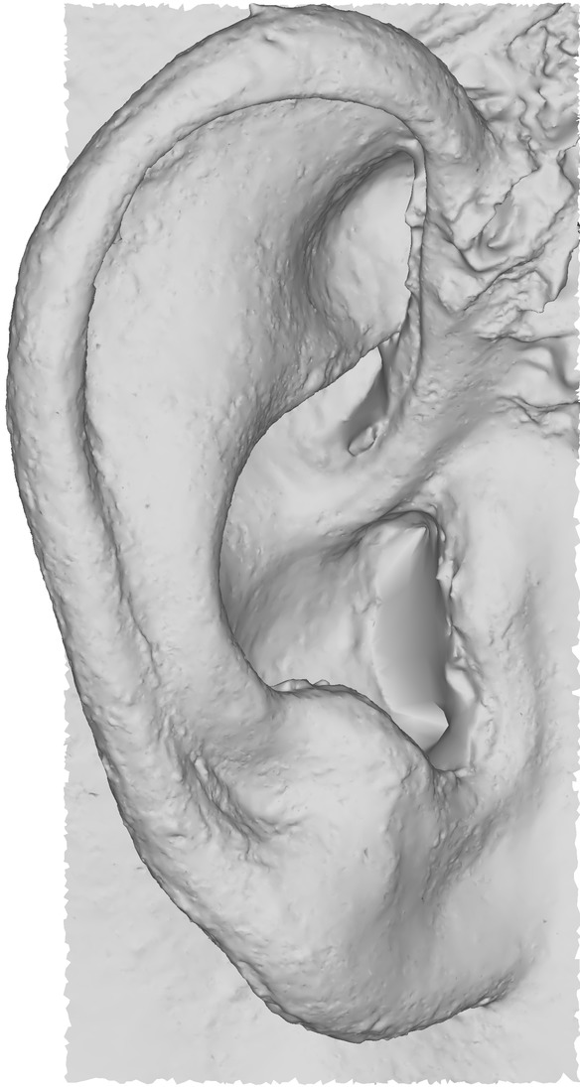

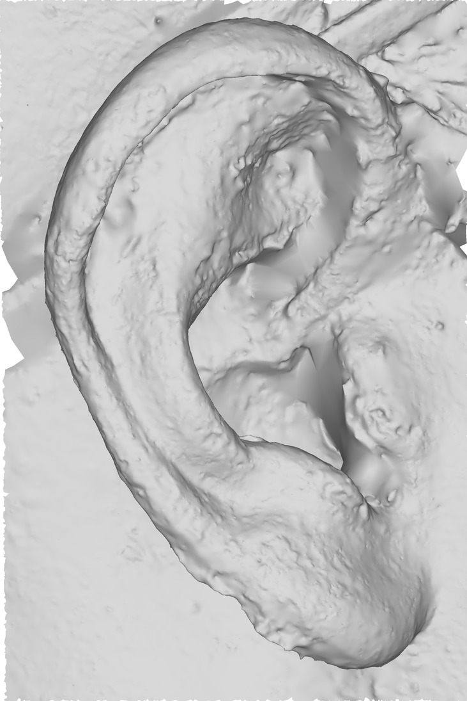
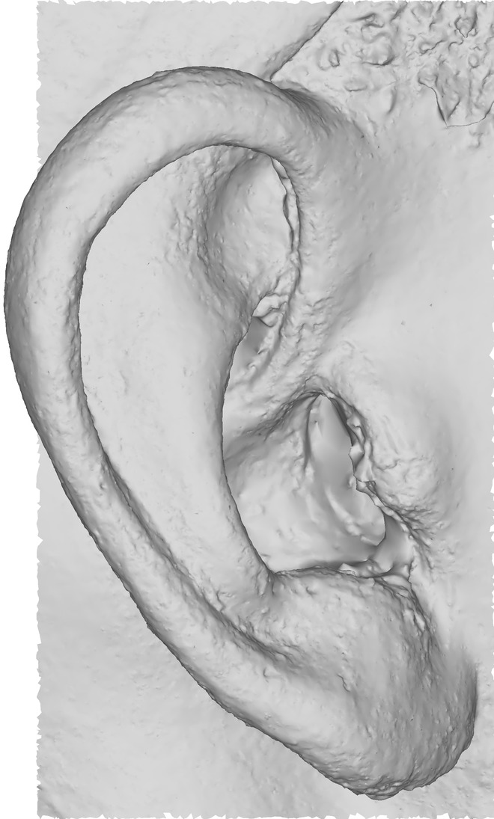
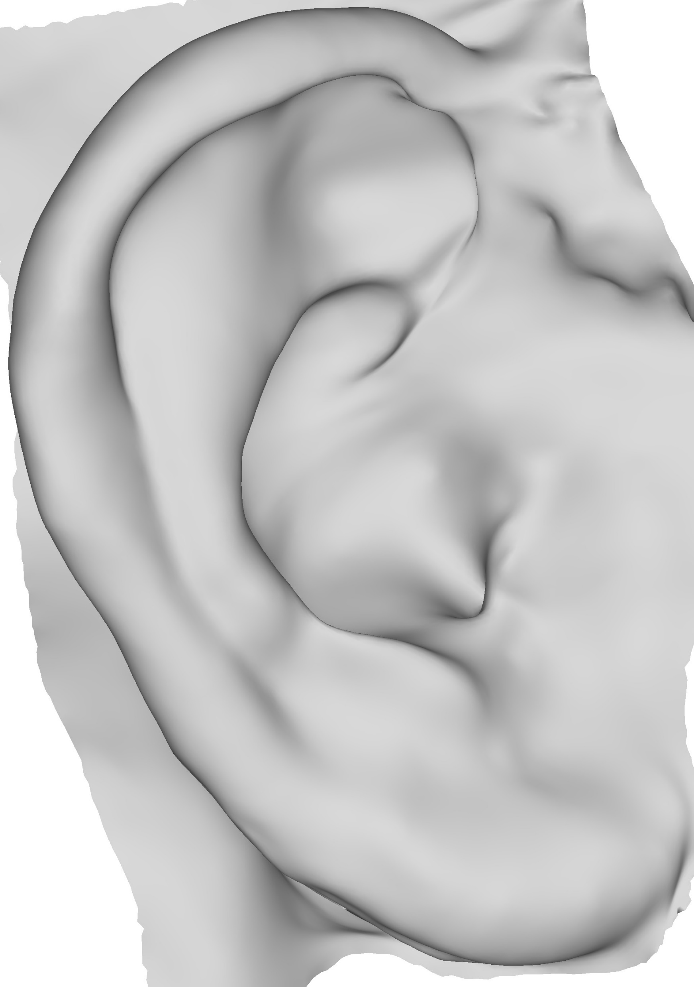
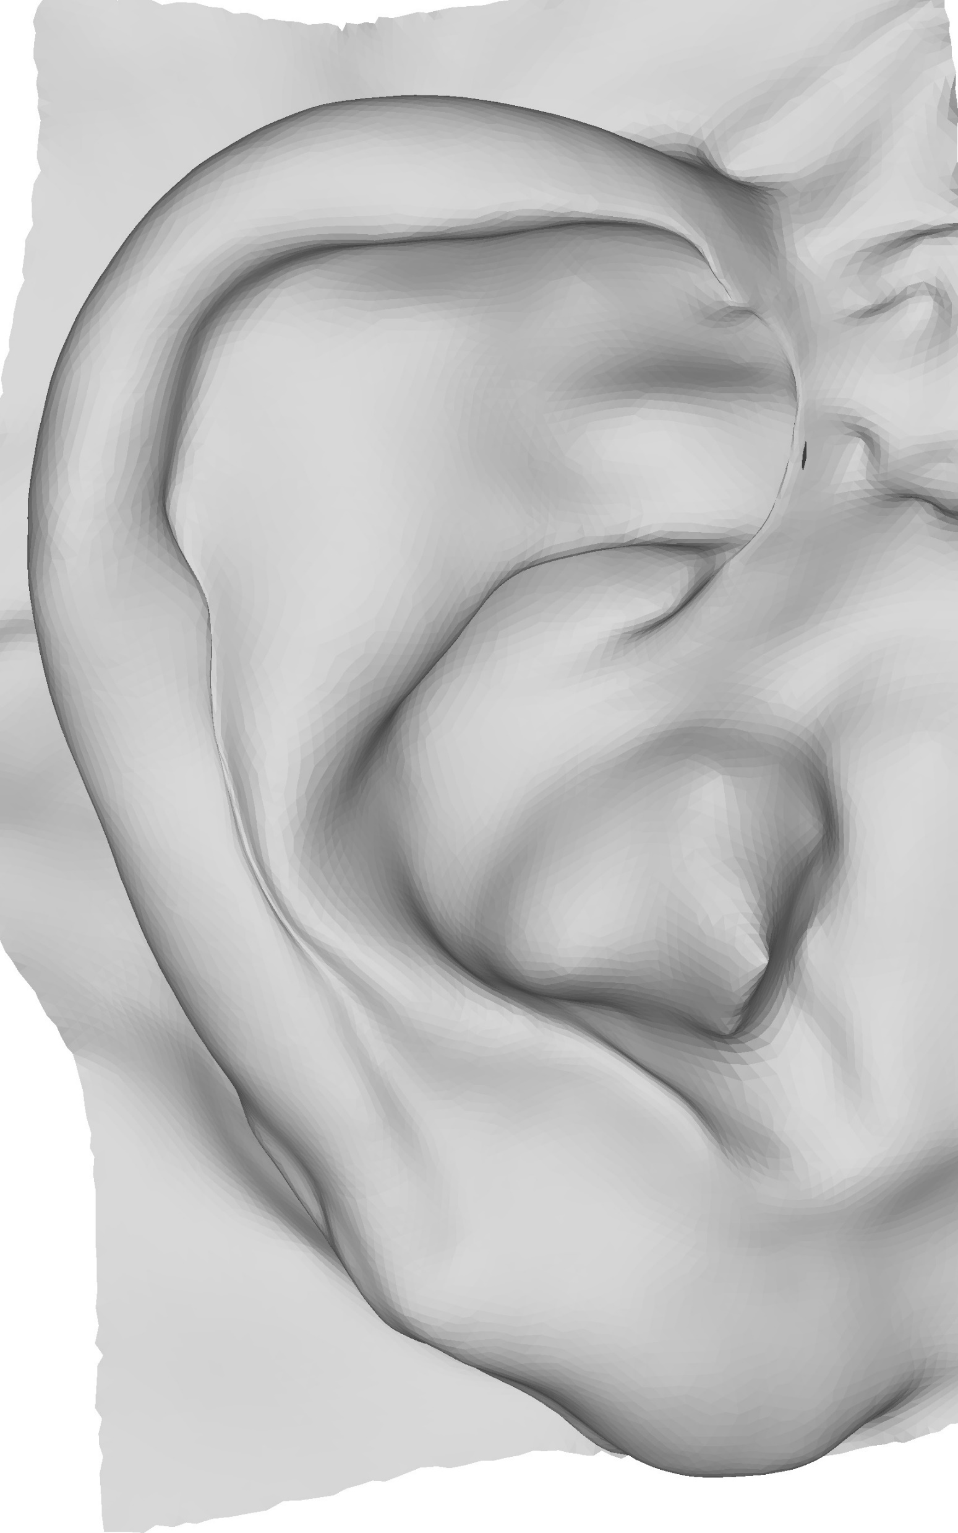
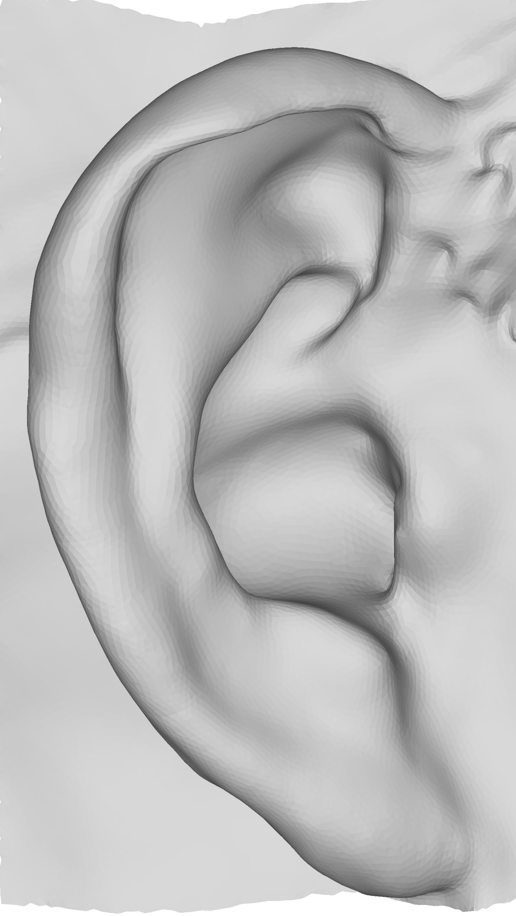
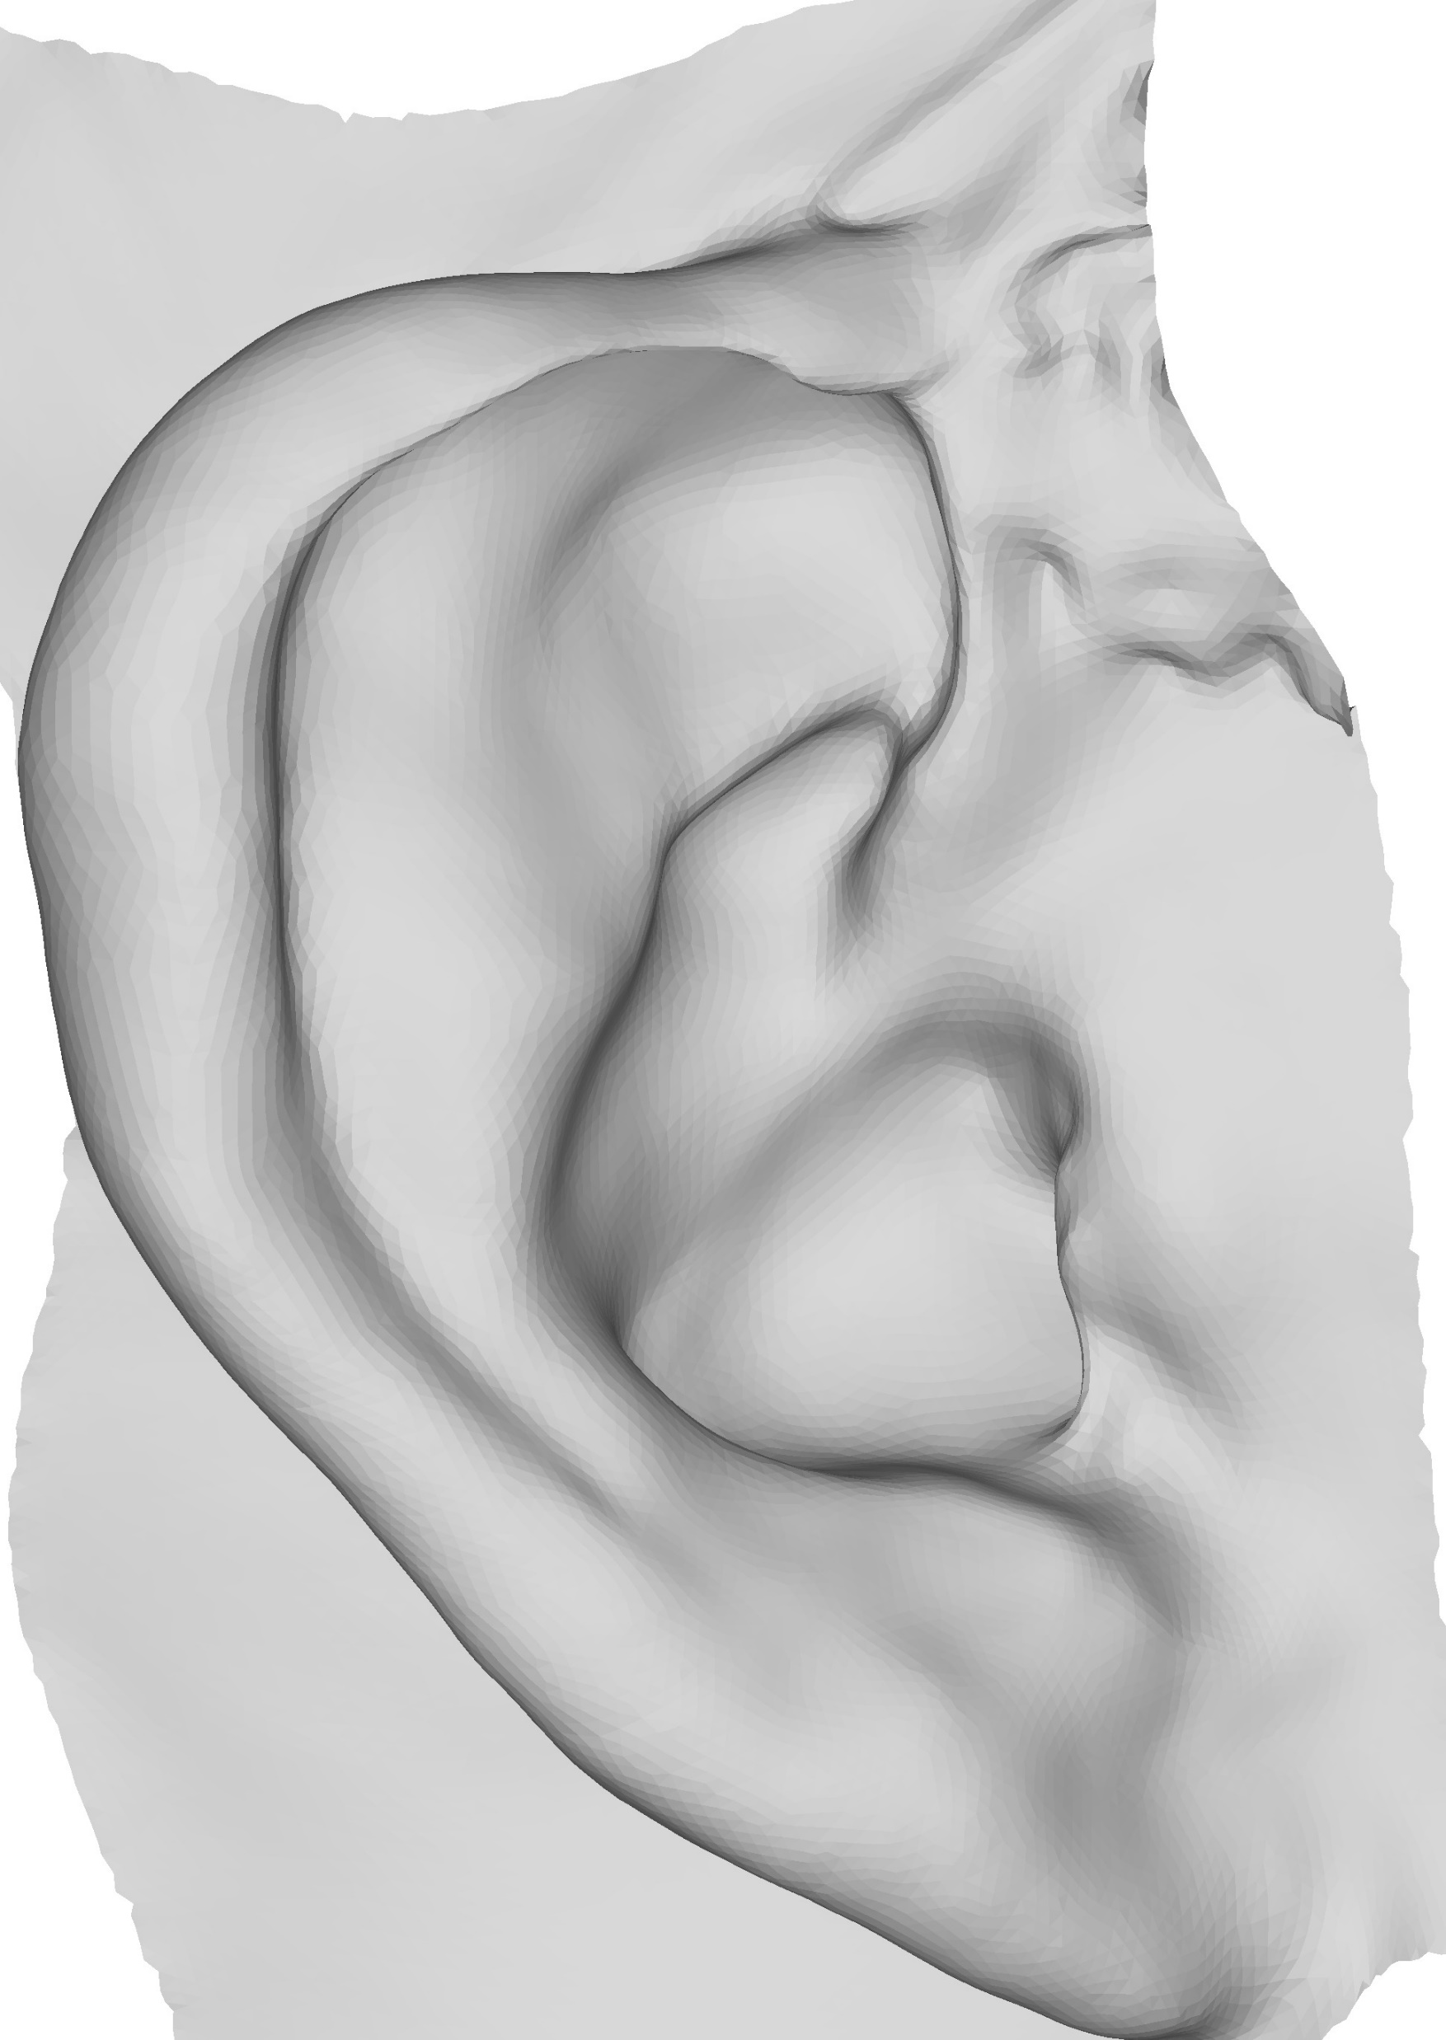




Results (1/2)
Scans
Fitted Templates
Notes:
The slide here shows the template fitting with various scans in our data set. The first row shows the original scans, while second row shows the fitting results. In the results it can be seen that the template fitting works well and is faithful to the shape of the scans.

Slide 26













Results (2/2)
Scans
Fitted Templates
Notes:
Here we present a second set of scans and fitted templates. We see from all of these results that our approach avoids reconstructing the noise or geometry problems. The spectral reconstruction adds a boost to the template fitting because of its Laplacian term that tries to enforce the original details.

Slide 27


Pipeline
Smooth
Domain
Spectral
Reconstruction
Constraints
Deformed
Template
and Scan
Input
Meshes
$$S_{k}$$
Align
Map
$$\hat{T_{k}}$$
$$\tilde{T}$$
$$T_{k}$$
$$S_{k}$$
$$C_{T}$$
$$C_{S}$$
$$S$$
Rigid
Aligned
no
Transfer
Deform $\overline{T_{k}}$
Surface
Orientation-Based
Deformation
$$T$$
$$S$$
$a_{d}$< t
$$T′$$
$$S$$
yes
$$\overline{T_{k}}$$
$$C_{\overline{T_{k}}}$$
$$C_{S_{k}}$$
$$\hat{T_{k}}$$
$$\hat{T_{k}}$$
$$T′$$
Notes:
To verify this we tried our pipeline without (Click to Animate) considering the spectral reconstruction.
(Click to Animate) Instead we tried fitting based on the closest points between the iteratively deformed smooth template and the smooth scan.
(Click to Move to Next Slide)

Slide 28













Spectral Reconstruction Benefits
Closest point constraints from $\hat{T_{k}}$ to $S_{k}$ result in lateral sliding
$$\tilde{T}$$
$$S$$
$$↔$$
With spectral reconstruction
Without spectral reconstruction
$$↔$$
$$\hat{T_{k}}$$
$$S_{k}$$
Notes:
There were significant differences between both results when viewed with a colored region segmentation of the template.
(Click to Animate) As you can see the results using the smooth meshes induce lateral sliding, showing mismatched fitting areas.
(Click to Animate) Conversely, our regular pipeline using spectral reconstruction provides results exempt of lateral sliding and with a smoother surface.

Slide 29

Comparison to Mapping Method
Scans have bad geometry (holes, handles, noise)
  Most mapping methods fail
Method of Lähner et al. [25] produces a sparse mapping
  $≈ 3000 points$
Deform $T$ to $S$
  Avoid smooth domain
  $3000 points$ as constraints to Laplacian surface editing
Notes:
Also we compared our pipeline to a current mapping method proposed by Lahner et al. This specific method was considered since most of the state of the art methods weren’t suitable because of our scan meshes quality. A drawback of this method is that it fails to produce dense mapping with our scans as they are high density scans. Nevertheless it was able to produce a sparse mapping of around 3000 points. We used these 3000 points as constraints for a Laplacian surface deformation, just as we do in the last step of our pipeline.

Slide 30







Comparison to Mapping Method
$$T$$
$$S$$
Lähner et al. [25]
Ours
Notes:
This slide shows the result of the template fitting with two different scans using the constraints from the method of Lahner compared to using our closest points.
(Click to Animate) As you can notice the results of Lahner show lateral sliding pointed by the red arrows. The semantic correspondence is clearly better with our results.

Slide 31







Limitations
Sometimes helix region misaligns
Region of helix close to crux is also affected
$$S$$
$$T′$$
$$T$$
Notes:
Though our approach is robust, it has limitations.
(Click to Animate) A first problem is that the helix regions are sometimes misaligned as seen in these examples
(Click to Animate) Also it can be noticed that the helix region close to the crux is sometimes affected (point to the red arrows).

Slide 32
Conclusion
Fully automatic approach to template fitting
Robust to bad mesh quality
Coarse-level and fine-level template alignment
Iterative alignment process
Our new spectral reconstruction is general
  Could be used for deformation purposes other than ear fitting
Notes:
In conclusion we presented an approach that is
fully automatic and robust to bad mesh quality
We demonstrated how a template is aligned both on coarse and fine levels with a scan through iterative deformation processes.
We feel that our spectral reconstruction approach is general, and should be applicable for purposes other than ear fitting.

Slide 33
Future Work
Replace the fixed template with a 3D morphable model [21]
Generalize the pipeline to other type of shapes
Improve on the choice of constraints
  To work on shapes different from ears
Notes:
As a future work,
we want to consider replacing the fixed ear template with a 3D morphable ear model.
Also, future work could investigate the generalization of the pipeline to consider shapes other than ears
Finally, a major improvement area is the choice of constraint as the current choice is more restricted to ears.

Slide 34




Thank You
Thanks to all participants for the scanning
Our sincere thanks to
Thanks to Zorah Lähner from Technical University, Munich, Germany for her code
Implemented using
Notes:
Thank you for your time to view this video.

Slide 35









Selection of $k$ Eigen Vectors
The selection of $k$ is crucial and impacts
  Simpler shape in smooth domain
  Number of constraints for spectral reconstruction
Selected based on template’s shape
Smaller $k=3$ results in lesser features and constraints
Higher $k=100$ is higher features but also poses alignment challenges
$$T$$
Lower $k = 3$
Optimal $k =20$
Higher $k =100$

