Slide 1
Procedural and interactive icicle modeling
Jonathan Gagnon
Eric Paquette

Slide 2
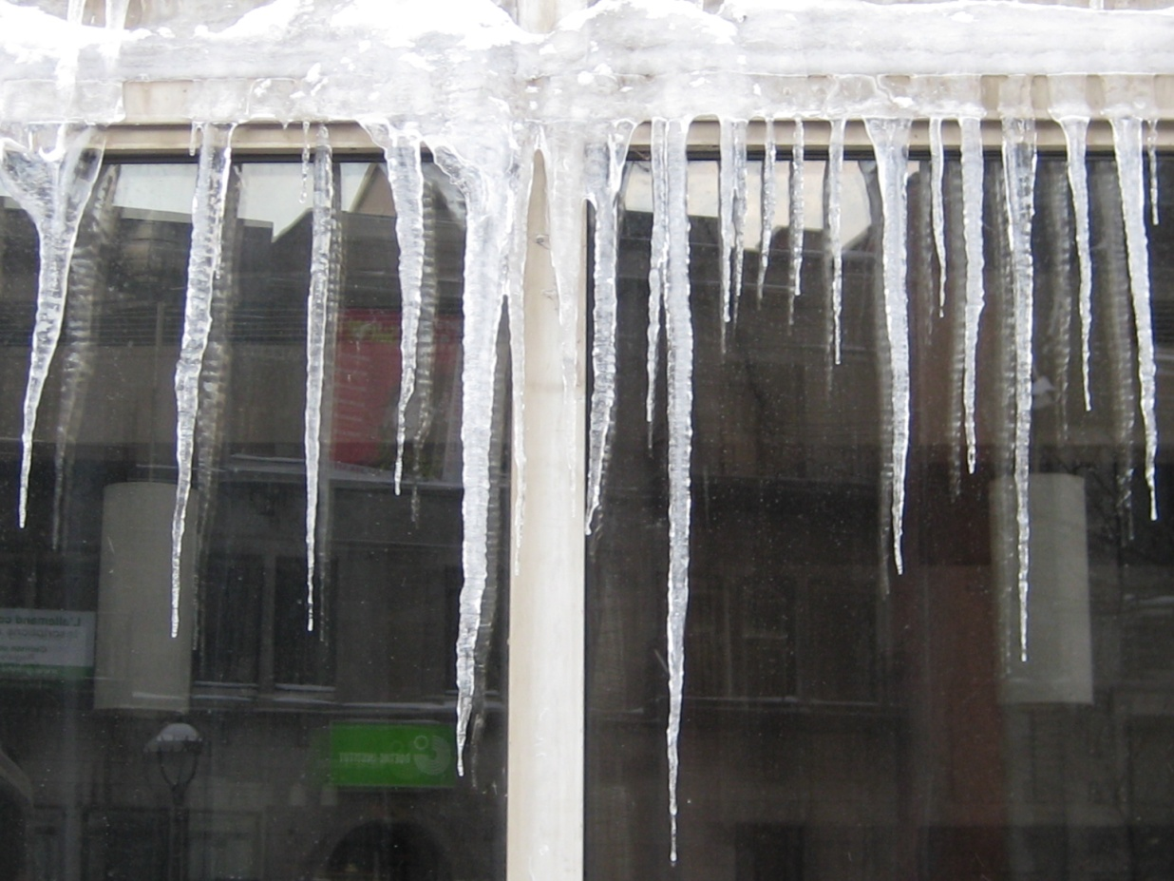
Icy challenges
Goal
Control
Fast computation
photograph

Slide 3
Overview
Previous work
Proposed approach
Results
Limitations & Conclusion

Slide 4
Overview
Previous work
Proposed approach
Results
Limitations & Conclusion

Slide 5
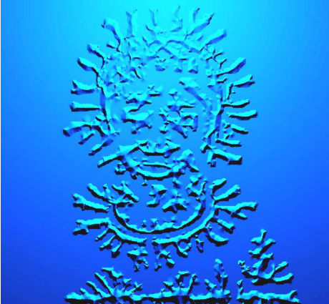
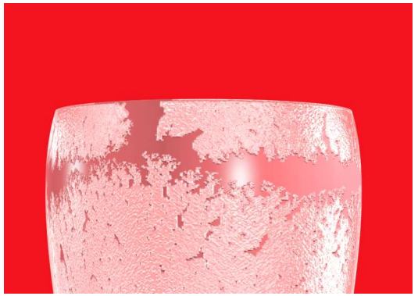
Previous work: Frost
Microdroplets
Kim et al . 2003
Phase field
Kim et al. 2004a
Phase field, DLA, fluid simulation
Realistic
No volume

Slide 6
Previous work: Glaciology
Makkonen 1988
Growth vectors
Convection and conduction
Maneo et al. 1994
Dentritic growth
Szilder et Lozowski 1994
Predict the form

Slide 7
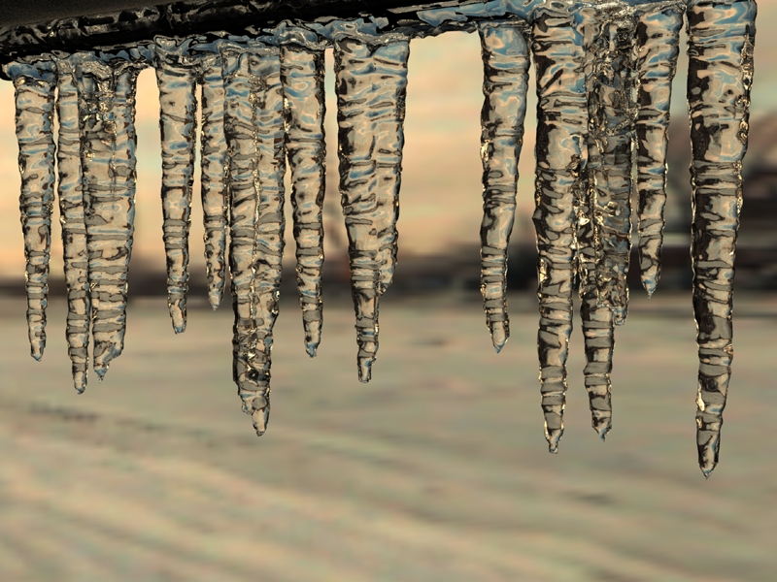
Previous work: Computer Graphics
Kharitonsky et Gonczarowski 1993
Surface tension, tendency of water drop to follow a wet path.
Kim et al. 2006
Stephan problem
Problems
Control
Computation time

Slide 8
Overview
Previous work
Proposed approach
Results
Limitations & Conclusion

Slide 9
Procedural icicle modeling

Slide 10
Procedural icicle modeling

Slide 11
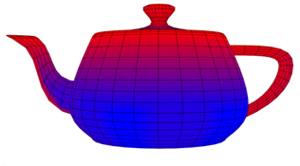
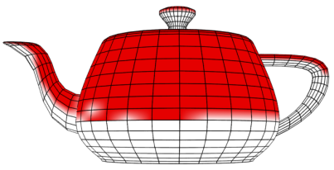
Water Coefficients
Goal
Compute the water flow
Steps
Compute the water supply
Compute the water coefficient

Slide 12
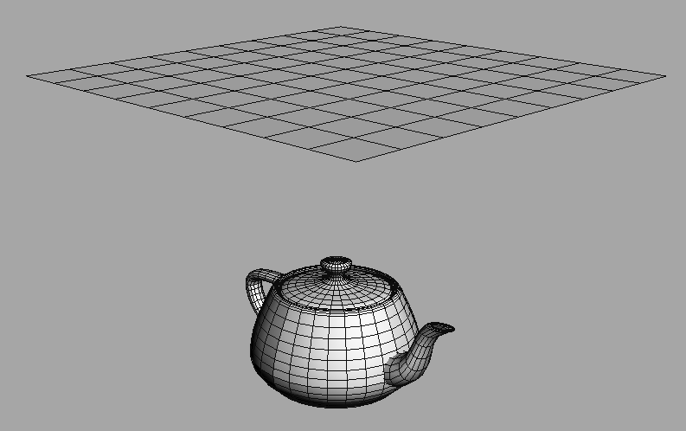
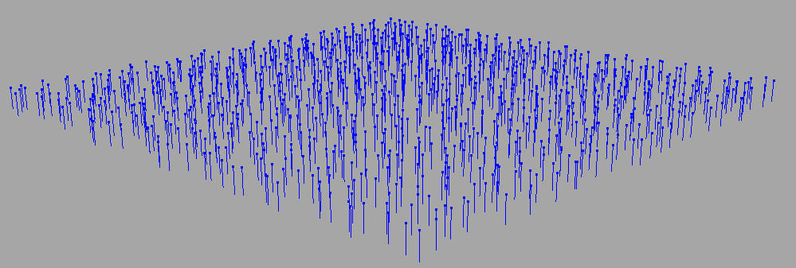
Water Supply
Source surface
Scatter & Ray-trace

Slide 13
Water Supply

Slide 14
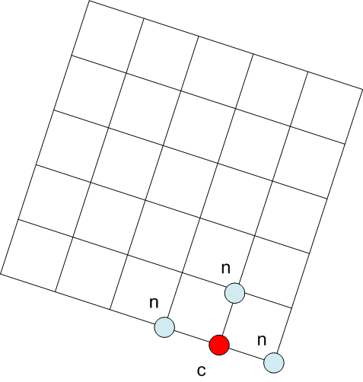
Water Flow
Compute the water coefficient

Slide 15
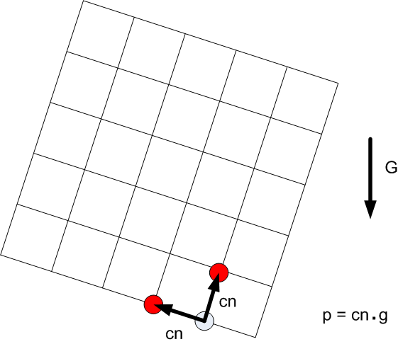
Water Flow
Compute the water coefficient

Slide 16
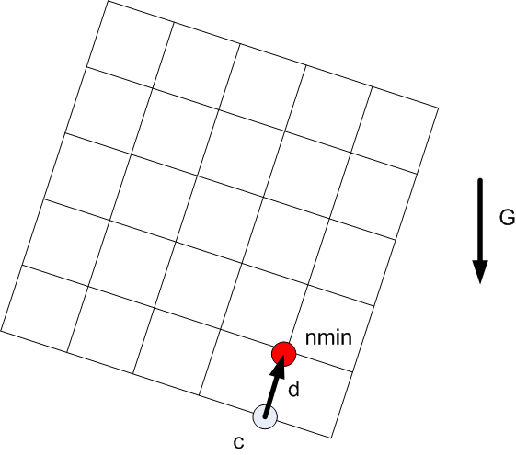
Water Flow
Compute the water coefficient

Slide 17
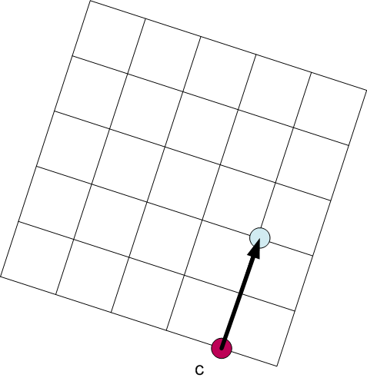
Water Flow
Compute the water coefficient

Slide 18
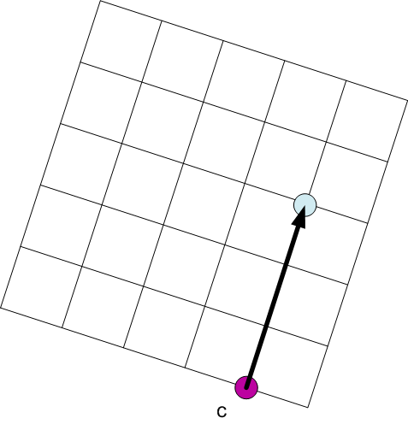
Water Flow
Compute the water coefficient

Slide 19
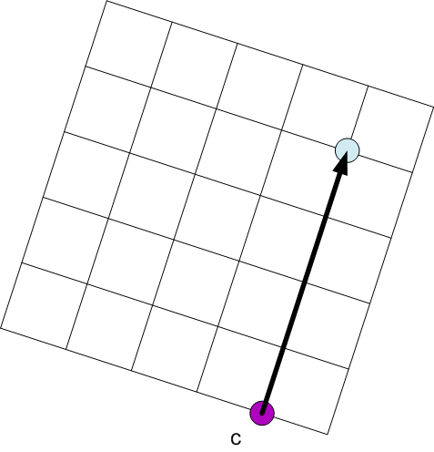
Water Flow
Compute the water coefficient

Slide 20
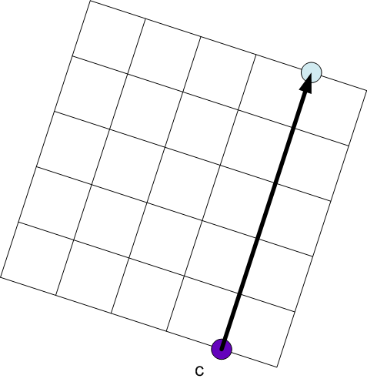
Water Flow
Compute the water coefficient

Slide 21
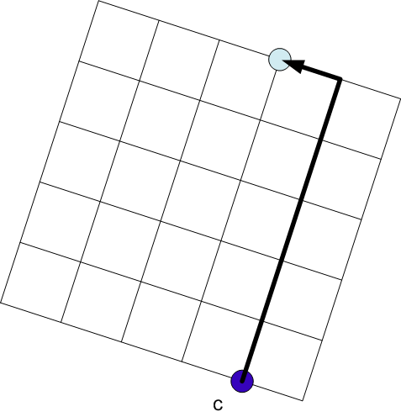
Water Flow
Compute the water coefficient

Slide 22
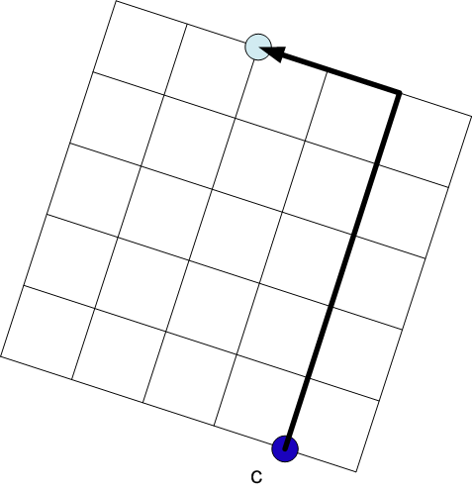
Water Flow
Compute the water coefficient

Slide 23
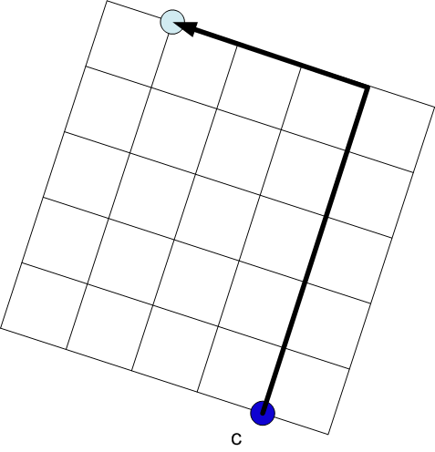
Water Flow
Compute the water coefficient

Slide 24
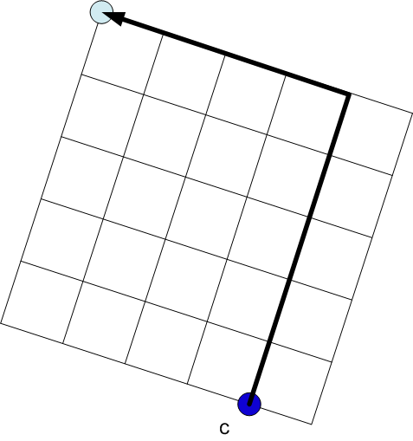
Water Flow
Compute the water coefficient

Slide 26
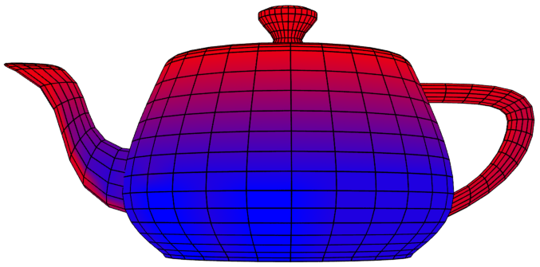
Water Coefficients

Slide 27
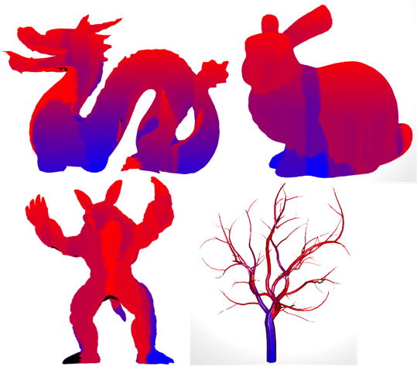
Water Coefficients
Works well with several surfaces

Slide 28
Procedural icicle modeling

Slide 29
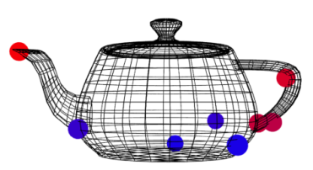
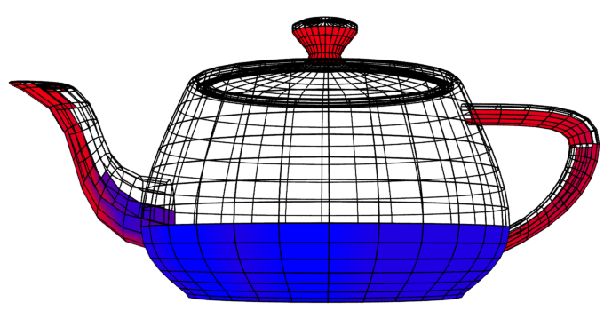
Drip points identification
Goal
Find were the water drips
Steps
Find drip region
Place drip points

Slide 30
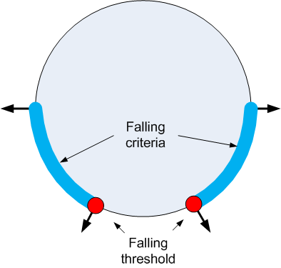
Drip Criterion

Slide 31
Drip region

Slide 32
Drip points
Randomly distributed on the drip region

Slide 33
Procedural icicle modeling

Slide 34
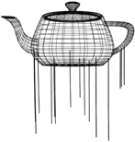
Icicles’ trajectories
Goal
Create a guide for each icicle
Previzualisation
Interactive modification
Simulate different icicle types
Straight
Curved
Divided

Slide 35
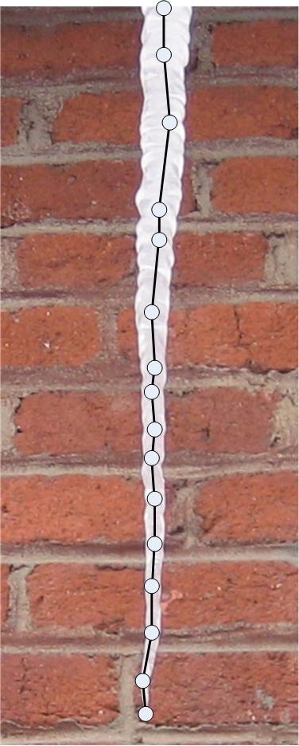
Icicles’ trajectories
L-System

Slide 36
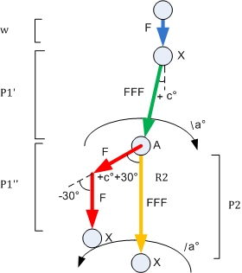
L-System

Slide 37
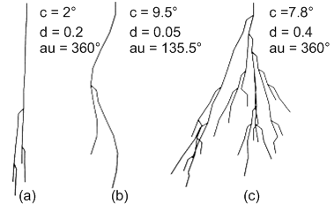
Broad range of results

Slide 38
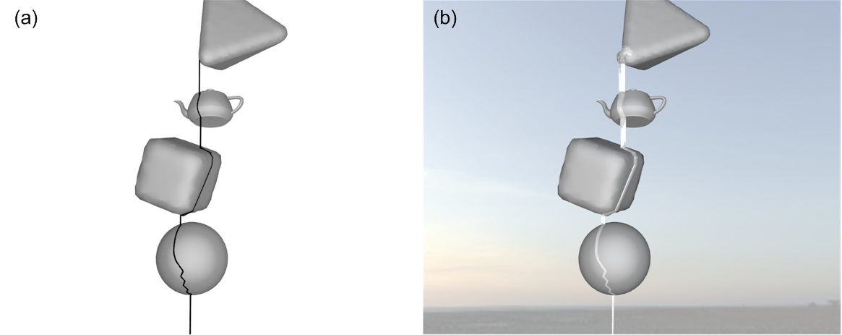
Collision handling

Slide 39
Procedural icicle modeling

Slide 40
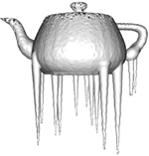
Surface creation
Goal
Create a photorealistic icicle mesh
Provide configurable surface
Manage fusion between icicles
Attach the icicle to the surface

Slide 41
Surface creation
Methodology
Profile function
Icicle’s base function
Glaze ice function

Slide 42
Surface creation
Methodology
Profile function
Icicle’s base function
Glaze ice function

Slide 43
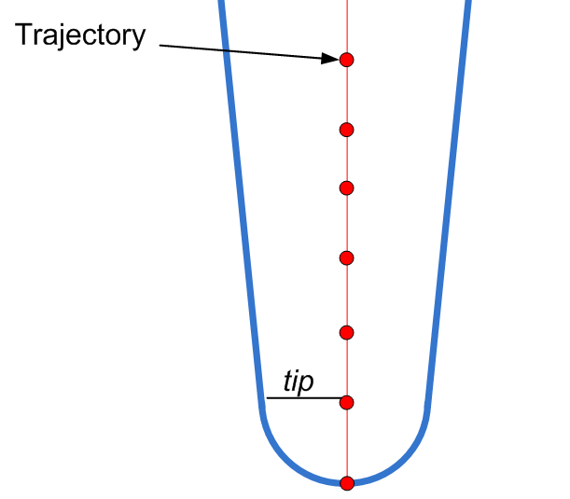
Profile function

Slide 44
Profile function

Slide 45
Profile function
{
{

Slide 46
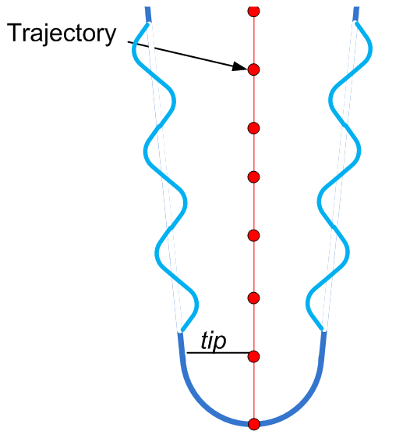
Profile function

Slide 47
Implicit surface modeling
Using metaballs
Radius is defined by the profile function
Positionned along the trajectory

Slide 48
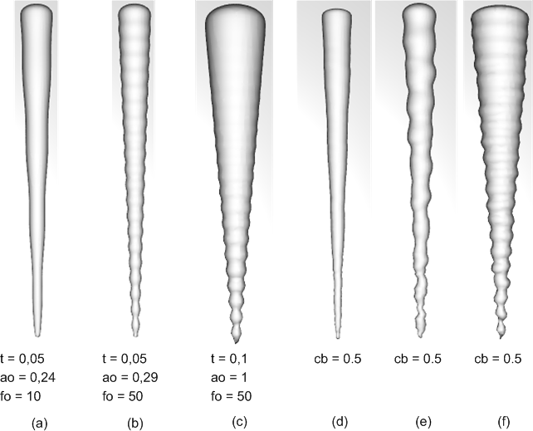
Surface creation: results

Slide 49
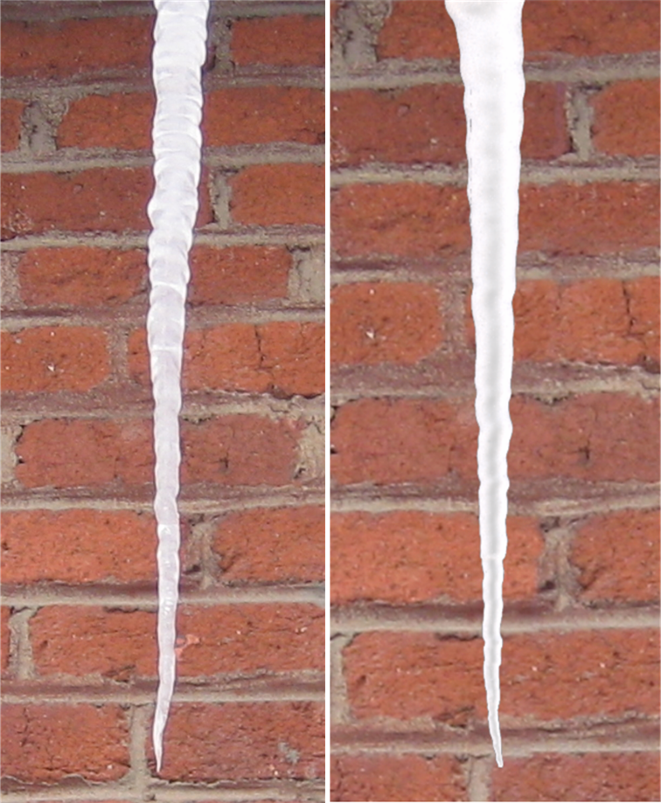
Real vs generated

Slide 50
Surface creation
Methodology
Profile function
Icicle’s base function
Glaze ice function

Slide 51
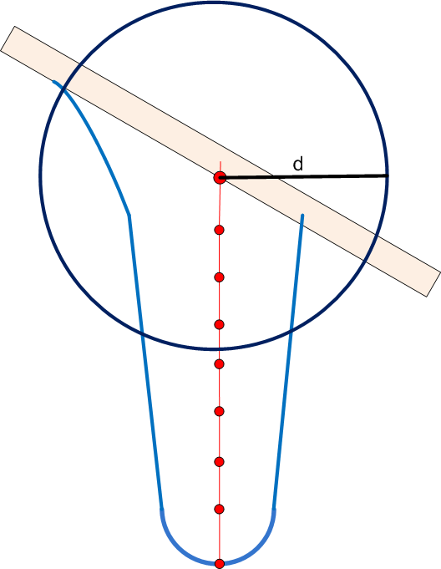
Icicle’s base

Slide 52
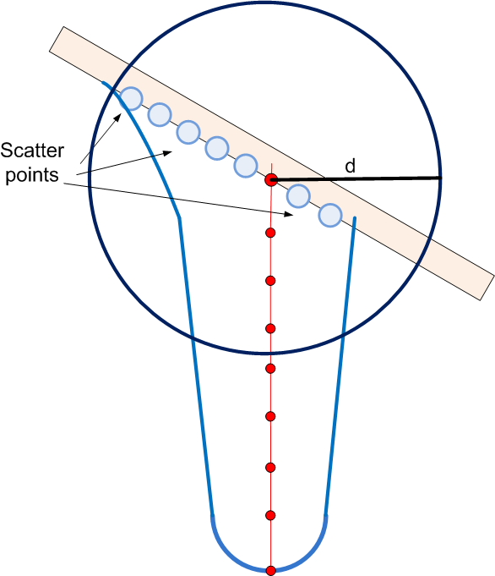
Icicle’s base

Slide 53
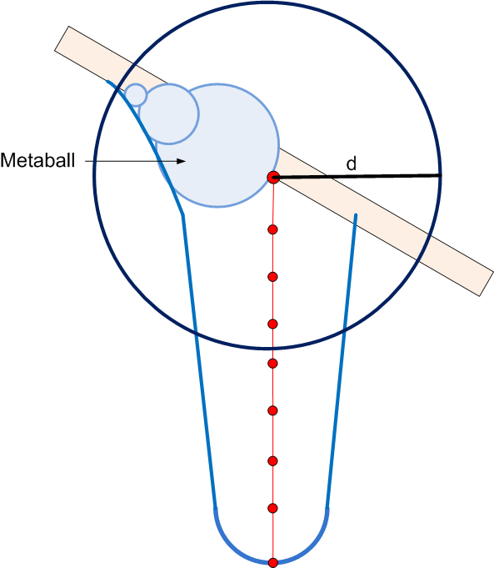
Icicle’s base
Modeled with metaballs
Radius function

Slide 54
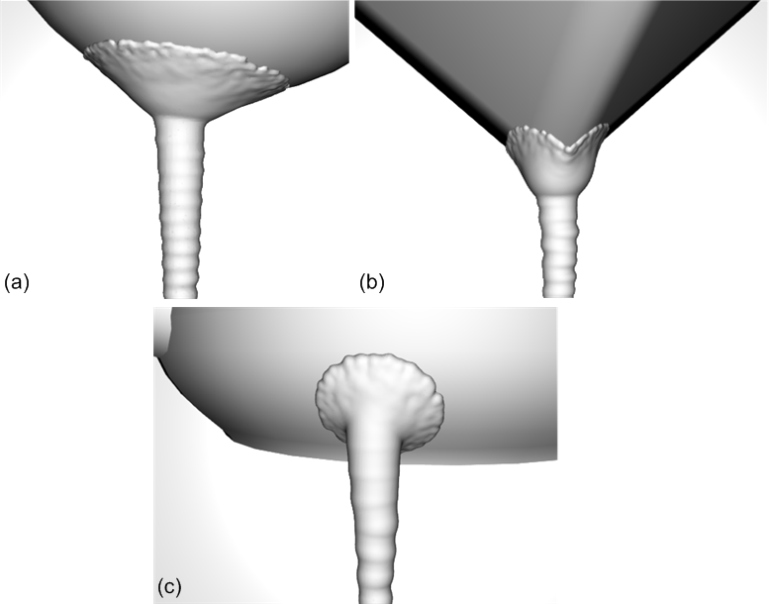
Icicle’s base: Results

Slide 55
Surface creation
Methodology
Profile function
Icicle’s base function
Glaze ice function

Slide 56
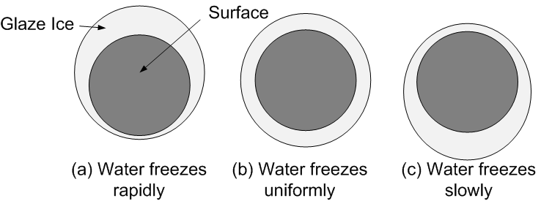
Glaze ice
Three type of solidification

Slide 57
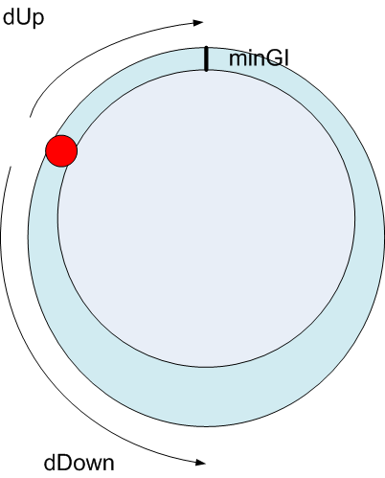
Glaze ice

Slide 58
Glaze ice: Results

Slide 59
Overview
Previous work
Proposed approach
Results
Limitations & Conclusion

Slide 60
Results
Video

Slide 61
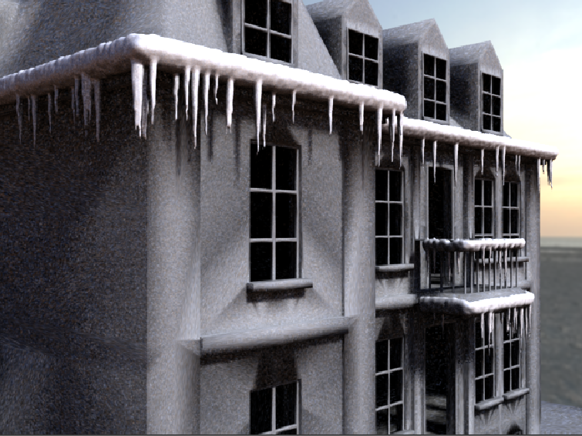
L. Leblanc, J. Houle and P. Poulin Modeling with Blocks, CGI 2011.

Slide 62
Results statistics
Figures | Teapot | Fountain | Buddha | Bunny | Armadillo | Dragon | Tree
Number of icicles | 12 | 300 | 10 | 20 | 200 | 200 | 400
Computation times (seconds)
Water coefficients | 0.1 | 0.1 | 0.5 | 0.3 | 5 | 0.4 | 0.3
Drip points | 0.1 | 0.5 | 0.2 | 0.1 | 0.5 | 0.5 | 0.5
Trajectories | 0.1 | 0.2 | 0.1 | 0.2 | 0.5 | 0.5 | 1
Surface modeling | 11 | 55 | 60 | 20 | 116 | 19.5 | 36
Total time | 11.3 | 55.8 | 60.8 | 20.6 | 122 | 20.9 | 37.8

Slide 63
Overview
Previous work
Proposed approach
Results
Limitations & Conclusion

Slide 64
Limitations
Not physically accurate
Implicit surface modeling is slow
Rendering is slow

Slide 65
Conclusion
Control
L-System to generate several icicle types
Functions for ice thickness
Interactivity
Computation rearranged in four phases
Fast computation of flow and trajectories

Slide 66
Questions

Slide 67
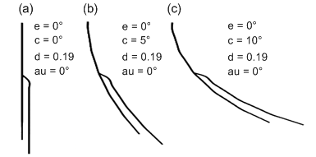
Curvature angle c

Slide 68
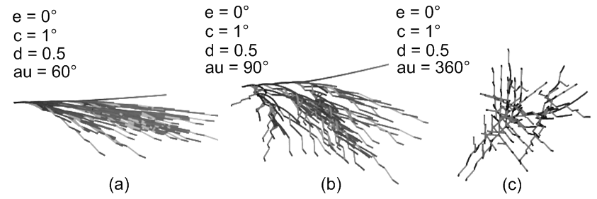
Dispersion angle au
a = au x 137.5˚/360 ˚

