Slide 1



Real-Time Virtual Pipes Simulation and Modeling for Small-Scale Shallow Water
François Dagenais, Julián Guzmán, Valentin Vervondel, Alexander Hay, Sébastien Delorme, David Mould, and Eric Paquette
VRIPHYS 2018

Slide 2
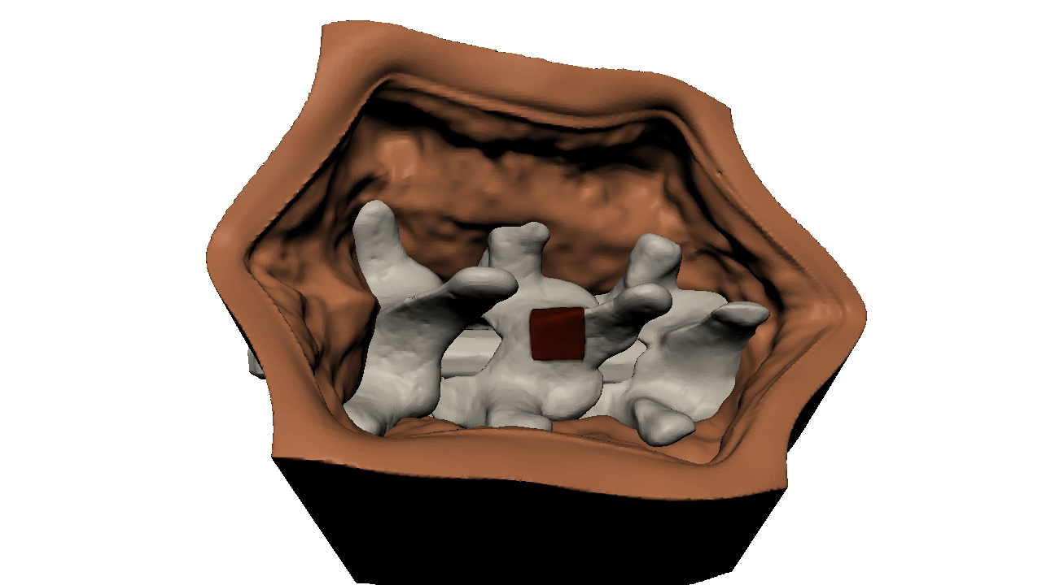
Real-Time Fluid Simulation

Slide 3
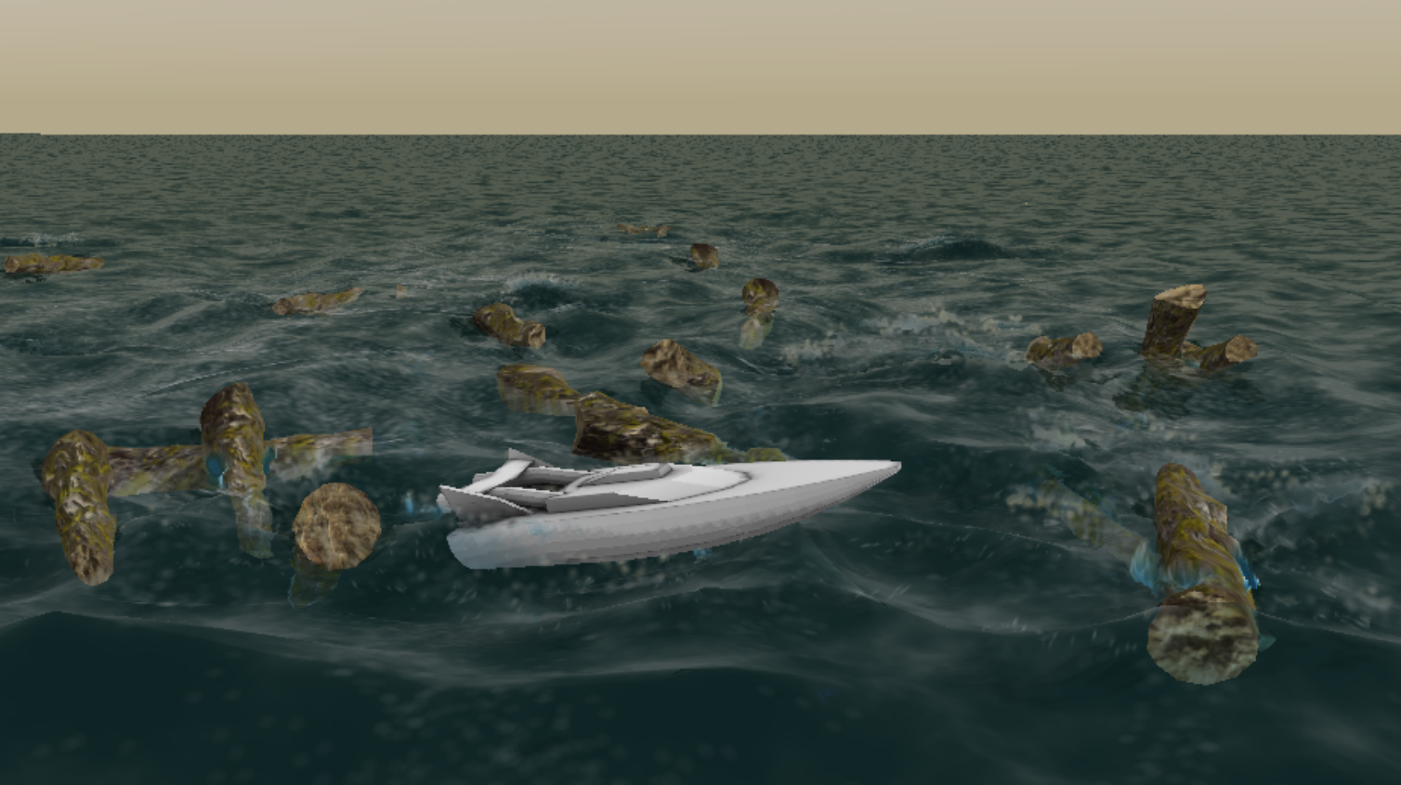
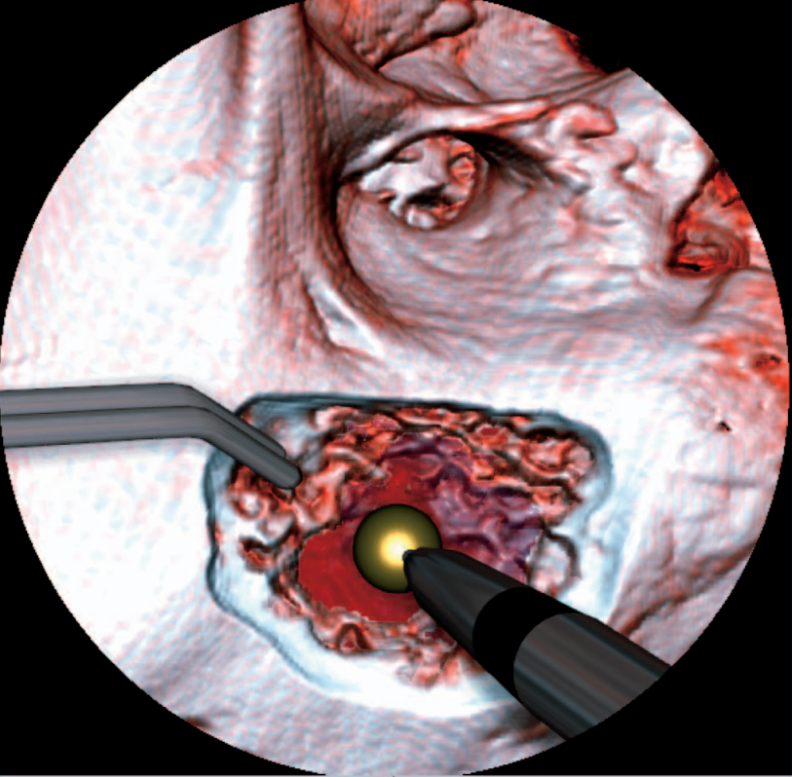
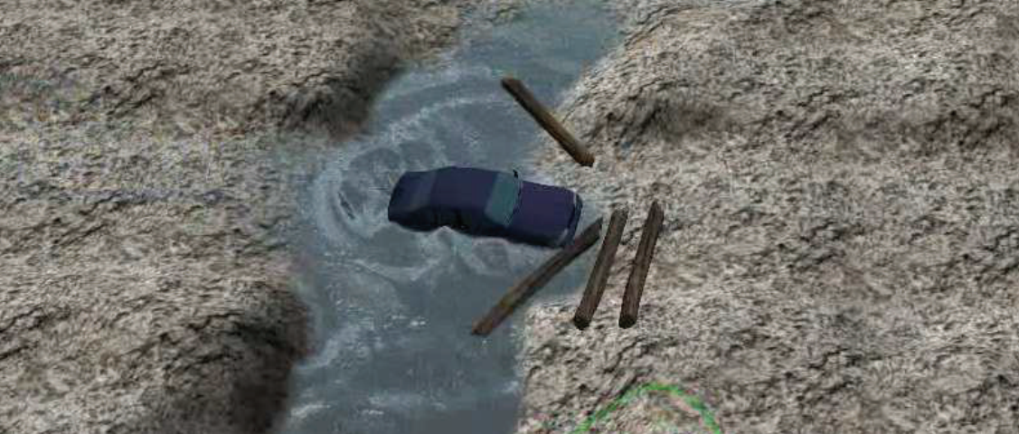
Related Work
Heightmap simulation methods
Shallow Water [CM10]
  Much slower than virtual pipes
2D Navier-Stokes [KSS09]
  Lack of liquid depth information
Virtual Pipes [MDH07; vBBK08; BMPG11; Kel14]
[CM10]
[KSS09]
[Kel14]

Slide 4
Related Work-Comparison & Contributions
 | [MDH07] | [vBBK08] | [KSS09] | [CM10] | [BMPG11] | [Kel14] | Ours
Viscosity | No | No | No | No | No | No
Multi-layer | No | No | No | No
Flow in passages | No | No | No | No
Meniscus shading | No | No |  | No | No | No
Surface optimization | No | No | No |  | No

Slide 5
Related Work-Comparison & Contributions
 | [MDH07] | [vBBK08] | [KSS09] | [CM10] | [BMPG11] | [Kel14] | Ours
Viscosity | No | No | No | No | No | No | Physically- based
Multi-layer | No | No | No | No
Flow in passages | No | No | No | No
Meniscus shading | No | No |  | No | No | No
Surface optimization | No | No | No |  | No

Slide 6
Related Work-Comparison & Contributions
 | [MDH07] | [vBBK08] | [KSS09] | [CM10] | [BMPG11] | [Kel14] | Ours
Viscosity | No | No | No | No | No | No | Physically- based
Multi-layer | No | No | No | No | Yes | Yes | Yes
Flow in passages | No | No | No | No | Blocked if full | Blocked if full | Axis aligned
Meniscus shading | No | No |  | No | No | No
Surface optimization | No | No | No |  | No

Slide 7
Related Work-Comparison & Contributions
 | [MDH07] | [vBBK08] | [KSS09] | [CM10] | [BMPG11] | [Kel14] | Ours
Viscosity | No | No | No | No | No | No | Physically- based
Multi-layer | No | No | No | No | Yes | Yes | Yes
Flow in passages | No | No | No | No | Blocked if full | Blocked if full | Axis aligned
Meniscus shading | No | No | Limited | No | No | No | Yes
Surface optimization | No | No | No |  | No

Slide 8
Related Work-Comparison & Contributions
 | [MDH07] | [vBBK08] | [KSS09] | [CM10] | [BMPG11] | [Kel14] | Ours
Viscosity | No | No | No | No | No | No | Physically- based
Multi-layer | No | No | No | No | Yes | Yes | Yes
Flow in passages | No | No | No | No | Blocked if full | Blocked if full | Axis aligned
Meniscus shading | No | No | Limited | No | No | No | Yes
Surface optimization | No | No | No | Limited | No | Limited | Yes

Slide 9
Overview
Virtual pipes
Viscosity model
Extended pipes
Surface
  Creation
  Optimization
Meniscus
Discussion

Slide 10
Virtual Pipes

Slide 11
Virtual Pipes

Slide 12
Virtual Pipes

Slide 13
Virtual Pipes
Typical simulation loop:
Update liquid fluxes
Scale liquid fluxes
Update liquid heights
Source liquid in the simulation

Slide 14
Virtual Pipes
Our simulation loop:
Update extended pipes connections
Update liquid fluxes
Apply viscosity
Scale liquid fluxes
Update liquid heights
Source liquid in the simulation

Slide 15
Overview
Virtual pipes
Viscosity model
Extended pipes
Surface
  Creation
  Optimization
Meniscus
Discussion

Slide 16
Viscosity

Slide 17
Viscosity
Close to the boundary between the liquid and terrain
  Interaction with the terrain slows down the liquid
Shear stress
force

Slide 18
Viscosity
Close to the boundary between the liquid and terrain
  Interaction with the terrain slows down the liquid
Shear viscous
force
Shear stress
force

Slide 19
Velocity - Virtual Pipes
Velocity is the same at all depths
u_{i,j}
u_{j,k}
u_{k,l}
u_{l,m}

Slide 20
Viscosity - Our varying velocity
Velocity as a function of depth
Varies
vertically
u^{p}_{i,j}(z)

Slide 21
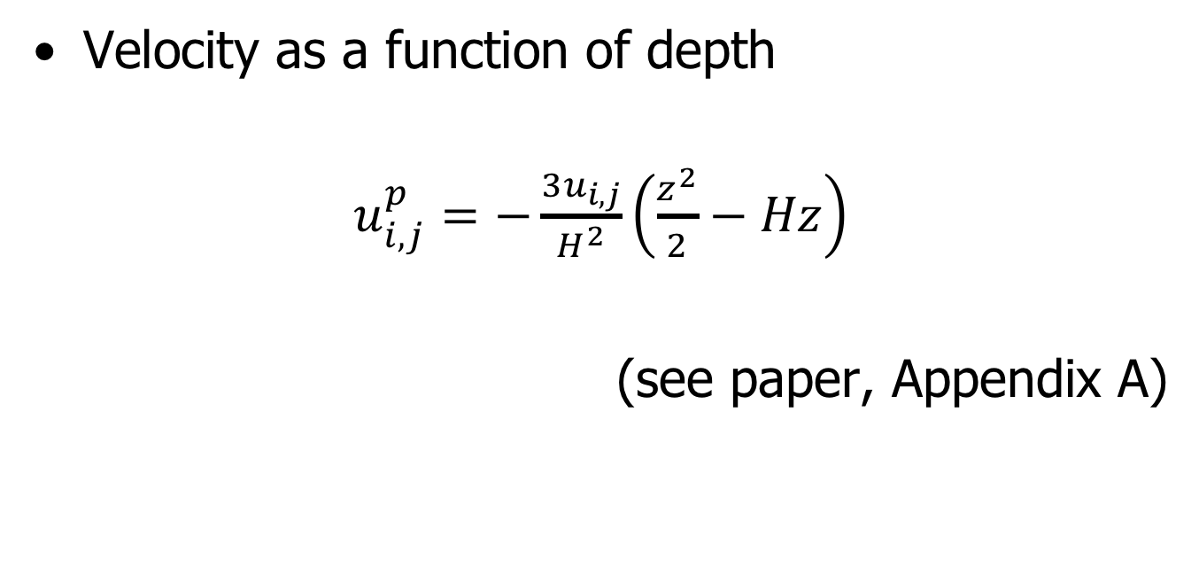
Viscosity - Our varying velocity
Velocity as a function of depth
$u_{i,j}^{p}=−\frac{{3u}_{i,j}}{H^{2}}\left(\frac{z^{2}}{2}−Hz\right)$
(see paper, Appendix A)

Slide 22
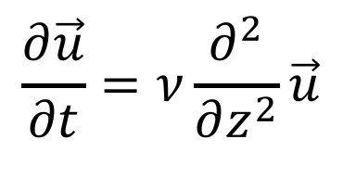
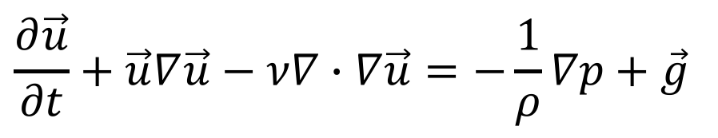
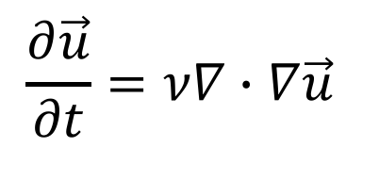
Viscosity - Velocity update (App. B)
$$\frac{∂\vec{u}}{∂t}+\vec{u}∇\vec{u}−ν∇∙∇\vec{u}=−\frac{1}{ρ}∇p+\vec{g}$$
Navier-Stokes
$$\frac{∂\vec{u}}{∂t}=ν∇∙∇\vec{u}$$
Hypothesis
$$\frac{∂\vec{u}}{∂t}=ν\frac{∂^{2}}{∂z^{2}}\vec{u}$$
Notes:
UPDATED

Slide 23
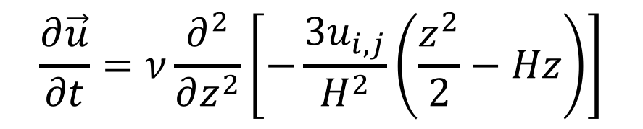


Viscosity - Velocity update (App. B)
$$u_{i,j}^{p}$$
$$\frac{∂\vec{u}}{∂t}=ν\frac{∂^{2}}{∂z^{2}}\left[−\frac{{3u}_{i,j}}{H^{2}}\left(\frac{z^{2}}{2}−Hz\right)\right]$$
$$\frac{∂\vec{u}}{∂t}=ν\frac{∂^{2}}{∂z^{2}}\vec{u}$$
$$\frac{∂\vec{u}}{∂t}=−ν\frac{{3u}_{i,j}}{H^{2}}$$
Notes:
UPDATED

Slide 24
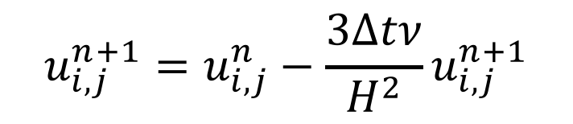
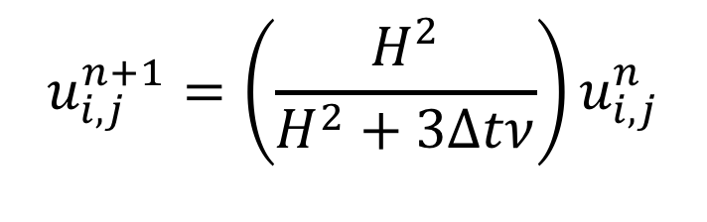
Viscosity - Velocity update (App. B)
$$u_{i,j}^{n+1}=u_{i,j}^{n}−\frac{3∆tν}{H^{2}}u_{i,j}^{n+1}$$
Implicit
integration
$$u_{i,j}^{n+1}=\left(\frac{H^{2}}{H^{2}+3∆tν}\right)u_{i,j}^{n}$$
$$\frac{∂\vec{u}}{∂t}=−ν\frac{{3u}_{i,j}}{H^{2}}$$

Slide 25
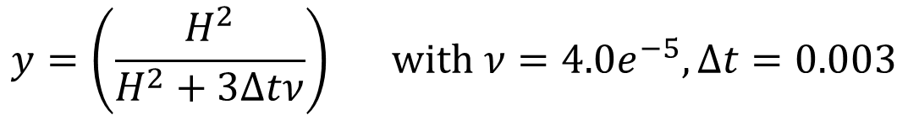
Viscosity - Effect of height (H)
$$y=\left(\frac{H^{2}}{H^{2}+3∆tν}\right) with ν={4.0e}^{−5},∆t=0.003$$
H

Slide 26

Viscosity - Effect of viscosity ($ν$)
$$y=\left(\frac{H^{2}}{H^{2}+3∆tν}\right) with H=0.001,∆t=0.003$$
$$ν$$

Slide 27
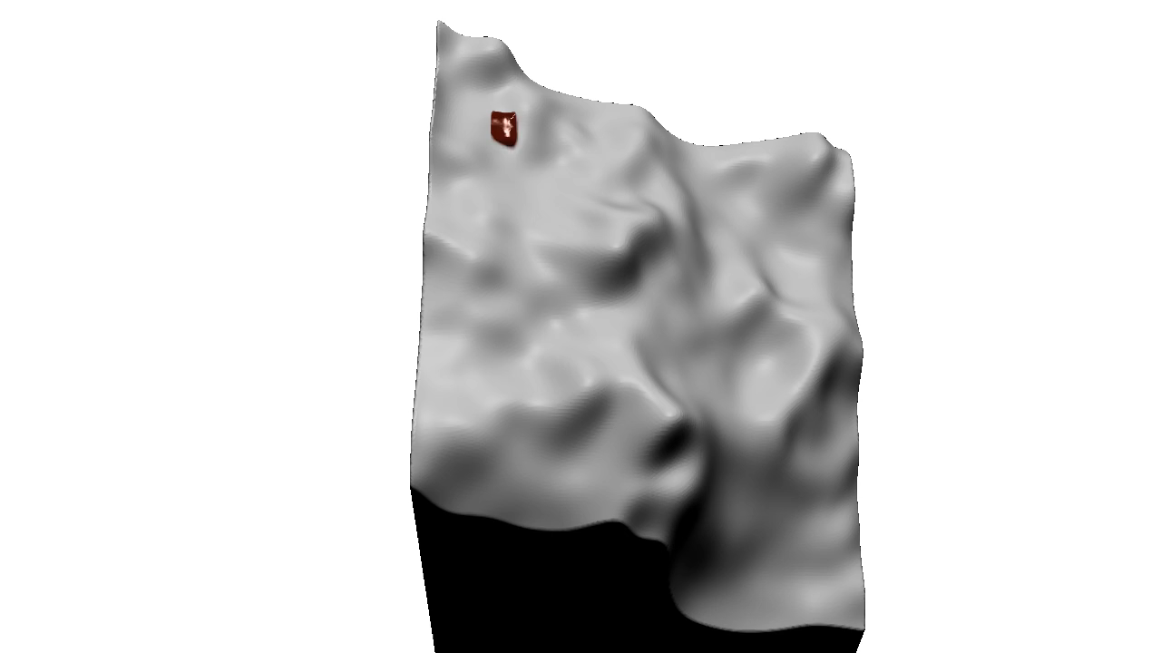



Viscosity - Results
ν = 0 m²/s
ν = 4.0E-6 m²/s
ν = 4.0E-5 m²/s
ν = 4.0E-1 m²/s
Notes:
NOTE: nu = kinematic viscosity

Slide 28
Overview
Virtual pipes
Viscosity model
Extended pipes
Surface
  Creation
  Optimization
Meniscus
Discussion

Slide 29
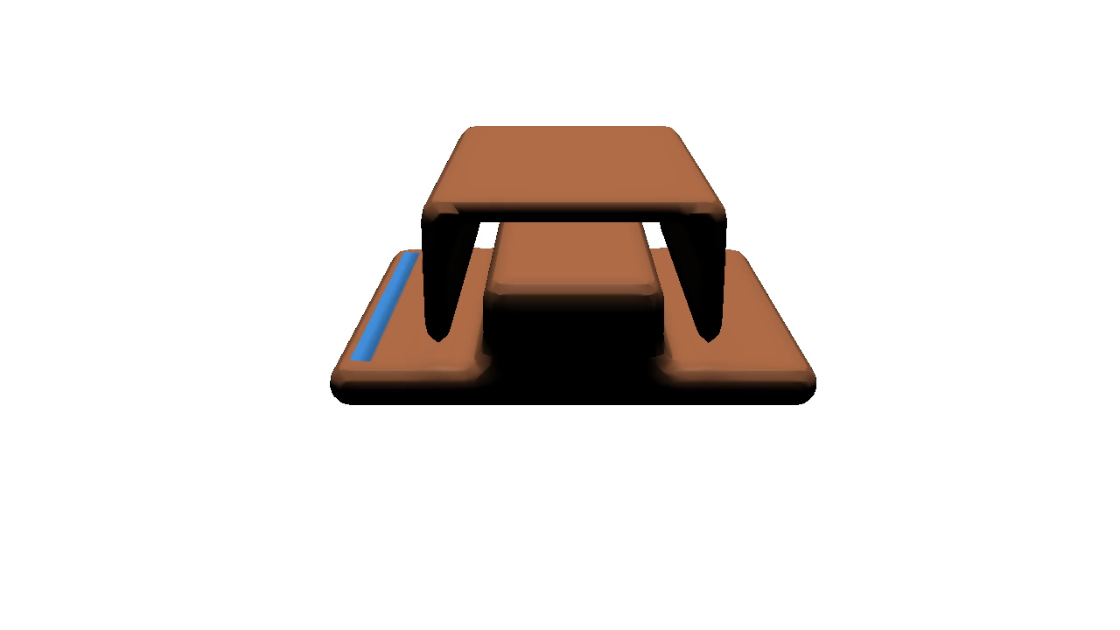
Virtual Pipes - Problem with “Passages”

Slide 30
Virtual Pipes - Problem with “Passages”

Slide 31
Virtual Pipes - Problem with “Passages”

Slide 32
Virtual Pipes - Problem with “Passages”

Slide 33
Virtual Pipes – Extended Pipes

Slide 34
Virtual Pipes – Extended Pipes

Slide 35
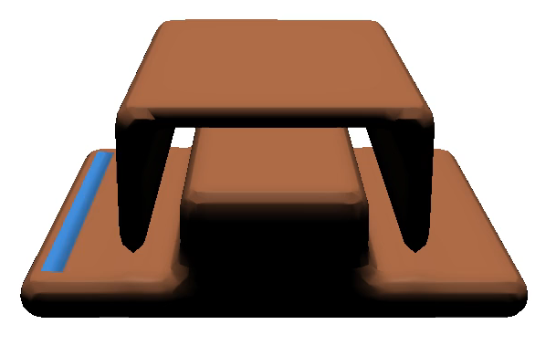
Extended Pipes – Results
Without Extended Pipes
Ours: With Extended Pipes

Slide 36
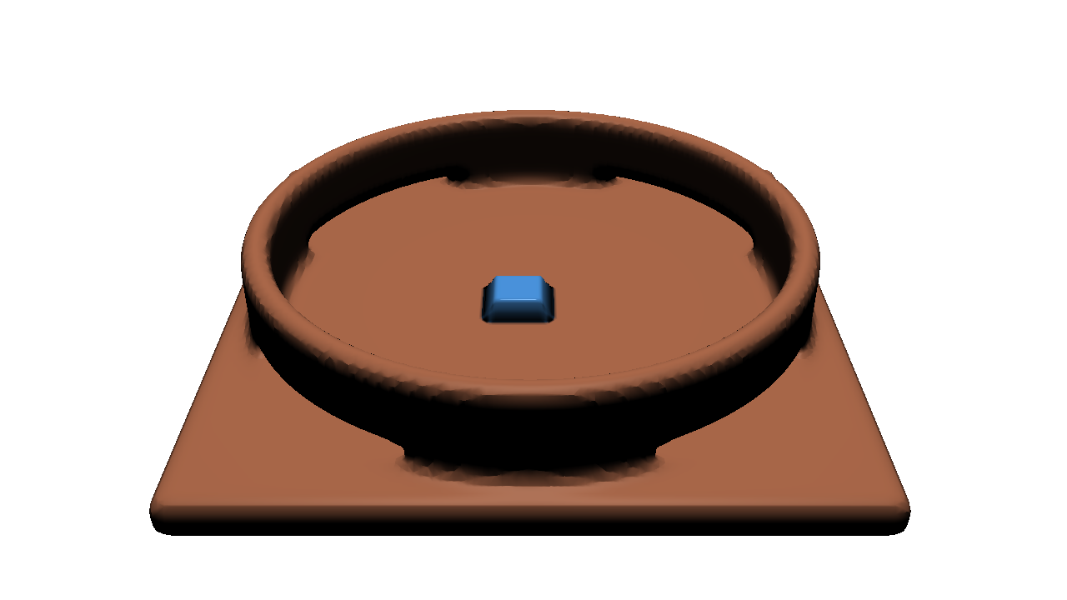
Extended Pipes - Results

Slide 37

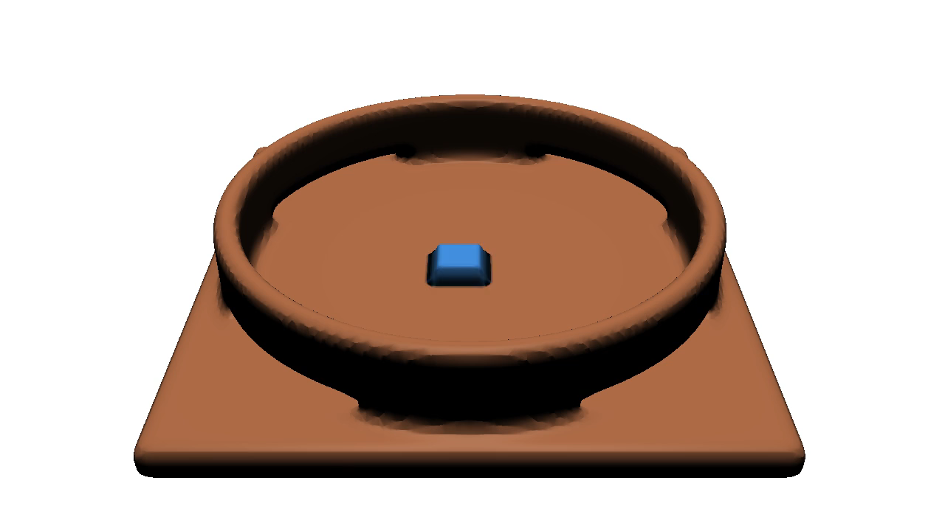
Extended Pipes - Results
Without Extended Pipes
Ours: With Extended Pipes

Slide 38
Overview
Virtual pipes
Viscosity model
Extended pipes
Surface
  Creation
  Optimization
Meniscus
Discussion

Slide 39
Multi-Layer Surface Linking

Slide 40
Multi-Layer Surface Linking

Slide 41
Multi-Layer Surface Linking
i

Slide 42
Multi-Layer Surface Linking
i
j

Slide 43
Multi-Layer Surface Linking
max_{j}
i
j
min_{j}

Slide 44
Multi-Layer Surface Linking
max_{j}
h_{i}
i
j
min_{j}

Slide 45
Multi-Layer Surface Linking
max_{j}
max_{i}
h_{j}
h_{i}
i
j
min_{i}
min_{j}

Slide 46
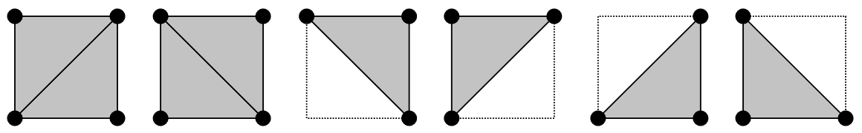
Columns to Triangles

Slide 47
Overview
Virtual pipes
Viscosity model
Extended pipes
Surface
  Creation
  Optimization
Meniscus
Discussion

Slide 48
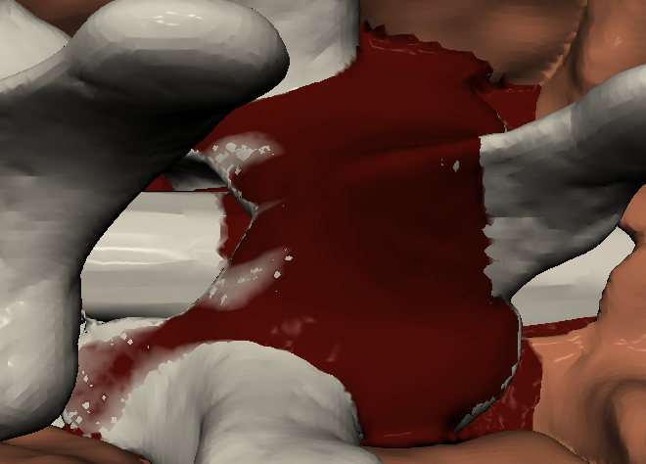
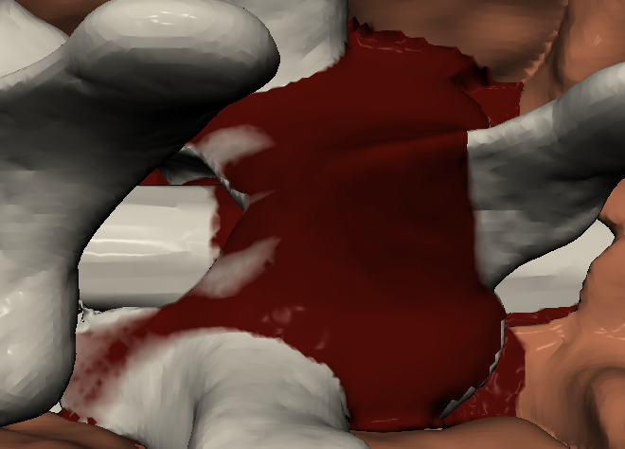
Solid-Liquid Interpenetrations

Slide 49
Solid-Liquid Interpenetrations
With surface optimization

Slide 50
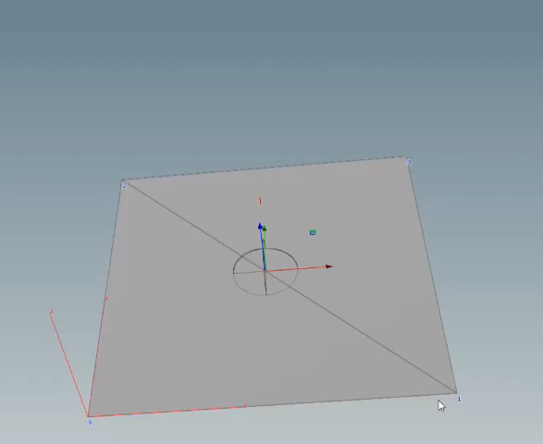
Surface Optimization

Slide 51

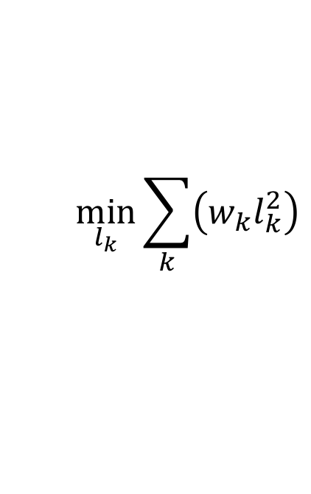
Surface Optimization
$$\min_{l_{k}}{\sum_{k}{\left(w_{k}l_{k}^{2}\right)}}$$
$$h_{v}+ε=bilinear\left(b_{k}+l_{k}\right)$$

Slide 52
Overview
Virtual pipes
Viscosity model
Extended pipes
Surface
  Creation
  Optimization
Meniscus
Discussion

Slide 53
Meniscus – Contact Angle

Slide 54
Meniscus - Bump Mapping

Slide 55
Meniscus - Bump Mapping

Slide 56
Meniscus - Bump Mapping

Slide 57
Meniscus - Normal Correction

Slide 58
Meniscus - Normal Correction
From contact angle α

Slide 59
Meniscus - Normal Correction
From contact angle α and terrain slope β

Slide 60
Meniscus - Normal Correction
From contact angle α and terrain slope β
Calculate tilt angle ψ

Slide 61
Meniscus - Normal Correction
From contact angle α and terrain slope β
Calculate tilt angle ψ
Tilt the normal

Slide 62
Meniscus - Normal Correction
From contact angle α and terrain slope β
Calculate tilt angle ψ
Tilt the normal
Interpolate the rotation

Slide 63
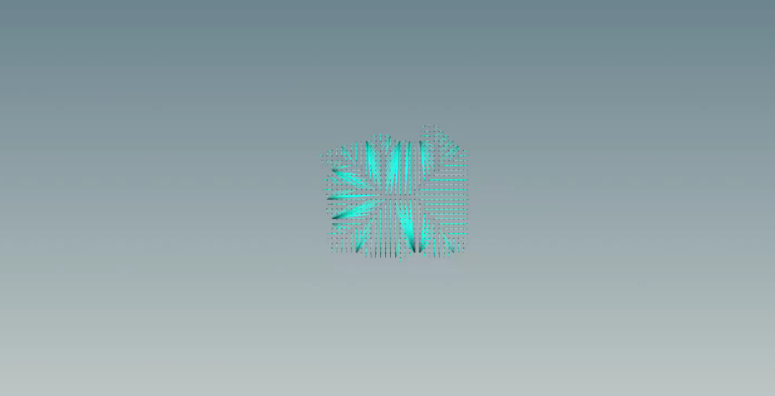
Meniscus - Normal Correction
For each wet column
  Distance to boundary
  Direction to boundary
  Terrain slope estimate

Slide 64
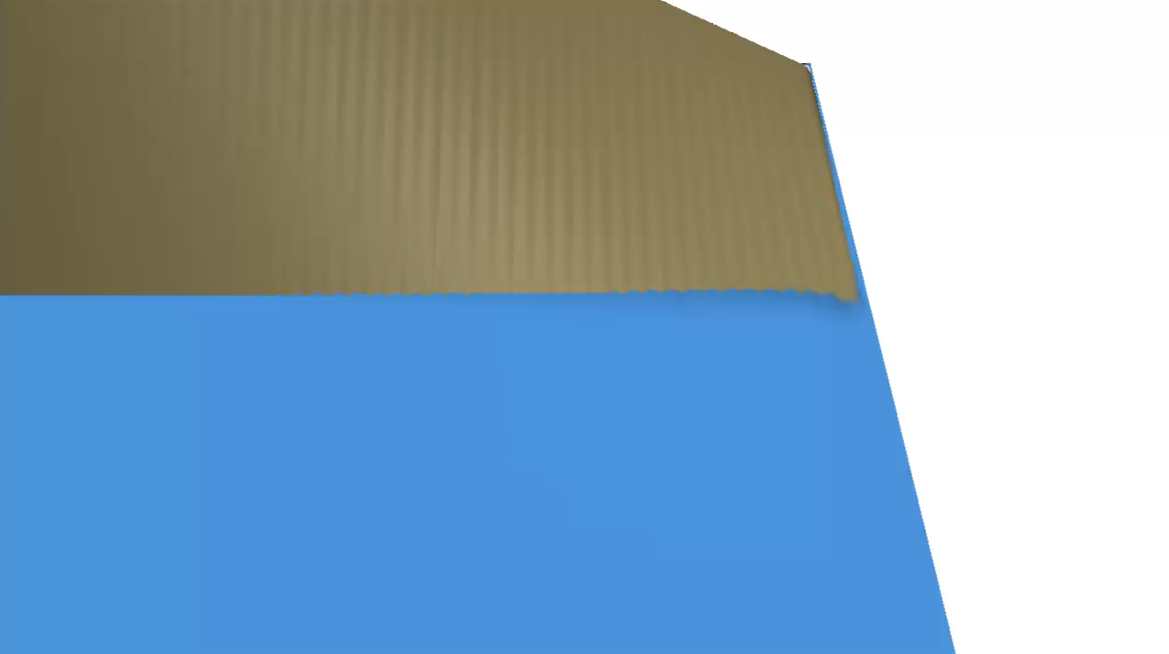
Meniscus - Convex, None, Concave
Concave Meniscus
Convex Meniscus
No Meniscus
Notes:
Add the part of the video where we show the different types of meniscus

Slide 65
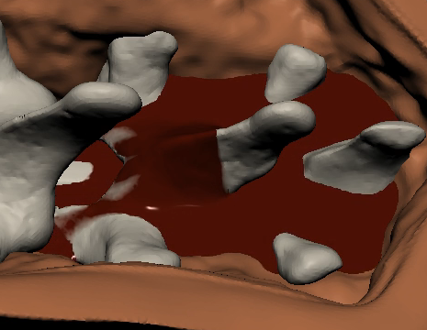

Meniscus
Without Meniscus
Ours: With Meniscus

Slide 66
Overview
Virtual pipes
Viscosity model
Extended pipes
Surface
  Creation
  Optimization
Meniscus
Discussion

Slide 67
Results
Example | Resolution (NxNxLayers) | Δt (ms) | ν (m²/s) | Simulation Avg. (ms) | Surface Avg. (ms) | Render Avg. (ms) | Total Avg./Max (ms)
Surgery | 200 x 200 x 5 | 3.0 | 4.0E-6 | 4.86 | 1.10 | 0.34 | 6.30/7.04
Viscosity | 200 x 200 x 1 | 3.0 | 0 | 0.61 | 0.43 | 0.16 | 1.21/1.63
Viscosity | 200 x 200 x 1 | 3.0 | 4.0E-6 | 0.62 | 0.46 | 0.16 | 1.22/1.63
Viscosity | 200 x 200 x 1 | 3.0 | 4.0E-5 | 0.60 | 0.44 | 0.16 | 1.21/2.41
Viscosity | 200 x 200 x 1 | 3.0 | 4.0E-1 | 0.60 | 0.41 | 0.16 | 1.20/2.40
Three layers | 100 x 100 x 3 | 9.0 | 4.0E-6 | 0.32 | 0.37 | 0.17 | 0.86/1.53
Passages | 100 x 100 x 3 | 9.0 | 4.0E-6 | 0.26 | 0.34 | 0.15 | 0.78/2.36

Slide 68
Results
Example | Resolution (NxNxLayers) | Δt (ms) | ν (m²/s) | Simulation Avg. (ms) | Surface Avg. (ms) | Render Avg. (ms) | Total Avg./Max (ms)
Surgery | 200 x 200 x 5 | 3.0 | 4.0E-6 | 4.86 | 1.10 | 0.34 | 6.30/7.04
Viscosity | 200 x 200 x 1 | 3.0 | 0 | 0.61 | 0.43 | 0.16 | 1.21/1.63
Viscosity | 200 x 200 x 1 | 3.0 | 4.0E-6 | 0.62 | 0.46 | 0.16 | 1.22/1.63
Viscosity | 200 x 200 x 1 | 3.0 | 4.0E-5 | 0.60 | 0.44 | 0.16 | 1.21/2.41
Viscosity | 200 x 200 x 1 | 3.0 | 4.0E-1 | 0.60 | 0.41 | 0.16 | 1.20/2.40
Three layers | 100 x 100 x 3 | 9.0 | 4.0E-6 | 0.32 | 0.37 | 0.17 | 0.86/1.53
Passages | 100 x 100 x 3 | 9.0 | 4.0E-6 | 0.26 | 0.34 | 0.15 | 0.78/2.36
Timestep and computation time independent of viscosity
Notes:
Viscosity does not affect timestep nor computation times

Slide 69
Results
Example | Resolution (NxNxLayers) | Δt (ms) | ν (m²/s) | Simulation Avg. (ms) | Surface Avg. (ms) | Render Avg. (ms) | Total Avg./Max (ms)
Surgery | 200 x 200 x 5 | 3.0 | 4.0E-6 | 4.86 | 1.10 | 0.34 | 6.30/7.04
Viscosity | 200 x 200 x 1 | 3.0 | 0 | 0.61 | 0.43 | 0.16 | 1.21/1.63
Viscosity | 200 x 200 x 1 | 3.0 | 4.0E-6 | 0.62 | 0.46 | 0.16 | 1.22/1.63
Viscosity | 200 x 200 x 1 | 3.0 | 4.0E-5 | 0.60 | 0.44 | 0.16 | 1.21/2.41
Viscosity | 200 x 200 x 1 | 3.0 | 4.0E-1 | 0.60 | 0.41 | 0.16 | 1.20/2.40
Three layers | 100 x 100 x 3 | 9.0 | 4.0E-6 | 0.32 | 0.37 | 0.17 | 0.86/1.53
Passages | 100 x 100 x 3 | 9.0 | 4.0E-6 | 0.26 | 0.34 | 0.15 | 0.78/2.36
Simulation is the most time consuming step
Notes:
Most time consuming: Simulation

Slide 70
Results
Example | Resolution (NxNxLayers) | Δt (ms) | ν (m²/s) | Simulation Avg. (ms) | Surface Avg. (ms) | Render Avg. (ms) | Total Avg./Max (ms)
Surgery | 200 x 200 x 5 | 3.0 | 4.0E-6 | 4.86 | 1.10 | 0.34 | 6.30/7.04
Viscosity | 200 x 200 x 1 | 3.0 | 0 | 0.61 | 0.43 | 0.16 | 1.21/1.63
Viscosity | 200 x 200 x 1 | 3.0 | 4.0E-6 | 0.62 | 0.46 | 0.16 | 1.22/1.63
Viscosity | 200 x 200 x 1 | 3.0 | 4.0E-5 | 0.60 | 0.44 | 0.16 | 1.21/2.41
Viscosity | 200 x 200 x 1 | 3.0 | 4.0E-1 | 0.60 | 0.41 | 0.16 | 1.20/2.40
Three layers | 100 x 100 x 3 | 9.0 | 4.0E-6 | 0.32 | 0.37 | 0.17 | 0.86/1.53
Passages | 100 x 100 x 3 | 9.0 | 4.0E-6 | 0.26 | 0.34 | 0.15 | 0.78/2.36
Average and maximal time are similar and much less than 16 ms
Notes:
Avg/Max are close, and much lower than 16.6666

Slide 71
Results
Example | Resolution (NxNxLayers) | Δt (ms) | ν (m²/s) | Simulation Avg. (ms) | Surface Avg. (ms) | Render Avg. (ms) | Total Avg./Max (ms)
Surgery | 200 x 200 x 5 | 3.0 | 4.0E-6 | 4.86 | 1.10 | 0.34 | 6.30/7.04
Viscosity | 200 x 200 x 1 | 3.0 | 0 | 0.61 | 0.43 | 0.16 | 1.21/1.63
Viscosity | 200 x 200 x 1 | 3.0 | 4.0E-6 | 0.62 | 0.46 | 0.16 | 1.22/1.63
Viscosity | 200 x 200 x 1 | 3.0 | 4.0E-5 | 0.60 | 0.44 | 0.16 | 1.21/2.41
Viscosity | 200 x 200 x 1 | 3.0 | 4.0E-1 | 0.60 | 0.41 | 0.16 | 1.20/2.40
Three layers | 100 x 100 x 3 | 9.0 | 4.0E-6 | 0.32 | 0.37 | 0.17 | 0.86/1.53
Passages | 100 x 100 x 3 | 9.0 | 4.0E-6 | 0.26 | 0.34 | 0.15 | 0.78/2.36
CFL Condition: Timestep related to resolution
Notes:
Timestep inversely proportional to the resolution

Slide 72
Timestep - CFL Condition

Slide 73
Computation Time vs. Resolution

Slide 74
Applicablability of the approach
Contributions are amenable to other simulations models
  Viscosity model
  Surface creation and optimization
  Meniscus rendering

Slide 75
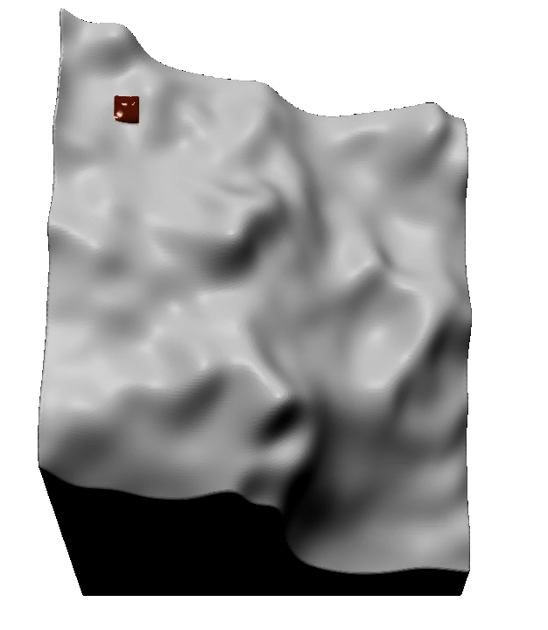


Viscosity comparison - VP vs. SWE [CM10]
VP
SWE
ν = 4.0E-5 m²/s
ν = 4.0E-6 m²/s
ν = 4.0E-1 m²/s

Slide 76
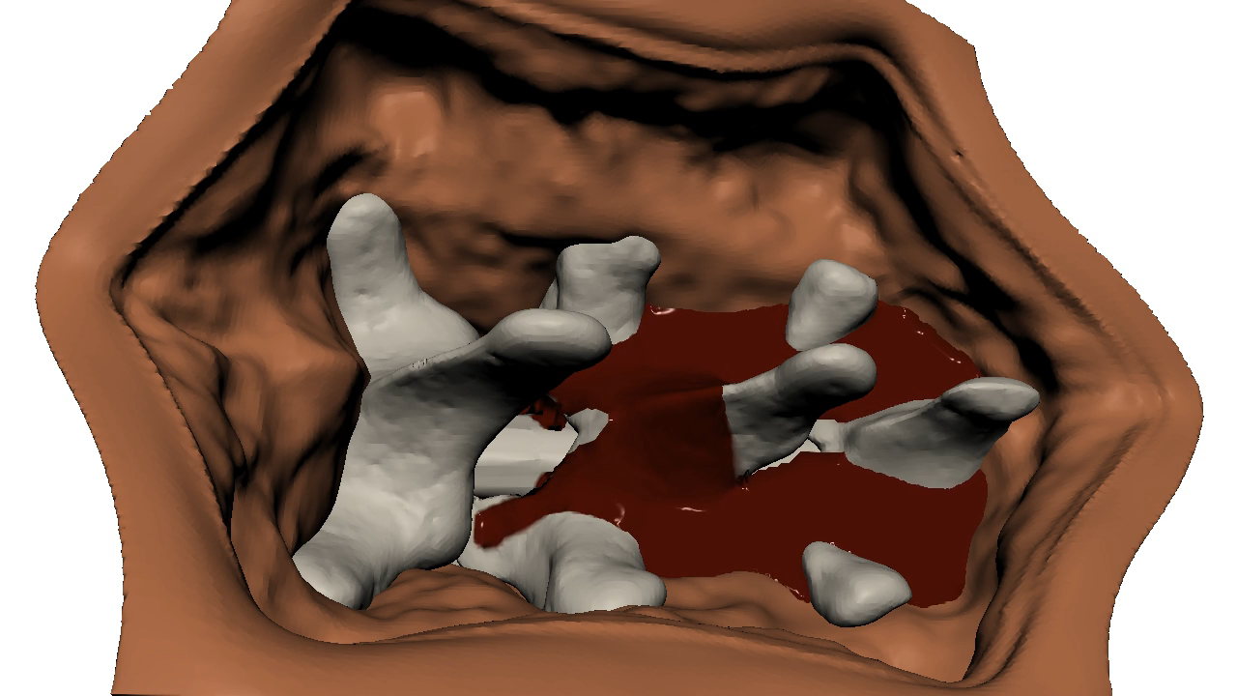
SWE [CM10] w our viscosity, surface, meniscus
NOT real-time
Notes:
Note that this is not real-time

Slide 77
Conclusion
Viscosity model
  Efficient and stable
Extended pipes
  Flow in passages
Meniscus shading
Surface optimization
Contributions applicable to other heightmap methods

Slide 78
Limitations & Future Work
Introduces some ripples
  Improve the connection process of extended pipes
Limited passage detection
  Derive an efficient detection process for arbitrary passages
Does not handle splashes
  Combine with methods such as [CM10]

Slide 79

Questions?
Thank you for your attention
Notes:
UPDATED

Slide 80
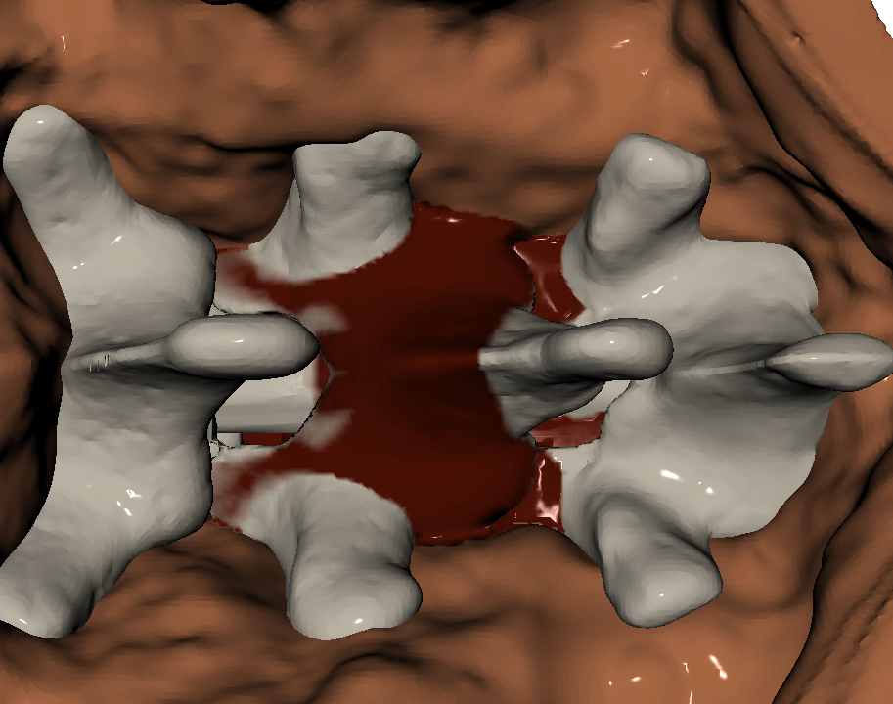

Importance of our Multi-Layer Surface
Borgeat et al. 2011
Ours surface
Notes:
Seams
Boundary adopts underlying geometry (we see small popping has the surface propagates)

Slide 81
Results
Example | Resolution (NxNxLayers) | Δt (ms) | ν (m²/s) | Simulation Avg. (ms) | Surface Avg. (ms) | Render Avg. (ms) | Total Avg./Max (ms)
Surgery | 200 x 200 x 5 | 3.0 | 4.0E-6 | 4.86 | 1.10 | 0.34 | 6.30/7.04
Viscosity | 200 x 200 x 1 | 3.0 | 0 | 0.61 | 0.43 | 0.16 | 1.21/1.63
Viscosity | 200 x 200 x 1 | 3.0 | 4.0E-6 | 0.62 | 0.46 | 0.16 | 1.22/1.63
Viscosity | 200 x 200 x 1 | 3.0 | 4.0E-5 | 0.60 | 0.44 | 0.16 | 1.21/2.41
Viscosity | 200 x 200 x 1 | 3.0 | 4.0E-1 | 0.60 | 0.41 | 0.16 | 1.20/2.40
Three layers | 100 x 100 x 3 | 9.0 | 4.0E-6 | 0.32 | 0.37 | 0.17 | 0.86/1.53
Passages | 100 x 100 x 3 | 9.0 | 4.0E-6 | 0.26 | 0.34 | 0.15 | 0.78/2.36
Notes:
Computation times increase with the number of layers

Slide 82
Extended Pipes - Identification
Obstacle
Full
Extended Pipe
Notes:
For the extended pipes, would it be possible to have a top view of the simulation grid, with color codes for the cells (possibly white = normal, mid-grey = obstacle, light-red = full, light-blue = extended pipes extremities) and with lines (black) connecting end points of extended pipes?
In the ideal scenario, we would have an animation of this, but to begin with, it would be great to see an example of this grid for the circular access when extended pipes are connected. I would do this just for the first layer.

