Slide 1



Virtual Environment Stereoscopic Parameters Adjustment by Evaluation of the Point of Regard
Jessica Conti, Benoît Ozell, Eric Paquette, Patrice Renaud
Graphics Interface 2018

Slide 2
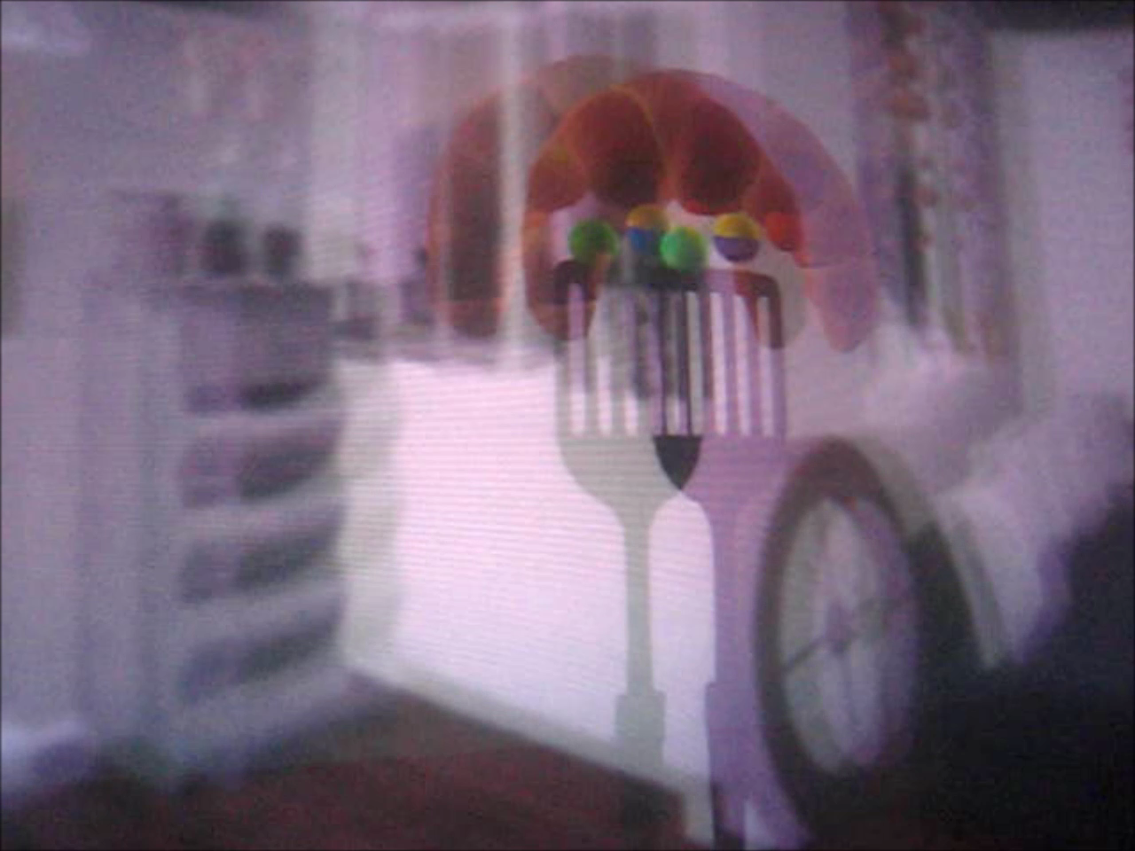
Depth of Field Blur & Inter-Camera Distance

Slide 3
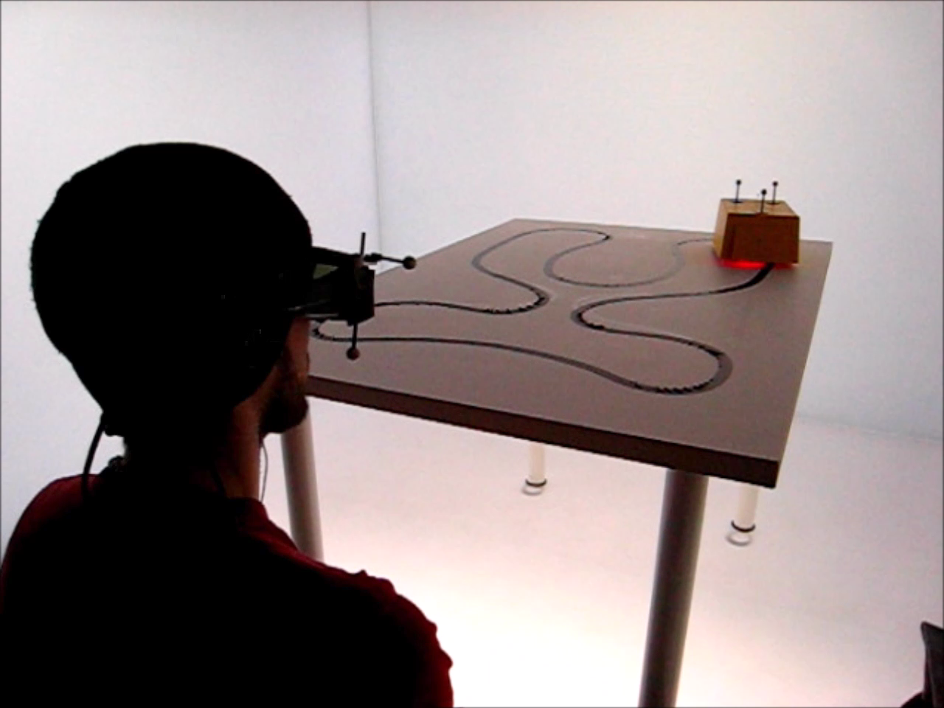
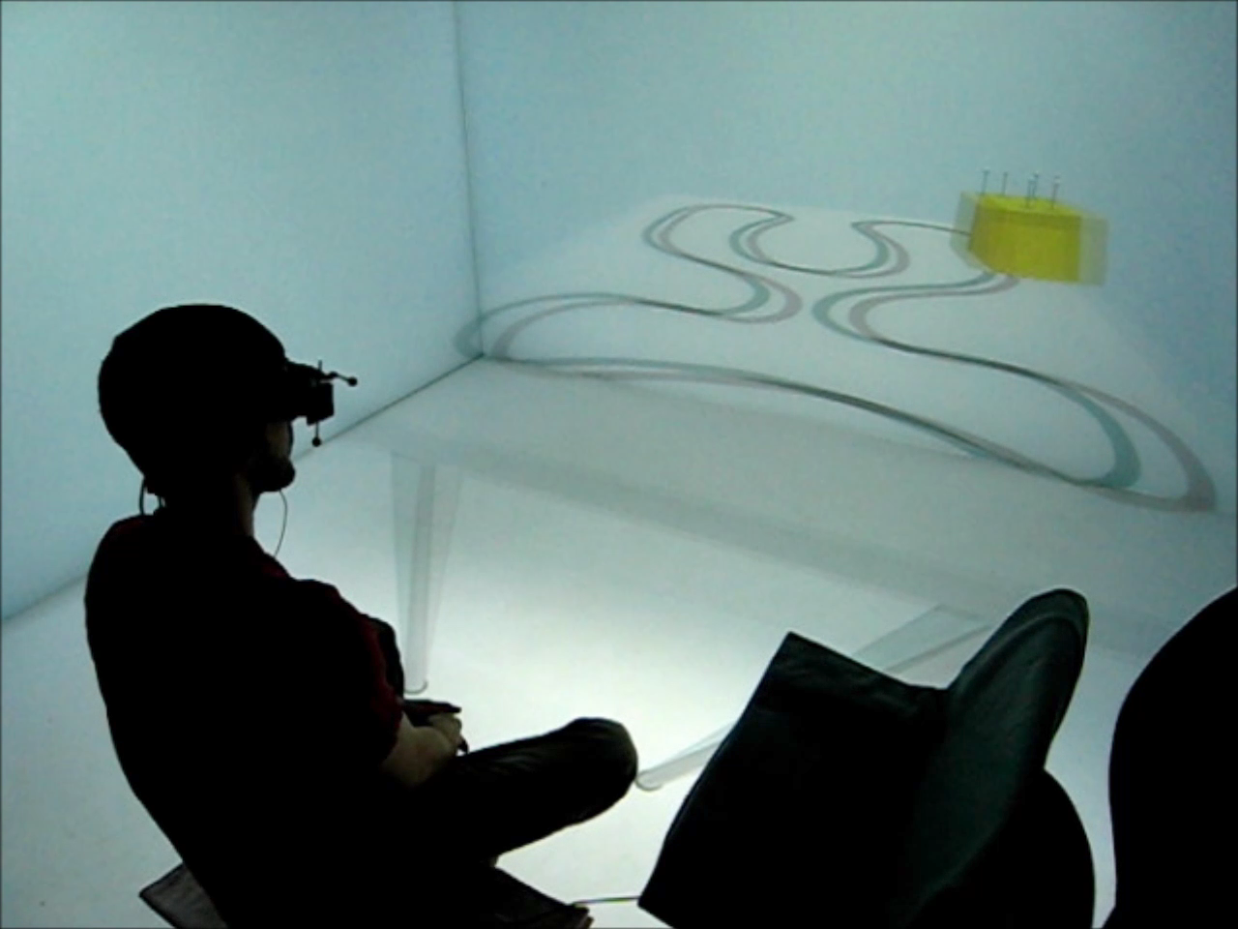
Eye Behavior Comparison
Real setup
Virtual setup

Slide 4
Related Work
Dynamic inter-camera distance (ICD)
  Jones et al. [9], Ware [19], Celikcan et al. [21]
  LaViola Jr [22], Bernhard et al. [23]
Ours
  Dynamic based on 3 user selected ICD
  Using eye tracking

Slide 5
Related Work
Depth of field (DOF) blur
  Vinnikov and Allison [5], Moreau [6], Hillaire et al. [11, 24], Leroy et al. [25], Duchowski et al. [26], Brooker and Sharkey [28]
Note quite clear if DOF blur provides improvements
Ours
  Dynamic with respect to the point of regard (POR)
  Using eye tracking

Slide 6
Overview
System, Calibration, 3D point of regard
Experiments
Evaluation
  Navigation
  Limits of fusion
  Real vs. virtual
Discussion
Conclusion

Slide 7
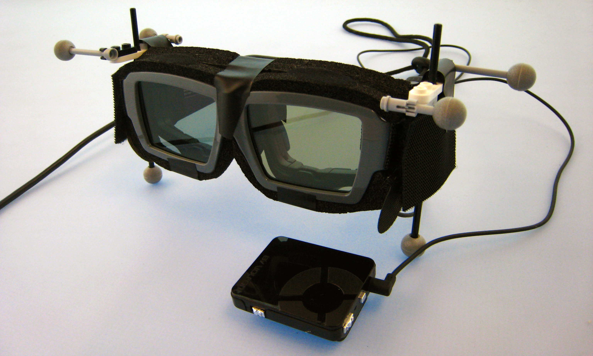
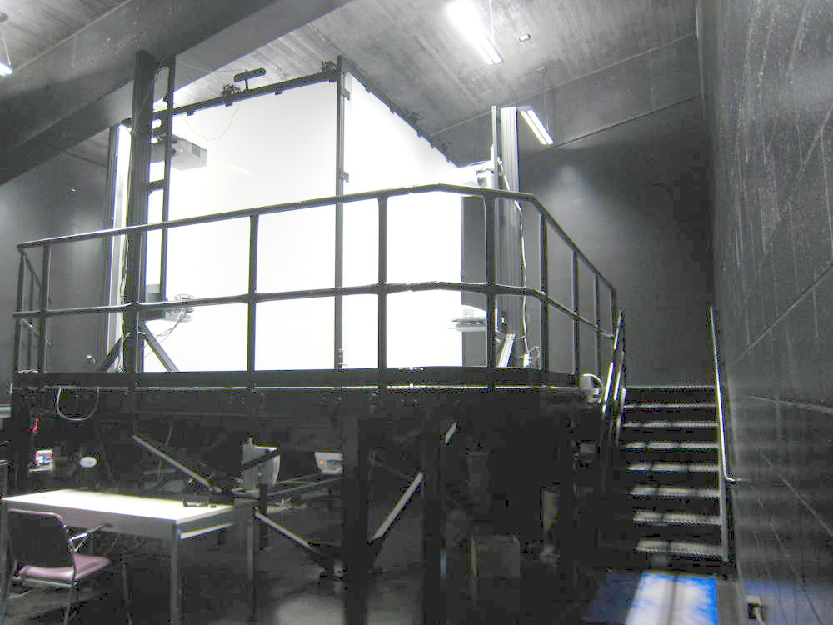
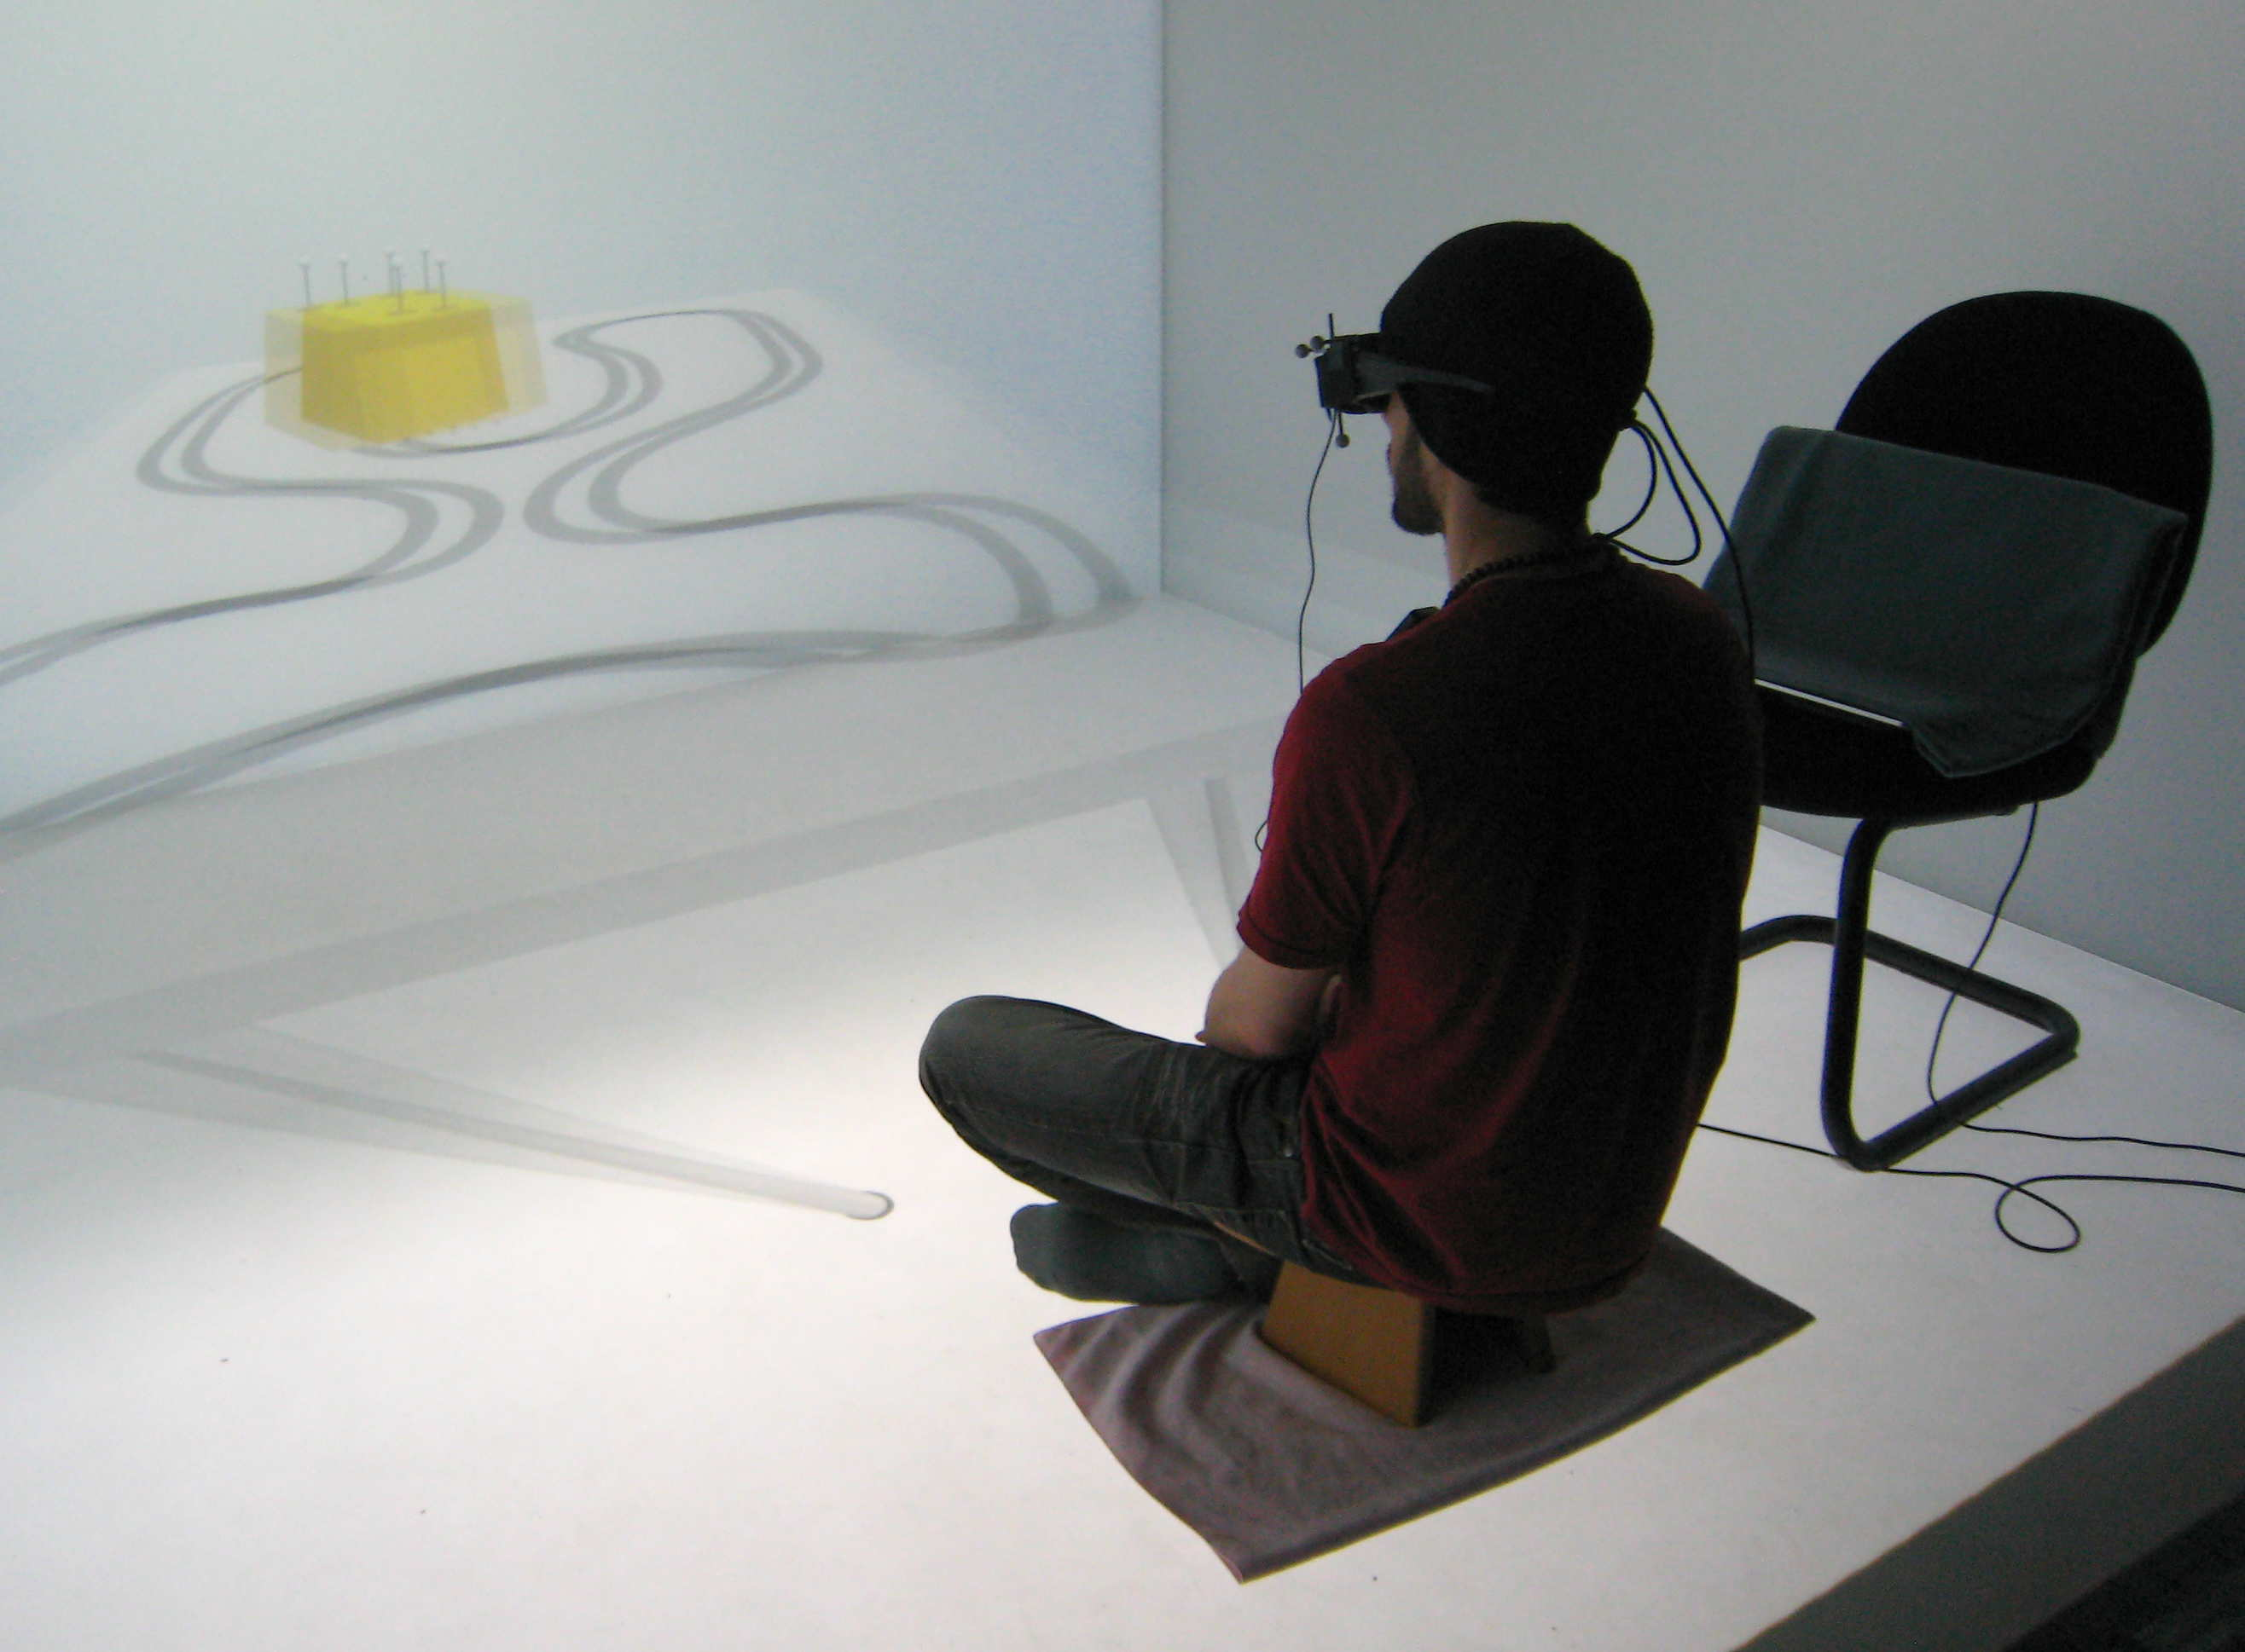
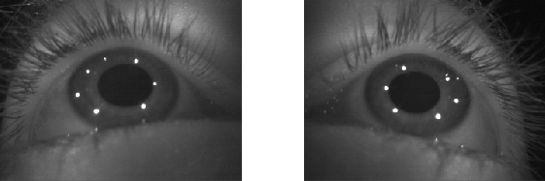
Virtual Reality System

Slide 8
Calibration
Hardy’s Multiquadric [33]
  Rectilinear grid of nine markers
  Average error of 6.47 cm / 1.85 ̊
    targets at 2 m

Slide 9
3D Point of Regard (POR)
Intersect the lines of sight with the scene
  left sight direction corrected with calibration
    error 5.0 cm
  right sight direction corrected with calibration
    error 2.7 cm
  average of raw left and right corrected with calibration
    error 2.6 cm
  average of corrected left and right
    error 3.1 cm

Slide 10
Overview
System, Calibration, 3D point of regard
Experiments
Evaluation
  Navigation
  Limits of fusion
  Real vs. virtual
Discussion
Conclusion

Slide 11
Participants
18 participants
  15 male and 3 female
Experience with 3D or virtual reality
  4 to 11 3D movies (average 11)
  14 participants playing video games
    average 8.6 h/week
Age: 22 to 49 (average 28)

Slide 12
Blur
Blur | Without | B– | B– | B–

Slide 13
Blur
Depth of Field Scatter of Unity [36]
  single blur intensity
Blur | Without | B– | B– | B–
 | With | B+ | B+ | B+

Slide 14
Inter-Camera Distance (ICD)
Interpupillary Distance (IPD)
 |  | ICD
 |  | Anatomical
Blur | Without | B–AICD | B– | B–
 | With | B+AICD | B+ | B+

Slide 15
Inter-Camera Distance (ICD)
User selected
 |  | ICD
 |  | Anatomical | Fixed
Blur | Without | B–AICD | B–FICD | B–
 | With | B+AICD | B+FICD | B+

Slide 16
Inter-Camera Distance (ICD)
User selected
  0.4 m (near), 1 m (middle), 2.5 m (far)
 |  | ICD
 |  | Anatomical | Fixed | Variable
Blur | Without | B–AICD | B–FICD | B–VICD
 | With | B+AICD | B+FICD | B+VICD

Slide 17
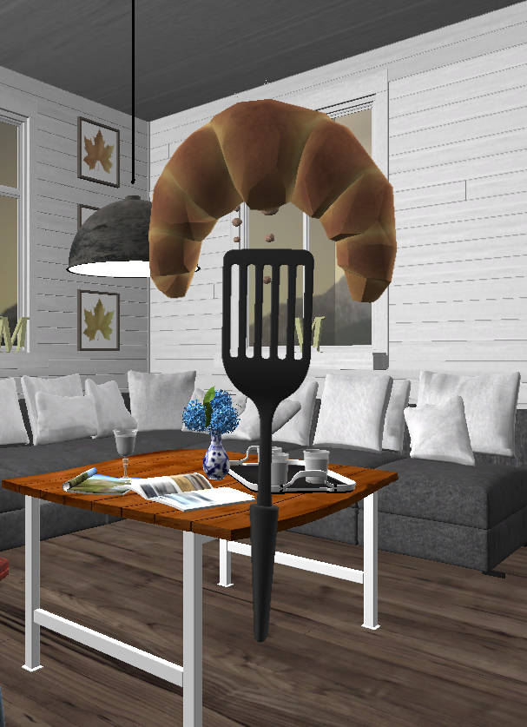
Start-up
User selection
  FICD
  VICD-near
  VICD-middle
  VICD-far

Slide 18
Overview
System, Calibration, 3D point of regard
Experiments
Evaluation
  Navigation
  Limits of fusion
  Real vs. virtual
Discussion
Conclusion

Slide 19
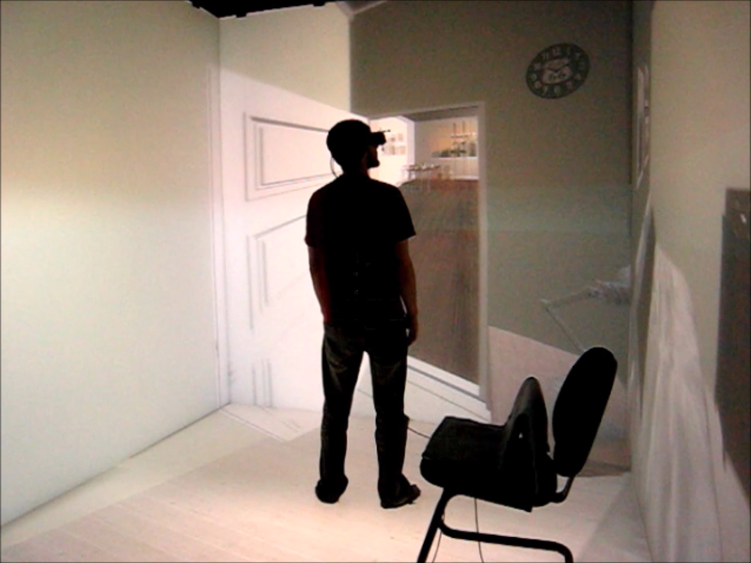
Navigation
Predefined path

Slide 20
Evaluation Criteria
Visual comfort
Rendering realism
Fun
Depth and distance perception
Sense of immersion
Likert scale, 7-point
  “very negative” to “very positive”

Slide 21
Evaluation

Slide 22
Evaluation
ANOVA (1-way & 2 way)
  blur worsened “depth and distance perception”
Notes:
confirms findings of others [5,11,26,28]
stronger in our case; possible explanation
blurred (9.4 FPS) vs. non-blurred (13.0 FPS)

Slide 23
Evaluation
AICD > VICD > FICD
  8 out of 10 times

Slide 24
Overview
System, Calibration, 3D point of regard
Experiments
Evaluation
  Navigation
  Limits of fusion
  Real vs. virtual
Discussion
Conclusion

Slide 25
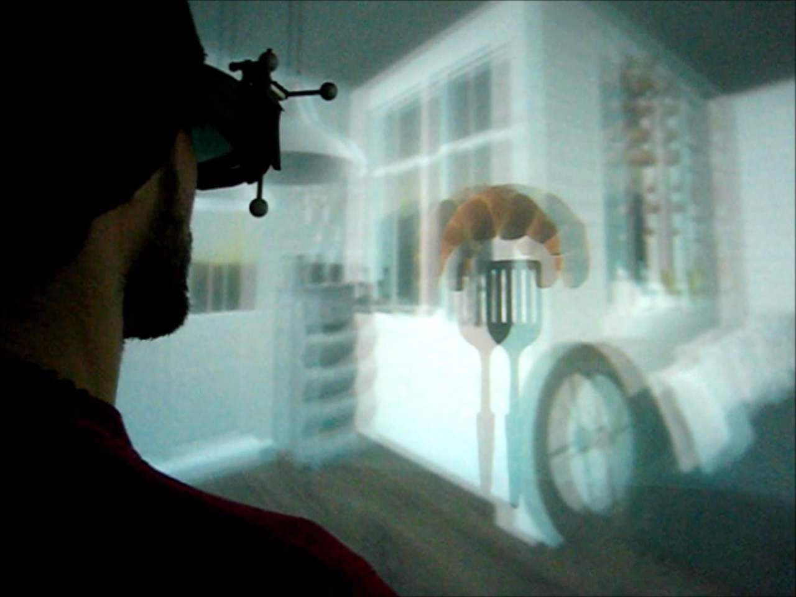
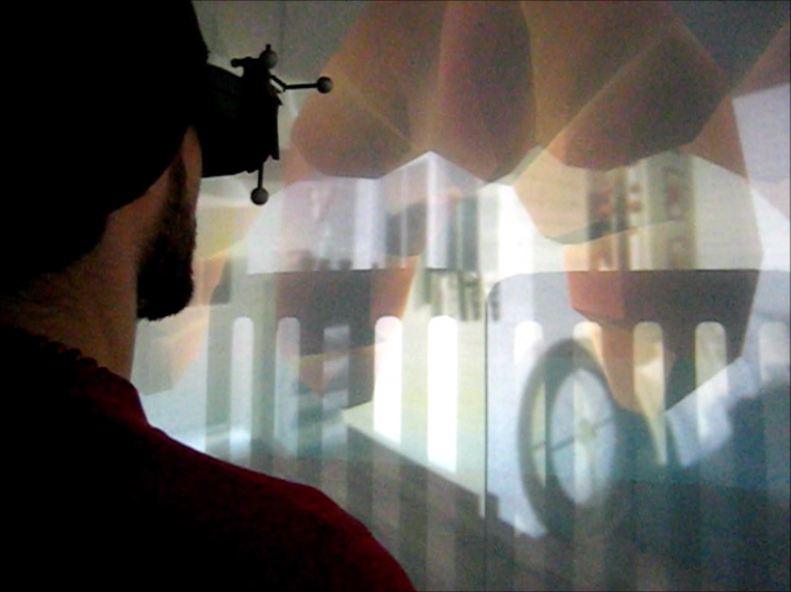
Limits of Fusion
Increasing disparity
Decreasing disparity

Slide 26
Evaluation
ANOVA (two-way)
  Fixed ICD is worst
Notes:
Animate
Fig. 11 ; FIX THE MISSING + FOR THE LOWER 3

Slide 27
Evaluation
Fixed ICD
  participants select large disparity

Slide 28
Overview
System, Calibration, 3D point of regard
Experiments
Evaluation
  Navigation
  Limits of fusion
  Real vs. virtual
Discussion
Conclusion

Slide 29
Vergence Comparison
Real setup
Virtual setup

Slide 30
Vergence Comparison

Slide 31
Vergence Real vs. Virtual
ANOVA (one-way, two-way)
  no significant differences

Slide 32
Angular Deviation
Real setup
Virtual setup

Slide 33
Angular Deviation

Slide 34
Angular Deviation
ANOVA (one-way, two-way)
  no significant differences

Slide 35
Overview
System, Calibration, 3D point of regard
Experiments
Evaluation
  Navigation
  Limits of fusion
  Real vs. virtual
Discussion
Conclusion

Slide 36
Discussion
Contact lenses
  one-way ANOVA test (F=13.43, p=0.002)
  significantly higher POR imprecision

Slide 37
Overview
System, Calibration, 3D point of regard
Experiments
Evaluation
  Navigation
  Limits of fusion
  Real vs. virtual
Discussion
Conclusion

Slide 38
Conclusion
Depth of field (DOF) blur
  limited impact
Inter-camera distance (ICD)
  avoid using a single ICD across all participant
  ICD fixed by the participants performs poorly
  dynamic ICD is an option
  anatomical from eye tracking glasses works well
Experiment to compare real and virtual setups

Slide 39
Limitations & Future Work
Tested a single DOF blur configuration
Walkthrough experiment: FPS differences

Slide 40

Questions?
Thank you for your attention

Slide 41
Additional Material

Slide 42
DOF Blur
ANOVA (1-way & 2 way)
  blur worsened “depth and distance perception”
  confirms findings of others [5,11,26,28]
  stronger in our case; possible explanation
    blurred (9.4 FPS) vs. non-blurred (13.0 FPS)

