Slide 1


WSCG 2015 – June 8-12
Localized Search
for High-Definition Video Completion
Jocelyn Benoit
Eric Paquette
École NAD, Montréal, Canada
jbenoit@nad.ca
ca.linkedin.com/in/JocelynBenoit
ÉTS, Montréal, Canada
Eric.Paquette@etsmtl.ca
ca.linkedin.com/in/EricPaquette
Notes:
HI, good morning. I am glad to be here with you this mornng.
This project was made by Eric Paquette and myself.
On the screen, you have our contact informations. Feel free to get in touch with us by mail or via linkedin.
I am a professor from École NAD, a 3D animation school in Montréal, and I am currently finishing my PhD at École de technologie Supérieure de Montréal. Eric is a professor there.

Slide 2
Introduction
Video completion is an important task
Automatically fill missing regions in a visually plausible manner
Size matters!
1920 x 1080 is common place
4K
Notes:
Both image and video completion are important tasks in many multimedia applications. Their goal is to automatically ﬁll missing regions of an image or video in a visually plausible manner. However, using an image completion technique on each frame when completing a video can produces undesired temporal artifacts. Moreover, it is more important for video completion to be time- and memory-efﬁcient since video contains much more data than image.
Also, size matters! High definition videos are now common place in the industry and a completion method should handle HD video.

Slide 3
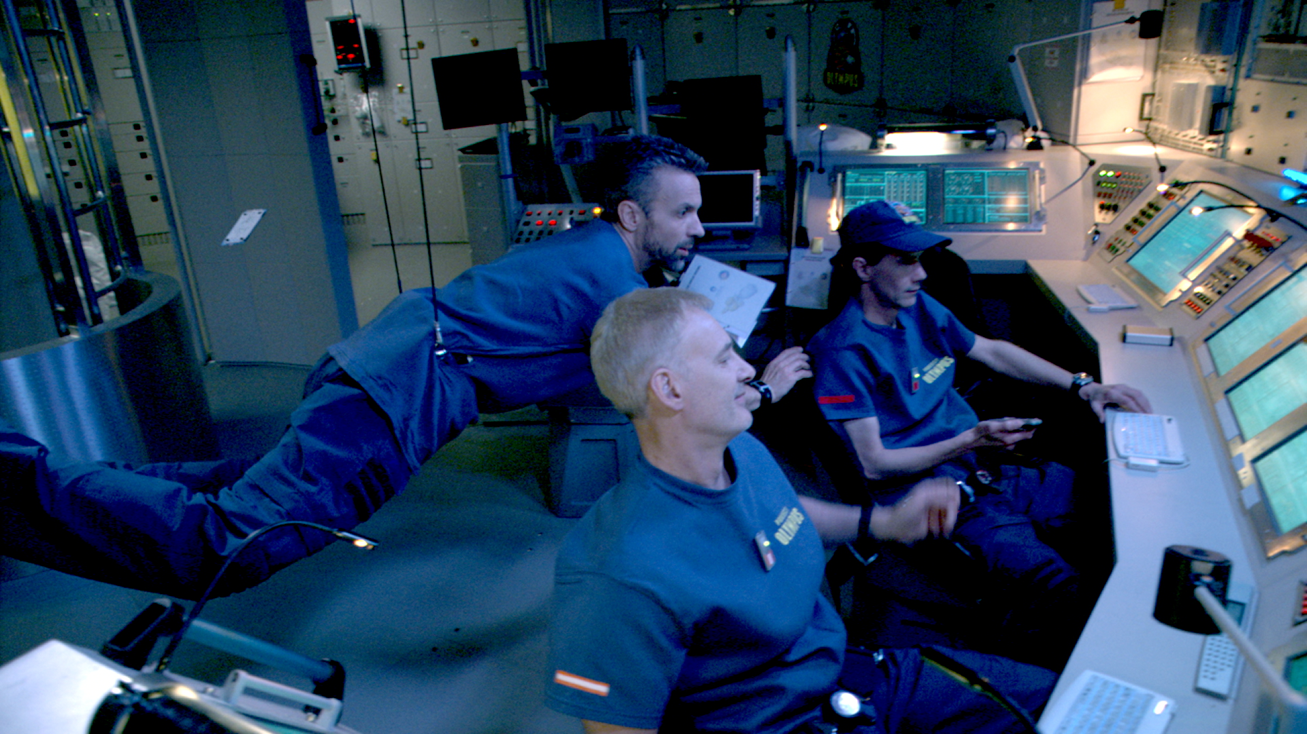
Introduction
Video completion should be automated
5 seconds shot, wire removal: 2 weeks to complete for an artist
Image from Race To Mars (Discovery Channel)
Notes:
Video completion does not need an artistic vision and should be automated. Unfortunately, most of the video completion is still done manually by artists during the postproduction phase. As you can imagine, it is costly and it took a long time to edit a video sequence.
For example, it took two weeks for an artist to remove the wire from this 5 seconds shot from Race to Mars, a show aired on discovery channel.

Slide 4
Presentation
Previous work
Objectives
Proposed approach
Dual inpainting-sampling filling-order completion
Coherence-based matches refinement process
Localized search completion
Results and limitations
Conclusion and future work
Notes:
My presentation will follow a common structure as you can see on the screen
I will start by covering previous work and state the objectives of the project. I will then explain the proposed approach, show you some results and expose the limitation. Finally, I will conclude and talk about future work.

Slide 5
Previous Work
Video Completion
Markov Random Fields and non-parametric patch sampling
Good results
Too much memory
Long computation times
Larger primitives instead of pixels
Reduce de search time
Per-pixel approaches are more likely to restore fine details of HD videos
[Wexler et al.; Shiratori et al.; Xiao et al.]
[Shih et al.; Cheung et al.]
Notes:
In the past years, many new solutions have been proposed for video completion. It has been shown that exemplar-based methods, that use non-parametric patch sampling, work well and provide good results.
Those methods are based on an iteration through each patch in the missing regions and a search in all of the patches of the existing regions to ﬁnd a replacement candidate. Even with optimization methods, the search time of the non-parametric patch sampling methods still remains excessive. Furthermore, the structures needed for theses optimization methods require too much memory, making them inappropriate for HD videos.
While some methods use per-pixel searches, other approaches use larger primitives instead of pixels: Shih et al. use fragments, while Cheung et al. use “epitomes”. Those methods can reduce the search time and improve overall coherence, but per-pixel searches are more likely to correctly restore the ﬁne and subtle details found in HD video sequences.

Slide 6
Previous Works
Coherence Techniques
Results of texture synthesis
Contain large contiguous regions of the input textures
Can be accelerated by using information from previous searches
[Ashikhmin et al.]
Notes:
When Ashikhmin introduced the concept of coherence, he observed that the results of synthesis algorithms often contain large contiguous regions of the input texture when using non-parametric patch sampling. Consequently, the independent search for every patch in the input texture or image can be accelerated by using information from previously computed searches.

Slide 7
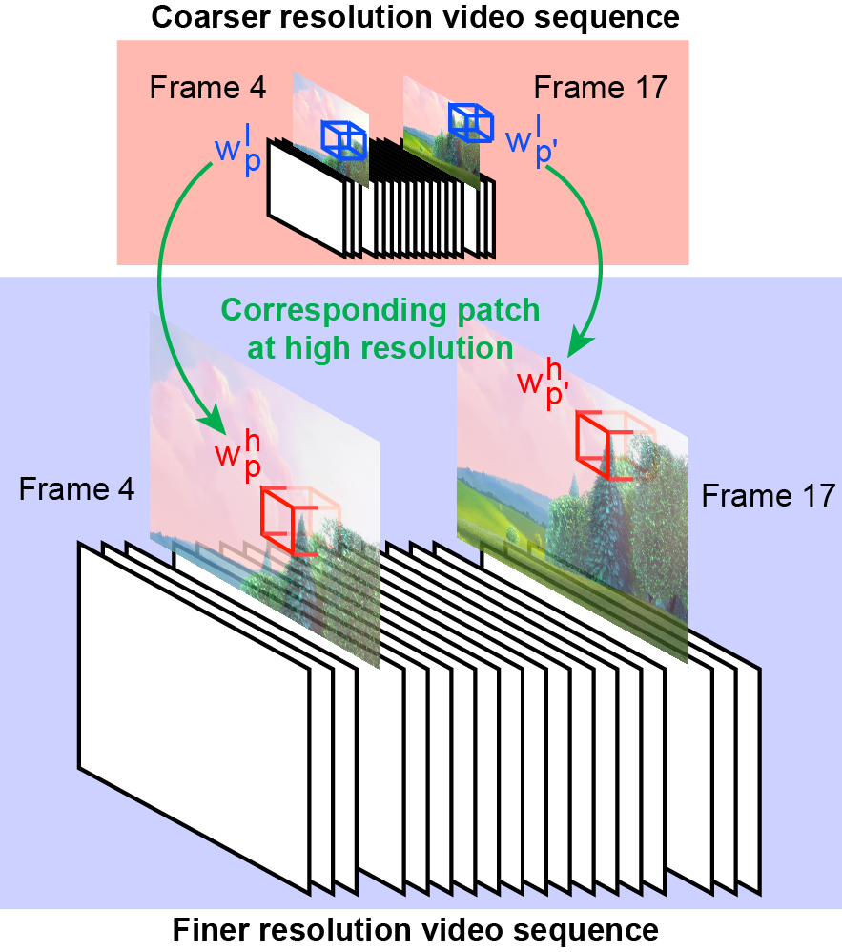
Observation
Notes:
This observation from Ashihkmin led us to believe that the same reasoning can be apply to video completion. First, let us consider two patches at coarser resolutions: patch WP from the missing region and its most similar patch WP-PRIME from the existing region. If we look at the corresponding patch of WP at the finer resolution, its most similar patch is likely to be found near the corresponding patch of WP-PRIME at finer resolution.
Rather than trying to accelerate the nearest neighbors search, the proposed method narrows the search space at ﬁner resolutions using information obtained at coarser resolutions.

Slide 8
Proposed Method
Contributions
a dual inpainting-sampling ﬁlling-order completion approach
a new coherence-based matches reﬁnement process
improves the quality of the matches when approximate search approaches are used
a new localized search completion approach
based on an exact search using uncompressed data
restricted to a localized region
Notes:
This paper presents an approach for the completion of high-definition video sequences that produce visually plausible results within reasonable timeframes. Moreover, the approach requires very little memory at the ﬁnest resolution except for the input video storage.
The three main contribution are :
a dual inpainting-sampling ﬁlling-order completion method.
a new coherence-based matches reﬁnement process that improves the quality of the matches when approximate search method are used.
a new localized search completion method based on an exact search using uncompressed data but restricted to a localized region.

Slide 9
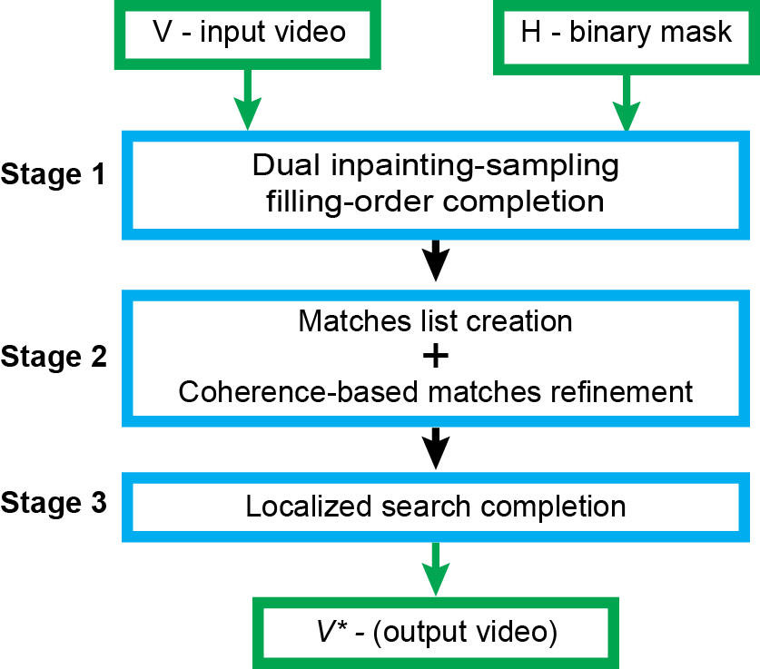
Overview
High Definition Video Completion
V
Original video sequence containing the missing region
H
Binary video sequence identifying the missing region
V*
Completed video sequence
P = (x,y,t)
Notes:
Here’s a overview of the proposed method.
Starting with an input video sequence V containing a missing region H, the proposed method ﬁlls H in a visually plausible manner by copying similar patches found in the existing region, thus creating a completed video sequence V*.
In order to maintain spatio-temporal consistency, we consider the input video as a space-time volume, and thus a pixel located at (x, y) in frame t can be represented by the space-time point p = (x, y, t)
Consenquently, a patch can be seen as a spatio-temporal cube of pixels centered at p

Slide 10
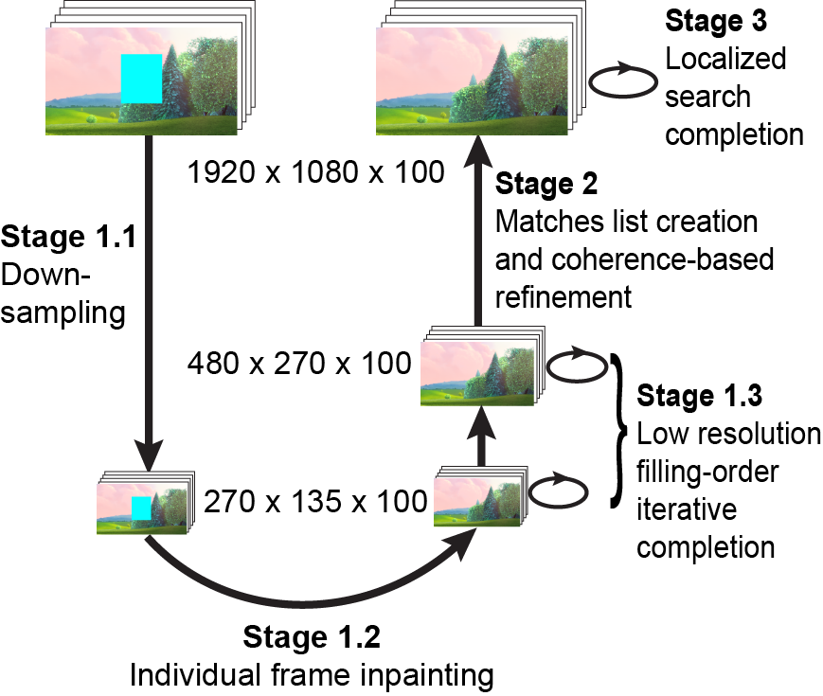
Overview
High Definition Video Completion
Notes:
First, in stage 1, the input video is downsampled and completed by a dual inpainting-sampling ﬁlling-order completion (stage 1.1 to 1.3)
Then, in stage 2, we create a match List in which each missing pixel is associated with its best matching patch. The next step consists of an iterative coherence-based refinement process that improves the search results for the worst matching patches in the list.
Finally, in stage 3, the matches list is used by the localized search completion method to narrow the search space.

Slide 11
Inpainting
Dual Inpainting-Sampling Filling Order Completion
Initialization of H with an image inpainting technique [Bertalmio et al.]
Speed up the convergence by using existing information around H
Done only once
Notes:
The ﬁrst step is to downsample V to a coarse resolution. Then, before starting the completion, the values of each space-time point of the missing region need to be initialized. Unlike most methods that use random values or RBG colors of the existing region, the proposed approach ﬁlls H using an image inpainting technique based on Bertalmio et al.
Our aim is to speed up the convergence by using the existing information around H. This initialization is done only once, prior to the ﬁrst iteration of the low resolution r iterative completion approach. Since this image inpainting technique is done on the lowest resolution, it is really fast.

Slide 12

Iterative Completion
Dual Inpainting-Sampling Filling Order Completion
Iterative process minimize the objective function:
D() is the similarity metric between two patches
Sum of Squared Differences (SSD) of color
Notes:
Then, the method performs an iterative process, improving the overall coherence of H. During each iteration, the approach seeks a replacement color value for every missing space-time point in order to minimize the objective function. Unlike previous methods, which used scan-line ordering, our method ﬁlls H using a 3D hole-ﬁlling ordering, thus ensuring that each patch w contains information that is more reliable. Consequently, it speeds-up the convergence and reduces discontinuities near the boundaries of H.
To seek a replacement color for a space-time point, the approach uses a single best-matching patch that minimizes this similarity metric. Compared to other methods that blend together several matches, using the single best-matching patch does not result in blurring artifacts and preserves ﬁlm grain and noise from the original video.
To enforce spatio-temporal consistency, this iterative process is done on multiple scales using spatial pyramids. Because it involves long computation times and a lot of memory for the search structure, this iterative process is impractical at ﬁner pyramid levels for HD videos. Therefore, the proposed approach stops the iterative process when it reaches a ﬁxed resolution (typically 480×270).

Slide 13
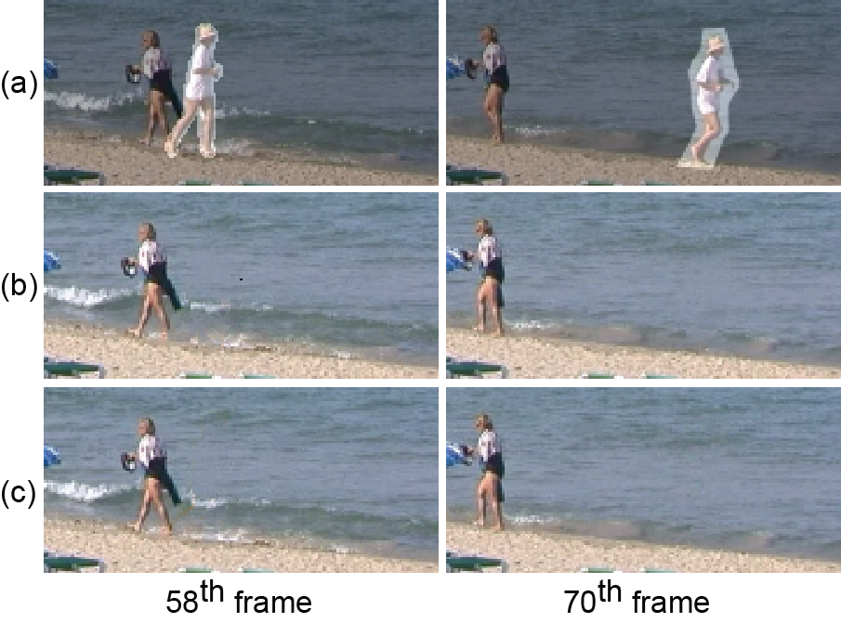
Comparison
Dual Inpainting-Sampling Filling Order Completion
Results with a quality equivalent to those of Wexler et al.
Wexler: 1 hour per iteration
Proposed: 4 min. per iteration
Notes:
The proposed dual inpainting-sampling ﬁlling-order completion approach produces results with a quality equivalent to the results of Wexler et al. , but within much less time.
Lets see the video.

Slide 14
Match List Creation
Coherence-Based Matches Refinement
Creation of the matches list (ML)
For efficiency reasons, optimization methods (ANN, PCA) are used in Stage 1
They often provide matches that do not minimize the objective function
Notes:
When Stage 1 is over, each patch of H is associated with the best matching patch. This information is then stored in a matches list ML. During the high-resolution completion iterative process, ML enables the approach to narrow the search space to only sub-regions of the entire video.
For efﬁciency reasons, optimization methods such as principal component analysis and approximate nearest neighbors search are used in Stage 1. While these methods are helping to achieve acceptable search times, they often provide matches that do not minimize the objective function.
The information contained in ML must be reliable in order for visually plausible results to be possible with the localized search completion iterative process. Consequently, ML needs to be reﬁned before being use in stage 3.

Slide 15
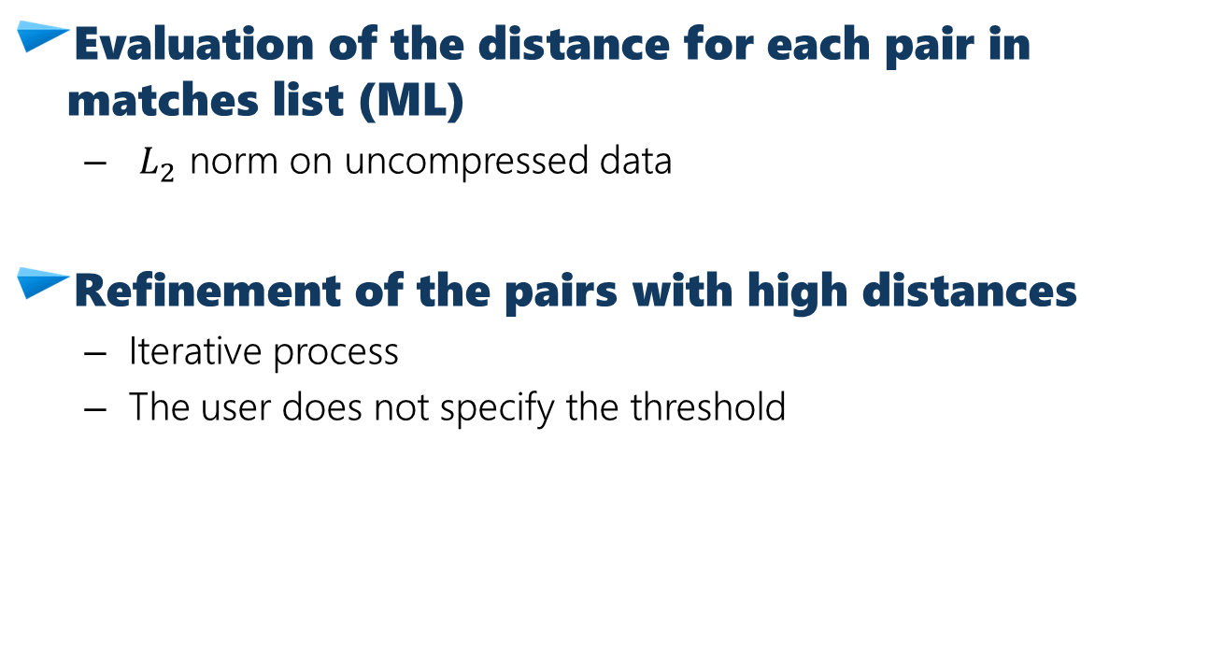
Coherence-Based Matches Refinement
Evaluation of the distance for each pair in matches list (ML)
$L_{2}$ norm on uncompressed data
Refinement of the pairs with high distances
Iterative process
The user does not specify the threshold
Notes:
In order to refine ML, the approach first computes the distance for each pair stored in it using uncompressed data.
Then an iterative process reﬁnes pairs with distances higher than a given threshold. During the ﬁrst iteration, this threshold is automatically set such that 15% of the pairs are reﬁned. After each iteration, this threshold is reduced by 20% of its initial value. For each pair above the threshold, the method seeks for a replacement best matching patch that decreases the similarity metric.

Slide 16
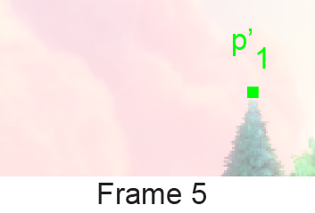

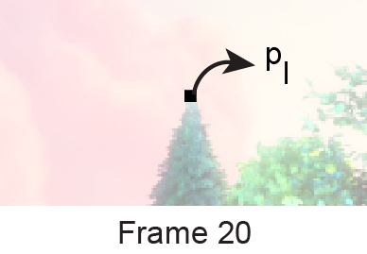

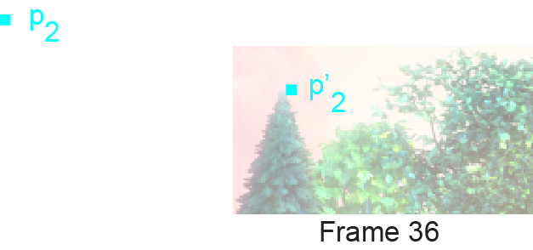
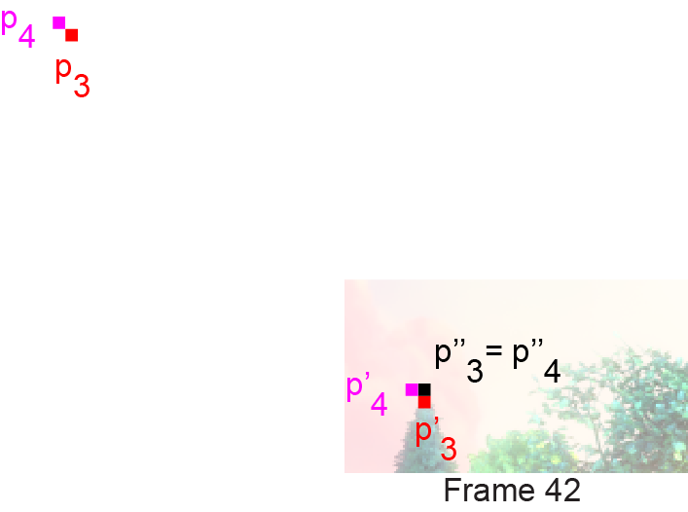

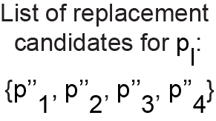
Coherence-Based Matches Refinement
The search is restricted around the best matching patches of the neirghbors
Notes:
Instead of using a method that searches the entire video sequence for a replacement patch, the search is restricted around the best matching patches of pl neighbors (top, right, bottom and left).
Let’s consider PL. Its top neighbor is P1 and its most similar patch is found at p1PRIME according to ML. Then, we look at P1-DOUBLEPRIME and compute the distance with PL. We do the same process with the 4 neighbors, thus creating a list of 4 possibles replacement candidates. If one of the distance is smaller than the current value, we update ML. Otherwise, we leave ML unchanged.

Slide 17
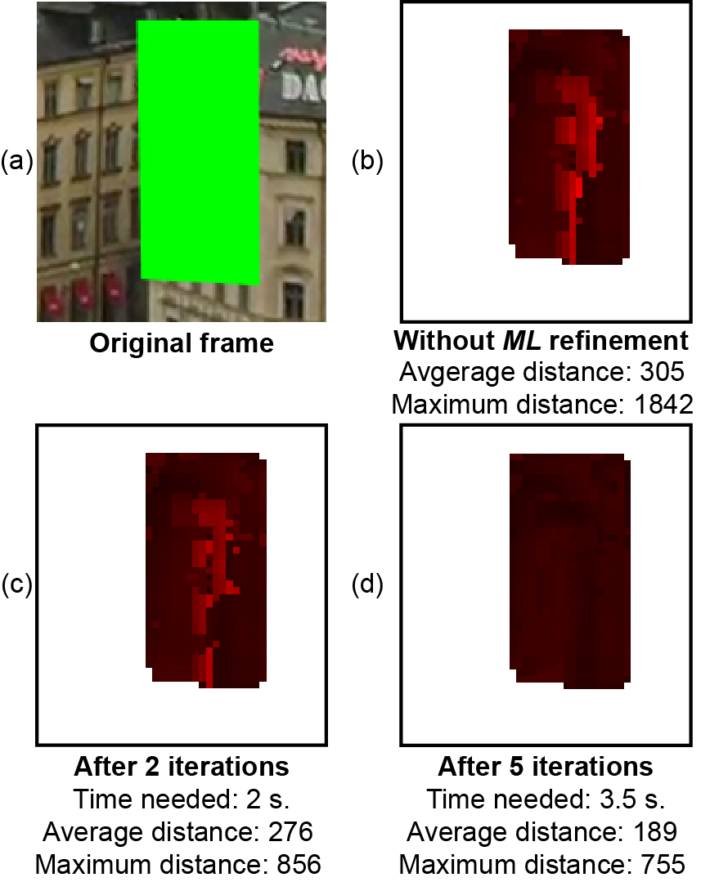
Coherence-Based Matches Refinement
Impact of the matches list coherence-based match refinement
Notes:
The ML reﬁnement provides a signiﬁcant quality improvement within a few seconds. On the right picture, we can see that the average and maximum distances are greatly reduce within only 3.5 seconds.

Slide 18
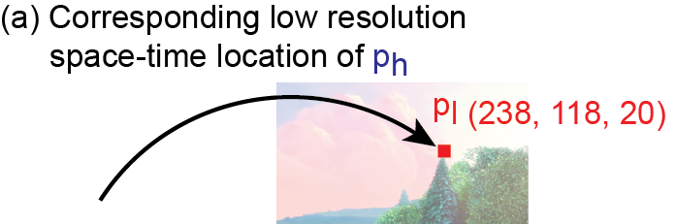

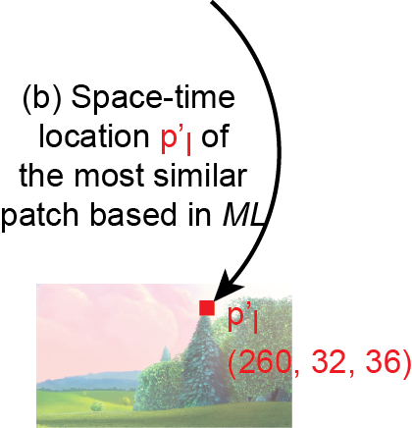
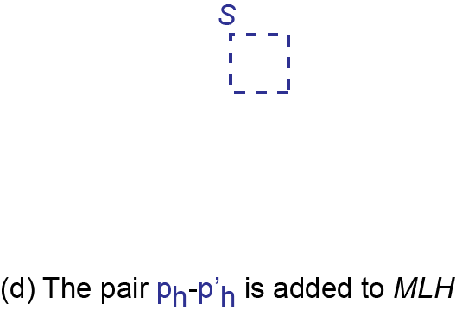
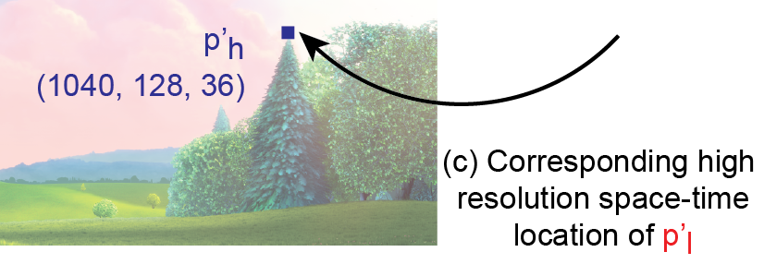
Localized Search Completion
Matches list must be scaled up to finer resolution (MLH)
Notes:
Next, the information contained in ML must be scaled up to the ﬁner resolution. For each space-time point PH in H at a ﬁner resolution, its corresponding low-resolution PL is found as well as the space-time location PL-PRIME contain in ML.
The space-time location PL-PRIME is then scaled up to a ﬁner resolution resulting in PH-PRIME. The pair PH – PH-PRIME is then added in a new matches list MLH which will be used by the localized search completion process to narrow the search space.

Slide 19

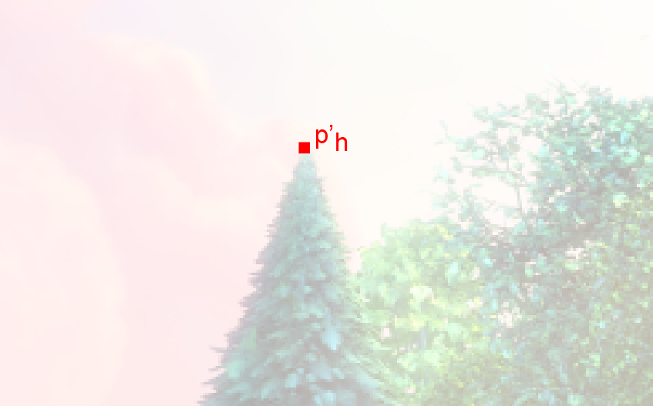
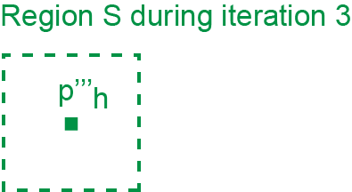
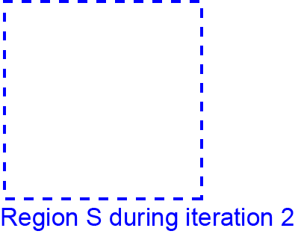

Localized Search Completion
The localized search seeks replacement colors based on the matches list (MLH)
Notes:
The main steps of the localized search completion process are similar to those of the low-resolution process: using a 3D hole-ﬁlling approach, the method seeks a replacement color for every missing pixel in H using a single best-matching patch.
However, instead of searching through the entire video sequence, the approach narrow the search space to a small sub-region S, based on the information from MLH. Next, the approach searches only in S for the best-matching patch (the result is pDOUBLE-EPRIME here). In the next iteration, the sub-region S will be recentered around this updated space-time location. The window size of S is decreased after each iteration.
Obviously, the search time is dramatically reduced when using MLH to narrow the search space, as compared to using methods such as ANN and PCA. Moreover, the computation time for the creation and the reﬁnement of ML and MLH is shorter than the time needed for the creation of the structures used by ANN and PCA. Another important advantage of the proposed method is that MLH requires much less memory than typical search structures, such as ANN. Finally, the proposed MLH search does not rely on compressed data, and thus can provide better matches.

Slide 20
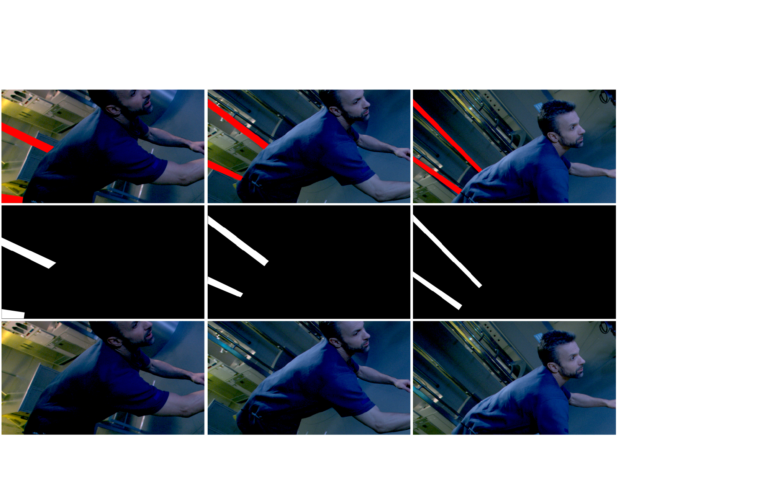
Results – Race to Mars
Avg. 9,546 pixels / frame, 1.5 min. / frame
Image from Race To Mars (Courtesy of Discovery Channel)
Notes:
Lets see a real application.

Slide 21
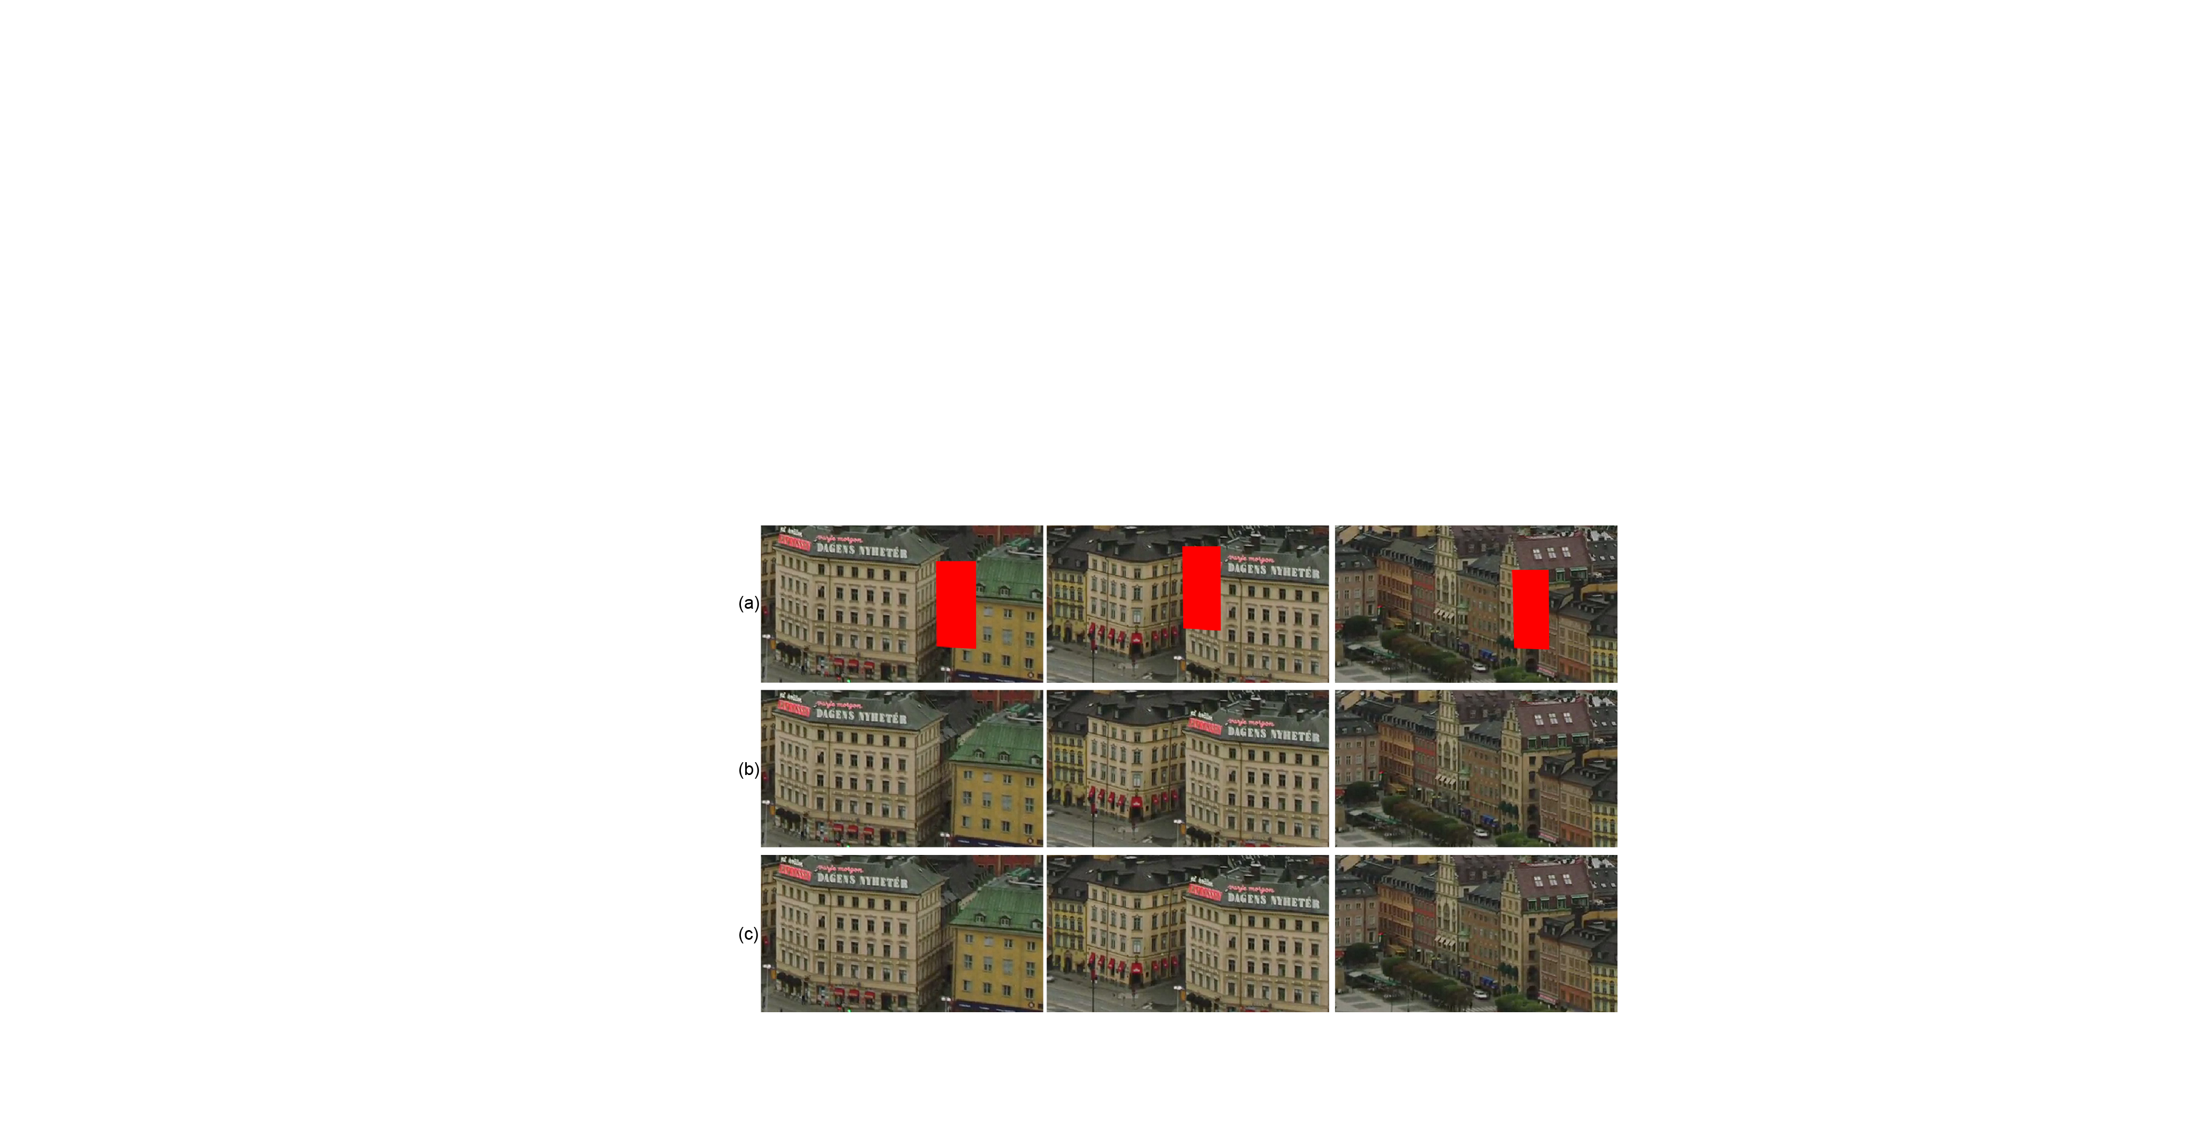
Results – Old Town Cross
Avg. 8,456 pixels / frame, 1.25 min. / frame
Image from https://media.xiph.org/video/derf/

Slide 22
Limitations
Video with occluded moving objects
Video with drastic camera movements
Does not work well with exposition changes
Notes:
The proposed method come with some limitations. Since we only use RGB color to compute the distances, the technique is not able to complete video with occluded moving object.
Also, since the algorithm is searching the existing video, the missing patch must be found in it. So, the proposed method is not optimal when the input video present drastic camera movements or exposition changes.

Slide 23
Conclusion
We presented a system that can handle much higher resolutions
dual inpainting-sampling ﬁlling-order completion approach
new coherence-based matches reﬁnement
new localized search completion approach
based on an exact search using uncompressed data
Notes:
In conclusion, we presented a system that can complete video sequence with much higher resolution than previous works due to the 3 main contributions listed here.

Slide 24
Future Work
Handle video sequence with more drastic camera mouvement
Rotation, zoom, etc.
Use Barnes et al. work (PatchMatch) for video completion
Notes:
The future work will consist of handling video sequence with more drastic camera movement. One possible solution is the use of invariant feature tracking like SIFT or SURF.
I would also like to apply the PatchMatch approach of Barnes et al. to video completion in order to reduce even more the search time.

Slide 25




Acknowlegdements
We would like to thank
And all our reviewers!
Jocelyn Benoit
Eric Paquette
École NAD, Montréal, Canada
jbenoit@nad.ca
ca.linkedin.com/in/JocelynBenoit
ÉTS, Montréal, Canada
Eric.Paquette@etsmtl.ca
ca.linkedin.com/in/EricPaquette
Notes:
Finnaly, I would like to thanks FQRNT, Mokko Studio, ÉTS and École NAD.
As I said earlier, feel free to get in touch with us by mail or via linkedin.

