Slide 1



SSILK
[1]
[2]
[3]
Self-Supervised Integration of Latent Kinematics for Joint-Driven Neural Garments
SCA 2026
Maksym Perepichka^{[1,3]}, Arnaud Schoentgen^{[1]}, Eric Paquette^{[2]}, Tiberiu Popa^{[3]}

Slide 2
Background
Physics simulations are costly
NNs offer an efficient representation
Traditional supervised methods require lots of data
Self-supervised methods offer an alternative

Slide 3
Background
Two families:

Slide 4
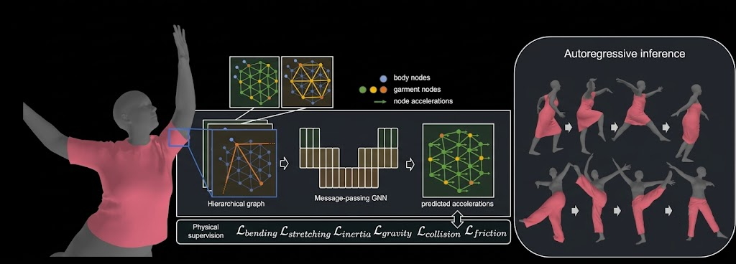
Background
Two families:
  Graph based: HOOD, ContourCraft, SENC
    Predict vertex acceleration using GNNs
    Accurate, generalizable, but computationally expensive
[4]
[4] - Diagram from Grigorev, A., et al. "HOOD: Hierarchical Graphs for Generalized Modelling of Clothing Dynamics." CVPR (2023).

Slide 5
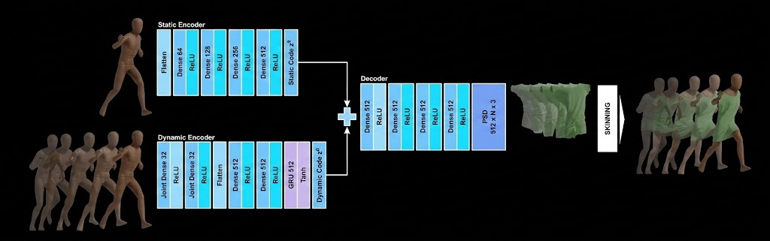
Background
Two families:
  Pose based: PBNS, SNUG, NCS, GAPS
    Learn a mapping from character pose to blendshape weights
    Fast, but limited in expressibility, generalizability
[5]
[5] – Diagram taken from Bertiche, H., et al. "Neural Cloth Simulation." ACM Transactions on Graphics (2022).

Slide 6
Background
Weaknesses:
  Pose-based methods rely on LBS
  Lack of explicit integration formulation
  Out-of-distribution scenarios

Slide 7

Method
Neural dynamics for loose garments (capes, robes, etc.)
Self-supervised training strategy
Verlet-inspired latent integration
Hybrid joint + blendshape decoder
Data-augmentation strategy for improved generalization

Slide 8
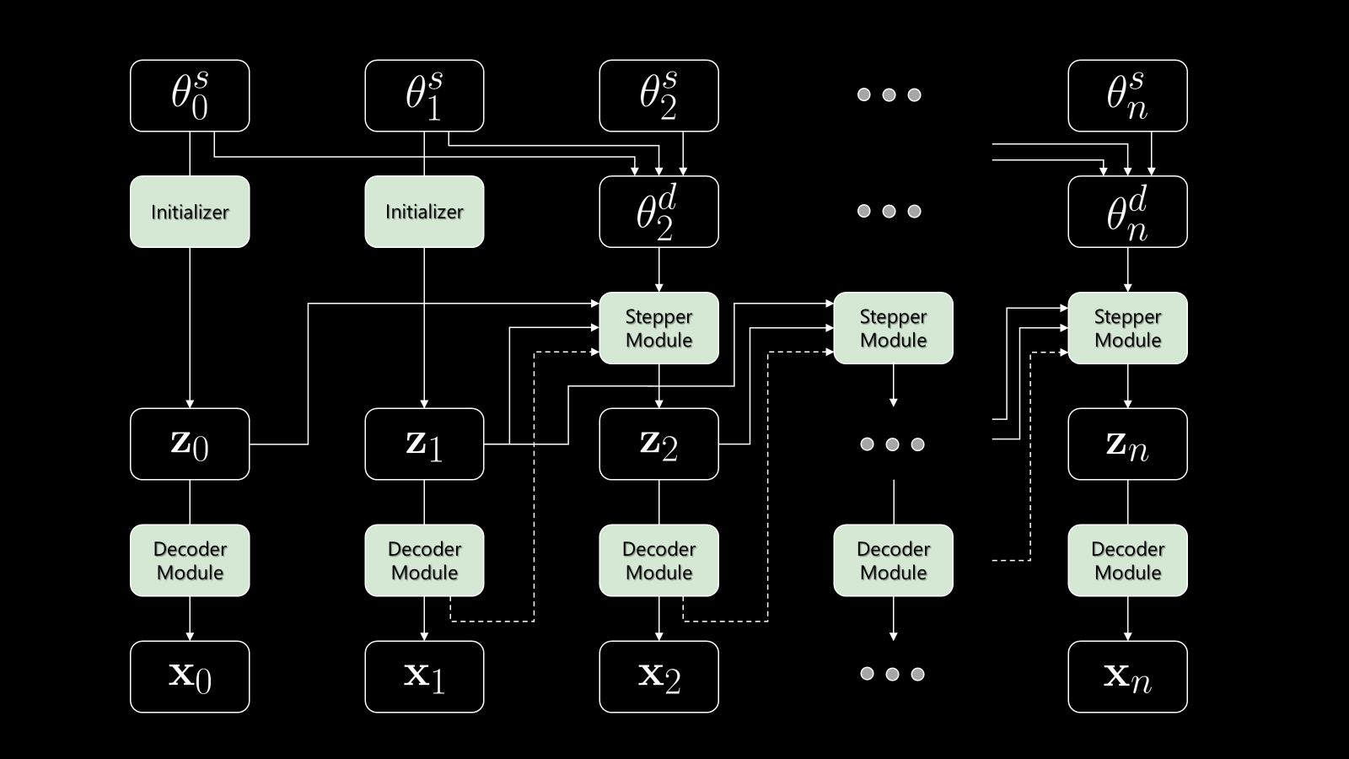
Method – Latent Integrator

Slide 9
Method – Latent Integrator

Slide 10
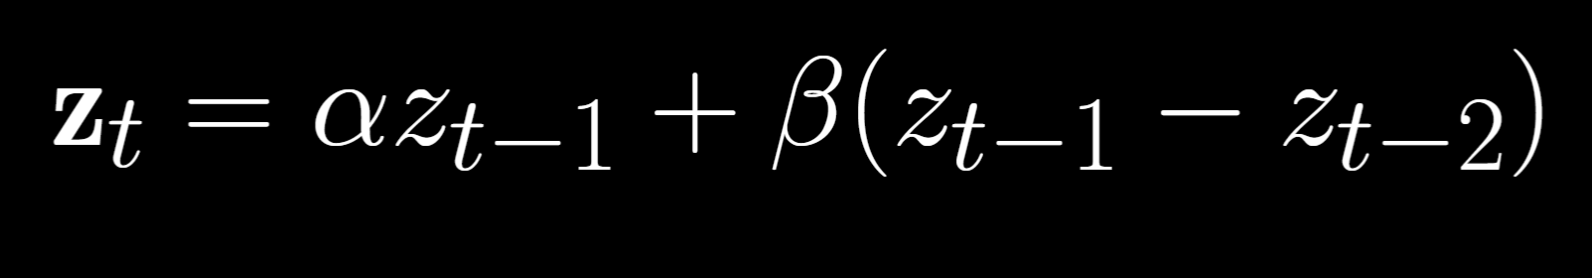
Method – Latent Integrator
Verlet inspired latent stepper module formulation

Slide 11
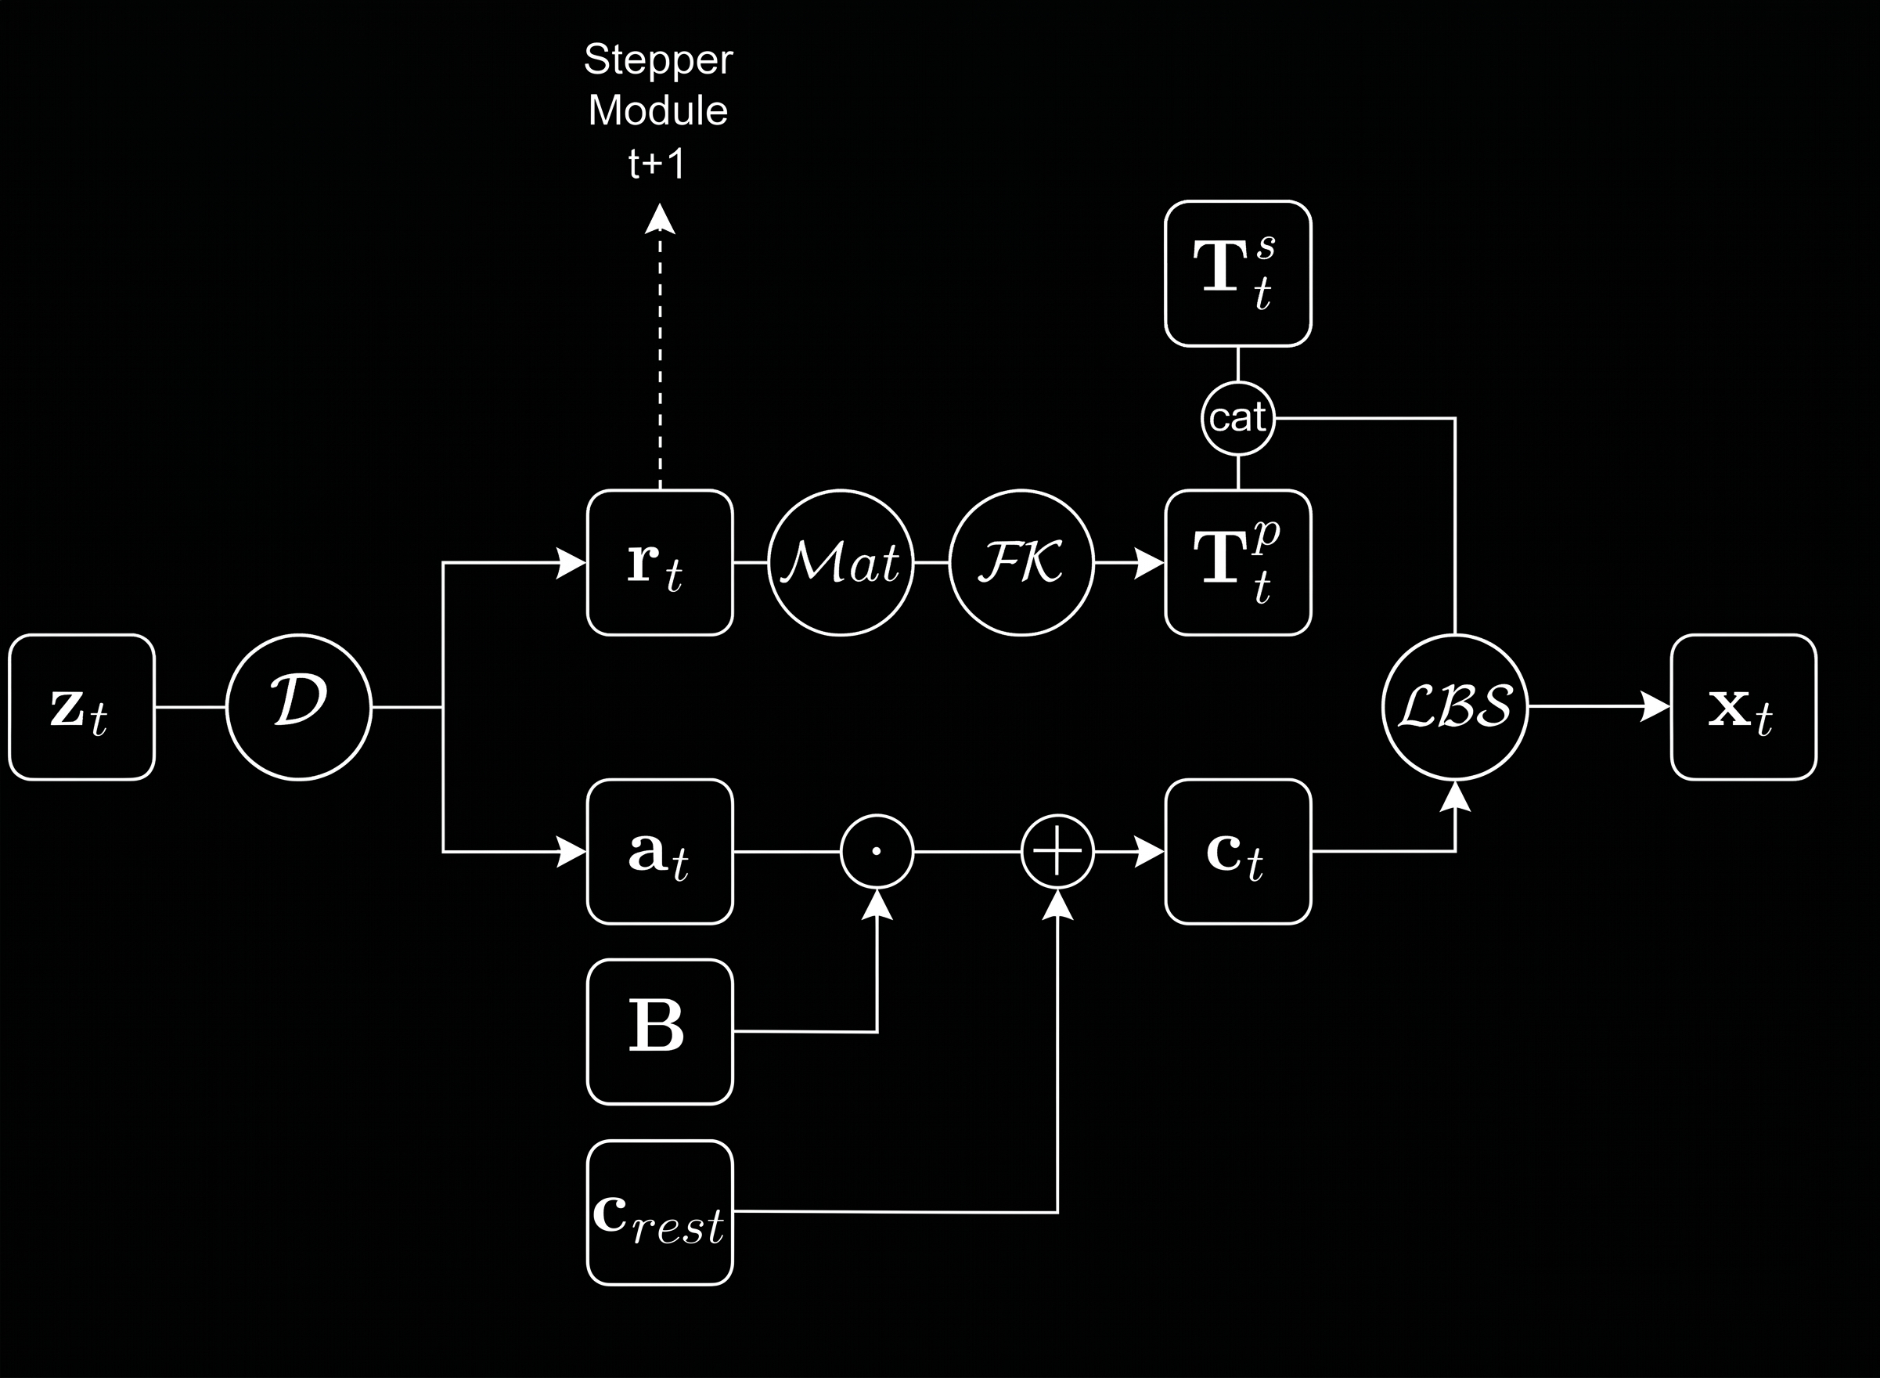
Method – Decoder Module
Two-part decoder module:
  Blendshape weights
  Proxy joint rotations

Slide 12
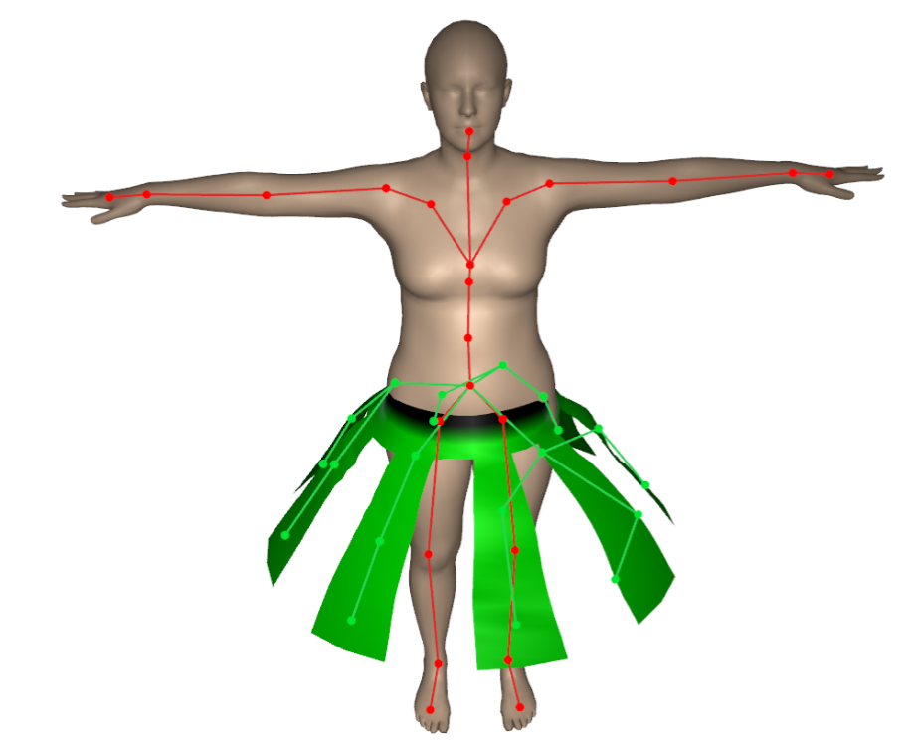

Method – Proxy Joints Setup
Manual artist-driven setup or heuristic based algorithm
Heuristic based algorithm
  Segment into loose and tight vertices
  Evenly sample proxy joints on loose clusters
  Connect character joints to nearest proxy joints

Slide 13
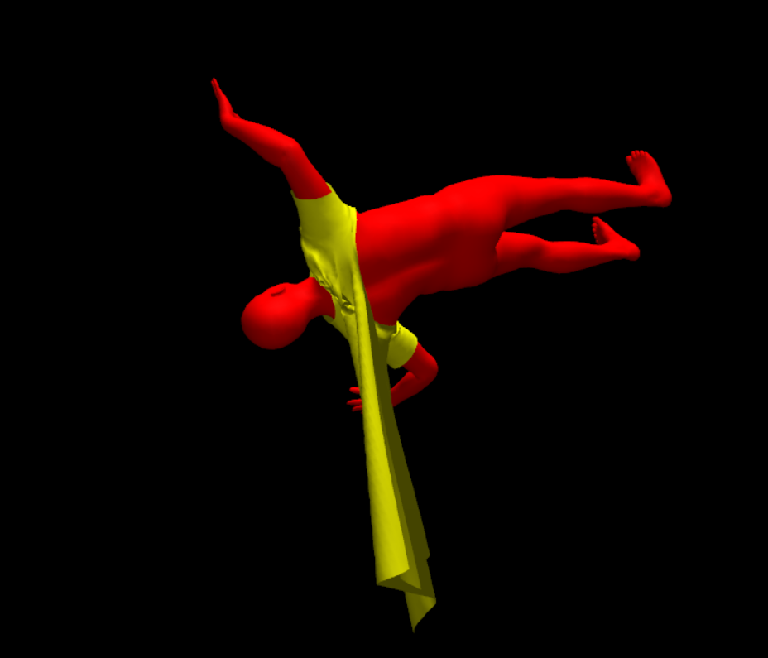
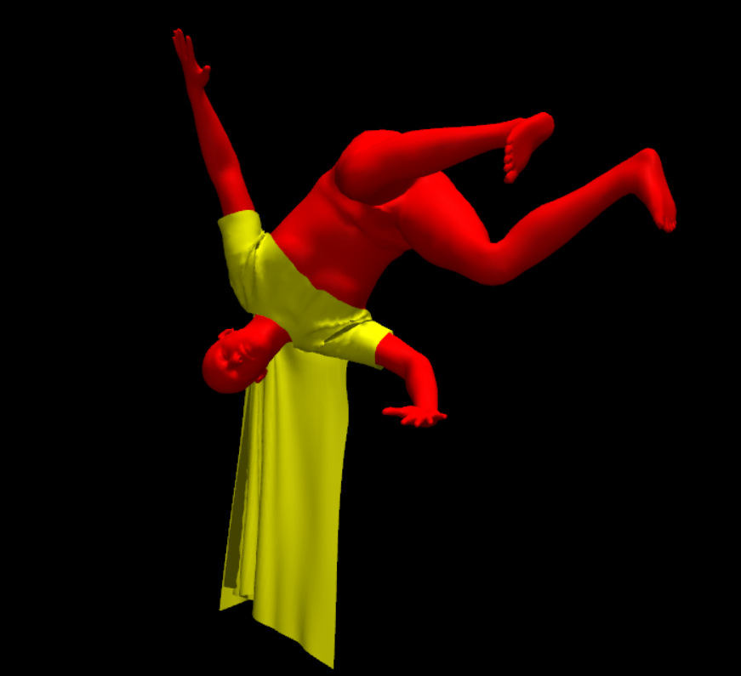
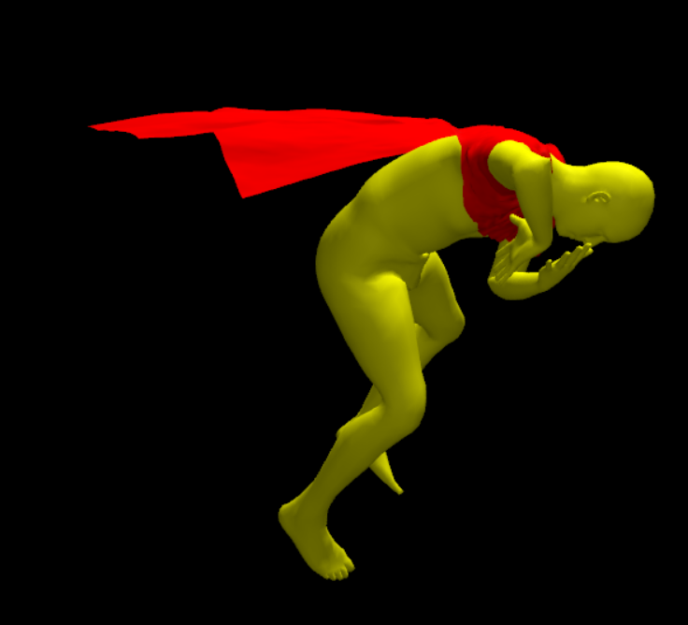
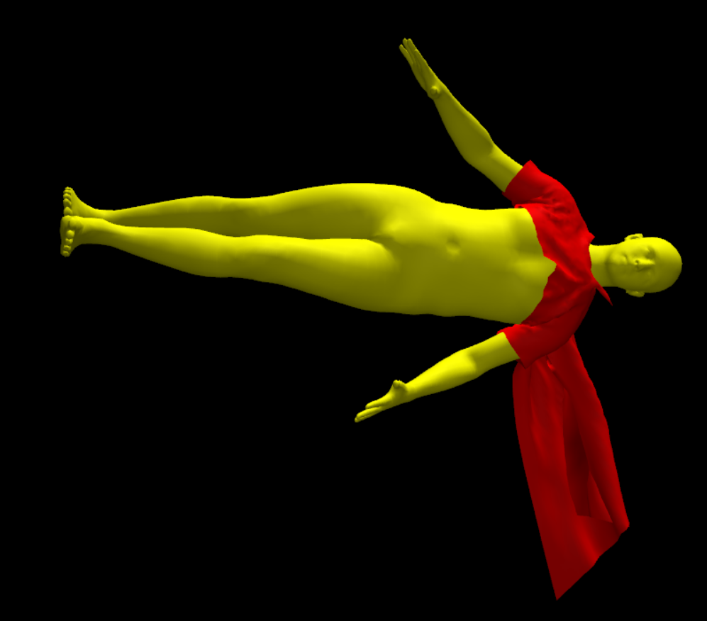
Method – Data Augmentation
Out-of-distribution poses give poor performance
Simple idea: apply random root rotations

Slide 14
Method
Trained with self-supervised losses – same as NCS

Slide 15
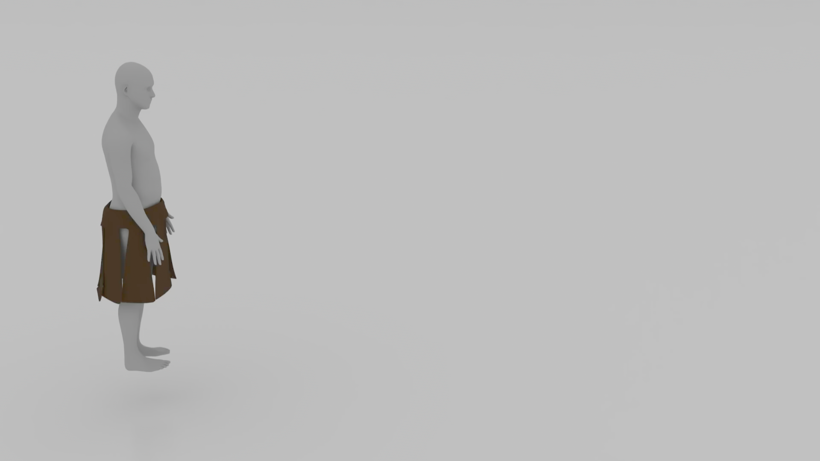
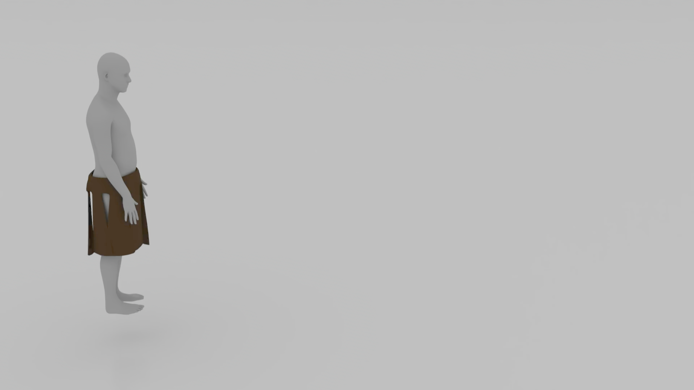
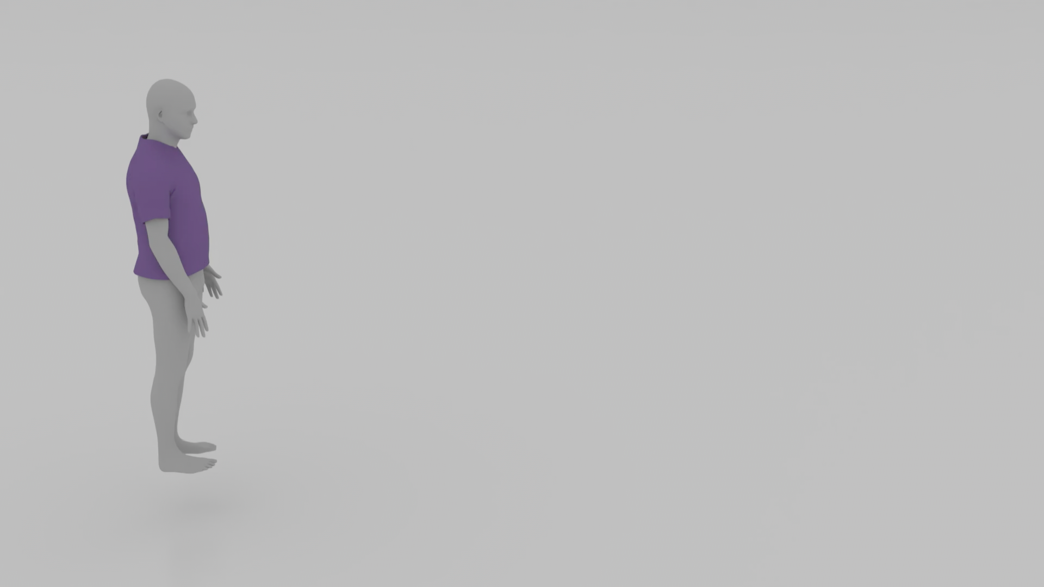

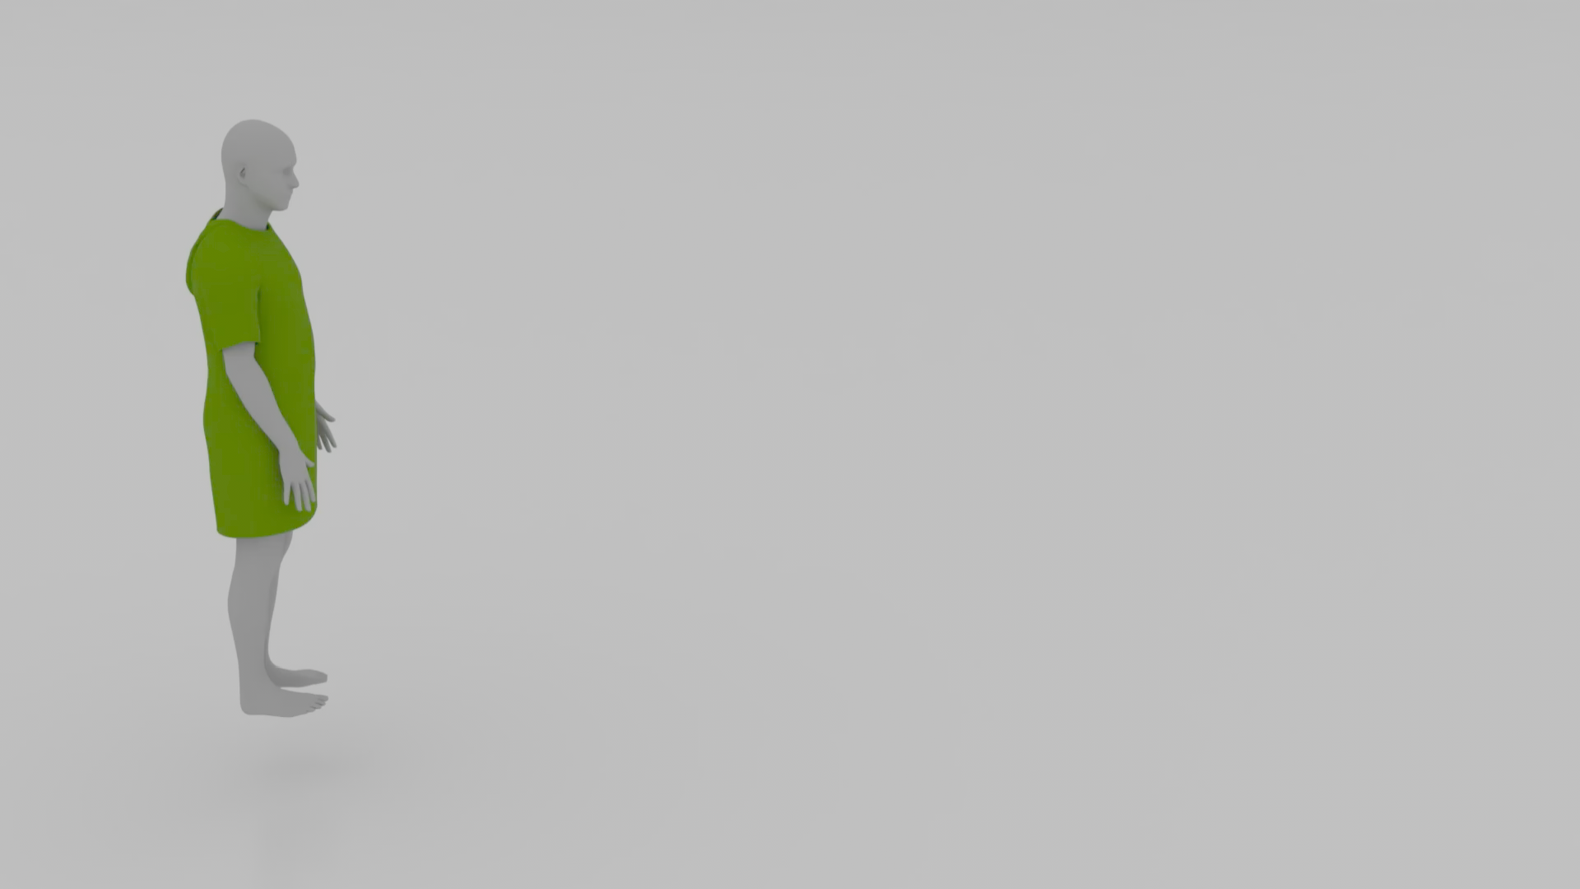
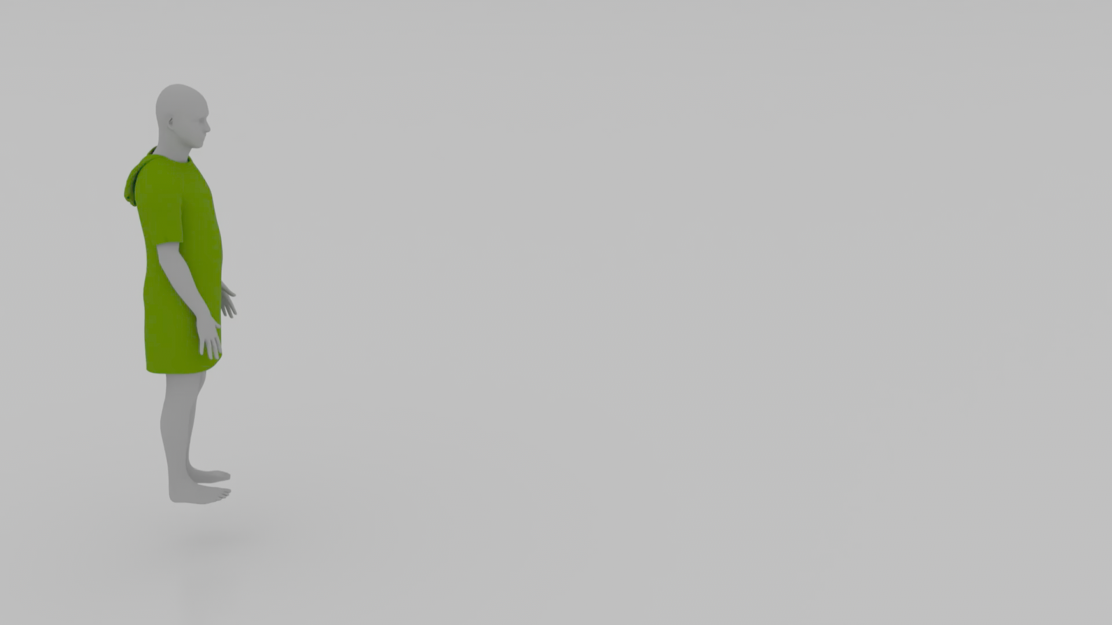
Results
SSILK
NCS

Slide 16
Results - Skirt
SSILK
NCS

Slide 17
Results - Tshirt
SSILK
NCS

Slide 18
Results - Dress
SSILK
NCS

Slide 19
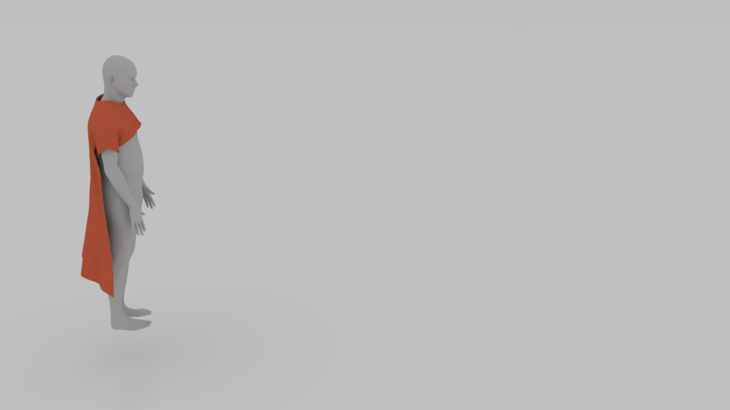
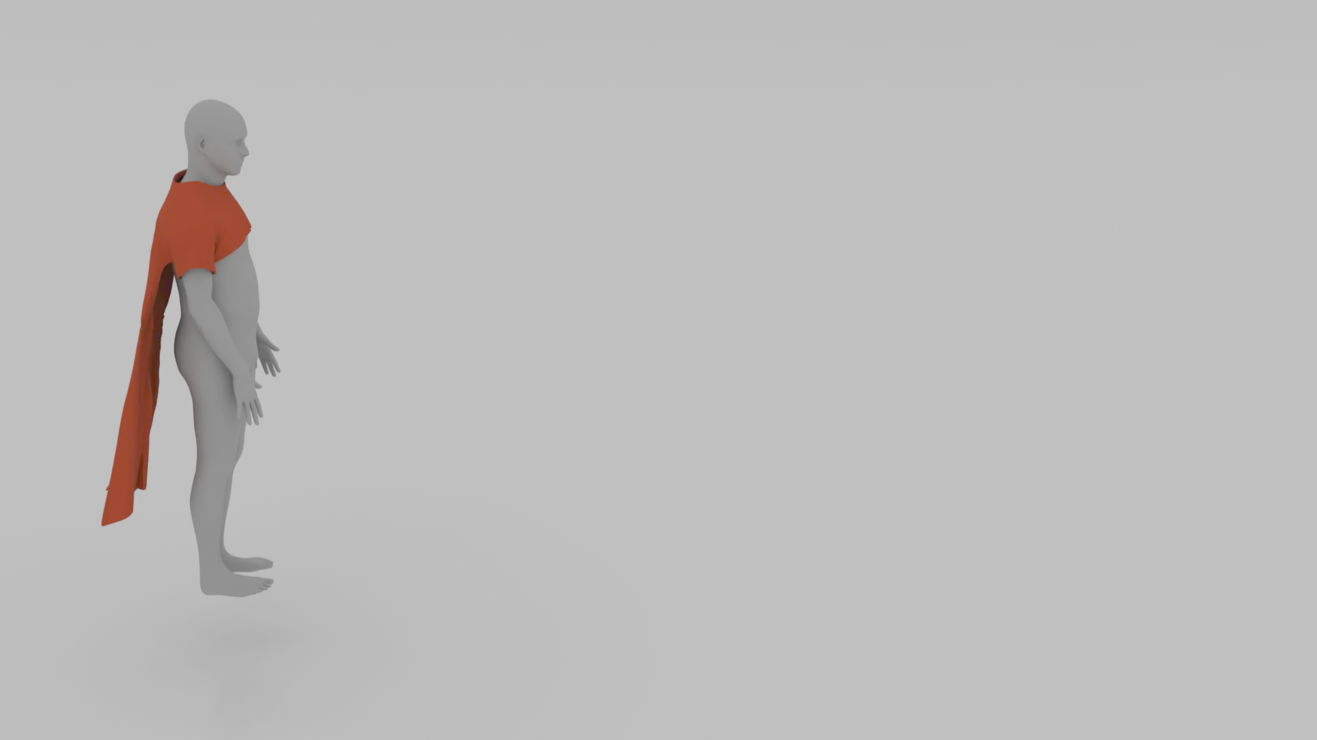
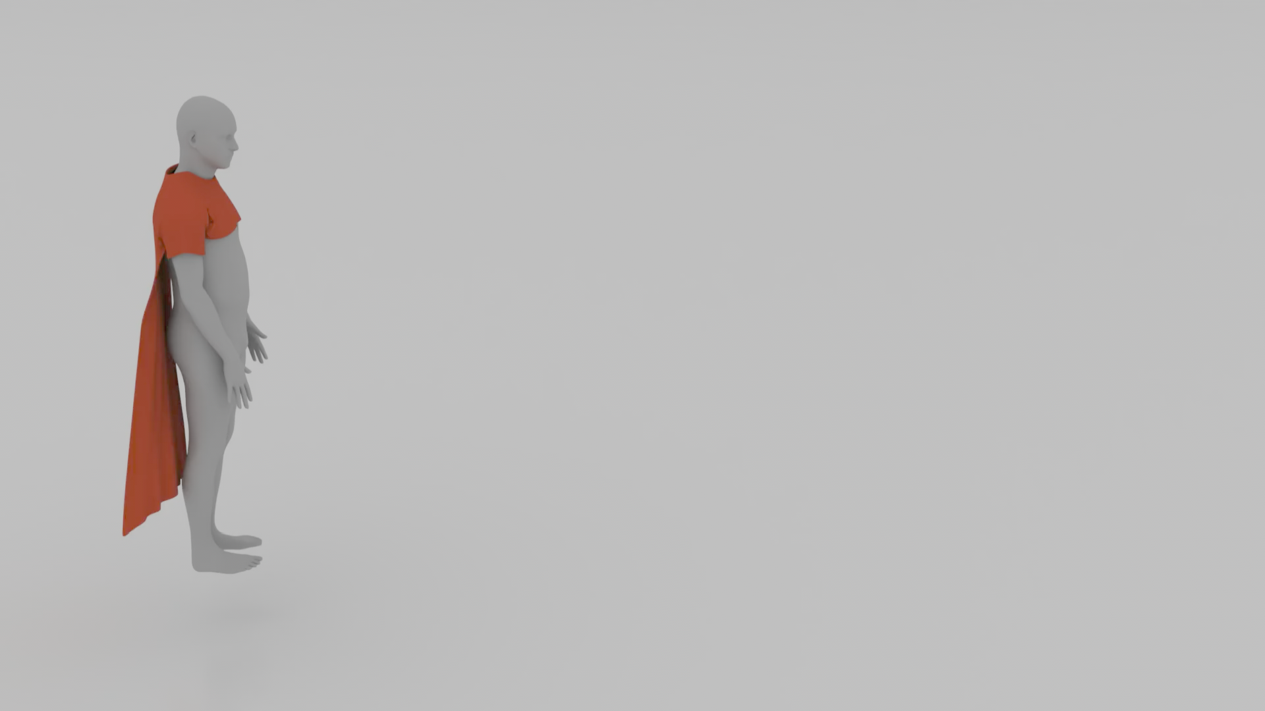
Results - Cape
SSILK
NCS
SIM

Slide 20
Results
SSILK yields superior performance on multiple garments across several datasets compared to NCS
Asset | Method | CMU Valid |  | DanceDB |  | CMU Inertia |  | CMU Flips
 |  | L_tot | ε_col | L_tot | ε_col | L_tot | ε_col | L_tot | ε_col
Cape | SSILK | 1.7252 | 0.58% | 1.7835 | 0.78% | 1.7700 | 0.51% | 1.1124 | 0.55%
 | NCS | 1.7372 | 0.79% | 1.7816 | 1.00% | 1.7595 | 0.83% | 1.4740 | 0.93%
T-Shirt | SSILK | 5.2646 | 1.60% | 5.3979 | 1.77% | 5.3979 | 1.46% | 3.4863 | 1.19%
 | NCS | 6.9831 | 1.86% | 6.3837 | 1.75% | 7.1457 | 1.86% | 4.7760 | 1.27%
Skirt Fringe | SSILK | 0.7030 | 0.34% | 0.7243 | 0.34% | 0.7296 | 0.37% | 0.4969 | 0.99%
 | NCS | 0.7122 | 0.39% | 0.7377 | 0.76% | 0.7467 | 0.46% | 0.7046 | 1.43%
Hooded Dress | SSILK | 7.8222 | 0.48% | 8.1418 | 0.69% | 8.0499 | 0.48% | 5.3570 | 0.38%
 | NCS | 7.9418 | 0.79% | 8.2434 | 0.85% | 8.0845 | 0.87% | 6.4317 | 0.51%
Pants | SSILK | 3.5043 | 0.51% | 3.8121 | 1.25% | 3.7987 | 0.72% | 3.0584 | 1.00%
 | NCS | 3.5439 | 0.53% | 3.9402 | 1.56% | 3.8196 | 0.53% | 3.8268 | 1.37%
Long Sleeve | SSILK | 5.1621 | 1.02% | 5.5063 | 0.99% | 5.2518 | 0.81% | 3.4801 | 0.45%
 | NCS | 5.5032 | 2.36% | 5.7658 | 2.30% | 5.5005 | 2.22% | 4.0782 | 2.05%

Slide 21
Results
Computational cost is roughly similar to NCS
Costs measured in Pytorch, further optimizations can be achieved
Device | NCS (ms/frame) | SSILK (ms/frame)
CPU | 5.34 ± 4.01 | 7.26 ± 3.15
GPU | 4.38 ± 0.18 | 5.38 ± 0.52

Slide 22
Results
Computational cost is roughly similar to NCS
Device | Metric | NCS (ms/frame) | SSILK (ms/frame)
CPU | Full Pipeline | 5.34 ± 4.01 | 7.26 ± 3.15
 | Model only | 3.64 ± 3.99 | 2.83 ± 1.75
 | Model + FK | 3.64 ± 3.99 | 2.85 ± 1.75
 | Blendshapes + Skinning | 1.69 ± 0.37 | 4.41 ± 2.62
GPU | Full Pipeline | 4.38 ± 0.18 | 5.38 ± 0.52
 | Model only | 2.19 ± 0.07 | 2.75 ± 0.20
 | Model + FK | 2.20 ± 0.07 | 2.77 ± 0.20
 | Blendshapes + Skinning | 2.18 ± 0.16 | 2.61 ± 0.48

Slide 23
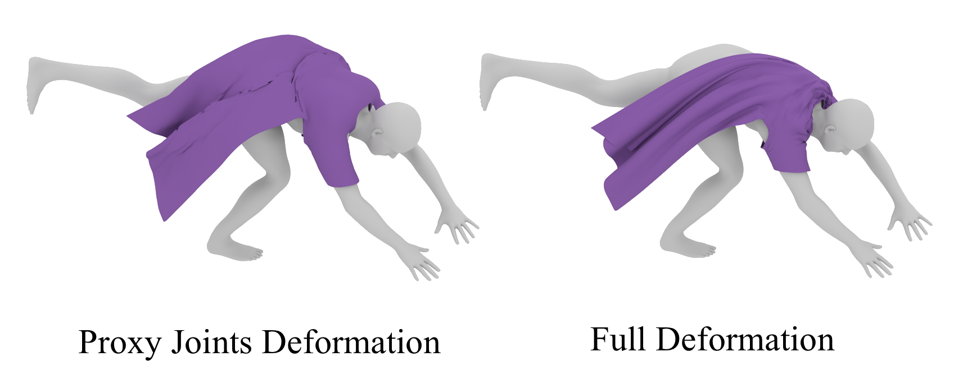
Results – Proxy Joints vs Full Pipeline

Slide 24
Conclusion
SSILK contributions:
  Pose-based method with support for loose garments (capes, dresses)
  Novel proxy-joint blendshape hybrid architecture
  Explicit Verlet-inspired latent integration
  Data-augmentation for out-of-distribution scenarios

Slide 25
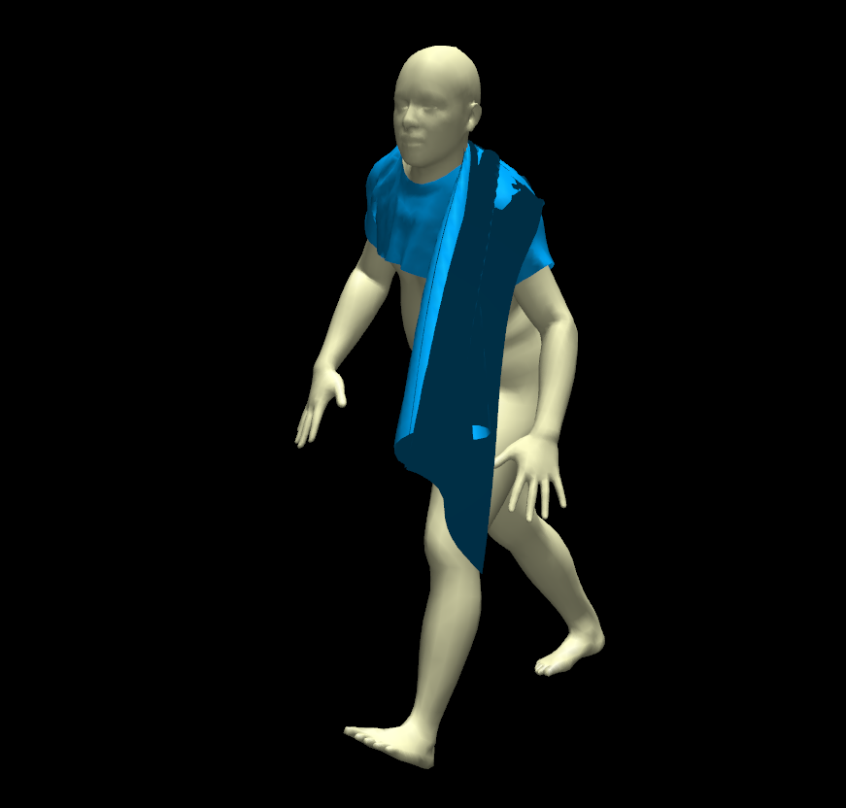
Conclusion
Limitations and future work:
  No support for self-collision

Slide 26
Conclusion
Limitations and future work:
  No support for self-collision
  Fixed topology model (needs re-training for each garment)

Slide 27
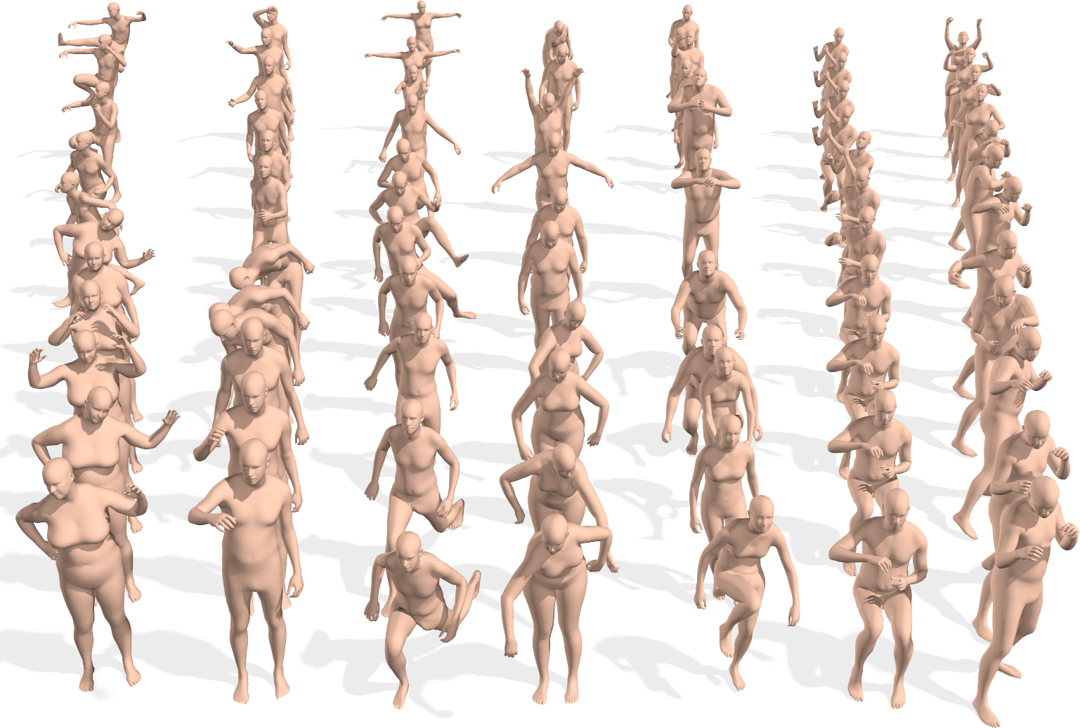
Conclusion
Limitations and future work:
  No support for self-collision
  Fixed topology model (needs re-training for each garment)
  Requisite of character pose animation dataset (AMASS)
[6]
[6] – AMASS Diagram, taken from Mahmood, N., et al. "AMASS: Archive of Motion Capture as Surface Shapes." ICCV (2019).

Slide 28
Conclusion
Limitations and future work:
  No support for self-collision
  Fixed topology model (needs re-training for each garment)
  Requisite of character pose animation dataset (AMASS)
  Currently only rotational proxy-joints supported

Slide 29
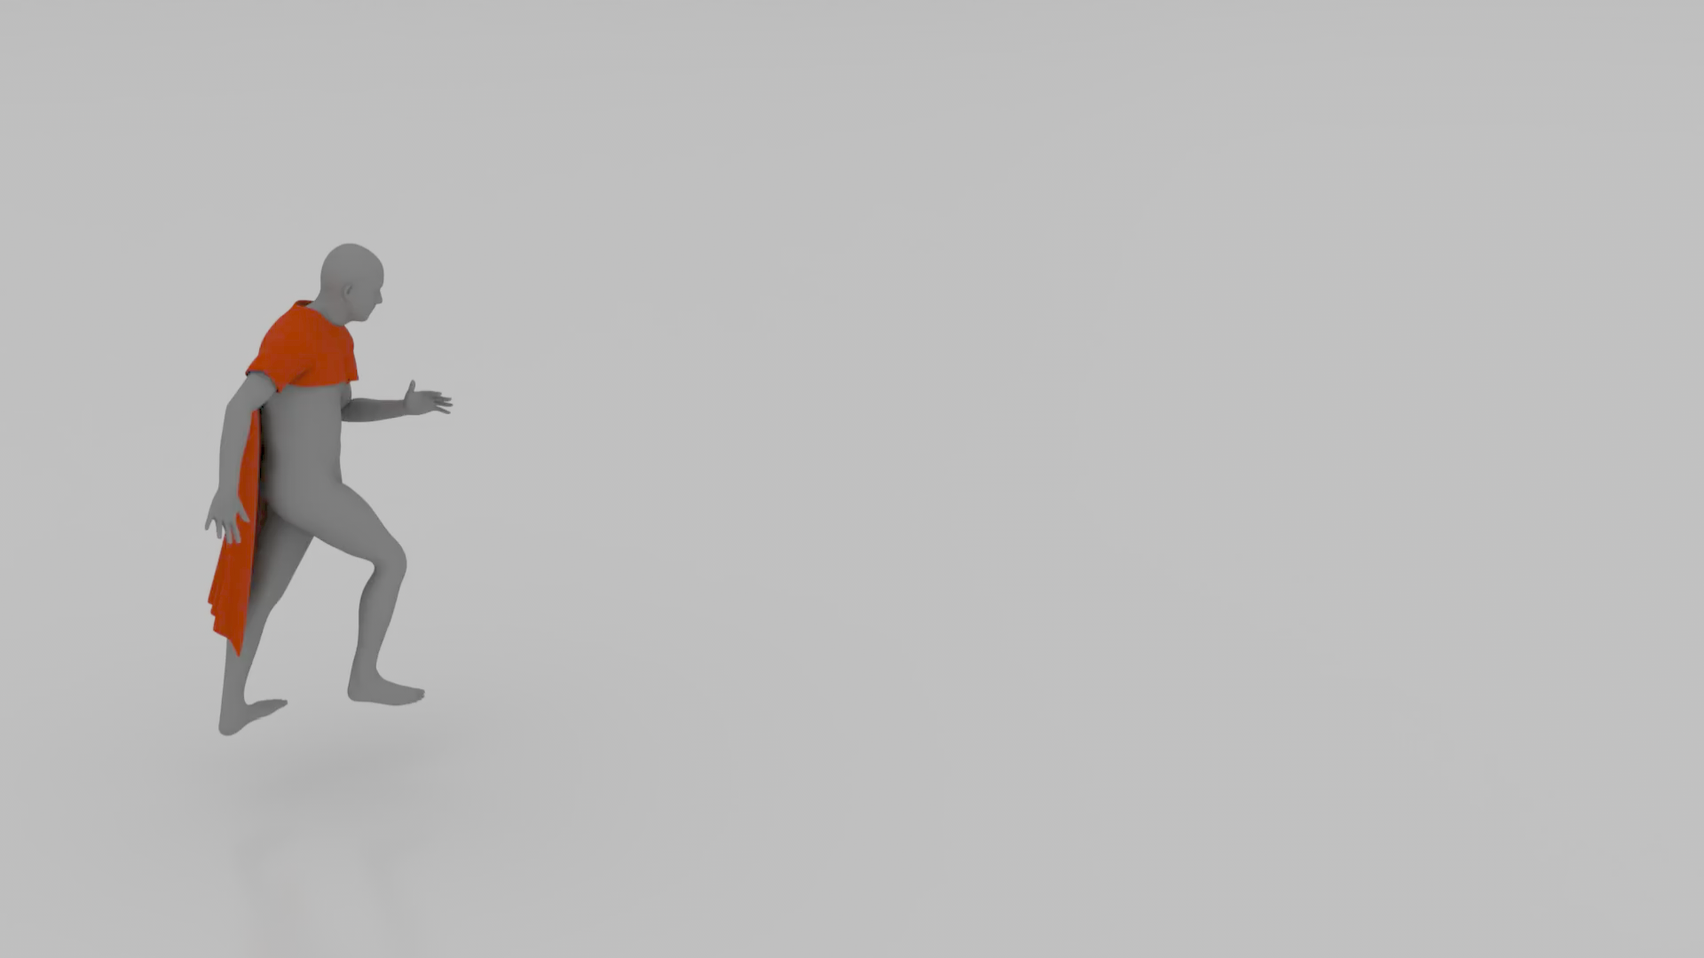

THANKS!

