Slide 1
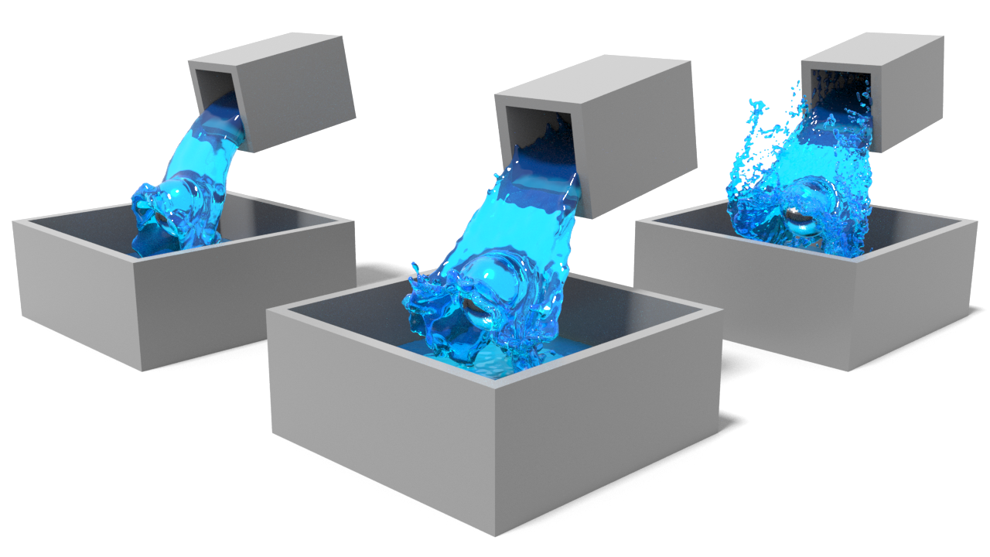
Neural UpFlow: A Scene Flow Learning Approach to Increase the Apparent Resolution of Particle-Based Liquids
Bruno Roy^{1,3}, Pierre Poulin¹, Eric Paquette²
¹ Université de Montréal
² École de technologie supérieure
³ Autodesk
Notes:
Alright, Thank you for the introduction
Hello everyone
My name is Bruno and today I’ll be presenting our up-resing approach leveraging deep learning to express scene flows as Lagrangian motions for particle-based liquids

Slide 2
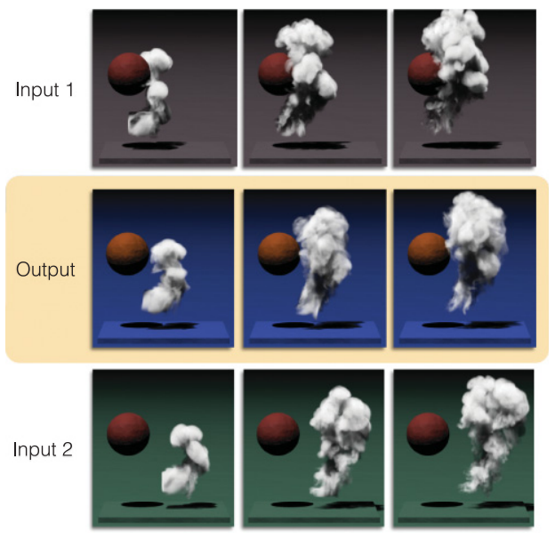
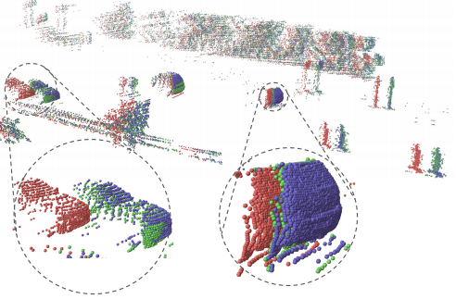
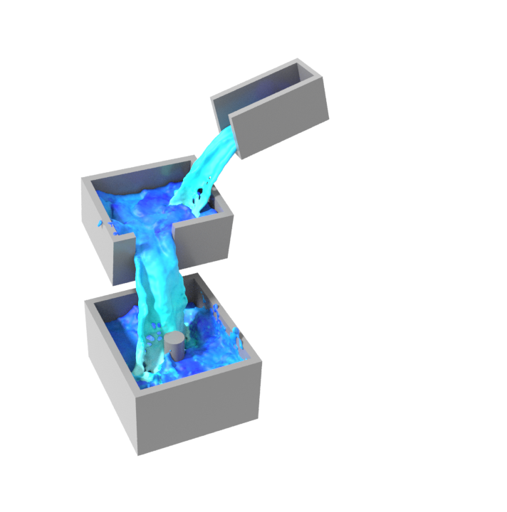
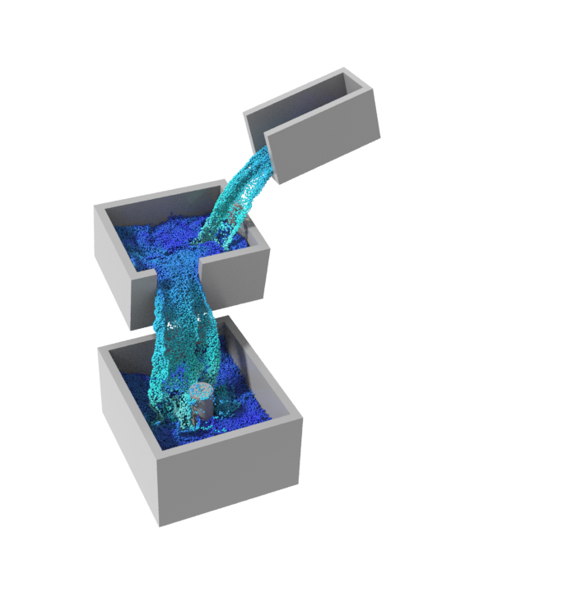
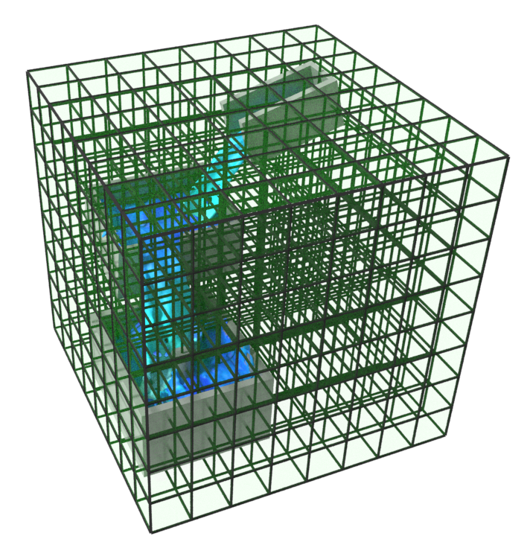
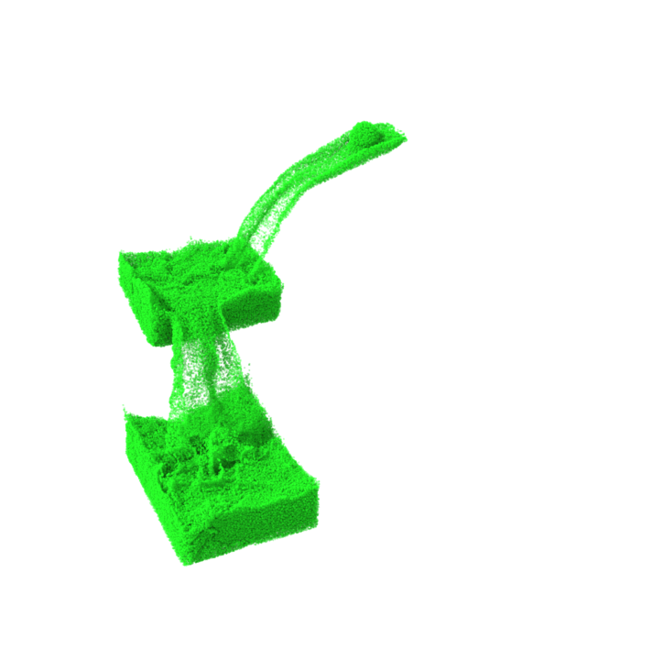
Motivation
Deep learning has proven to be effective for scene flow estimations on point clouds
Particle-based liquids are suitable to generate small-scale details
High-resolution liquids remain computationally expensive
Coarse liquids are interactively controllable
Grid res.: 192³
Liu et al. [2019]
# particles: 1.1M
Thuerey [2017]
Notes:
In recent years, deep learning has proven to be very effective for scene flow estimations on point clouds
Lately, scene flows have also been used to produce high-quality interpolations between fluids
As we know, Lagrangian and hybrid methods are usually preferred to generate small-scale details such as those included in splashes and other types of dynamic behaviors in liquids.
These methods allow computational efforts to be concentrated in regions where the fluid contributes most to visual details
Nevertheless, these simulations still require a significant amount of particles to produce the desired level of detail at the surface
Even today, high-resolution liquids remain computationally expensive
Working with a low-resolution liquid can offer better interactivity for the users in the artistic community for visual effects

Slide 3
Up-resing Particle-Based Liquids
Notes:
Our approach is capable of generating high-resolution details by predicting displacements directly applied on the particles of a coarse input liquid;
Our network was able to reproduce similar details present in the high-resolution reference

Slide 4
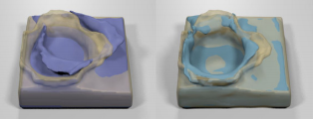
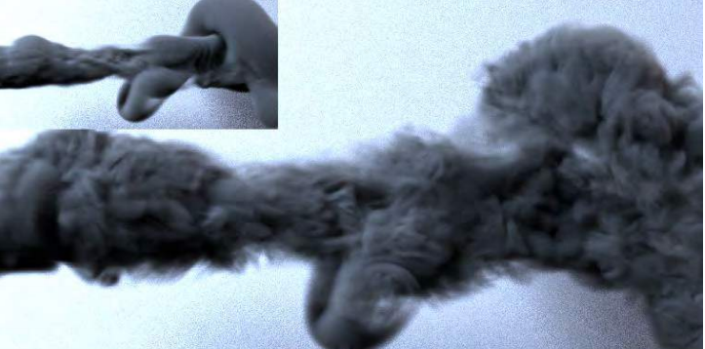
Related Work
[Prantl et al., 2017] “Generating Liquid Simulations with Deformation-Aware Neural Networks”
Focuses on pre-computing deformations for real-time applications
[Chu et al., 2017] “Data-Driven Synthesis of Smoke Flows with CNN-Based Feature Descriptors”
Matches high-resolution pre-computed patches to upscale flow physical quantities
[Xie et al., 2018] “tempoGAN: A Temporally Coherent, Volumetric GAN for Super-Resolution Fluid flow”
Encodes and synthesizes fine details of space-time flows
[Bai et al., 2020] “Dynamic Upsampling of Smoke Through Dictionary-Based Learning”
Upsamples high-resolution velocity field
Notes:
In the last years, several works were proposed to increase the apparent resolution of fluid simulations with machine learning
The work most similar to ours in spirit is the one by Prantl et al.:
focusing on pre-computing deformations for real-time applications
Around the same time, Chu et al.
Proposed a method that matches high-resolution pre-computed patches to upscale flow physical quantities
Xie et al. also introduced a method to improve visual appearance of fluids by
encoding and synthesizing fine details of space-time flows
And most recently, Bai et al. proposed a dictionary-learning method to
Upsample high-resolution velocity field
Although some of these works are proposing ways to upscale low-resolution simulations, only one of them is applied on liquids;
Moreover and to the best of our knowledge, our approach is the first to tackle the up-resing problem of liquid simulations from a Lagrangian perspective.

Slide 5
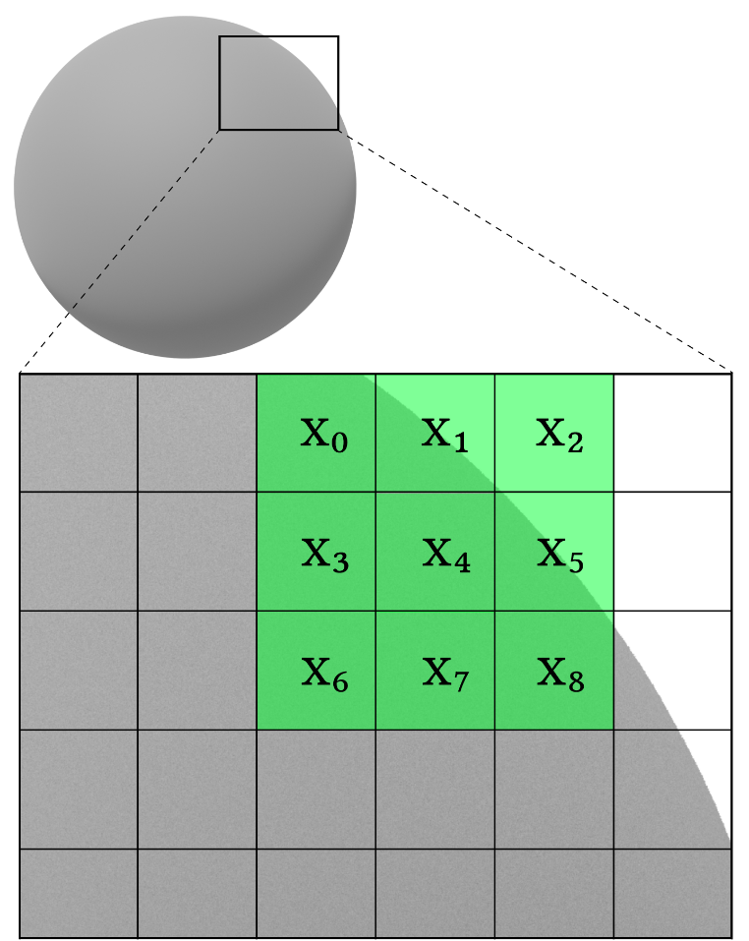
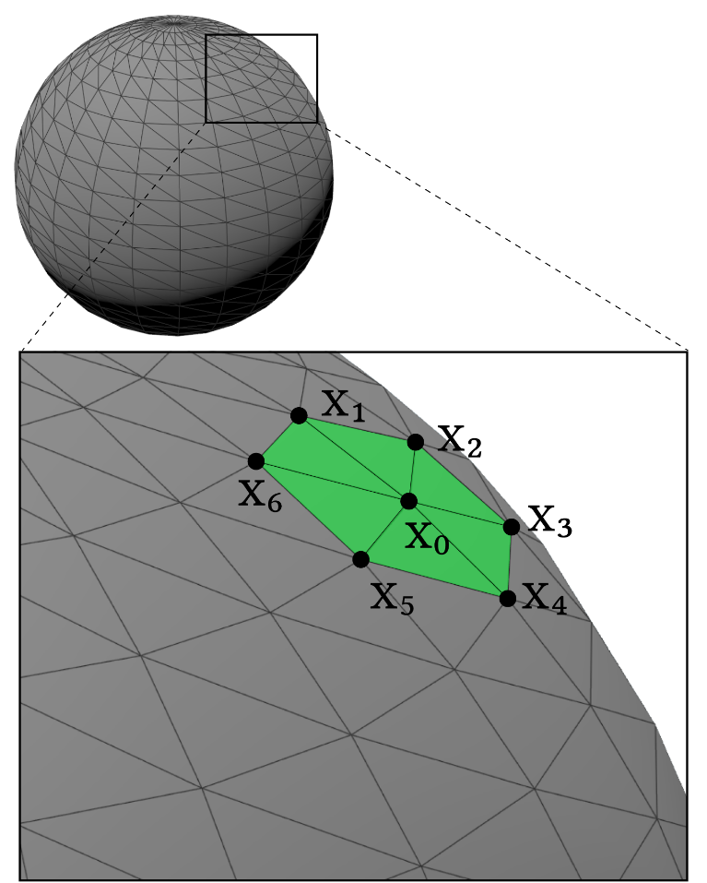
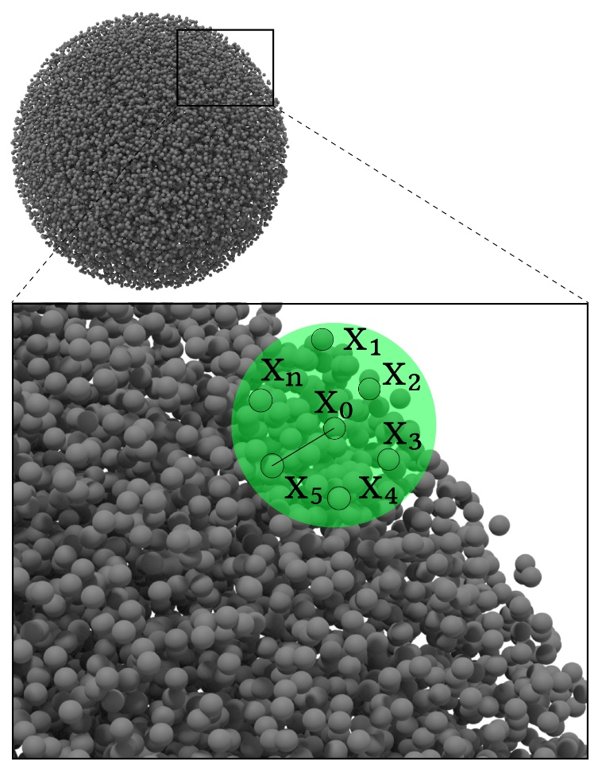
Fundamentals
Using CNN with particles can be challenging…
Notes:
But before we dive in, let us take a step back and highlight one of the challenges related to using convolutional neural networks with particles
Using convolutions is rather intuitive with 2D image datasets
Things get a bit more complicated with irregular structures such as meshes. However, the neighborhood can still be retrieved to preserve internal connectivity
Working with point clouds and particle systems slightly complicates a bit further the learning task using convolutional operations
Our task is to define particle neighborhoods throughout convolutions

Slide 6
Contributions
A deep neural network using the particle neighborhoods and a deformation-aware loss function
An advection scheme transposing a scene flow into a Lagrangian motion
An interpolation approach for matching topological changes on key events between liquids using different discretizations
A data augmentation framework that artificially grows an existing particle-based simulation dataset
Notes:
In contrast with previous work, we encode the deformations directly on the particles of liquid simulations
We use an advection scheme allowing us to express the predicted scene flow into Lagrangian motions
Our datasets are prepared using an interpolation approach matching topological changes on key events between liquids simulated at different discretizations
Lastly, using that same interpolation approach, we introduce a data augmentation framework allowing to grow an existing particle-based simulation dataset

Slide 7
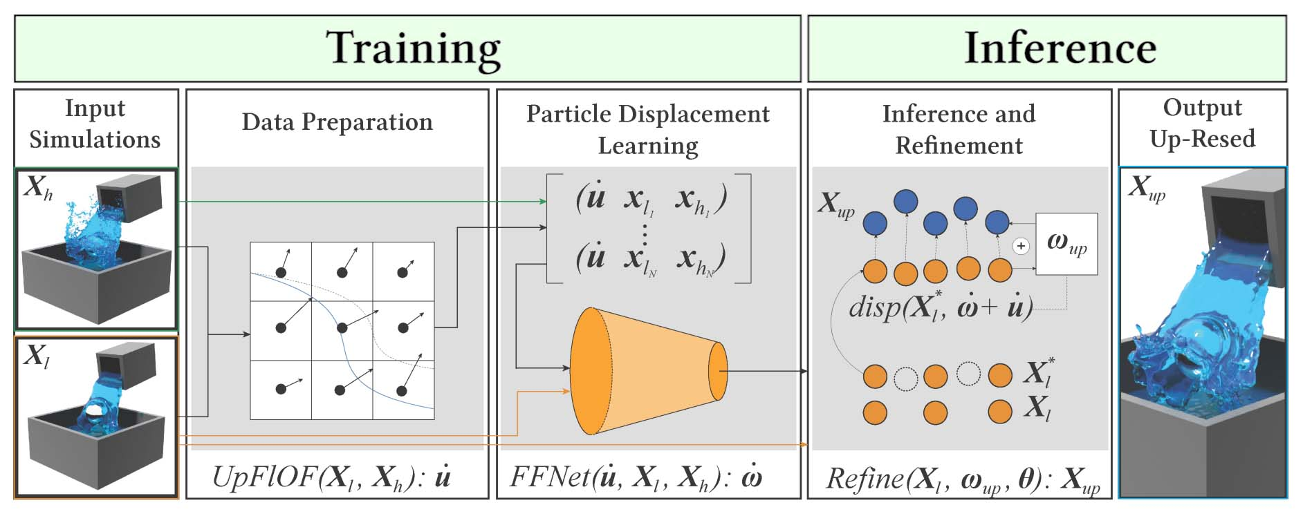
Overview
7
Notes:
This is the pipeline overview of our approach

Slide 8
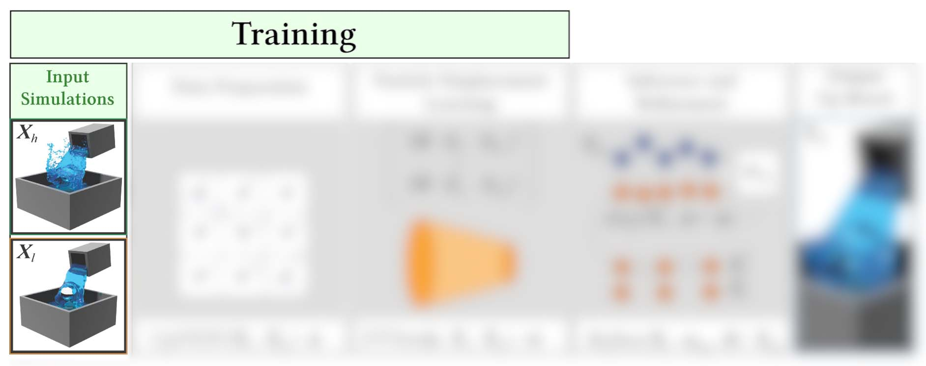
Overview
8
Notes:
We train our network as follows...
We use pairs of multi-resolution inputs as training and validation sets

Slide 9
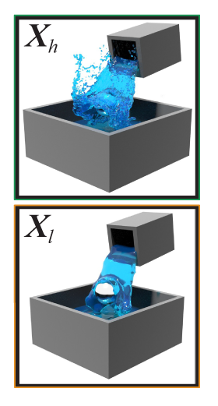
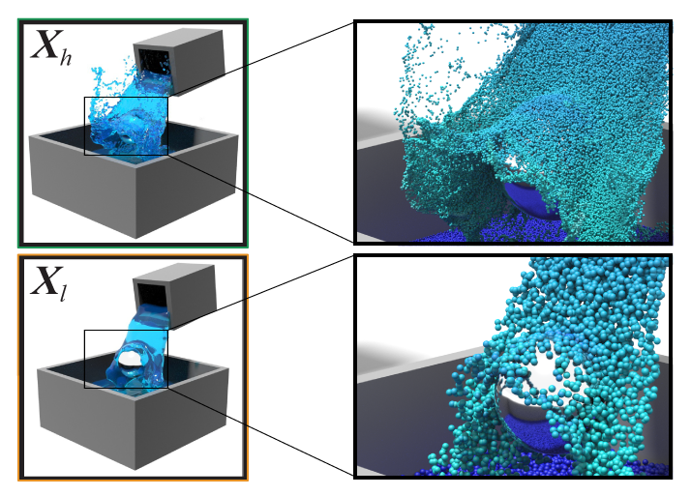
Multi-resolution Inputs
Pairs of particle-based liquids: low and high resolution
Using the same initial conditions
Except for the discretization
>10M
part.
<500k
part.
9
Notes:
Each multi-resolution pair includes a low- and a high-resolution particle-based liquid
Both liquids were simulated using the same initial conditions
Except for the discretization
Take this single frame of animation as an example
The low-resolution is composed of roughly 500 thousand particles
while its high-resolution equivalent is about 10 million.

Slide 10
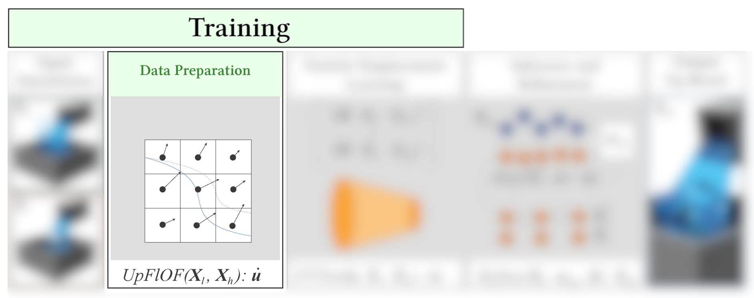
Overview
10
Notes:
Using these multi-resolution inputs, we compute an additional feature along with the positions to define the deformation required to map the low-resolution to the high-resolution inputs
Using a deformation prior, we can approximate the upscaling factor as the differences between low- and high-resolution liquids

Slide 11
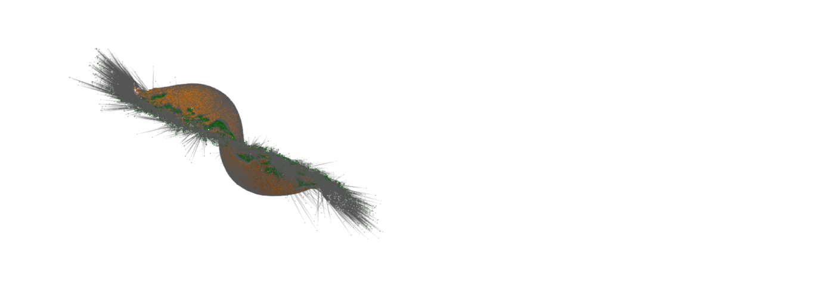
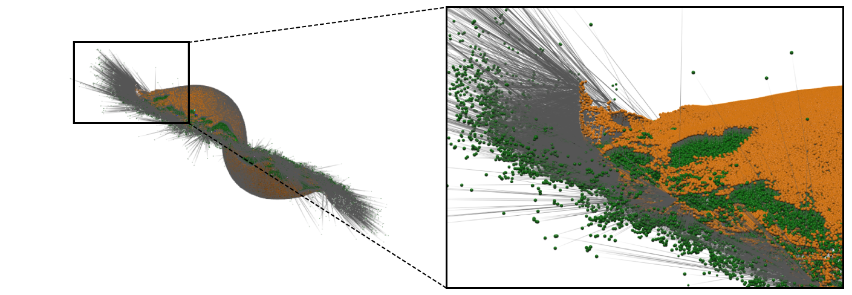
Data Preparation: Deformation Prior
( - )
$$Φ_{l}=SDF(X_{l})$$
$$X_{l}^{′}=upsample(X_{l},Φ_{l})$$
$$\dot{ω}≈X_{h}−X_{l}^{′}$$
?
11
Notes:
This deformation prior is used as an initial belief we infer to our network
The objective is to compute a displacement field from the low-resolution to the high-resolution particles
Naively, we can express the Lagrangian displacement as the difference between the upsampled coarse liquid and the high-resolution ground truth
We wish to express that displacement with physical quantities such as velocities

Slide 12
Data Preparation: Deformation Prior
$Φ_{l}^{′}=upscaleInterp(Φ_{l}, r_{h})$
$u_{ω}=FlOF\left(Φ_{l}^{′},Φ_{h},α=1\right)$ [Thuerey, 2017]
$\dot{ω}=advect(X_{l}^{′},u_{ω})$
12
Notes:
To do so, we adapted a state-of-the-art method to interpolate between particle-based liquids, and that, at different resolutions.
We first upscale and interpolate the coarse SDF to match the high-resolution input
Then, we use Thuerey’s interpolation method to generate a deformation field morphing the input low-resolution liquid into the target high-resolution liquid
From there, we use our advection scheme to displace the particles accordingly
As shown in this comparison, ours preserves the target details while keeping a liquid appearance

Slide 13
Data Preparation: Improved Alignment
$$A_{UpOF}= ∇Φ_{h}^{T}∇Φ_{h}+β_{S}\sum_{j}{L_{j}}+β_{T}I$$
Linear system $A_{UpOF}u=b$: solving for $u$where $b={[∇Φ_{h}]}^{T}$ $Φ_{δ}$ and $Φ_{δ}$ is the finite difference between $Φ_{h}$ and $Φ_{l}$
Complex cells: $c_{i}$ is flagged using complex cell tests with piecewise linear isosurfaces
Weighted using inverse distances to key surface point $d_{i}=\frac{1}{d_{x_{i}→x_{k}}}c_{i}$
Soft constraint to minimize this distance: $A_{UpOF}= ∇Φ_{h}^{T}∇Φ_{h}+β_{S}\sum_{j}{L_{j}}+β_{T}I+D$
13
Notes:
However, since we aim to match features between different discretization, we need to enforce an additional alignment term to make sure our solution is valid:
The correspondence between frames of the input animations is crucial during the training step)
Solving for the deformations u using a state-of-the-art optical flow solver, we introduce what we called “key-events alignment” to align our scene flow solution with flagged topological changes between the low- and the high-resolution liquids
We use complex cells to identify regions in which we should map these key events
Within the complex cells, a set of key feature particles is computed to align the deformations with these key events
The resulting term is added to our system as a soft constraint to provide an improved alignment.
Complex cell test (detect complex edges or faces, comparing the SDF cells with generated maching cube surface), we do not perform the resampling part as the original paper, our goal is solely to identify cells with topological events such as collision, merging of volumes, etc.
Original Varadhan
Since ICP isn’t meant for highly deformable point clouds such particle systems, we need to use the complex cell test to narrow down and approximate the lookout regions
This is performed before the upsampling step to reduce the computational overhead

Slide 14
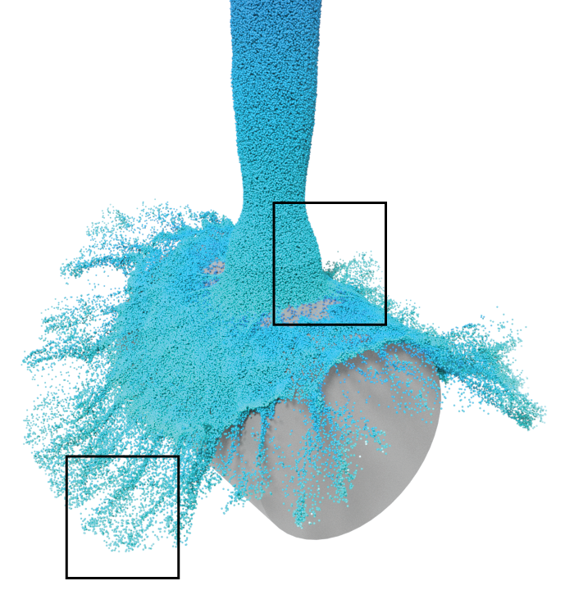
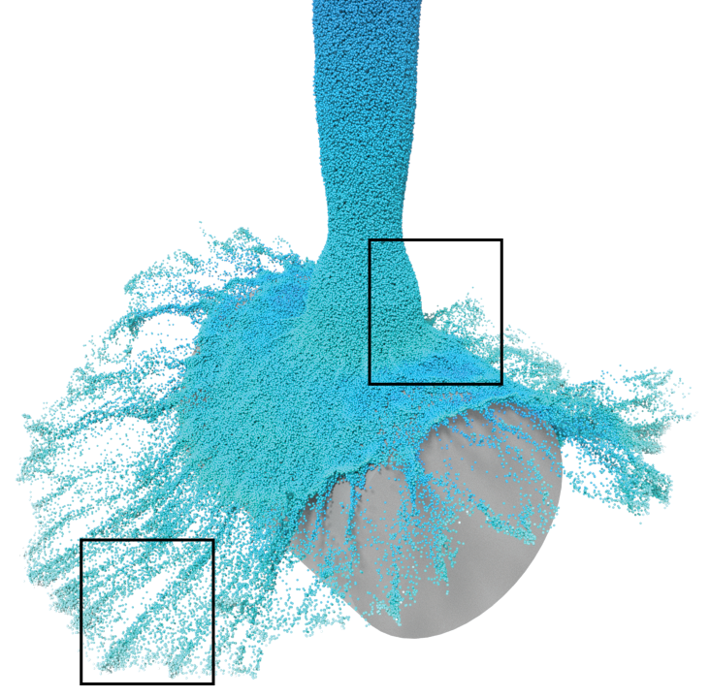
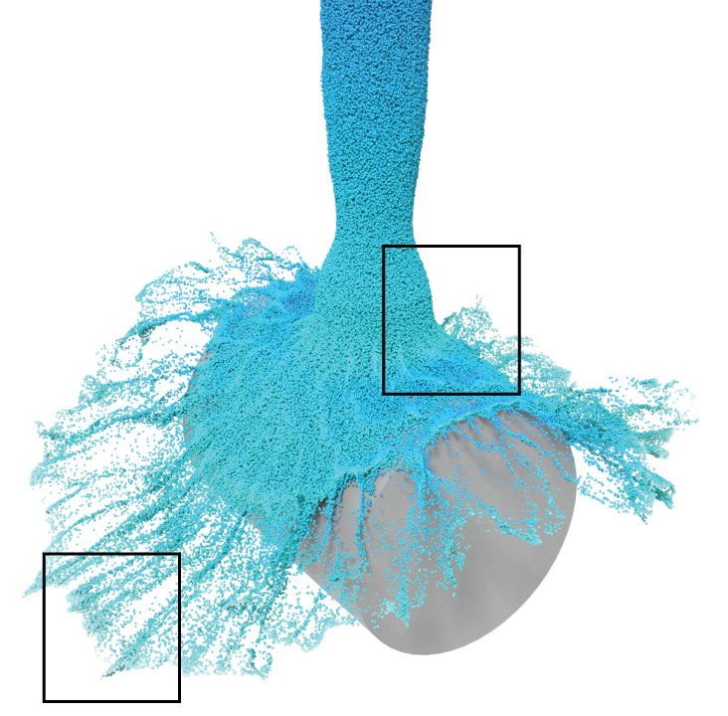
Data Preparation: Improved Alignment
Without
Alignment
With
Alignment
Reference
14
Notes:
Here’s a comparison to highlight our alignment term

Slide 15
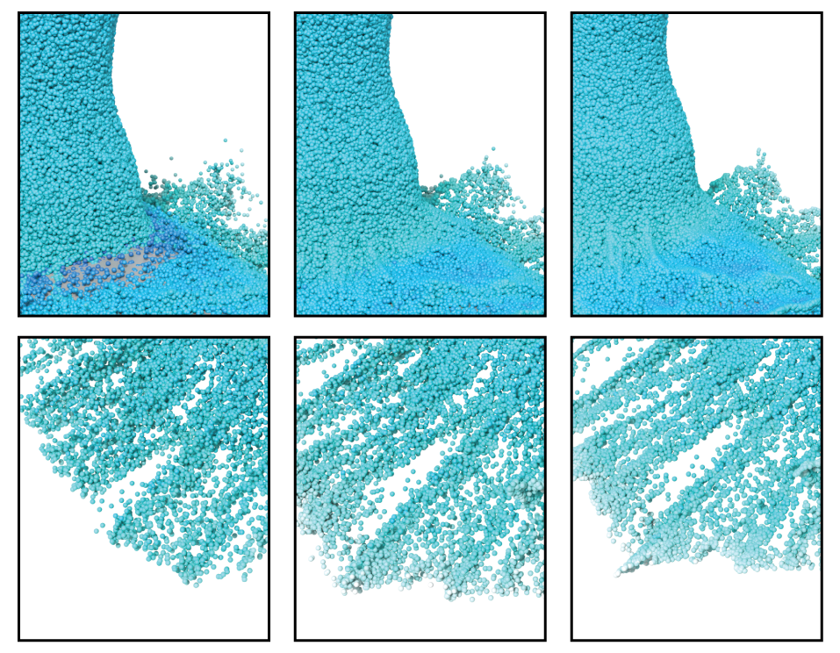
Data Preparation: Improved Alignment
Artifacts:
Key-event alignment:
Not following
obstacles
Following
obstacles
Losing small-scale
details
Preserving small-scale
details
$$UpFlOF(X_{l})$$
$$UpFlOF(X_{l},d_{i})$$
Reference
15
Notes:
As shown in these enlarged views, undesirable artifacts are generated at the impact location and within diffuse regions using the traditional method
Because of the significant differences between both input resolutions, particles are displaced within obstacles as presented on the top left figure
Misalignment can also dissipate small-scale details in turbulent liquids such as highlighted in the bottom left view
Using our alignment term, we prevent undesirable artifacts while preserving most of the small-scale details present in the high-resolution reference

Slide 16
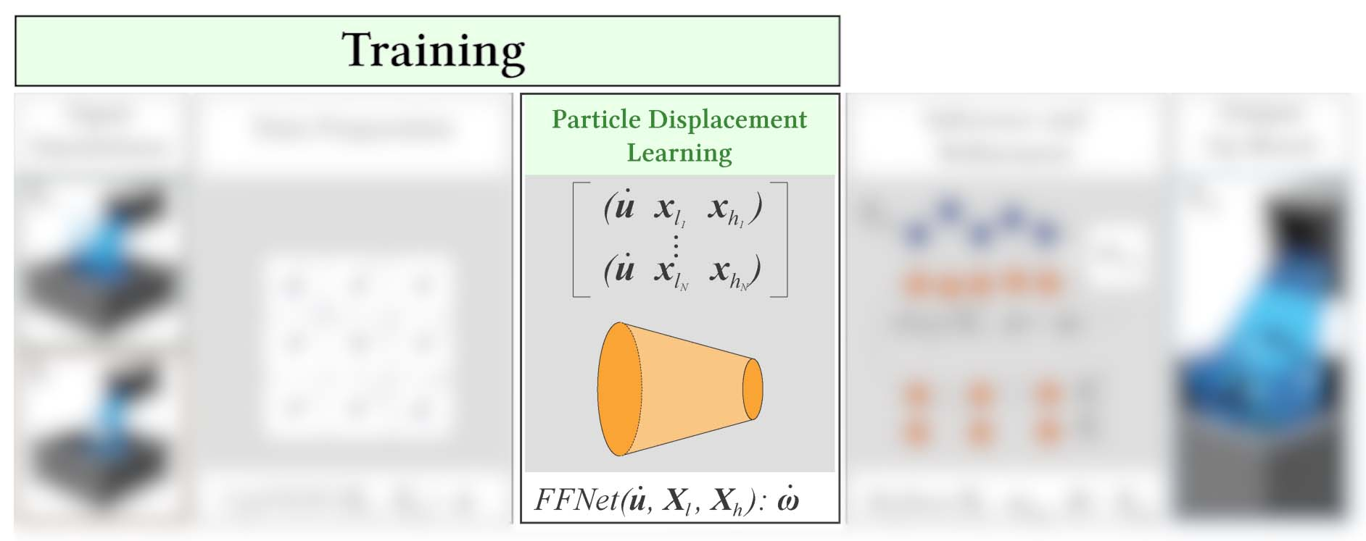
Overview
16
Notes:
Once the data preparation step is complete, our deep neural network takes these inputs and returns particle displacements

Slide 17
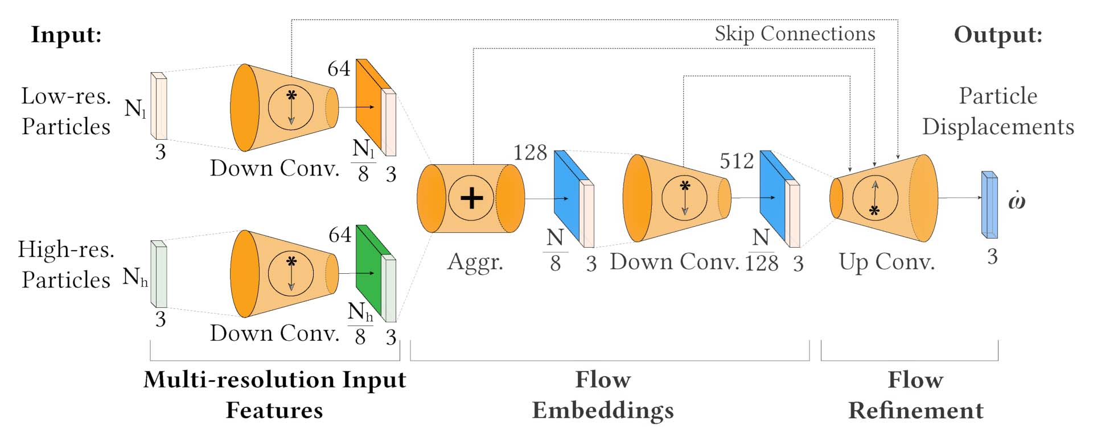
Neural Network Architecture
17
Notes:
Inspired by the hierarchical features learning, we’ve designed our network to support weighted features similarly to Lagrangian methods in computational fluid dynamics
our proposed Fluid Flow Net architecture is divided into three main parts

Slide 18
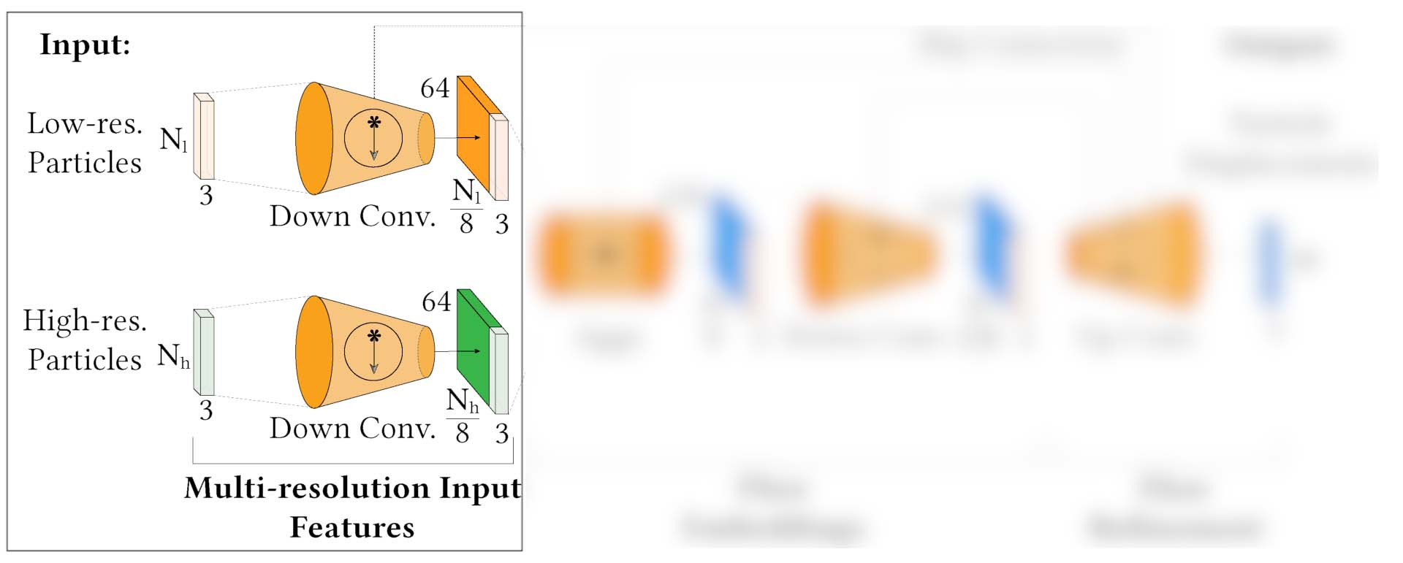
Neural Network: Input Features
Each particle $p_{i}$ in N: $\{x_{i},f_{i}\}$
Compute weighted local features $f_{i}^{∗}$ for a neighborhood $n_{j}$
$f_{i}^{∗}\left(x\right)=f_{i}\left|x−{\overline{x}}_{n_{j}}\right|$ with ${\overline{x}}_{n_{j}}=\sum_{i∈n_{j}}{w_{i}x_{i}}$
Weights $w_{i}$ are computed as a weighted average:
$w_{i}\left(x\right)=\frac{k\left(\left|x−x_{i}\right|R^{−1}\right)}{\sum_{j}{k\left(\left|x−x_{j}\right|R^{−1}\right)}}$, $k\left(s\right)=max\left(0,{\left(1−s^{2}\right)}^{3}\right)$.
Element-wise max pooling operation on an MLP:
$$f_{n_{j}}^{∗}=\underset{\left\{i:\left\|x_{i}−x_{n_{j}}^{′}\right\|≤R\right\}}{MAX}\left\{h\left(f_{i}^{∗}, x_{i}−x_{n_{j}}^{′}\right)\right\}$$
18
Notes:
The first part computes weighted local features f_i for the particles neighborhoods located at x_i
As proposed by Zhu and Bridson, weights are computed using weighted averages w_i and a kernel function k for smooth transitions between neighbor contributions
Local features per neighborhood are then gathered using a nonlinear MLP function within an element-wise max-pooling operation

Slide 19
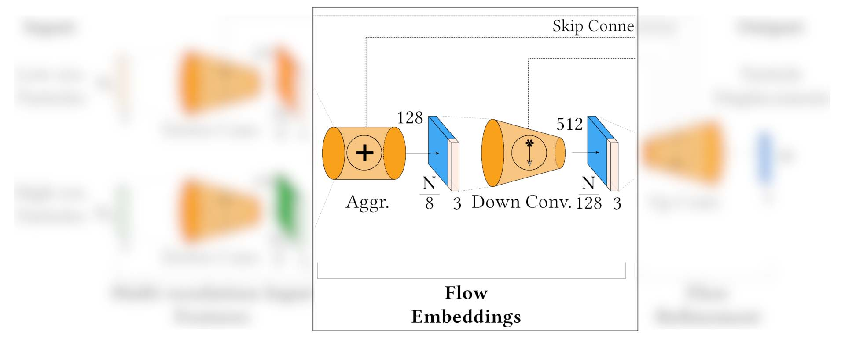
Neural Network: Mapping Neighborhoods
Combine $X_{l}$ and $X_{h}$
using their respective weighted local
features $f_{n_{j}}^{∗}$ and $g_{n_{j}}^{∗}$
and with same neighborhood $n_{j}$
Encoding each particle’s motion as:
$e_{i}=\underset{\left\{i:\left\|x_{i}−x_{n_{j}}^{′}\right\|≤R\right\}}{MAX}{F}$,
$$F=\left\{h\left(f_{n_{j}}^{∗}⊕g_{n_{j}}^{∗}, {\left\{x_{l}\right\}}_{i}−{\left\{x_{h}\right\}}_{i}\right)\right\}$$
19
Notes:
Similarly to FlowNet3D, we combine both particle-based liquids by leveraging feature similarities to encode the motion between them
We encode the particle’s motion using the same neighborhood for both resolutions to preserve correspondence
The aggregation is performed for each neighbor contribution prior to being max pooled.

Slide 20
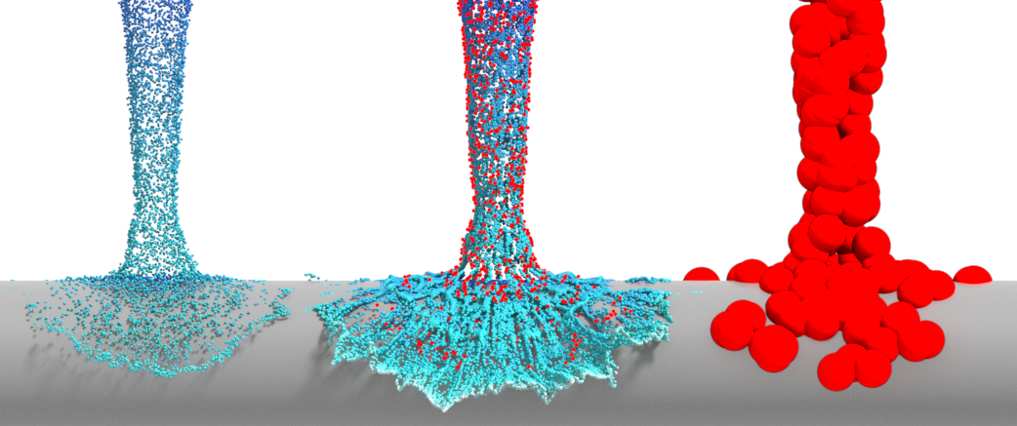
Neural Network: Mapping Neighborhoods
20
Notes:
As shown in this example

Slide 21
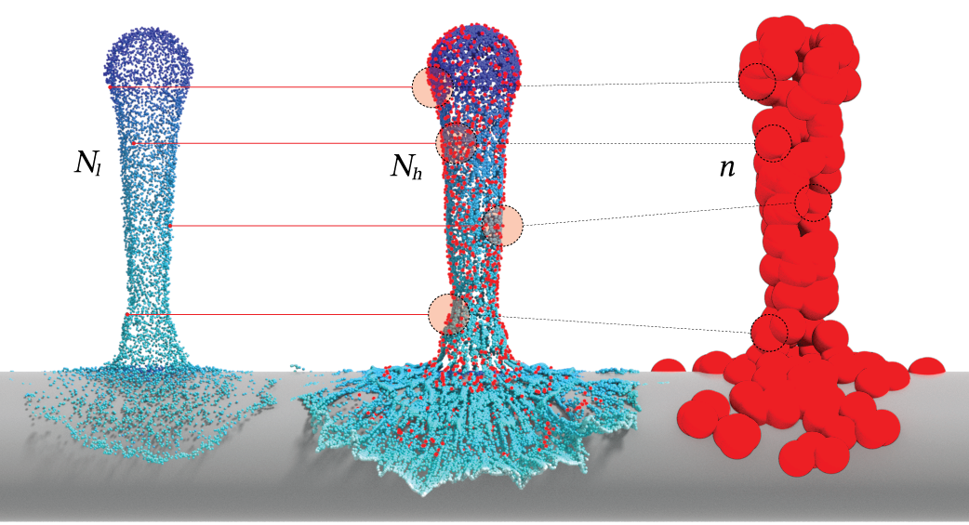
Neural Network: Mapping Neighborhoods
21
Notes:
Our weighted local features are encoded to create meaningful and common neighborhoods between discretizations

Slide 22
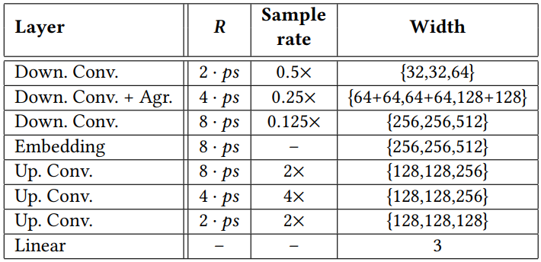
Neural Network: Convolutions on Neighbors
22
Notes:
Throughout convolutions, we encode neighborhoods up to 8 times the particle separation used to simulate the liquids
We perform similar sampling rates, but in reverse during upsampling convolutions

Slide 23
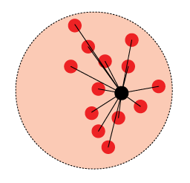
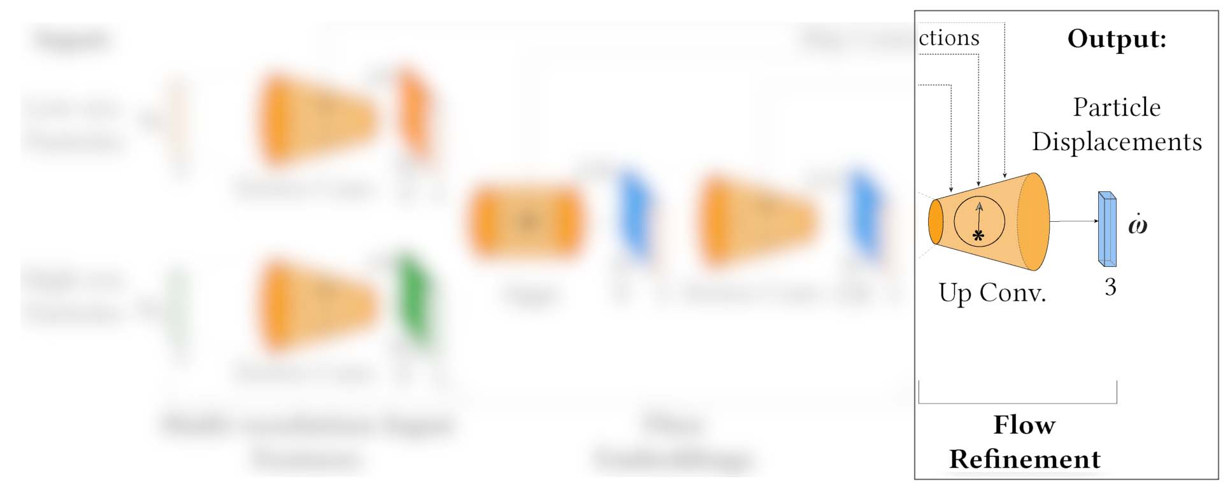
Neural Network: Refinement
Upsampling conv.: learning to project
weighted features $f_{n}^{∗}$ back to $N$
$$w_{i}$$
23
Notes:
The last part of our network is the refinement step occurring within the upsampling layers
We, therefore, follow the FlowNet3D architecture and propagate the embedded features 𝑒_𝑖 from the downsampled neighborhood n_j to the original low-resolution input particles
And naturally with respect to their weighted contributions

Slide 24
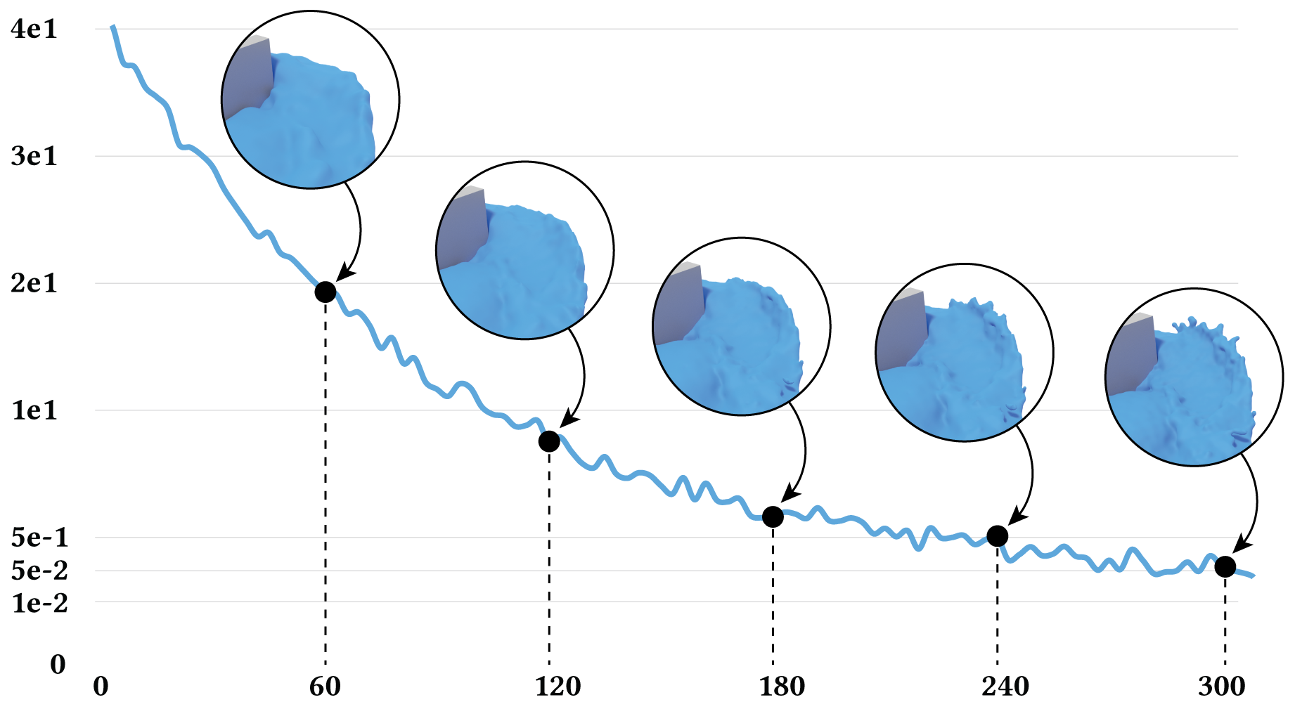
Neural Network: Loss Function
Encode an $L_{1}$ loss as the absolute differences between the predicted displacements and the
ground truth:
$$L_{up}=\frac{1}{n_{j}}\sum_{i}^{n_{j}}{{\left\|ω_{i}−ω_{i}^{∗}\right\|}_{1}}$$
to which we add a cycle-consistency
regularization term:
$$L_{up}=\frac{1}{n_{j}}\sum_{i}^{n_{j}}{{\left\|ω_{i}−ω_{i}^{∗}\right\|}_{1}+}{λ_{n_{j}}\left\|{ω_{i}^{←}−ω}_{i}\right\|}_{1}$$
$λ_{n_{j}}$: normalized $ω_{i}$ magnitude computed by $UpFlOF$
$ω_{i}^{←}$: advected displacements using the ground truth $ω_{i}^{∗}$
24
Notes:
As our network performs backpropagation, we update the loss function by encoding the absolute differences between the predicted displacements and the ground truth’s
In addition, we use a cycle-consistency regularization term to enforce the bidirectionality of our predicted solution
In other words, we guide the optimization process by minimizing the differences between the advected displacement (using our advection scheme) and the predicted displacement
We also use the normalized deformation magnitudes to guide the convergence during training by using an adaptive lambda term

Slide 25
Neural Network Architecture
25
Notes:
A last and dense regression layer is used after the upsampling convolutions to project back the scene flow predictions in R3
Also as noted in that diagram, we use skip connections between downsampling and upsampling layers to infer multi-scale feature learning.

Slide 26
Data Augmentation
26
Notes:
Using the same adapted interpolation approach, we also propose a framework to artificially augment an existing particle-based simulation dataset
Given two pairs of inputs
We interpolate an intermediate scenario between both low- and high-resolution liquids

Slide 27
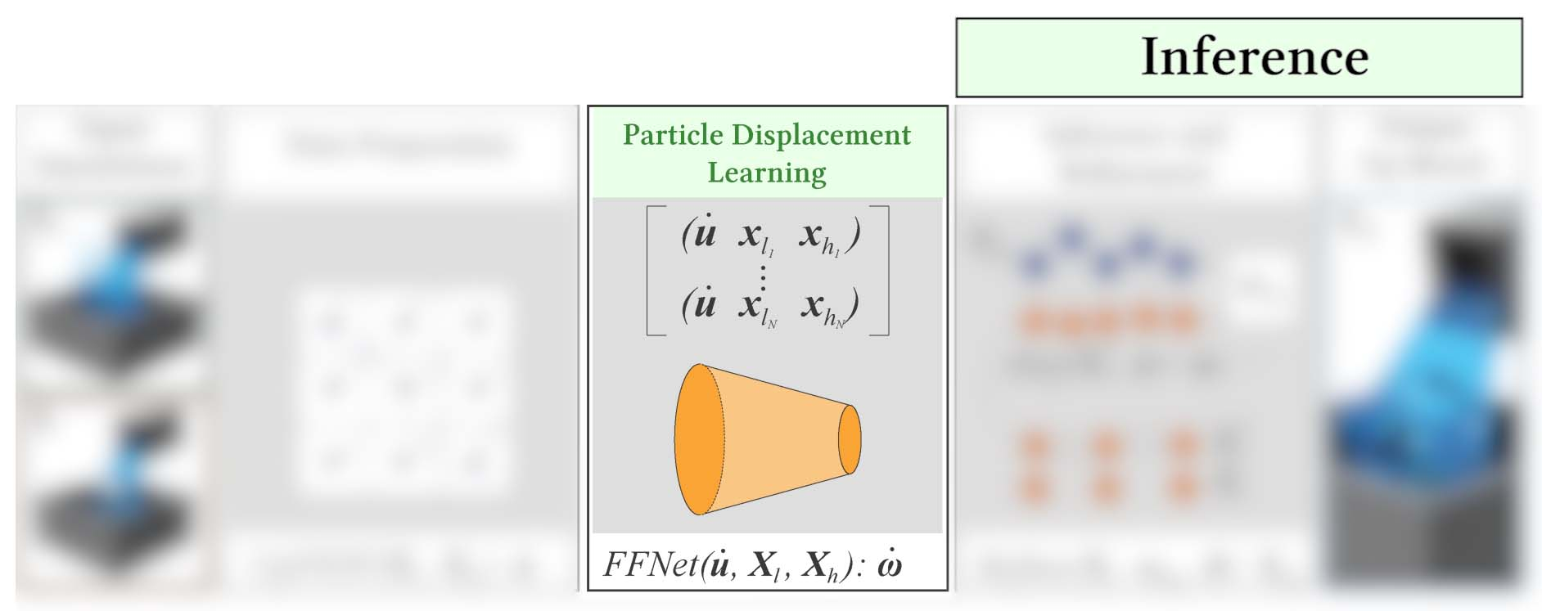
Overview
27
Notes:
Once we have a trained model, we used the resulting weights to infer particle displacements as input to our advection scheme

Slide 28
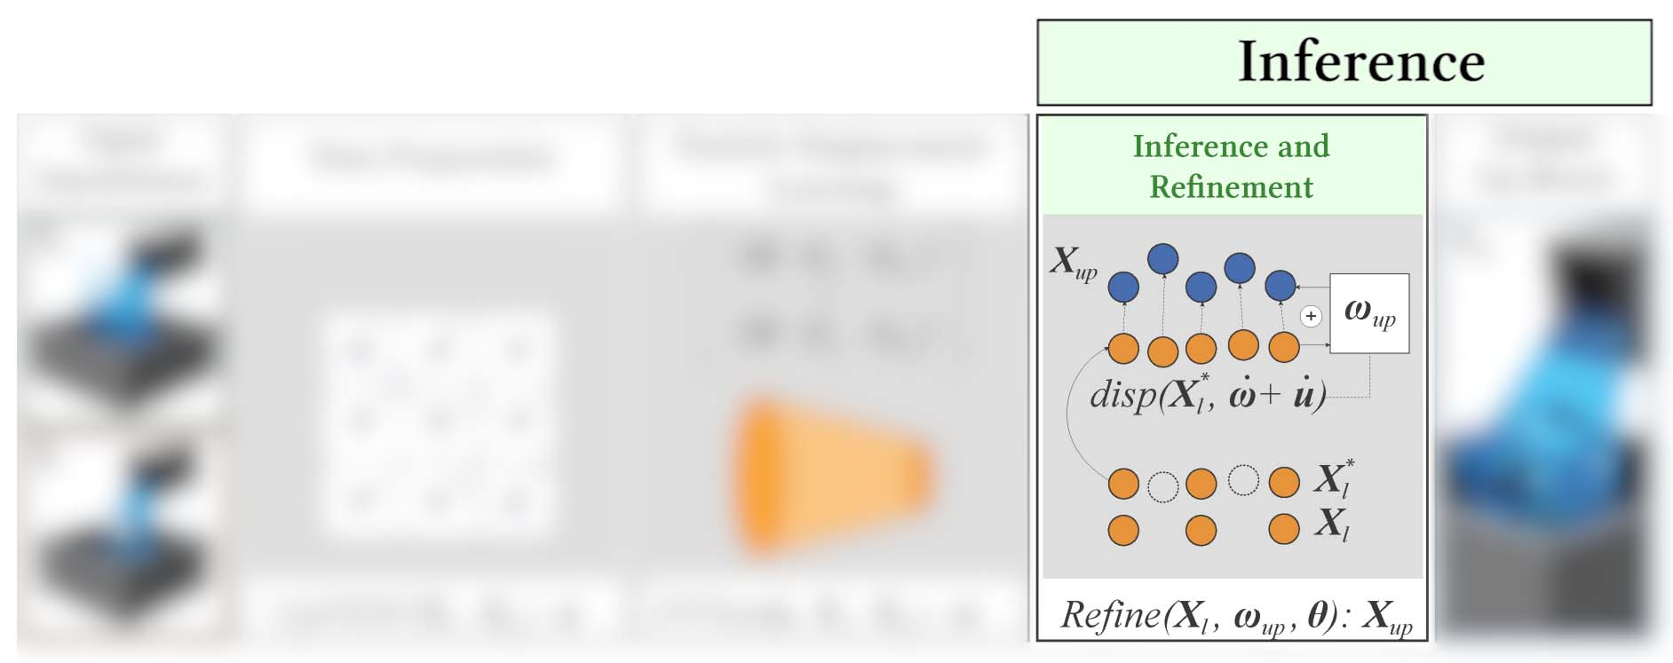
Overview
28
Notes:
But before that, A few additional steps are performed during inference to improve the resulting quality of the displacements

Slide 29
Refinement: Varying Thickness
$$d=R$$
$$d=0.75R$$
$$d=0.5R$$
$$d=0.25R$$
29
Notes:
We first perform a few inference iterations using different particle band thicknesses
Using the narrow band FLIP as our simulation method, we can easily change the band thickness of the inputs

Slide 30
Refinement: Reduce Inference Noise
30
Notes:
By using average displacements from these iterations, we are able to significantly reduce the inference noise at the surface
Our goal is to reach an ideal point where the resulting surface isn’t too noisy and that; without losing most of the inferred details
Also, this helps our approach to avoid cases where particles emerge from the depth of the liquid after being displaced

Slide 31
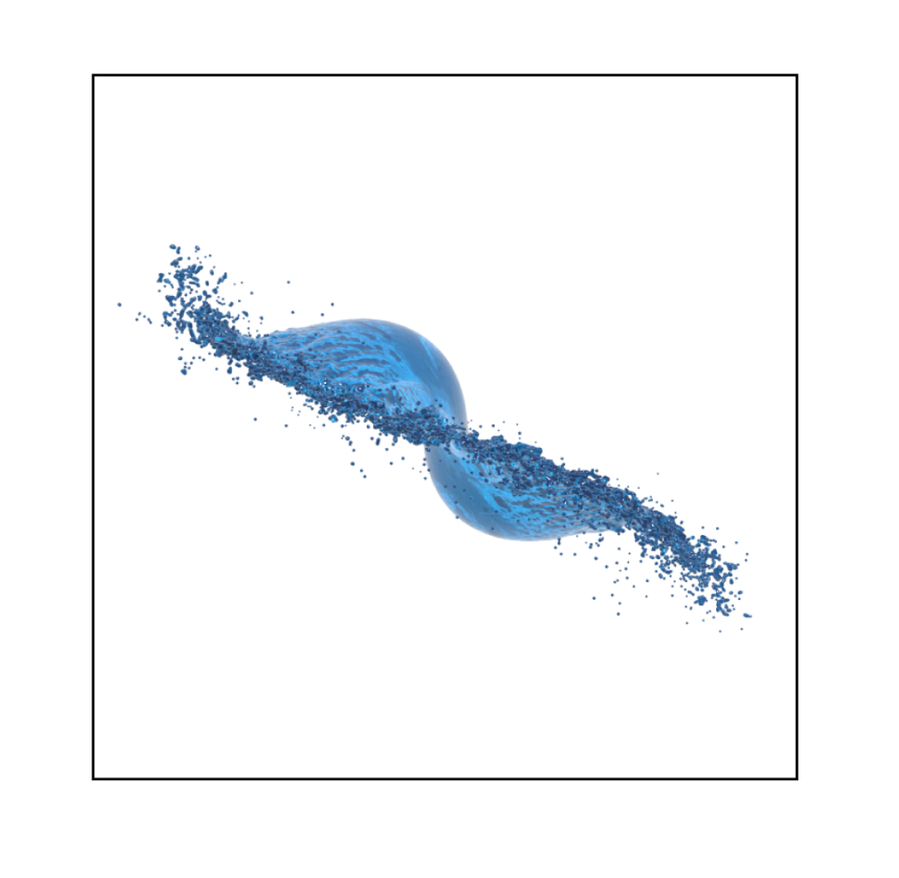
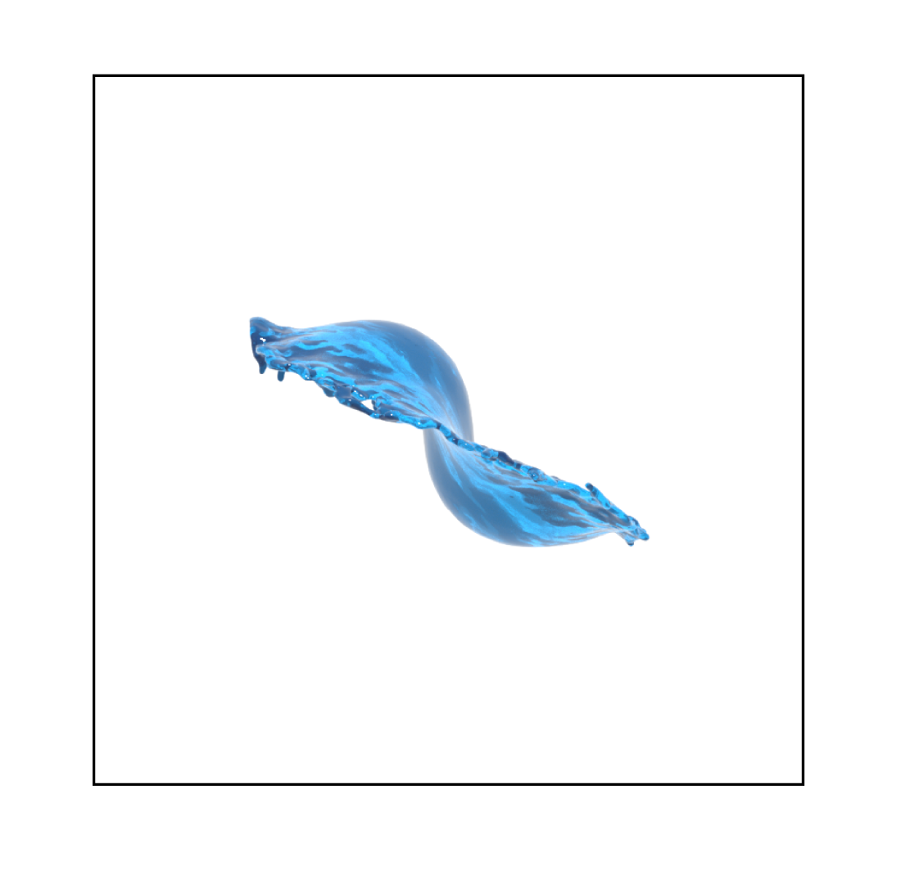
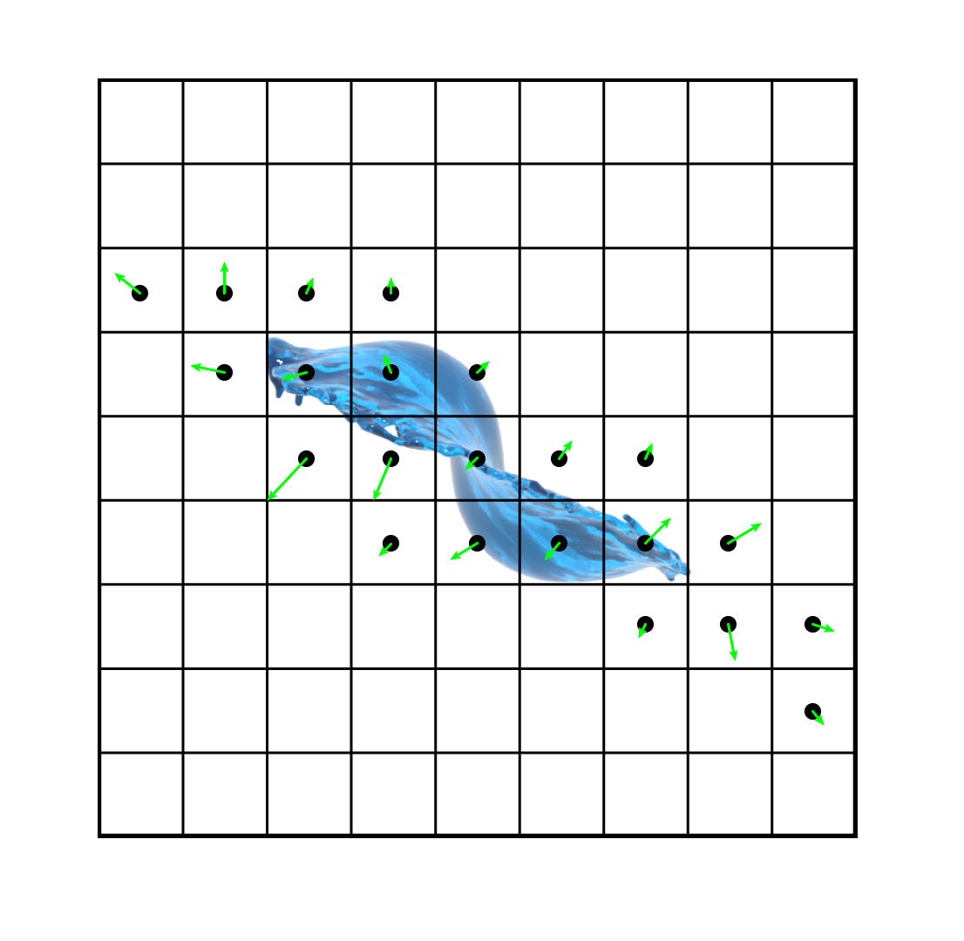
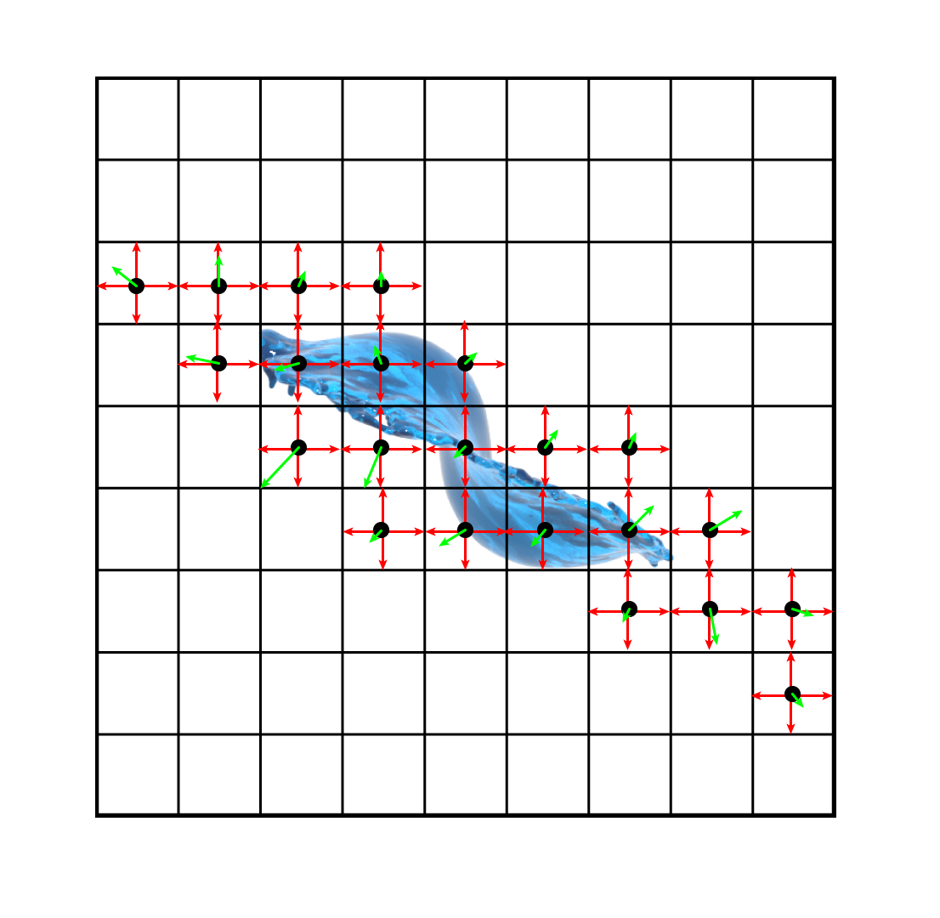
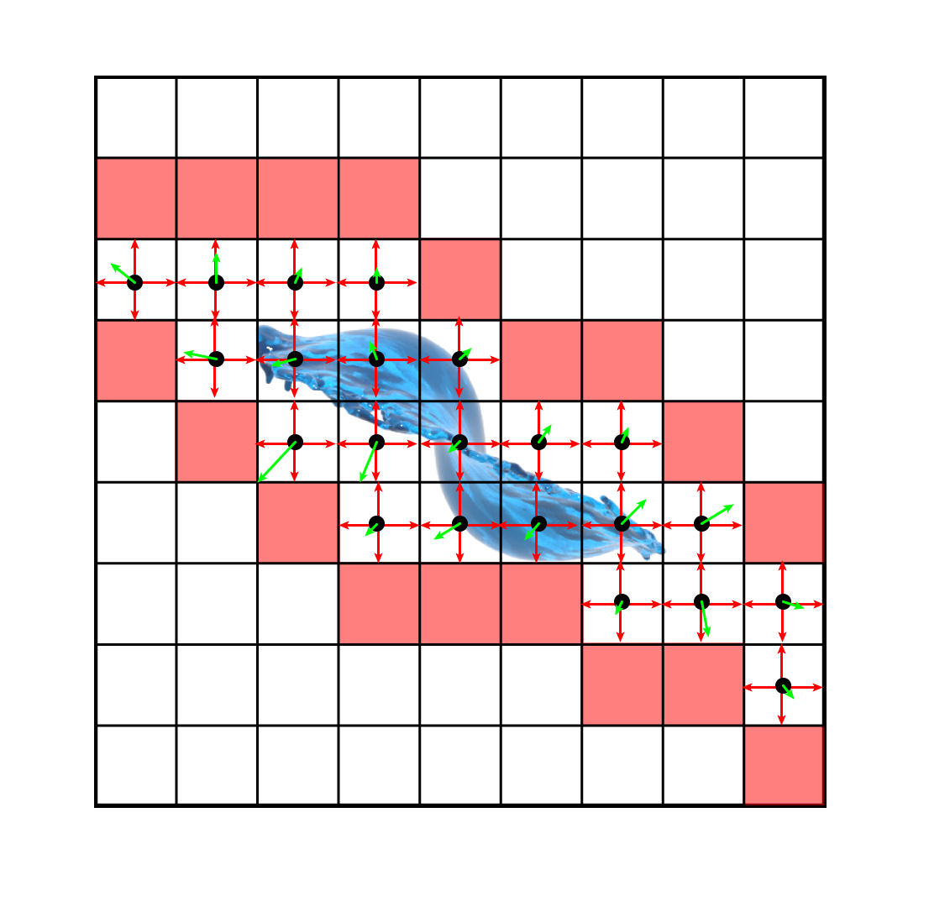
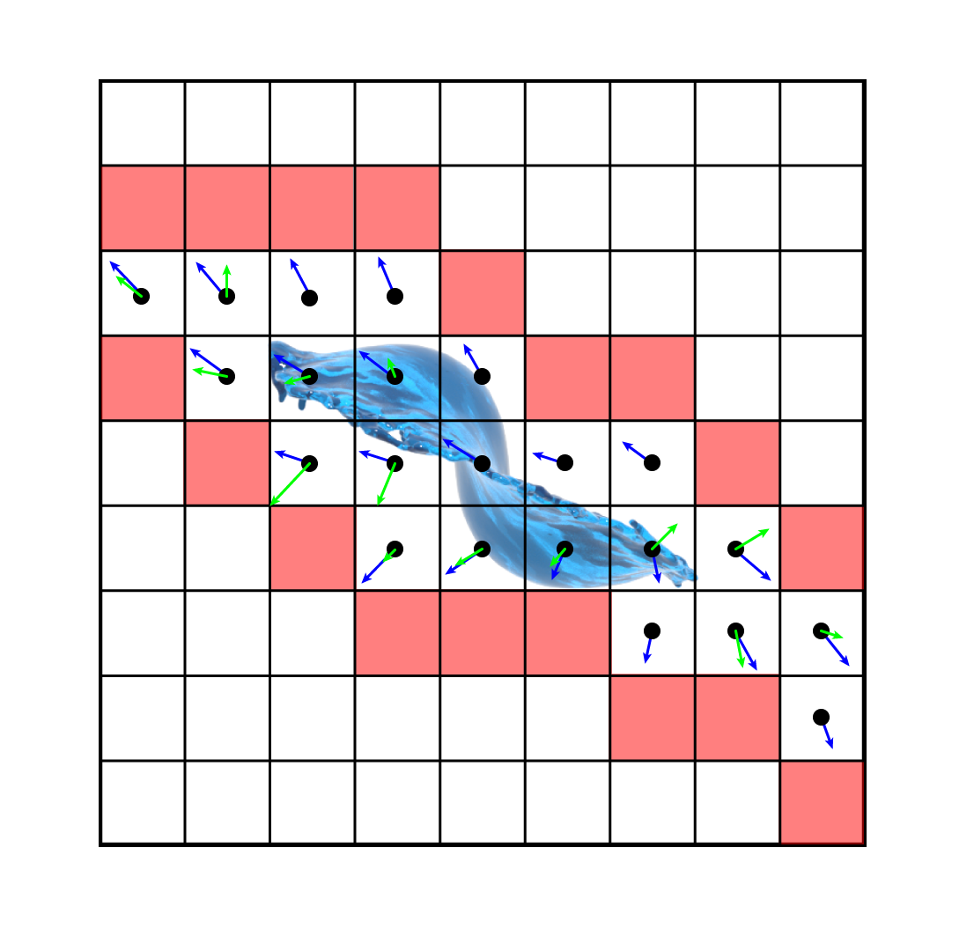
Advection Scheme
Resample predicted $u_{ω}$ to the input velocity grid $u_{MAC}$
Extrapolate $u_{MAC}$ by a small distance
Weigh $u_{MAC}$using resampled magnitudes $\left\|{\hat{u}}_{ω}\right\|$
Inject weighted velocities to deformations ${\hat{u}}_{ω}$
Advect $X_{l}^{′}$ using the resulting deformations
31
Notes:
We use the predicted displacements to govern our advection scheme as follows:
Our goal is to infer these small details to that coarse input using these deformations
We first resample the predicted deformations into the input MAC grid
We extrapolate a bit further the modified velocity grid in order to fully cover the simulation domain of the upsampled input particles
Then, the extrapolated velocity grid is weighted using the normalized deformation magnitudes in order to extract the high-frequencies
The weighted input velocities are injected into the computed deformations to preserve the coarse motion and temporal coherence
Finally, we advect the upsampled particles using the resulting deformations
These steps are performed to advect the up-resing displacements along with the coarse liquid

Slide 32
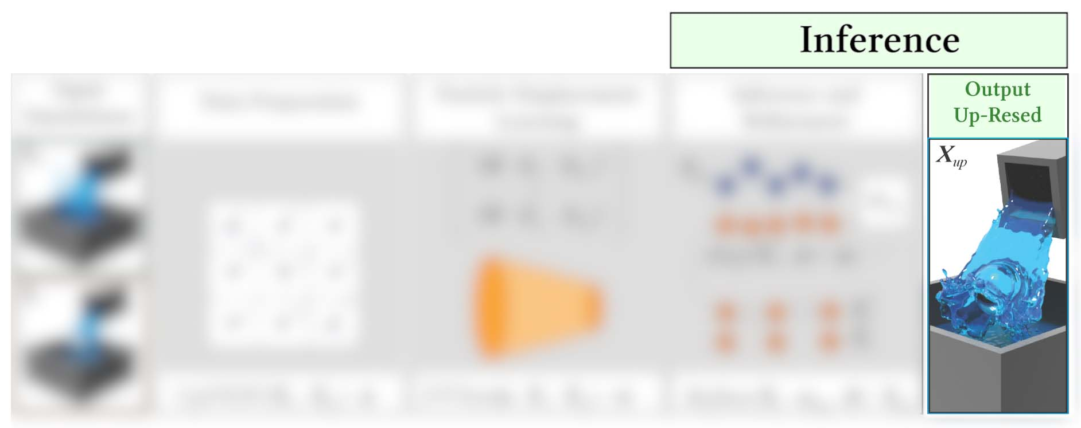
Overview
32
Notes:
Our final results are obtained by generating a surface from the upsampled and displaced particles
Now let’s take a look at a few results

Slide 33
Results: Stirring Liquid
33
Notes:
our network successfully reproduced detailed eddies surrounding the moving obstacle
Compared to the high-resolution reference, we were unable to recreate every tiny droplet detached from the splashing portions of the liquid.
However, these details are usually added by procedural methods such as whitewater to facilitate control in production.

Slide 34
Results: More Dynamic Obstacles
34
Notes:
Here’s a more complex scenario with dynamic obstacles
In this visualization, we show the color-coded displacement magnitudes applied by our network, and that prior to being advected
Except for the complex interactions occurring around the obstacles, in-depth displacements are mostly inexistent
Therefore, we used narrow-band FLIP simulations as inputs to our method to generate most of the presented examples.

Slide 35
Results: Multiple Stages
35
Notes:
At each level of that cascading stream, our approach was able to infer dynamic and turbulent behavior within impacted regions.
In the lower container, we have noticed that our result was showing a slightly different but plausible turbulence behavior when compared to the high-resolution ground truth.

Slide 36
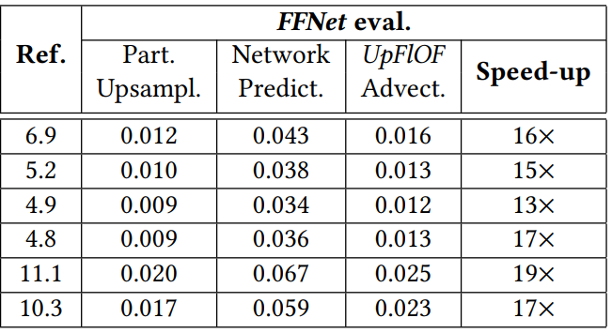
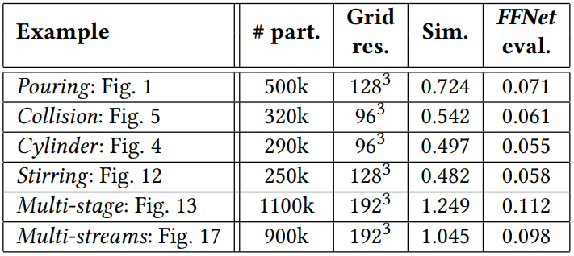
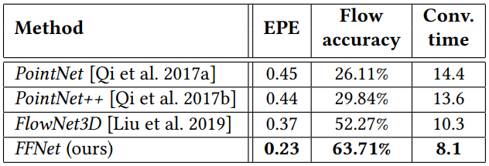
Results: Few Statistics
36
Notes:
As shown, we manage to provide fair speed ups compare to high-resolution simulations
To be fair, the speed-up factors are calculated by combining the cost of simulating the low-resolution input used by our approach with the deformation network evaluation times
We also provided decent improvements in terms of both computation times and accuracy when compared with previous work for learning motions on unstructured data.

Slide 37
Results: Dynamic Boundaries
37
Notes:
With this example, we show that our approach also works with dynamic boundaries
Despite a few small eddies being left out in more static regions, we were able to generate convincing splashes at the edge of the moving boundary

Slide 38
Results: Multiple Streams
38
Notes:
Here we demonstrate the generalization power on this example fully outside of the settings used during training
As previously mentioned, although our approach does not capture the diffuse particles very well (e.g., droplets), we can still observe a few detached chunks of liquid at the stream impacts.
Another interesting aspect observed in this result is the ability to reproduce the energy level of the simulations at higher resolutions. As shown on the right, we were able to reproduce the intensity of the streams coming out at the top in our generated result

Slide 39
Conclusion
Our approach is capable of generalizing realistic details at the surface of particle-based liquids
We also proposed an interpolation framework to augment an existing particle-based dataset for learning
Future Work:
Explore position-based fluids with our approach
Extend capabilities to cover a broader range of diffuse phenomena (e.g., predicting splash particles)
Notes:
Our approach is capable of generalizing realistic details at the surface of particle-based liquids
We also proposed an interpolation framework to augment an existing particle-based dataset for learning
As future work
We would like to explore position-based fluids with our approach
With this formulation, we would be able to offer a purely Lagrangian approach for up-resing particle-based liquids
That way we could remove the back-and-forth part in the grid at the advection step to offer a fully gridless approach
Furthermore, we would be interested in extending the capabilities of our approach to a broader range of diffuse phenomena such as spray and droplets
PBF: matching local densities between low- and high-resolution liquids
Since we are already using neighborhood similarly to SPH, adapted our model with this additional constraint would highly feasible
However, moving to a gridless approach would be challenging to preserve a consistent deformation prior

Slide 40
Thanks!
Preprint (arXiv): https://arxiv.org/abs/2106.05143
Special Thanks
Feedback: TUM (Nils Thuerey) and SCA Reviewers
Notes:
Thanks for listening
And I’ll be happy to answer any questions

