Slide 1
Network of Centers for Very Small Entities (VSEs)
Jeju, Korea
May 23th, 2012
ISO/IEC JTC 1/SC 7- Working Group 24

Slide 2
Agenda
Overview of activities since last meeting
Brazil, Canada, Czech Republic, Japan.

Slide 3
Brazil
Compliant Process Template
ISO IEC 29110 – Basic Profile
3

Slide 4
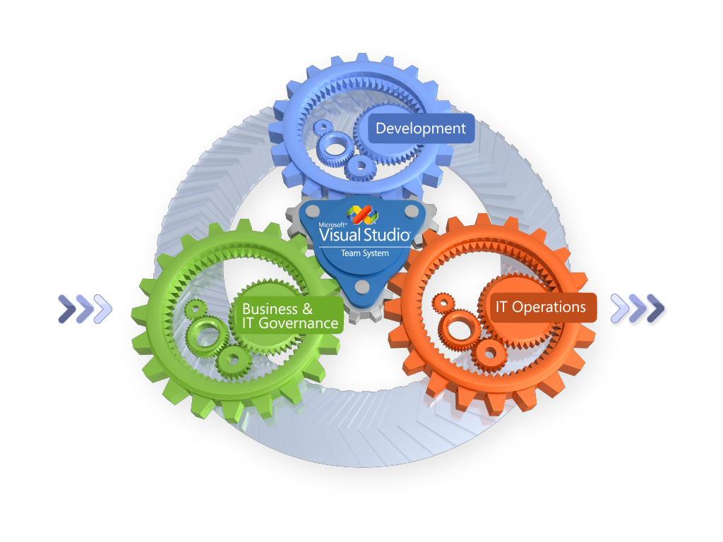
Compliant Process Template
ISO IEC 29110 – Basic Profile
ALM (Application Lifecycle Management):
coordination of the activities of the development lifecycle
requirements, modeling, development, construction, testing, maintenance and operations.
4

Slide 5
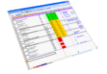
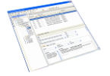
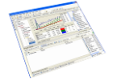
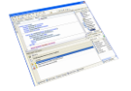
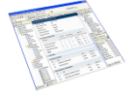
Developer
Designer
DBA
Architect
QA
Real Time Report
Business Analyst
IT Management
Bug Tracking
Task Control
Business Requirements
Advanced Versioning
Development Process and Methodology
Web Test
Load Test
Unit Test
Code Analysis
Project Documentation
Architecture Tools
Tools for Database

Slide 6
Work Process
Bugs
Builds
Business Requirements
Test
Scenarios
Tasks
Business Analyst
Development Team
Change Request
Project Manager
Deployment
Bugs
Work Items are the unit of communication between the people of a team
Operations

Slide 7
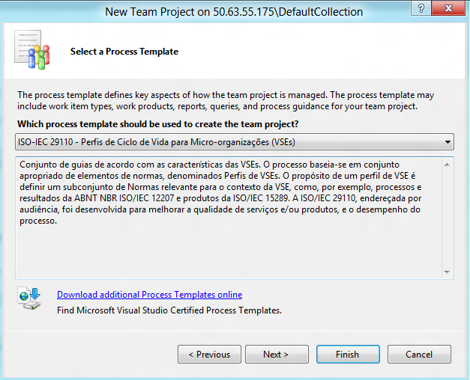
ISO Template in TFS

Slide 8
ISO Template in TFS

Slide 9
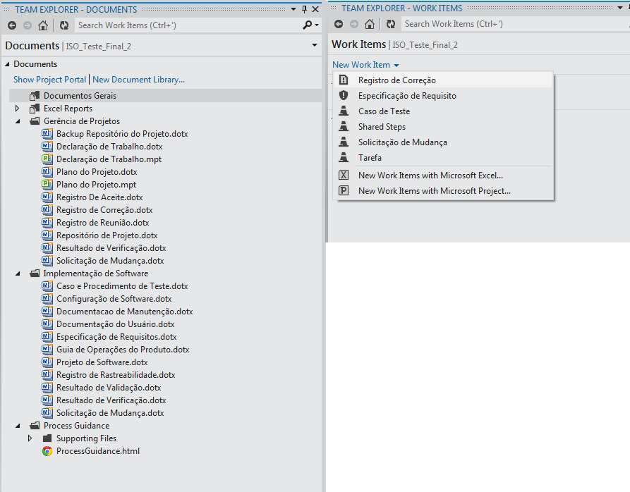
Template ISO in TFS

Slide 10
Template ISO in TFS

Slide 11
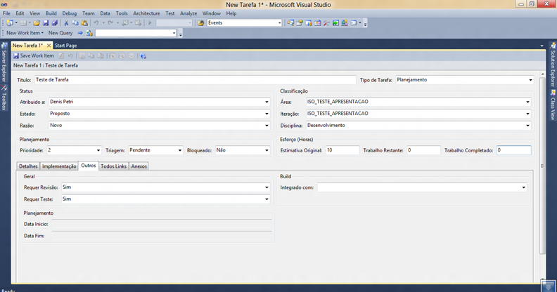
ISO Template in TFS

Slide 12
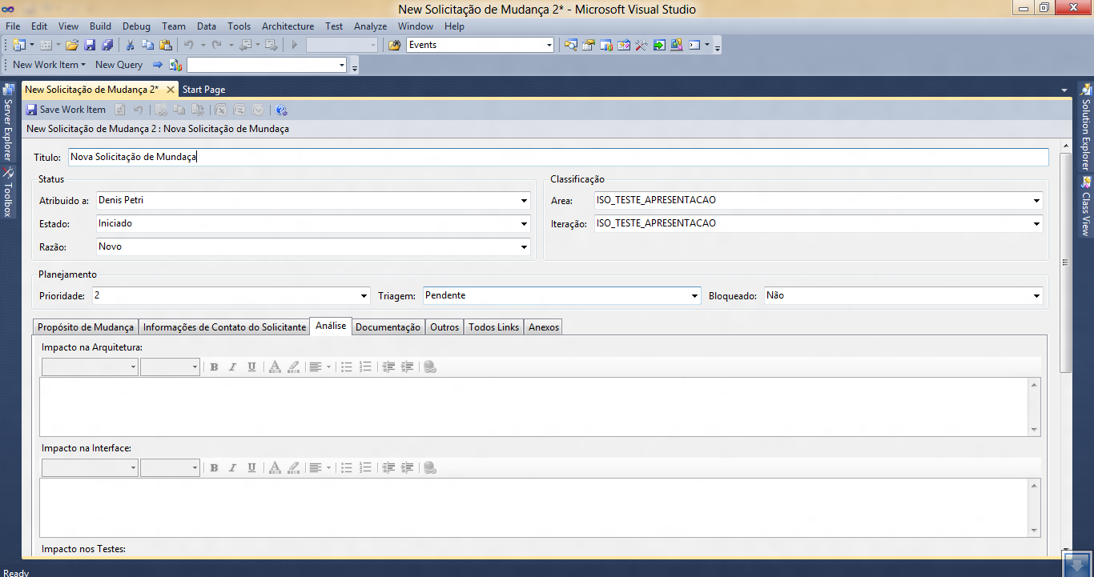
ISO Template in TFS

Slide 13
On Going…
VSEs certified by September/2012
MS Process Template free available - June/2012
(Portuguese)
MS Process Template free available – TBD
(English, Spanish)
MS Process Template – Agile - TBD

Slide 14
On Going…
International Collaboration
Program Replication
Certification

Slide 15
Canada
Implementation of ISO 29110 in VSEs
Start-up VSE in the transportation domain (e.g. subway communication and security)
Application of the System Engineering Basic Profile
Engineering Firm
Designs, engineers and manufactures components of heating, air conditioning/cooling and refrigeration systems
Large Engineering Firm
Implementation of the ISO 29110 Project Management process in small engineering projects
Project of less than 2 months, of 4 people or less and with a budget between 5,000$ and 70,000$
Start-up VSE involved in the development of web services for travelers
Application of the Software Engineering Basic Profile
A 12-people VSE involved in the design of embedded systems
Application of the System Engineering Basic Profile

Slide 16
Canada
Implementation of ISO 29110 in education
Undergraduate Software Quality Assurance course at ÉTS,
Graduate Software Quality Assurance course and Process Improvement course at ÉTS,
IT 3-year technical degree program,
Undergraduate Software Quality Assurance course in Haiti.
ETS will hold a one-day course on ISO 29110 in June
Targeted at professional engineers
Educational Material – Introduction to ISO/IEC 29110
A new set of 90 Power Point slides has been published
http://profs.etsmtl.ca/claporte/English/VSE/Education/Introduction%20to%20ISO%2029110.pptx
Translation of Engineering and Management Guide in French
Translation is completed

Slide 17
Publications and Communications
Laporte, Claude, Y., Fanmuy, Gauthier, Ptack, Ken, The Development of Systems Engineering International Standards and Support Tools for Very Small Enterprises, 22nd Annual International Symposium of the International Council on Systems Engineering, Rome, July 9-12, 2012.
O'Connor, Rory, V., Laporte, Claude, Y., Software Project Management in Very Small Entities with ISO/IEC 29110, Euro SPI 2012, Vienna, Austria, June 25-27, 2012.
Laporte, C.Y., Fanmuy, G., Ptack, K., Marvin, J., Systems and Software Engineering Standards for Very Small Entities, INSIGHT, Vol. 15, Issue 1, April 2012, pp 32-33.
Laporte, C.Y., Fanmuy, G., Ptack, K., Marvin J., Normes d’ingénierie système et logiciel pour les très petites organisations, Revue Génie Logiciel, Numéro 100, mars 2012, pp 55-61.
O'Connor, Rory, V., Laporte, Claude, Y., Using ISO/IEC 29110 to Harness Process Improvement in Very Small Entities, Euro SPI 2011, Roskilde, Denmark, June 27-29, 2011.
O'Connor, Rory, V., Laporte, Claude, Y., Deploying Lifecycle Profiles for Very Small Entities: An Early Stage Industry View, in R.V. O'Connor et al. (Eds.): SPICE 2011, CCIS 155, pp. 227–230, Dublin, Irleand, 30 mai-1 juin 2011.
Systems Engineering International Standards for Very Small Entities, International Council on Systems Engineering (INCOSE) International Workshop, 21 janvier, 2012, Jacksonville (Florida).
The Development of a Set of Tools to Facilitate the Adoption and the Implementation of the ISO/IEC 29110 Standard by Very Small Entities, RIOSOFT 2011, Rio de Janeiro, Brésil, 29 septembre, 2011.
The Development and Diffusion of International Standard ISO/IEC 29110 for Very Small Enterprises involved in Software Development, Université UNAM (Mexico) Mexique, 26 août 2011.
Videos
English video: http://www.youtube.com/watch?v=viP7WLaFC8E
French video: http://www.youtube.com/watch?v=w8wCIyDqYLI&feature=g-upl

Slide 18
ISO/IEC 29110 in the Czech Republic
By Alena Buchalcevova

Slide 19
Overview of activities
Pilot project for Deployment Package Software Testing was conducted during 2010
September 2011 – January 2012 - new master course Software Process Improvement was accredited and taught (54 students attended)
Localization of deployment packages into Czech, their evaluation and improvements proposition
Architecture and Detailed Design
Construction and Unit Testing
Product Delivery
Project Management
Requirement Analysis
Survey of using standards by small entities in the Czech Republic

Slide 20
Publications
paper presented at the Information system development conference in 2011 in Edinburgh
Software Process Improvement in small companies as a path to Enterprise Architecture
it is not published yet (Springer)
1 master thesis finished
2 master thesis in progress

Slide 21
Future work
Conducting pilot projects on deployment packages
Communications
making a web site focused on 29110
translate Wikipedia page into Czech
exploring possibilities of making 29110 a Czech national standard
Courses
second running of the master course Software Process Improvement in autumn 2012
Other work
Localization other deployment packages into Czech
Publications
survey results, ....

Slide 22
Publications and Communications VSE activities in Japan
Translation of 29110-4 as JIS (Japanese Industrial Standards) was done and is expected to be published soon.
Found problems to be corrected.
Planning to make a guide book for VSE
VSE Center at Keio SDM Lab.
SPINA3CH (IPA) training for VSEs
1 day seminar & training 3 times (total 40 person)
www.vse.jp provide info. in Japanese so far.

