Slide 1


















Systems Engineering International Standards for Very Small Entities
Department of Software and IT Engineering
Professor Claude Y Laporte, Eng., Ph.D.
Editor of ISO/IEC JTC1 SC7 Working Group 24
April 2012
Notes:
Member of INCOSE for about 15 years
INCOSE is a member of WG 24

Slide 2
Content
Introduction
Needs for Software Standards for Very Small Entities (VSEs)
Establishment of ISO Working Group 24
Approach used by Working Group 24
Survey of VSEs
Description of ISO/IEC 29110 Standards and Technical Reports
Network of VSE Support Centers
Deployment Packages
Pilot Projects
Development of Systems Engineering Standards and Guides
Next Steps
VSEs = Very Small Entities are enterprises, projects or departments having up to 25 people.
ISO/IEC JTC 1/SC7 = International Organization for Standardization/ International Electrotechnical Commission Joint Technical Committee 1/Sub Committee 7.

Slide 3
Size of Enterprises
European Union
  93 % are micro enterprises (less than 10 employees)
Micro enterprises account for 70% to 90% of enterprises in OECD* countries (about 57% in USA)
Greater Montréal Area - Software Enterprises.
Number of employees | Number of Software Enterprises | Percentage
1 to 25 | 540 | 78 %
25 to 100 | 127 | 18 %
Over 100 | 26 | 4 %
About 50% of enterprises have less than 10 employees
Source: Montreal International, 2006
* OECD: Organisation for Economic Co-operation and Development

Slide 4
The Importance of VSEs
VSE
Manufacturer
Prime (60)
Suppliers (600)
Producers (~6,000)
A software defect from one of the producers went into a product and resulted in a loss of over $200 million by the manufacturer
(Adapted from: Shintani, Small Settings Workshop, Software Engineering Institute, 2006)
Notes:
Many VSEs at all levels of the production chain

Slide 5
Observations, Vision and Strategy
Observations
  Most software engineering standards have not been designed having in mind VSEs;
  VSEs’ negative perceptions of software engineering standards are primarily driven by negative views of cost, documentation and bureaucracy;
  In many VSEs software processes are ad hoc and chaotic;
  Worldwide, VSEs’ software products are very important to the economy.
Vision
  VSEs worldwide are using, in their daily development activities, software engineering standards, adapted to their needs, which guide them develop required products, constantly improving their performances and their competitiveness.
Strategy
  Participate actively to the development of international software engineering standards adapted for VSEs;
  Lead the development of means to accelerate the adoption and implementation of new standards by VSEs;
  Lead the development of educational material to teach the standards to undergraduate and graduate software engineering students;

Slide 6

Development
of International Standards for VSEs
Phase 1 - Recognition of Needs and Problems (2004)
Phase 2 - Basic and Applied Research (2005-2006)
Phase 3 - Development (2006-2010)
Phase 4 - Commercialization (2010)
Phase 5 - Diffusion and Adoption (2006- )
Phase 6 - Consequences (2011 - )
(adapted from Rogers, 2003)
Notes:
Diffusion: The process over which an innovation is communicated through certain channels over time among the member of a social system.
Adoption: A decision to make full use of an innovation as the best course of action possible
Commercialization: The production, manufacturing, packaging, marketing and distribution of a product that embodies an innovation
Consequence: A change that occurs in an individual or a social system as a result of the adoption or rejection of an innovation

Slide 7

International Organization for Standardization
Joint Committee for IT
Standardization of processes, supporting tools and supporting technologies for the engineering of software products and systems.
Sub committee (SC) 7
Working Group (WG) 24
Page 7

Slide 8
1. Needs and Problems
SC7 Plenary Meeting - Australia – 2004
Canada raised the fact that small enterprises require standards adapted to their size and maturity,
A meeting of interested parties was held with 8 delegates from national bodies (Australia, Canada, Czech Republic, South Africa, and Thailand)
  Consensus reached:
    Make the current software engineering standards more accessible to VSEs;
    Provide turn key material that require minimal tailoring and adaptation effort;
  Approach selected:
    Establish a Special Interest Group (SIG) to develop:
      Statement of requirements;
      The outline of key deliverables, and the associated process to create them
        e.g. how to create profiles;
      Terms of Reference for the group;
      Prepare a Proposal for the next Plenary meeting in Finland.

Slide 9

Establishment of ISO Working Group 24
Two Workshops in Thailand – 2005 *
  Sponsored by the Thai Industrial Standard Institute and the Thai Software Industry Promotion Agency,
  Representatives
    Australia, Belgium, Brazil, Canada, Czechoslovakia, Finland, South Africa, South Korea, USA and Thailand.
SC7 Plenary Meeting in Finland – May 2005
  Proposal to establish a new Working Group (WG) was tabled
  Twelve countries offered their support to staff WG 24
    Belgium, Canada, the Czech Republic, Ireland, Italy, Japan, Korea, Luxembourg, South Africa, Thailand, the United Kingdom, and the United States
Working Group 24 (WG 24) was approved - Fall 2005
  Mr. Tanin Uthayanaka (Thailand) was appointed Convener.
  Mr. Jean Bérubé (Canada) was appointed Secretary.
  Mr. Claude Y. Laporte (IEEE Computer Society) was appointed Project Editor

Slide 10
Use of Software Engineering Standards by VSEs
Hypothesis of the SIG (Bangkok 2005)
Reasons for not using Standards
  Not written for or difficult to use by VSEs,
  Current SW standards do not specifically address VSEs’ needs,
  Current SW standards requires critical mass (staff, budget, time) to implement,
  Compliance with existing standards difficult to achieve,
  Net benefits not obvious,
  Most VSEs do not have the expertise to implement standards.
Benefits of Use (but not seen by VSEs)
  Reduction of risk (business, cost, schedule, quality),
  Enables measurement of effort, productivity and quality,
Standards are often developed by large organisations for large organisations !
SW = Software Engineering

Slide 11
Agenda
Phase 1 - Recognition of Needs and Problems (2004)
Phase 2 - Basic and Applied Research
  Survey of Process Improvement Initiatives (2005)
  Survey of VSEs worldwide (2006)
Phase 3 – Development (2006-2010)
Phase 4 – Commercialization (2010)
Phase 5 - Diffusion and Adoption (2006 -)
Phase 6 - Consequences (2011 - )
Notes:
Diffusion: The process over which an innovation is communicated through certain channels over time among the member of a social system.
Adoption: A decision to make full use of an innovation as the best course of action possible
Commercialization: The production, manufacturing, packaging, marketing and distribution of a product that embodies an innovation
Consequence: A change that occurs in an individual or a social system as a result of the adoption or rejection of an innovation

Slide 12






2. Research
Initiatives to Help SMEs and VSEs
Europe
  Ireland - Centre for Software Process Technologies (CSPT)
  Belgium - Centre d’Excellence en Technologies de l’Information et de la Communication (CETIC)
  Ireland (LERO)
  Luxembourg - Public Research Center Henri Tudor
  UK – National Computing Center
  European Software Institute
Australia - Software Quality Institute (Rapid)
Latin Countries
  Mexico - Moprosoft
  COMPETISOFT Project – 13 Latin American countries, Spain, Portugal.
  Columbia – ParqueSoft Foundation
Asia
  Thailand - Association of Thai Software Industry
  Hong Kong – Productivity Council
North America
  Software Productivity Center (SPC) - Vancouver
  Software Engineering Institute - Improving Processes in Small Settings (IPSS)
SME = Small and Medium Enterprises

Slide 13
2. Research
Non-profit organization established in Columbia in 1999
Purpose
  Create and develop enterprises providing goods and services to the information technology
Integrates 11 sites in Columbia
  Cali, Popayán, Pasto, Buga, Tuluá, Palmira, Buenaventura, Armenia, Manizales, Ibague, Villavicencio, Medellin, Sincelejo and Pereira.
Houses more than 200 VSEs
  Over 120 VSEs under the same roof in Cali
  1000 Software Engineering Professionals,
  About 200 professionals provide support in technical, administrative and business development processes
    Q.A., Test, Finance, Communication, Contract, Publication, etc.
  Cost of expertise is pay-as-you-use and shared between VSEs.
www.parquesoft.com

Slide 14
2. Research
Survey of VSEs
Objectives
  Identify VSEs' utilization of standards
  Identify problems and potential solutions to help VSEs apply standards and become more capable and competitive.
Method
  Web-based Survey
  Questionnaire translated in 9 languages
    English, French, German, Korean, Portuguese, Russian, Spanish, Thai and Turkish.
  Invitation to participate in survey widely broadcasted via:
    WG 24 Network of contacts
    Centers and initiatives focused on SMEs/VSEs
      e.g., SIPA (Thailand), CETIC (Belgium), Parquesoft (Colombia)

Slide 15
Over 435 Responses from 32 Countries
Country | Number of Responses | Country | Number of Responses | Country | Number of Responses
Argentina | 2 | Finland | 13 | New Zealand | 1
Australia | 10 | France | 4 | Peru | 4
Belgium | 10 | Germany | 1 | Russia | 4
Brazil | 72 | India | 57 | South Africa | 10
Bulgaria | 3 | Ireland | 10 | Spain | 4
Canada | 10 | Italy | 2 | Taiwan | 1
Chile | 1 | Japan | 3 | Thailand | 59
Colombia | 109 | Korea (South) | 4 | Turkey | 1
Czech Republic | 3 | Luxembourg | 3 | United Kingdom | 2
Dominican Republic | 1 | Mexico | 20 | United States | 3
Ecuador | 9 | Morocco | 1

Slide 16
Why don't VSEs use Standards?
2. Research
10%
24%
15%
Not required
9%
Lack of support
Lack of resources
14%
Too time-consuming
*
Standard(s)
*
28%
Other
* Difficult, Bureaucratic, not enough guidance.

Slide 17
2. Research
Requests from VSEs
Certification and Recognition
  Only 18% are certified
    Over 53% of larger companies are certified
  Over 74% indicated that it was important to be either recognized or certified
    ISO certification requested by 40%.
    Market recognition requested by 28%
    Only 4% are interested in a national certification
Needs Regarding Documentation
  62% are asking for more guidance and examples
  55% are requiring 'lightweight' standards that are easy to understand and apply and come with templates.
Notes:
The Survey - Weaknesses
The Sample
Survey was initiated through WG24 contacts
Not a true random sample
Geographical Distribution of the Responses
Strong representation: Latin America (50%)
Weak representation: Europe (11%), US (0.6%)
Application Domain
Strong representation
40% of life/mission-critical systems
34% of regulated developments.

Slide 18
2. Research
Subset of Requirements
to Develop Standards for VSEs
R 08 - Use of the set of workproduct must be affordable.
  i.e. consultant services should not be necessary.
R 15 - The set of workproduct should provide the whole spectrum of documents
  i.e. from standards and guides to education material
R 33 - The set of workproduct should propose definition of documents.
  e.g. typical content of a document, templates (e.g. requirements templates - use cases)
R 52 - The guide should provide examples
  e.g. plans, workproducts and other deliverables.
R 57 - The guide should be available free on the web
(BK1-032 2005)
Notes:
Fisrt set of requirements were documented in 2005 at the Bangkok workshops

Slide 19
Agenda
Phase 1 - Recognition of Needs and Problems (2004).
Phase 2 - Basic and Applied Research (2005-2006)
Phase 3 - Development
  The Development of International Standards for VSEs (2006 - 2010)
Phase 4 – Commercialization (2010)
Phase 5 - Diffusion and Adoption (2006 - )
Phase 6 - Consequences (2011 - )
Notes:
Diffusion: The process over which an innovation is communicated through certain channels over time among the member of a social system.
Adoption: A decision to make full use of an innovation as the best course of action possible
Commercialization: The production, manufacturing, packaging, marketing and distribution of a product that embodies an innovation
Consequence: A change that occurs in an individual or a social system as a result of the adoption or rejection of an innovation

Slide 20
3. Development
The Strategy of WG 24
To develop standards and guidelines for VSEs
Use the notion of ‘Profile’ to develop a roadmap and standards to meet the needs of VSEs.
  A profile is an ‘assemblage’ from one or more base standards to accomplish a particular function.
  A Profile Group (PG)
    A collection of profiles which are related either by composition of processes (i.e. activities, tasks), or by capability level, or both.
Focus first on VSEs developing Generic software (Profile Group)
  i.e. do not develop critical software products.
Use the Mexican national standard MoProsoft as a referential to start the development of profiles,
Use two types of standards, as the input, for the development of standards for VSEs:
  Process standards, such as ISO 12207, that define the activities required to achieve identified objectives or outcomes;
  Product standards, such as ISO 15289, that define the structure and content of artefacts produced by the processes;
Develop a set of documents to describe and specify the profiles.

Slide 21
3. Development
The "Generic" Profile Group
Applicable to VSEs that do not develop critical software products.
In the future domain-specific profiles may be developed
Critical software
Software whose failure could have an impact on safety or could cause large financial, environmental or social losses.
(adapted from IEEE 610.12)

Slide 22
3. Development
The Generic Profile Group
Entry - Targets VSEs typically developing 6 person-month projects or start-ups;
Basic - Targets VSEs developing only one project at a time;
Intermediate – Targets VSEs developing multiple projects within the organizational context;
Advanced – Targets VSEs which want to sustain and grow as an independent competitive software development business.
Advanced
Intermediate
Basic
Entry
ISO/IEC 29110

Slide 23
Set of 29110 Documents Targeted by Audience
29110 Overview (TR 29110-1)
For VSEs
29110 Profiles (IS)
Framework and Taxonomy (IS 29110-2)
For Standard producers, tool vendors, methodology vendors
Specifications of VSE Profiles (IS 29110-4)
Specification - VSE Profile Group m
(IS 29110-4-m)
List the Requirements
i.e. ‘What to do’
29110 Guides (TR)
Assessment Guide (TR 29110-3)
For Assessors
and VSEs
Management and Engineering Guide (TR 29110-5)
For VSEs
Management and
Engineering Guide
VSE Profile m-n
(TR 29110-5-m-n)
‘How to do’
ISO/IEC 29110
Obtained approval from ISO to make TRs available at no cost
Notes:
Part 1 - Overview is targeted at the general audience wishing to understand the series of documents.
It defines the business terms common to the VSE Profile Set of Documents. It introduces processes, lifecycle and standardization concepts, and the ISO/IEC 29110 Set of Documents. It also introduces the business aspects, characteristics and requirements of a VSE, and clarifies the rationale for VSE-specific profiles, documents, standards and guides.
Part 2 is targeted for standards producers, tool vendors and methodology vendors.
It introduces the concepts for Software Engineering International Standardized Profile (ISP) for VSEs, and defines the terms common to the VSE Profile Set of Documents. It establishes the logic behind the definition and application of ISP profiles. It specifies the elements common to all ISP profiles (structure, conformance, assessment) and introduces the taxonomy (catalogue) of ISO/IEC 29110 profiles.
Part 3 is targeted for Assessors,
it contains information that can be useful to developers of assessment methods and assessment tools. It defines the process assessment guidelines and compliance requirements needed to meet the purpose of the defined VSE Profiles.
Part 4 is targeted for standards producers, tool vendors and methodology vendors.
ISP provides the specifications for a VSE Profile of a profile group. In this case Basic Profile of the Generic Profile Group.
Part 5 is targeted to VSEs.
Provides Management and Engineering Guide to the Basic VSE Profile described in ISO/IEC IS 29110 Part 4-1 through Project Management and Software Implementation processes.
For new profiles: New Part 4 and 5 Only
VSE needs only to read Part 5

Slide 24
3. Development
Preparation Steps for the Basic Profile
1
VSEs’ Characteristics
derives
Base Standard ISO/IEC 12207
2
VSEs’ Needs and Competencies
Elements
responds
included
4
IS 29110-2
VSE Framework and Taxonomy
based on
IS 29110-4-1 Basic VSE Profile Specification
3
Base Standard ISO/IEC 15289
Elements
included
implements
TR 29110-5-1 Management and Engineering Guide
5
ISO/IEC 29110

Slide 25
ISO/IEC 29110 Part 5
Management and Engineering Guide
Part 5 provides a Management and Engineering Guide for the Basic Profile described in ISO/IEC 29110 Part 4
  i.e. the profile specifications
Advanced
Intermediate
Basic
Entry
ISO/IEC 29110 is not intended to preclude the use of different life cycles
such as: waterfall, iterative, incremental, evolutionary or agile.
ISO/IEC 29110

Slide 26
Management and Engineering Guide
Table of Contents
Foreword
Introduction
1. Scope
2. Normative references
3. Terms and definitions
Conventions and abbreviated terms
Overview
Project Management (PM) process
Software Implementation (SI) process
Roles (all roles)
Product description (all products)
Software tools requirements
Annex A (informative) – Deployment Package
Bibliography
ISO/IEC 29110

Slide 27
Process Structure Description and Notation
Name
Purpose
Objectives
Input Products
Output Products
Internal Products
Roles involved
Process Diagram
Activity Description
  Task - Description of the tasks to be performed.
  Role - Abbreviation of roles involved in the task execution.
  Input Products - Products needed to execute the task.
  Output Products - Products created or modified by the execution of the task.
ISO/IEC 29110

Slide 28
Part 5 - Project Management (PM) Process
Purpose
  To establish and carry out in a systematic way the tasks of the software implementation project, which allows complying with the project’s objectives in the expected quality, time and costs.
Seven Objectives
  PM.O1. The Project Plan for the execution of the project is developed according to the Statement of Work and reviewed and accepted by the Customer. The tasks and resources necessary to complete the work are sized and estimated.
6.3.1 Project Planning Process
a) the scope of the work for the project is defined;
c) the tasks and resources necessary to complete the work are sized and estimated;
e) plans for the execution of the project are developed; and
f) plans for the execution of the project are activated.
6.3.7 Measurement Process
a) the information needs of technical and management processes are identified.
[ISO/IEC 12207, 6.3.1, 6.3.7]
ISO/IEC 29110

Slide 29
Project Management (PM) Process – 7 Objectives
PM.O1. The Project Plan for the execution of the project is developed according to the Statement of Work and reviewed and accepted by the Customer. The tasks and resources necessary to complete the work are sized and estimated.
PM.O2. Progress of the project is monitored against the Project Plan and recorded in the Progress Status Record.
PM.O3. The Change Requests are addressed through their reception and analysis. Changes to software requirements are evaluated for cost, schedule and technical impact.
PM.O4. Review meetings with the Work Team and the Customer are held. Agreements are registered and tracked.
PM.O5. Risks are identified as they develop and during the conduct of the project.
PM.O6. A software Version Control Strategy is developed. Items of Software Configuration are identified, defined and baselined. Modifications and releases of the items are controlled and made available to the Customer and Work Team including the storage, handling and delivery of the items.
PM.O7. Software Quality Assurance is performed to provide assurance that work products and processes comply with the Project Plan and Requirements Specification.
ISO/IEC 29110

Slide 30
Part 5 - Project Management Process – 4 Activities
Advanced
Intermediate
Basic
Entry
ISO/IEC 29110

Slide 31
Project Management Process
Example of 2 Tasks of the Planning Activity
Role | Task List | Input Products | Output Products
PM TL | PM.1.1 Review the Statement of Work | Statement of Work | Statement of Work [reviewed]
PM CUS | PM.1.2 Define with the Customer the Delivery Instructions of each one of the deliverables specified in the Statement of Work. | Statement of Work [reviewed] | Delivery Instructions
ISO/IEC 29110

Slide 32
Software Implementation (SI) Process – 7 Objectives
SI.O1. Tasks of the activities are performed through the accomplishment of the current Project Plan.
SI.O2. Software requirements are defined, analyzed for correctness and testability, approved by the Customer, baselined and communicated.
SI.O3. Software architectural and detailed design is developed and baselined. It describes the software items and internal and external interfaces of them. Consistency and traceability to software requirements are established.
SI.O4. Software components defined by the design are produced. Unit test are defined and performed to verify the consistency with requirements and the design. Traceability to the requirements and design are established.
SI.O5. Software is produced performing integration of software components and verified using Test Cases and Test Procedures. Results are recorded at the Test Report. Defects are corrected and consistency and traceability to Software Design are established.
SI.O6. A Software Configuration, that meets the Requirements Specification as agreed to with the Customer, which includes user, operation and maintenance documentations is integrated, baselined and stored at the Project Repository. Needs for changes to the Software Configuration are detected and related Change Requests are initiated.
SI.O7. Verification and Validation tasks of all required work products are performed using the defined criteria to achieve consistency among output and input products in each activity. Defects are identified, and corrected; records are stored in the Verification/Validation Results.
ISO/IEC 29110

Slide 33
Part 5 - Software Implementation – 6 Activities
Advanced
Intermediate
Basic
Entry
ISO/IEC 29110

Slide 34
Comments Processed by Working Group 24
Title of Document | Berlin 2008 | Mexico 2008 | Hyderabad 2009 | Lima 2009 | Washington 2010 | Total
TR 29110-1 Overview | 71 | 61 | 60 | 37 | 9 | 238
IS 29110-2 Framework and Profile Taxonomy | 33 | 94 | 52 | 48 | 17 | 244
TR 29110-3 Assessment Guide | 18 | 38 | 40 | 31 | 8 | 135
IS 29110-4 Basic Profile Specification | 52 | 54 | 54 | 84 | 9 | 253
TR 29110-5 Basic Profile Management and Engineering Guide | 63 | 208 | 53 | 98 | 10 | 432
Total | 237 | 455 | 259 | 298 | 53 | 1302

Slide 35
Agenda
Phase 1 - Recognition of Needs and Problems (2004)
Phase 2 - Basic and Applied Research (2005-2005)
Phase 3 – Development (2006-2010)
Phase 4 – Commercialization (2010)
Phase 5 - Diffusion and Adoption
Phase 6 - Consequences (2011 - )
Notes:
Diffusion: The process over which an innovation is communicated through certain channels over time among the member of a social system.
Adoption: A decision to make full use of an innovation as the best course of action possible
Commercialization: The production, manufacturing, packaging, marketing and distribution of a product that embodies an innovation
Consequence: A change that occurs in an individual or a social system as a result of the adoption or rejection of an innovation

Slide 36
4. Commercialization
ISO Standard Development Processes
2005
NP
EXISTING
STANDARD
2006
WD
ISO
Standard
Non-ISO
Standard
2007
CD
PDAM
PDTR
Fast track process
2009
FCD
FPDAM
2010
FDIS
FDAM
DTR
DCOR
DIS
2011
IS
AMD
TR
COR
IS
SC7 develops
SC7 controls
ISO controls
ISO edits and publishes
Adapted from: SC7 Secretariat Training for ISO Editors, Hyderabad 2009
Notes:
NP = New work item Proposal
WD = Working Draft
CD = Comittee Draft
FCD = Final Comittee Draft
FDIS = Final Draft International Standard
IS = International Standard
TR = Technical Report
AMD = Amendment
PDTR - Proposed Draft Technical Report
DTR - Draft Technical Report
PDISP - Proposed Draft International Standardized Profile
FPDISP - Final Proposed Draft International Standardized Profile
FDISP - Final Draft International Standardized Profile
ISP - International Standardized Profile
DCOR - Draft Technical Corrigendum
COR - Technical Corrigendum

Slide 37
4. Commercialization
Publication by ISO
Commercialization begins when ISO publishes the Standard
  ISO Working Groups are not involved in commercialization
Needs of VSEs (from Survey)
  Not completely fulfilled with ISO/IEC 29110 Part 5 - Engineering and Management Guide
  VSEs requested readily usable processes
The concept of Deployment Packages (DPs) - Moscow Meeting
  To accelerate diffusion and adoption worldwide
    By providing readily usable information and made freely available
      e.g. detailed process descriptions (steps), templates, checklists, etc.
  Linked to ISO/IEC 29110 Part 5 - Annex A
Notes:
Commercialization: The production, manufacturing, packaging, marketing and distribution of a product that embodies an innovation
Diffusion: The process over which an innovation is communicated through certain channels over time among the member of a social system
Adoption: A decision to make full use of an innovation as the best course of action possible
Part 5 – still too abstract and not very usefull for most VSEs

Slide 38
Agenda
Phase 1 - Recognition of Needs and Problems (2004)
Phase 2 - Basic and Applied Research (2005-2005)
Phase 3 – Development (2006-2010)
Phase 4 – Commercialization (2010)
Phase 5 - Diffusion and Adoption (2006 - )
  Development of the Means to Accelerate the Adoption and Utilization of International Standards by VSEs (2006 - )
Phase 6 - Consequences (2011 - )
Notes:
Diffusion: The process over which an innovation is communicated through certain channels over time among the member of a social system.
Adoption: A decision to make full use of an innovation as the best course of action possible
Commercialization: The production, manufacturing, packaging, marketing and distribution of a product that embodies an innovation
Consequence: A change that occurs in an individual or a social system as a result of the adoption or rejection of an innovation

Slide 39
Commitment Curve and the Adoption of a Technology - Standard
Degree of
Support
Internalization
Institutionalization
Commitment Phase
Adoption
Installation
Acceptance Phase
Positive Perception
Understanding
Preparation
Phase
Awareness
Contact
Unawareness
Confusion
Aborted after extensive implementation
Negative perception
Aborted after initial
implementation
Decision not to
implement
Time
Connor 1992
Notes:
Standards will stay on ISO shelves because VSEs are not motivated to use standards
Editor proposed to develop a set of means to motivate VSEs in adopting the standards

Slide 40
Rate of Diffusion/Adoption
5. Diffusion
100
%
Later Adopters
90
%
Diffusion
Strategy X
80
%
70
%
Diffusion
Strategy Y
Percent
of
Adoption
60
%
50
%
40
%
Take-Off
30
%
Diffusion
20
%
Strategy Z
Earlier Adopters
No Strategy
10
%
0
%
Time (Years)

Slide 41


Network of Support Centers for VSEs
5. Diffusion
Objectives
  Help accelerate the development of ISO standards for VSEs
  Accelerate deployment of VSE Standards
  Accelerate the development and application of Deployment Packages
Belgium (Cetic)
Brazil
Canada (ÉTS)
Colombia (Parquesoft)
Finland
France (UBO)
Haiti
Honk Kong
Ireland (LERO)
Luxembourg (Tudor Research Center)
Mexico
Thailand (Institute of Software Promotion for Industries)
http://profs.logti.etsmtl.ca/claporte/English/VSE/VSE-network.html

Slide 42
Deployment Packages (DPs)
5. Diffusion
A Deployment Package (DP) is a set of artifacts developed to facilitate the implementation of a set of practices, of the selected framework, in a VSE.
  Deployment packages are not intended to preclude or discourage the use of additional guidelines that VSEs find useful.
By deploying and implementing a Deployment Package, a VSE can see its concrete step to achieve or demonstrate coverage to Part 5.
Deployment Packages are designed such that a VSE can implement its content, without having to implement the complete framework at the same time.
Each DP is reviewed and edited by at least 2 persons

Slide 43
Content of Deployment Packages
1. Technical Description
  Purpose of this document
  Why this topic is Important ?
2. Definitions
  Generic Terms
  Specific Terms
3. Relationships with ISO/IEC 29110 Part 5
4. Description of Processes, Activities, Tasks, Steps, Roles and Products
5. Template
6. Example
7. Checklist
8. Tool
9. Reference to Standards and Models: ISO 9001, ISO/IEC 12207, CMMI
10. References
11. Evaluation Form
Deployment Packages are free !

Slide 44
Deployment Packages
for the Software Basic Profile
Construction
and
Unit testing
Verification
and
Validation
Integration
and
Tests
Architecture
and
Detailed Design
Product
Delivery
Project
Management
Version
Control
Self-Assessment
Requirements
Analysis

Slide 45
Deployment Packages for the Basic Profile
Title of Deployment Package | Developed by
Requirements Analysis | Belgium, Canada
Architecture and Detailed Design | Canada
Construction and Unit Testing | Mexico
Integration and Test | Columbia
Verification and Validation | Canada
Version Control | Thailand
Project Management | Ireland
Product Delivery | Canada, Thailand
Self-Assessment | Finland
Additional DP: Conduct of Pilot Projects DP (Canada, Uruguay) *
http://profs.logti.etsmtl.ca/claporte/English/VSE/VSE-packages.html
Notes:
The Conduct of Pilot Projects DP will be used as an example of a DP

Slide 46
Pilot Projects
5. Diffusion
Definition
  A method for exploring the value of a new technological concept via an objective study conducted in a somewhat realistic setting (adapted from Glass 1997).
Successful pilot project is also an effective means of building adoption of new practices by members of a VSE.
To be credible, the pilot projects should satisfy the following requirements (Fenton 1994):
  The pilot project experiment has to be designed correctly,
  The pilot project has to be performed in a real situation.
    It is not a toy project, i.e. an artificial problem in an artificial situation,
  The measurements have to be appropriate to the goals of the experiment,
  The experiment has to be run for long enough.
* To develop a solid business case to promote the adoption of ISO 29110 by VSEs internationally
http://profs.logti.etsmtl.ca/claporte/English/VSE/VSE-pilot.html

Slide 47
Select and Conduct Pilot Project
Deployment Package
Purpose
  To provide tailorable and usable guidelines and materials in order to select and conduct pilot projects in VSEs.
Overview of the 4 Tasks
  Task 1 - Assess the opportunity to conduct a pilot project *
  Task 2 - Plan the Pilot Project
  Task 3 - Conduct the Pilot Project
  Task 4 - Evaluate the Results of the Pilot Project

Slide 48
Task 1 - Assess the Opportunity to Conduct a Pilot Project
Goals
  The pilot project coordinator and the management of the VSE assess the opportunity to conduct a pilot project.
  If the conclusion of the assessment is positive, the commitment of VSE’s management to conduct the pilot project is obtained.
Steps
  Step 1: Sign the Confidentiality Agreement (optional)
  Step 2: Define the characteristics and context of the VSE
  Step 3: Define the problem(s) to be addressed
    e.g. Perform an assessment using the Self-Assessment DP and tool
  Step 4: Select the technology to pilot
  Step 5: Select the project which will pilot the technology
  Step 6: Examine the cost and benefits of the pilot project
  Step 7: Obtain the commitment of VSE’s management

Slide 49
Pilot Projects Support
Support Tools for the Deployment Package
  Assessment Tool Spreadsheet
  Pilot Project Plan Template
  Pilot Project Report Template
  Confidentiality Agreement Template
Description of Pilot Projects*
  Projects Completed
  Projects Underway
  Projects Planned

Slide 50
Pilot Projects Completed in Canada - 1
Pilot Project in a Computer Aided Design (CAD) Software Support Organisation
  Distributes and supports three types of software products:
    Computer Aided Design, Computer Aided Manufacturing and Computer Aided Engineering.
  Products serve mainly the aerospace and the automobile industries.
  Defined the tasks of 4 developers and undertook to improve the following processes:
    Project management, Software configuration management, Issue tracking and Requirements management
Project conducted at a School Board of the Montréal Area
  Provide a stimulating environment for student learning.
  It represents 54 primary schools, 14 secondary schools, 2 general training centers and 4 vocational training centers.
    Over 8,000 employees,
  IT department with a staff of 4: 1 analyst and 3 developers.
  Studied, translated and implemented 3 DPs:
    Software Requirements, Version Control, Project Management

Slide 51
Pilot Projects Completed in Canada - 2
Software Engineering Graduate students – SQA Course *
  Insurance Company
    French global insurance companies group headquartered in Paris.
    IT staff of 11 in Montréal
  Support Organisation for Notaries
    Support the notary profession's transition into a virtual environment
      3,200 notaries in Québec
    Organisation of 70 people
    IT staff of 8
  Geographic Information System Modeling Company
    Leader in modeling and mapping software and technology
    Organisation of 1000 employees
    IT staff of 6 in Montréal
  Support Organisation for Lawyers
    Organisation of 200 employees: IT staff of 5
  University Research Laboratory
    Research Laboratory of a Business School
    ERP simulation (e.g. SAP)
* In each team, one student is a staff of the Organisation

Slide 52
Pilot Projects Completed in Canada - 3
Acme Software for Building Maintenance
  VSE of 8 in Canada and 3 in France.
  Will pilot verification practices : code review and requirements inspection
Acme Insurance
  About 300 staffs.
  QA department of 20
  Will pilot configuration management practices
Acme Security
  Develop security platforms
  VSE of 29 employees
  Will pilot requirements practices in the R&D group of 9 software developers
Acme Web Site Development
  Develop internet sites
  VSE of 25 employees
  Will pilot test practices
Acme Communications
  VSE of 25 employees spread in 2 cities
  IT staff of 2
  Will pilot requirements practices
* In each team, one student is a staff of the Organisation

Slide 53
Pilot Projects Underway
Belgium (CETIC)
  VSE of 25 people have developed a solution for managing Tram / bus / subway tickets in Brussels.
  Pilot project started in June with a process assessment phase aiming to identify strengths and weaknesses in development related processes.
  CETIC is preparing, with this company, the improvement actions mainly based on the following Deployment Packages:
    Requirement Analysis, Version Control, Project Management
France (UBO)
  A VSE of 14 employees producing pedestrian counters
  VSE of 2 IT staffs
Ireland (LERO)
  VSE of 10 people who are involved in designing software solutions for a range of business types and in addition they have created an in-house development platform.

Slide 54
Pilot Projects Underway in Haïti
Pilot projects in Montréal and Haiti
  Graduate student from Haiti
  Learns and implements a 29100 process in VSE in Montréal
  Implements a 29110 process in a VSE in Haiti

Slide 55
Education Interest Group
5. Diffusion
Concept: Deployment Packages for Education
Proposed at the Hyderabad meeting (May 2009)
  To help educators teach the future ISO standards for VSEs by developing and providing at no cost educational material,
  To sensitize undergraduate and graduate students to the ISO standard for VSEs.
Courses to Support ISO 29110 Standards and Technical Reports
  Introduction to ISO/IEC Software Engineering Standards (Ireland)
  Introduction to the ISO/IEC 29110 Standards, Technical Reports and Deployment Packages for VSEs (Canada)
  Development of a Software engineering Process using ISO/IEC 29110 – Engineering and Management Guide
  Software Development Using ISO/IEC 29110 TR - Engineering and Management Guide (Czech Republic)
  Self-Assessment of an ISO/IEC 29110-Based Software Process
  Conduct Deployment of ISO/IEC 29110 Standard in a VSE (Canada)
http://profs.logti.etsmtl.ca/claporte/English/VSE/VSE-Education.html
Notes:
Objectives
Course Description
Presentation Material
Additional material (e.g. exercises)

Slide 56
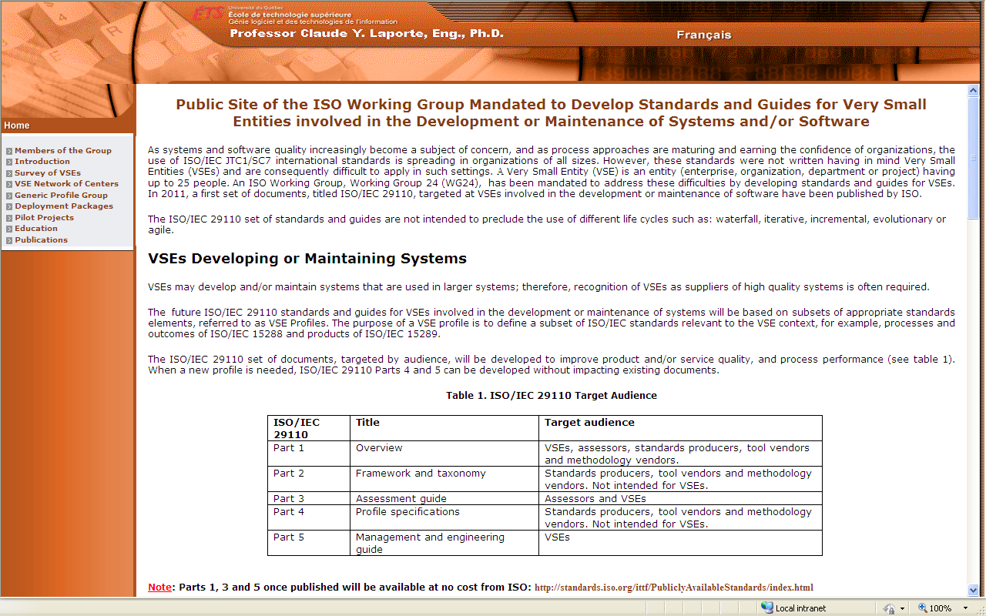
A Public Web Site
5. Diffusion
Members of WG
Introduction
Survey of VSEs
Network of Centers
Generic Profiles
Deployment Packages
Pilot Projects
Education DPs
Publications
http://profs.logti.etsmtl.ca/claporte/English/VSE/index.html
Notes:
DPs and support material (e.g. tools, training material), pilot project for developers
DPs for Educators
Number of Visitors per month = about 200
Number of countries = 30
Number of pages per month = about 1000
Number of VSE pages per month = over 400

Slide 57
5. Diffusion
Technology Transfer Center
for VSEs at the ÉTS
Mission
  To accelerate technology transfer to small and very small structures in Québec developing software products or software-based systems, or to provide IT services to make them more competitive, both at the national level and internationally, by developing and deploying software engineering practices tailored to their needs.
Objectives
  Identify, promote, and disseminate best practices in software engineering and services for very small entities;
  Accelerate the process of technology transfer in software engineering for VSEs;
  Provide information and technical and strategic information to managers of VSEs, outsourcers, and Government of Québec agencies;
  Participate in the development of international standards for VSEs;
  Promote international standards for VSEs in Québec;
  Promote research in software engineering for VSEs;
  Promote training and development courses on ISO standards for VSEs.

Slide 58

Thailand and APEC/ASEAN Countries
Thailand
  Budget
    1,000,000 $ over 3 years
  Objectives
    ISO 29110 as a standard in Thailand within 2 years after publication by ISO
    At least 10% growth rate of Thai industries especially a small size of entrepreneurs
    Strengthen the ability of competitiveness of the Thai software industry
  Target
    300 Thai VSEs assessed over 3 years
  Education
    Incorporate 29110 in undergraduate and graduate programs
APEC (Asia-Pacific Economic Cooperation )/ASEAN (Association of Southeast Asian Nations,10 countries)
  6 other countries are in the process of adopting ISO 29110
www.center4vse.net
Notes:
Thailand (2,000 VSEs)
Cambodgia (100)
Laos (200)
Myanmar (200)
Vietnam (500)
Malesia (1200)
Singapour (1000)
Indonesia (1500)
Philipines (2500)
Brunei (500)

Slide 59
Strategy of Thailand
5. Diffusion
Thailand is now using the new software engineering standard ISO 29110 in piloting software procurement related in Thai government agencies.
There are around 200 government agencies interested in this direction.
Within 3 years, Thailand hope to mandate ISO 29110 as the minimum requirement for all Thai government related for software and system procurement.
Dr. Anukul Tamprasirt, Nov 29th, 2010

Slide 60
Thai Implementation of ISO/IEC 29110
MICT
SIPA
NAC
TISI
ICT Purchasing Standard
of Government
VSE international
Forum
Accredit IB/CB
and Specialists
Develop Standards
1.Promotion
2.Standardization
3.Supporting Center
4.Meeting
IB/CB
Purchasing
Entity
Education
Enterprise
/ Company
Scheme
Standard
Certificate
Supporting
tools
Certificate
Data Center
Marketing
Host
Participation
Interim meeting
Primary meeting
Student
Train the trainer
Personal
Certificate
Company
Certificate
Innova Foundation
Export
ASEAN / APEC
Notes:
Courses/Seminars held in 2009 for THAI industry
Courses held in university (CAMT)
Partners; Governement agencies, Standard Institute, Promotion agency and Accreditation gency

Slide 61
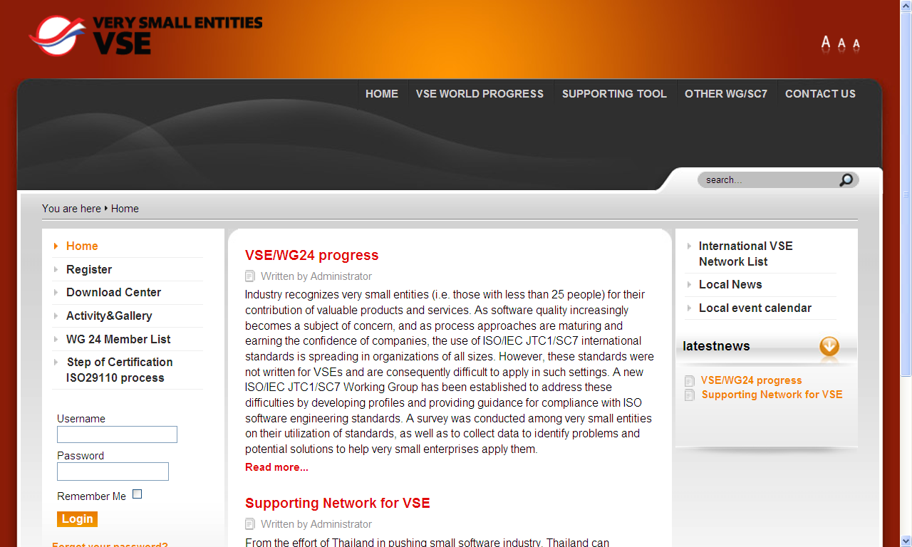
Thai VSE support Web Site
www.center4vse.net

Slide 62
Agenda
Phase 1 - Recognition of Needs and Problems (2004)
Phase 2 - Basic and Applied Research (2005-2005)
Phase 3 – Development (2006-2010)
Phase 4 – Commercialization (2010)
Phase 5 - Diffusion and Adoption (2006 - )
Phase 6 - Consequences (2011 - )
Notes:
Diffusion: The process over which an innovation is communicated through certain channels over time among the member of a social system.
Adoption: A decision to make full use of an innovation as the best course of action possible
Commercialization: The production, manufacturing, packaging, marketing and distribution of a product that embodies an innovation
Consequence: A change that occurs in an individual or a social system as a result of the adoption or rejection of an innovation

Slide 63
6. Consequences
Consequences
Promoters of an innovation are often optimistic
  Change agents and agencies tacitly assume that the consequences of innovations will be positive.
Consequences of an innovation usually manifest themselves over extended periods of time (e.g. months, years)
Possible consequences (undesirable, direct or indirect, anticipated or unanticipated) by:
  Imposing the standards on all the VSEs in a country or on all a customer’s VSEs
    e.g. from a large enterprise or a government agency
  Motivating VSEs to adopt the standards
    Government support: Awareness, training, certification, etc.
  Not imposing the standards on VSEs (laissez-faire)
Notes:
Consequence:
A change (undesirable, direct or indirect, anticipated or unanticipated) that occurs in an individual or a social system as a result of the adoption or rejection of an innovation
Imposing the Standard
The standards could reduce performance, harming the competitiveness (e.g. cost, development time) of some VSEs by mandating the use of processes
Some VSEs may lose valuable employees who do not want to use formal processes
Some VSEs may not have the knowledge required to understand the activities and tasks required by the standards
The standards may impose practices that are in opposition to the culture of a VSE
The standards may degrade the efficiency of the development of projects (e.g. longer development time, higher overhead, higher cost);
The standards may not be appropriate for the software domain of the VSEs (if imposed by government/enterprise)
VSEs have already invested resources in developing processes using another framework (e.g. the CMMI) and may not want to invest additional resources to comply with another framework;
VSEs cannot develop a product for one customer using one framework and a product for another customer using a different framework
Not imposing
Some VSEs may decide to ignore the standard, thereby slowly losing competitiveness
Some VSEs may not know that such a standard exists, thereby missing an opportunity to become more competitive
No government support is available to help VSEs adapt and implement the standards;
Each VSE would have to invest separately to implement the standard (e.g. purchase training courses, consulting);

Slide 64
Next Steps
Develop/finalize the remaining 3 software profiles
  Entry: six person-months effort or start-up VSEs *
  Intermediate: Management of more than one project
  Advanced: business management and portfolio management practices.
Advanced
Intermediate
Basic
Entry
Develop Profile Groups for other domains
  Critical software: e.g. medical, aerospace
  Game industry
  Scientific software development
Development of self-learning course modules to support DPs
Development of plug-in modules (e.g. Eclipse) to support DPs
Notes:
Measurement of the worldwide diffusion and adoption
Number of VSEs
attended awareness meetings
attended detailed course
participated in at least one pilot activity
has tried the new process for at least one cycle of typical tasks
routinely complete their work assignments using the improved processes
Certified
Adopting the Intermediate profile (moving up)
Number of Government agencies/Enterprises imposing on suppliers

Slide 65
First Draft of Entry Profile – PM Objectives
Objective ID | Objectives
PM.01 | The Project Plan for the execution of the project is developed according to the Statement of Work and reviewed and accepted by the Customer. The tasks and resources necessary to complete the work are sized and estimated.
PM.02 | Progress of the project monitored against the Project Plan and recorded in the Progress Status Record. Corrections to remediate problems and deviations from the plan are taken when project targets are not achieved. Closure of the project is performed to get the Customer acceptance documented in the Acceptance Record.
PM.03 | The Changes Requests are addressed through their reception and analysis. Changes to the software requirements are evaluated for cost, schedule and technical impact. impact.
PM.04 | Review meetings with the Work Team and the Customer are held. Agreements are registered and tracked.
PM.05 | Risks are identified as they develop and during the conduct of the project.
PM.06 | A software Version Control Strategy is developed. Items of Software Configuration are identified, defined and baselined. Modifications and releases of the items are controlled and made available to the Customer and Work Team. The storage, handling and delivery of the items are controlled. Items of Software Configuration are identified and controlled.
PM.07 | Software Quality Assurance is performed to provide assurance that work products and processes comply with the Project Plan and Requirements Specification.
Legend: Information added or modified to the Basic Profile is shown in blue while information deleted is shown like this: strike out.

Slide 66
First Draft of Entry Profile – SI Objectives
Objective ID | Objectives
SI.01 | Tasks of the activities are performed through the accomplishment of the current Project Plan.
SI.02 | Software requirements are defined, analyzed for correctness and testability, approved by the Customer, baselined and communicated.
SI.03 | Software components are identified. Software architectural and detailed design is developed and baselined. It describes the software components and internal and external interfaces of them. Consistency and traceability to software requirements are established.
SI.04 | Software components defined by the design are produced. Unit test are defined and performed to verify the consistency with software requirements. and the design. Traceability to the requirements and design are established.
SI.05 | Software is integrated and tested, and defects are corrected. Software is produced performing integration of software components and verified using Test Cases and Test Procedures. Results are recorded at the Test Report. Defects are corrected and consistency and traceability to Software Design are established.
SI.06 | Software configuration is prepared for delivery. A Software Configuration, that meets the Requirements Specification as agreed to with the Customer, which includes user, operation and maintenance documentations is integrated, baselined and stored at the Project Repository. Needs for changes to the Software Configuration are detected and related Change Requests are initiated.
SI.07 | Verification and Validation tasks of all required work products are performed using the defined criteria to achieve consistency among output and input products in each activity. Defects are identified, and corrected; records are stored in the Verification/Validation Results.
Legend: Information added or modified to the Basic Profile is shown in blue while information deleted is shown like this: strike out.

Slide 67
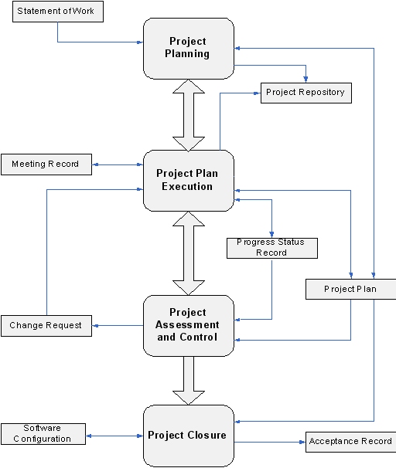
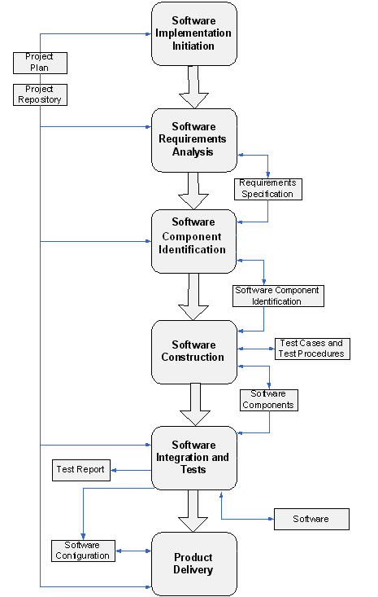
Entry Profile Under Review *
Project Management Process
Software Implementation Process
* To be discussed at the WG24 meeting in Korea (May 2012)
Notes:
VSEs Targeted by the Entry Profile
VSEs working on small projects
e.g. at most six person-months effort
Start-up VSEs.
Objectives
The Entry Profile could be used by recently established VSEs
i.e. as a ‘start-up kit’
The Entry Profile provides a foundation for a migration to the Basic Profile.

Slide 68
Intermediate and Advanced Profiles*
Intermediate Profile
  For VSEs developing multiple projects within the organizational context taking advantage of it.
Advanced Profile
  For VSEs which want to sustain and grow as an independent competitive software development business.
Examples of additional practices
  Additional QA practices,
  Configuration management (e.g. versus version control)
  Testing
    Improved Integration and Acceptance testing
  Other Practices
    Supplier management
    Measurement
Advanced
Intermediate
Basic
Entry
* To be discussed at the WG24 meeting in Korea

Slide 69
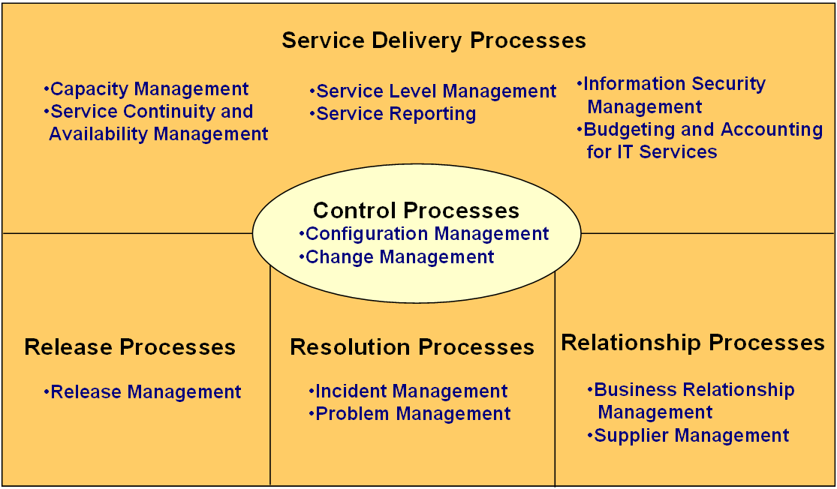
Application of ISO/IEC 20000 to VSEs
IT Service Management
  Defines the requirements for a service provider to deliver managed services of an acceptable quality for its customer.
Development of Deployment Packages
  Pilot projects conducted in a Computer support VSE

Slide 70


Development of Profiles and DPs
in Systems Engineering
Project done under sponsorship of INCOSE/AFIS
  International Council on Systems Engineering (INCOSE)
  Association Française d’ingénierie système (AFIS)
Goals
  To improve or make product development efficient by using Systems Engineering methodology
  To elaborate tailored practical guidance to apply to VSMEs in the context of prime or subcontractor, of commercial products
  To contribute to standardization
VSMEs = Very Small and Small Entities or Enterprises
Notes:
Co-chair
Intent to develop profiles and DP that could be integrated to WG24 documents
Follow the Strategy of WG24
International Survey- coordinated by myself at ETS ( 4 languages)
Profile and DPs
Pilot projects
Participants (11) (Canada, France, Germany, US)
Gauthier Fanmuy (ADN – France) – chair, Sven-Olaf Schulze (BERNER & MATTNER – Germany) – co-chair, Claude Y Laporte (Ecole de technologie supérieure – Canada) – co-chair, Ken ptack (US) – co-chair
Francis Peter (Management Sciences, Inc. – US), Phil Simpkins (Vitech corp.), Jackie Mcgettigan (Vitech corp.), Anne Sigogne (Thales – France), Clotilde Marchal (EADS - France), Suzan Garcia (SEI – US), Alexandre Loire (Galia – France)
The road map is the following:
Survey VSMEs and Small Projects: 31 Dec 09
Analyze and Post Survey Results: 15 Feb 10
Support Requested Follow-up Interviews: 15 Jun 10
Analyze Interview Results : 15 Jul 10
Define Project Plan: 15 Jul 10

Slide 71
Systems Engineering for VSEs
The initial strategy was to use the INCOSE Systems Engineering (SE) Handbook as the framework for a new ISO standard for VSEs involved in SE.
It was proposed, in December 2010, to ‘switch’ the reference used to develop a new SE standard from the INCOSE Handbook to the ISO/IEC 15288 standard and keep the Handbook (ISO/IEC TR 16337) for the development of the set of Deployment Packages.
Accomplishments
  A survey was performed
  Workshop conducted during INCOSE IW (Phoenix) in 2011
    ISO/IEC 29110 has been presented and discussed
    Systems engineers reviewed Software Basic Profile to propose SE Activities, tasks, documents, etc. to the Project Management Process and Implementation Process
    Draft document has been sent for reviews and updated
  A proposal to develop a new Standard for VSEs involved in SE has been tabled by Canada at the ISO SC7 Plenary meeting in Paris (May 2011)
    To develop a SE Basic profile (i.e. Part 4 and Part 5) to match the ISO 29110 Basic profile

Slide 72
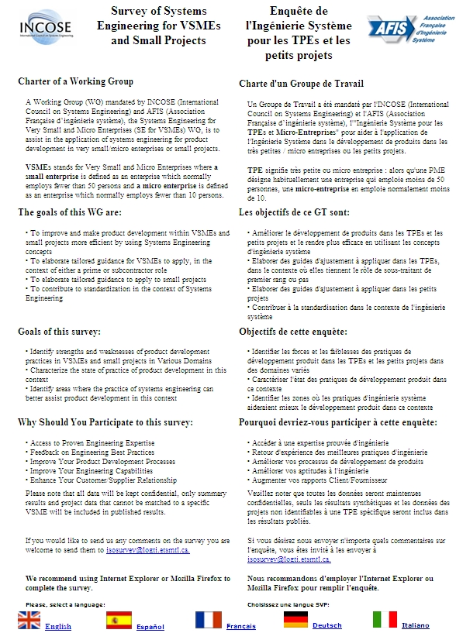
Survey
http://isosurvey.logti.etsmtl.ca/

Slide 73
Systems Engineering for VSEs
Recent Developments - 1
  The proposal to develop a new SE standard for VSEs was approved (Sep 2011)
    The editor nominated at the Paris meeting (Claude Y Laporte )
  At the 2011 meeting (Ireland) it was proposed to use existing ISO 29110 documents instead of developing a new set of document for each profile
    Part 1- Overview – Enlarge the scope from software engineering to system and software engineering
    Part 2 – Framework and taxonomy - Enlarge the scope from software engineering to system and software engineering
    Part 3 – Assessment Guide - Enlarge the scope from software engineering to system and software engineering
    Part 4 – Specifications of VSE Profile – Separate documents for SE and SW
    Part 5 – Engineering and management guide - Separate documents for SE and SW

Slide 74
Systems Engineering for VSEs
Recent Developments – 2
  A better understanding was developed during the WG24 Dublin meeting
    An hypothesis from people who developed the ISO 15288
      Engineers in a VSE have the expertise to select, from ISO 15288, the appropriate processes for a specific project, tailor them and develop the process for a specific project.
    It was also noted that many delegated of WG24 are from developing countries, which is not the case for most other SC7 working groups
      Most VSEs of developing countries do not have the expertise to tailor ISO 15288 for a specific project.

Slide 75
SE Project Management Process
No new activity, no change to name of activities, 3 new tasks
Software Project Management Process
System Project Management Process
PM.1.2 - Define with the Acquirer the Delivery Instructions (instead of Customer)
PM.1.3 - Define the System Breakdown Structure (new task)
PM.1.10 - Identify and document a Risk Management Approach (instead of Identify and document risks )
PM.1.11 - Identify and document a Disposal Management Approach (new task)
PM.1.12 - Document the Configuration Management Strategy in the Project Plan (instead of Version Control Strategy)

Slide 76
SE Project Management Process
Software Project Management Process
System Project Management Process
PM.2.5 Perform backup and recovery testing according to the Configuration Management Strategy (instead of Version Control Strategy)
No Change
PM.4.3 Execute the Disposal Management Approach (new task)

Slide 77
System Engineering Process
One new activity (Physical Construction), changes to name of activities, new tasks
Software Implementation Process
System Implementation Process

Slide 78
System Engineering Process
Software Implementation Process
System Implementation Process
No Change
Instead of SI 2.2 Document or update the Requirements Specifications:
  SY.2.2 - Elicit acquirer and other stakeholders requirements and analyze system context
  SY.2.3 - Elaborate System Requirements
  SY.2.4 - Elaborate System element Design Requirements
SY.2.6 Validate and obtain approval of the System Requirements Specification from the Acquirer and the Stakeholders (instead of Validate and obtain approval of the Requirements Specification )
SY.2.7 Document the preliminary version of the System User Documentation (instead of Software User Documentation)
SY.2.8 Verify and obtain approval of the System User Documentation (instead of Software User Documentation)
SY.2.9 Incorporate the Requirements Specifications, and System User Documentation to the System Configuration in the baseline (instead of Incorporate the Requirements Specifications, and Software User Documentation to the Software Configuration in the baseline)

Slide 79
System Engineering Process
Software Implementation Process
System Implementation Process
SY.3.2 Review System Requirements Document (instead of Understand Requirements Specification)
SY.3.3 Document or update the Logical System Design (instead of Document or update the Software Design)
SY 3.4 Make trade-offs of the System Architecture (new task)
SY.3.5 Document or update the Physical System Design (new task)
SY 3.6 Make trade-offs of the Physical Architecture (new task)
SY.3.7 Verify and obtain approval of the System Design (instead of Verify and obtain approval of the Software Design)
SY.3.8 Establish or update IVVQ plans and Verification Procedures (instead of Test Cases and Test Procedures)
SY.3.9 Verify and obtain approval of the IVVQ plan and Verification Procedures (new task)
SY.3.11 Incorporate the System Design, and Traceability Record to the System Configuration as part of the baseline (instead of Incorporate the Software Design, and Traceability Record to the Software Configuration as part of the baseline)

Slide 80
System Engineering Process
Software Implementation Process
System Implementation Process
SY.4 Software Construction
SY.5 Physical Construction (new activity)
  SY.5.1 Assign Tasks to the Work Team
  SY.5.2 Review Physical System Design.
  SY.5.3 Construct or update System Elements based on the Physical System Design.
  SY.5.4 Design or update IVVQ plans and Verification Procedures and apply them
  SY.5.5 Correct the defects found until successful verification (reaching exit criteria) is achieved.
  SY.5.6 Update the Traceability Record incorporating Components data (Requirements, Computer Aided Design, IVVQ data) constructed or modified.
  SY.5.7 Incorporate Components data and Traceability Record to the System Configuration as part of the baseline.

Slide 81
System Engineering Process
Software Implementation Process
System Implementation Process
SY.6 System Integration, Verification, Validation
  SY.6.2 Review IVVQ plans and Procedures (instead Understand Test Cases and Test Procedures)
  SY.6.3 Integrates the System using Components (Physical, Physical and Software, Software) and updates IVVQ plan and IVVQ Procedures for integration testing, as needed (instead of Integrates the Software using software Components and update Tests Cases and Test Procedures as needed)
  SY.6.4 Perform System verification using IVVQ plan and IVVQ Procedures (instead of Perform Software tests ...)
  SY.6.5 Perform System validation using IVVQ plan and IVVQ Procedures and document results in Validation Report (new task)
  SY.6.8 Document the System Operation Guide (instead of the Product Operation Guide)
  SY.6.9 Verify and obtain approval of the System Operation Guide (instead of the Product Operation Guide)
  SY.6.10 Document the System User Documentation (instead of the Software User Documentation)
  SY.6.12 Incorporate the IVVQ plan and Verification Procedures (instead of Test Cases and Test Procedures)

Slide 82
System Engineering Process
Software Implementation Process
System Implementation Process
SY.7 Product Delivery
  SY.7.2 Review System Configuration (instead of Understand Software configuration)
  SY.7.3 Document the System Maintenance Documentation or update the current one (instead of Maintenance documentation)
  SY.7.4 Document the System training to prepare transition with System Requirements Document and IVVQ plan (new task)
  SY.7.5 Verify and obtain approval of the System Maintenance Documentation and System Training Document (instead of Maintenance Documentation)
  SY.7.6 Incorporate the System Maintenance Documentation and System Training Document as baseline for the System Configuration (instead of Maintenance Documentation)

Slide 83
System Engineering Process
Roles added to the Software Basic Profile
  Acquirer
    Knowledge of the Customer processes and ability to explain the Customer requirements.
  System engineer
  IVVQ Engineer (Integration, Verification, Validation, Qualification)
Products (i.e. Documents) added to the Software Basic Profile
  System Breakdown Structure, System Requirements Specification
  System Elements, System Configuration, System Design Document
  System User Documentation, System Operation Guide
  Justification Document
    Documents the rationale (e.g. choices, decisions) during the System Implementation.
  IVVQ Plan, IVVQ Procedures, IVVQ Report

Slide 84
Proposed Deployment Packages
to Systems Engineering Basic Profile
Basic Profile
Verification
&
Validation
Interface
Management
Integration
Functional
& Physical Architecture
Project Management
Product Deployment
Requirements
Engineering
Configuration
Management
Change Management
Translated from (Fanmuy 2011)

Slide 85
Systems Engineering for VSEs
Next Steps
  Draft Basic systems engineering profile will be circulated for review within SC7 in January
    Comments will be analysed at WG24 meeting in Korea (May 2012)
    The ‘interim’ document number is «ISO/IEC PDTR 30126-5»
      At the meeting in Korea a resolution will be voted to change to «ISO/IEC TR 29110-5»
  Development of the SE Entry profile using the Software Entry Profile
    Draft SE Entry profile will be reviewed in Korea
  An article about this project will be sent to Insight
  A paper will be presented at INCOSE Symposium in Italy.

Slide 86
Next Steps
For members of WG 24
  Update actual ISO/IEC 29110 Part 1 and Part 3 to cover System and Software engineering
  Produce a Part 4 (i.e. Specification) for System Engineering Profiles
For participants of INCOSE International Workshop
  Review Draft Systems Engineering (SE) Basic Profile
  Develop SE Deployment Packages using:
    Software Deployment Packages (DP)
    INCOSE Handbook (ISO/IEC TR 16337)
    Other sources (TBD)

Slide 87
Conclusion
Phase 1 - Recognition of Needs and Problems (2004)
Phase 2 - Basic and Applied Research (2005-2006)
Phase 3 – Development (2006-2010)
Phase 4 – Commercialization (2010)
Phase 5 - Diffusion and Adoption (2006 - )
Phase 6 - Consequences (2011 - )
Why
For Who
How
When
What
Who
Notes:
Diffusion: The process over which an innovation is communicated through certain channels over time among the member of a social system.
Adoption: A decision to make full use of an innovation as the best course of action possible
Commercialization: The production, manufacturing, packaging, marketing and distribution of a product that embodies an innovation
Consequence: A change that occurs in an individual or a social system as a result of the adoption or rejection of an innovation

Slide 88
Thank you for your attention
Questions ?

Slide 89
Contact Information
Claude Y Laporte
  Voice: + 1 514 396 8956
  E-Mail: Claude.Y.Laporte@etsmtl.ca
  Web: http://profs.etsmtl.ca/claporte/English/index.html
Public site of WG 24
  Free access to Deployment Packages, presentation material and articles:
    http://profs.logti.etsmtl.ca/claporte/English/VSE/index.html

Slide 90
References
Fanmuy, G., L’Ingénierie et Management des Systèmes pour les PME/TPE et petits projets, Association Française d'Ingénierie Système (AFIS)/International Council on Systems Engineering (INCOSE), May 24th, 2011, Paris, France.
ISO/IEC JTC1/SC7 N3288, New Work Item Proposal – Software Life Cycles for Very Small Enterprises, Mai 2005.
ISO/IEC 12207:2008, Information technology – Software life cycle processes, International Organization for Standardization/ International Electrotechnical Commission: Geneva, Switzerland.
ISO/IEC 29110 - Lifecycle Profiles for Very Small Entities (VSEs) – Part 1: Overview. International Organization for Standardization/International Electrotechnical Commission: Geneva, Switzerland.
ISO/IEC 15289:2006 - Systems and software engineering - Content of systems and software life cycle process information products (Documentation)
Kabli, S., Conception, réalisation et mise a l’essai de trousses de déploiement pour faciliter et accélérer l’implémentation de la norme ISO/CEI 20000 par les très petites structures, ÉTS, 2009.
Laporte, C.Y., Alexandre, S., O’Connor, R., A Software Engineering Lifecycle Standard for Very Small Enterprises, in R.V. O’Connor et al. (Eds.): EuroSPI 2008, CCIS 16, pp. 129–141.
Rogers, Everett M., Diffusion of Innovations, fifth edition, Free Press, New York, 2003.

